Slide 1

Chapter 2: Intro to C++ Programming C++ How to Program: An Objects-Natural Approach, 11/e
Presented by Paul Deitel, CEO, Deitel & Associates, Inc.

Slide 2
Chapter 2: Intro to C++ Programming
Write simple C++ applications
cout/cin for command-line output and input
Fundamental types
Declare variables
Arithmetic, equality and relational operators
Decision making: if statements
Work with objects of pre-existing classes

Slide 3
Chapter 2: Intro to C++ Programming
“Objects Natural” Approach
Create and use objects of preexisting classes
Perform significant tasks with minimal code
Classes typically from
C++ standard library
Free third-party open-source
Reminder
Before You Begin for setup instructions
Chapter 1 Test-Drive videos for compile/execute instructions

Slide 4
Escape Sequences
Escape sequence | Description
\n | Newline. Positions the screen cursor to the beginning of the next line.
\t | Horizontal tab. Moves the screen cursor to the next tab stop.
\r | Carriage return. Positions the screen cursor to the beginning of the current line; does not advance to the next line.
\a | Alert. Sound the system bell.
\\ | Backslash. Includes a backslash character in a string.
\' | Single quote. Includes a single-quote character in a string.
\" | Double quote. Includes a double-quote character in a string.

Slide 5
Fundamental Types
Type double for specifying real numbers with decimal points, such as 3.4, 0.0 and –11.19
Type char for specifying a single lowercase letter, uppercase letter, digit or special character (e.g., $ or *)

Slide 6
Identifiers
A variable name is any valid identifier that is not a keyword
Consists of letters, digits and underscores (_)
Must not begin with a digit
C++ is case sensitive
a1 and A1 are different identifiers
Avoid identifiers that begin with underscores and double underscores

Slide 7
Arithmetic Operators
Operation | Arithmetic operator | C++ expression
Addition | + | f + 7
Subtraction | - | p - c
Multiplication | * | b * m
Division | / | x / y
Remainder | % | r % s

Slide 8
Integer Division
Integer division in which the numerator and the denominator are integers yields an integer quotient
7 / 4 evaluates to 1
17 / 5 evaluates to 3
Any fractional part in the result is truncated—no rounding occurs

Slide 9
Remainder Operator
x % y yields the remainder after dividing x by y using integer division
Can be used only with integer operands
7 % 4 yields 3
17 % 5 yields 2

Slide 10
Parentheses for Grouping Subexpressions
Parentheses group C++ expressions in the same manner as in algebra
To multiply a times the quantity b + c, write
a * (b + c)

Slide 11
Rules of Operator Precedence
C++ applies the operators in arithmetic expressions in a precise order determined by the rules of operator precedence—generally the same as in algebra
Expressions in parentheses evaluate first.
Multiplication, division and remainder operations evaluate next.
Applied from left-to-right.
Addition and subtraction operations evaluate last.
Applied from left-to-right.
Caution: If you have an expression such as (a + b) * (c - d) in which two sets of parentheses are not nested, but appear “on the same level,” the C++ Standard does not specify the order in which these parenthesized subexpressions will evaluate

Slide 12
Operator Grouping
Grouping refers to the order in which C++ applies certain operators
In the expression a + b + c the + operators group from left-to-right as if we had written (a + b) + c
Most C++ operators of the same precedence group left-to-right
We’ll see that some operators group right-to-left

Slide 13
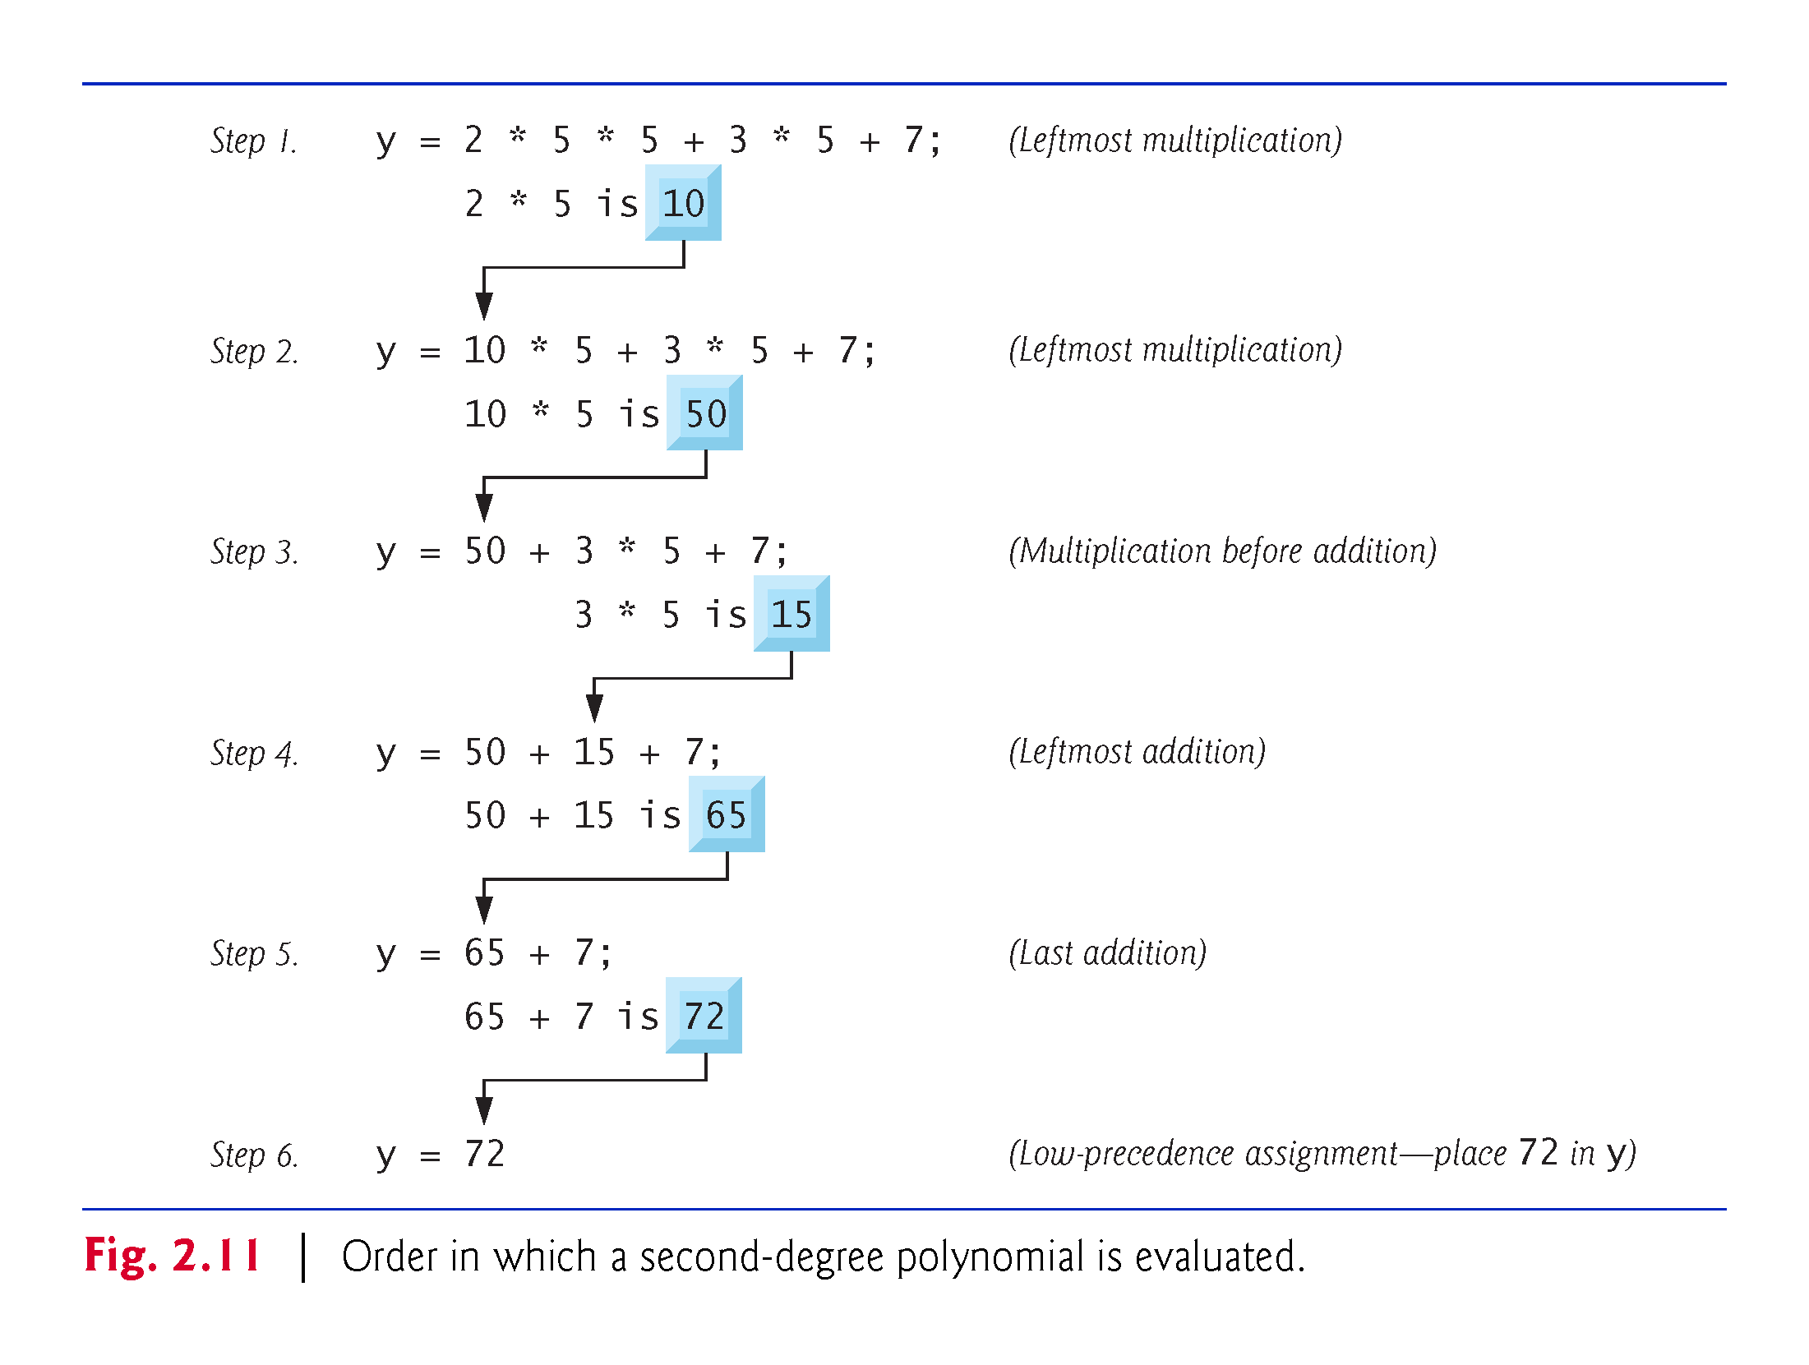

Slide 14
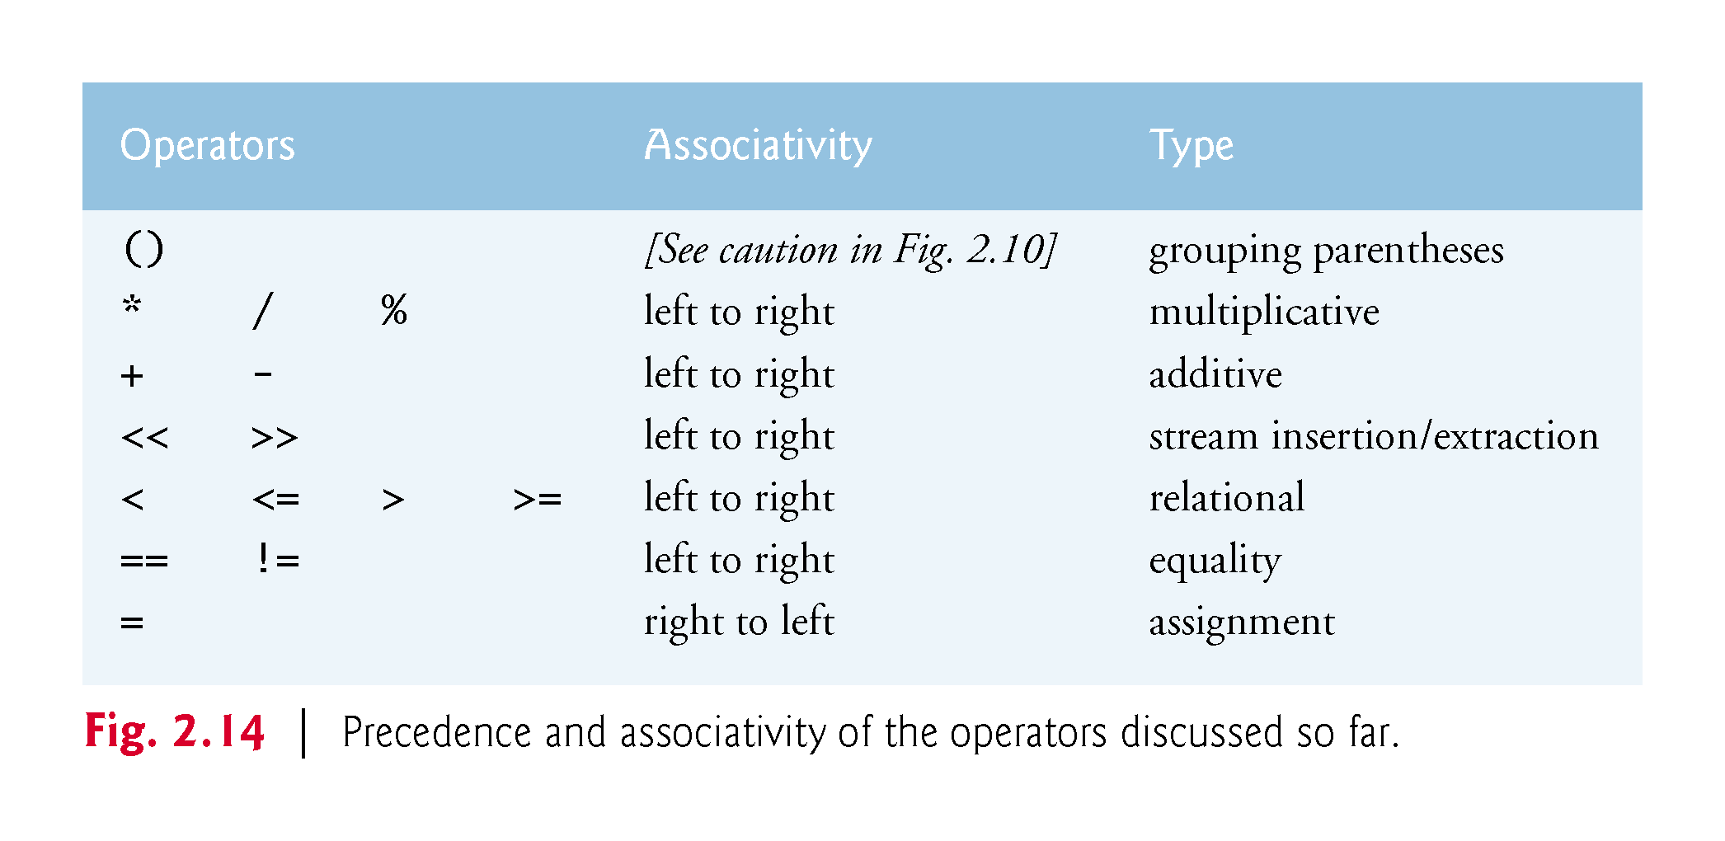

Slide 15
Equality and Relational Operators
Algebraic operator | C++ operator | Sample condition | Meaning
Relational operators
> | > | x > y | x is greater than y
< | < | x < y | x is less than y
≥ | >= | x >= y | x is greater than or equal to y
≤ | <= | x <= y | x is less than or equal to y
Equality operators
= | == | x == y | x is equal to y
≠ | != | x != y | x is not equal to y

Slide 16
Compound Assignment Operators
total = total + grade;
Assume: c = 3, d = 5, e = 4, f = 6, g = 12
Operator | Sample expression | Explanation | Assigns
+= | c += 7 | c = c + 7 | 10 to c
-= | d -= 4 | d = d - 4 | 1 to d
*= | e *= 5 | e = e * 5 | 20 to e
/= | f /= 3 | f = f / 3 | 2 to f
%= | g %= 9 | g = g % 9 | 3 to g

Slide 17
Increment and Decrement Operators
passes = passes + 1;
Operator | Operator name | Sample expression | Explanation
++ | prefix increment | ++number | Increment number by 1, then use the new value of number in the expression in which number resides.
++ | postfix increment | number++ | Use the current value of number in the expression in which number resides, then increment number by 1.
-- | prefix decrement | --number | Decrement number by 1, then use the new value of number in the expression in which number resides.
-- | postfix decrement | number-- | Use the current value of number in the expression in which number resides, then decrement number by 1.

