Slide 1

Chapter 3: Control Statements and Algorithm Development, Part 1 C++ How to Program: An Objects-Natural Approach, 11/e
Presented by Paul Deitel, CEO, Deitel & Associates, Inc.

Slide 2
Chapter 3: Control Statements, Part 1
if and if…else selection statements
while iteration statement
Compound assignment operators
Increment and decrement operators
Why fundamental data types are not portable
Objects Natural Case Study: Super-Sized Integers with Boost Multiprecision

Slide 3
Chapter 3: Algorithm Development and Control Statements—Part 1
Presented by Paul Deitel, CEO, Deitel & Associates, Inc.

Slide 4
Chapter 3: Algorithm Development and Control Statements—Part 1
Basic problem-solving techniques
Develop algorithms using top-down, stepwise refinement
if and if…else selection statements
while iteration statement
Counter-controlled iteration
Sentinel-controlled iteration

Slide 5
Chapter 3: Algorithm Development and Control Statements—Part 1
Nested control statements
Compound assignment operators
Increment and decrement operators
Why fundamental data types are not portable
Objects Natural Case Study: Super-Sized Integers with Boost Multiprecision

Slide 6
Algorithms
An algorithm is a procedure for solving a problem
actions to execute
order in which these actions execute
“Rise-and-shine” algorithm
(1) Get out of bed; (2) take off pajamas; (3) take a shower; (4) get dressed; (5) eat breakfast; (6) carpool to work
(1) Get out of bed; (2) take off pajamas; (3) get dressed; (4) take a shower; (5) eat breakfast; (6) carpool to work
Specifying the order in which statements (actions) execute in a program is called program control

Slide 7
Pseudocode
Informal language that helps you develop algorithms without worrying about C++ language syntax
Addition program pseudocode
Prompt the user to enter the first integer
Input the first integer
Prompt the user to enter the second integer
Input the second integer
Add first integer and second integer, store result
Display result

Slide 8
Control Structures
All programs can be written in terms of
Sequence
Selection
Iteration

Slide 9
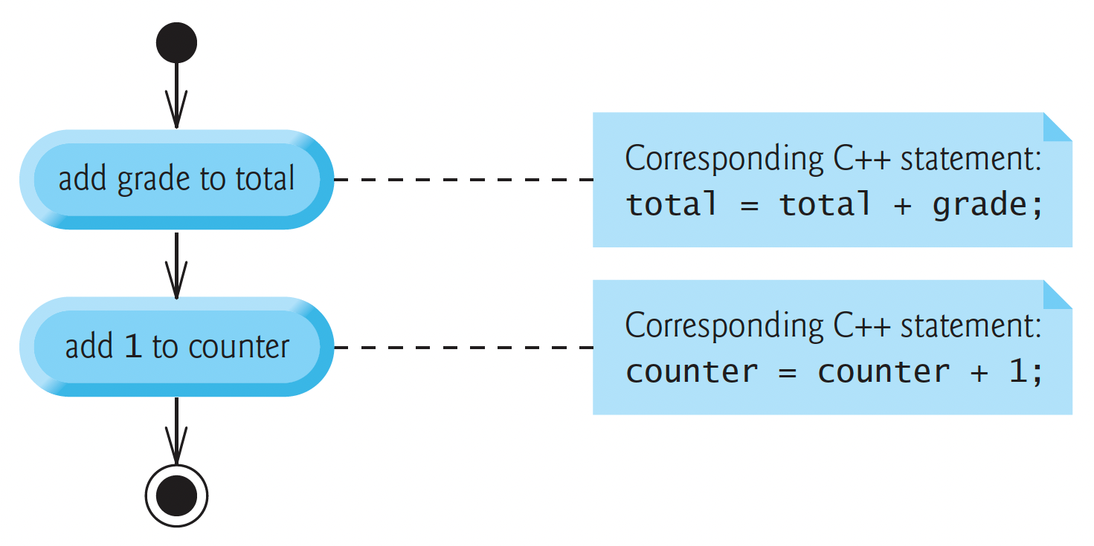
Sequence Structure

Slide 10
Selection Statements
if
if…else
switch

Slide 11
Iteration Statements
while
do…while
for
range-based for

Slide 12
Keywords (1 of 3)
Keywords common to C and C++
asm | auto | break | case | char
const | continue | default | do | double
else | enum | extern | float | for
goto | if | inline | int | long
register | return | short | signed | sizeof
static | struct | switch | typedef | union
unsigned | void | volatile | while

Slide 13
Keywords (2 of 3)
C++-only keywords
alignas | alignof | and | and_eq | bitand
bitor | bool | catch | char16_t | char32_t
class | compl | const_cast | constexpr | decltype
delete | dynamic_cast | explicit | export | false
friend | mutable | namespace | new | noexcept
not | not_eq | nullptr | operator | or
or_eq | private | protected | public | reinterpret_cast
static_assert | static_cast | template | this | thread_local
throw | true | try | typeid | typename
using | virtual | wchar_t | xor | xor_eq

Slide 14
Keywords (3 of 3)
C++20 keywords
char8_t | concept | char16_t | consteval | constinit
co_await | co_return | co_yield | requires
Other Special Identifiers
Identifiers with special meaning
final, import, module, override, transaction_safe, transaction_safe_dynamic
Experimental keywords
atomic_cancel, atomic_commit, atomic_noexcept, reflexpr, synchronized

Slide 15
if Single-Selection Statement
if (studentGrade >= 60) { cout << "Passed"; }
Indentation of the second line of this selection statement is optional, but recommended for program clarity

Slide 16
bool Data Type
Condition
Any expression that evaluates to zero or nonzero
Zero is false, nonzero is true
Data type bool for Boolean variables
Values true and false—each is a C++ keyword
For compatibility with C
true can be represented as any nonzero value
Compilers typically use 1
false can be represented as 0

Slide 17
if…else Double-Selection Statement
if (grade >= 60) { cout << "Passed"; } else { cout << "Failed"; }

Slide 18
Nested if…else Statements (1 of 2)
if (studentGrade >= 90) { cout << "A"; } else { if (studentGrade >= 80) { cout << "B"; } else { if (studentGrade >= 70) { cout << "C"; } else { if (studentGrade >= 60) { cout << "D"; } else { cout << "F"; } } } }

Slide 19
Nested if…else Statements (2 of 2)
if (studentGrade >= 90) { cout << "A"; } else if (studentGrade >= 80) { cout << "B"; } else if (studentGrade >= 70) { cout << "C"; } else if (studentGrade >= 60) { cout << "D"; } else { cout << "F"; }

Slide 20
Conditional Operator (?:)
Conditional operator (?:) can be used in place of an if…else statement
C++’s only ternary operator
cout << (studentGrade >= 60 ? "Passed" : "Failed");

Slide 21
while Iteration Statement
int product{3}; while (product <= 100) { product = 3 * product; }

Slide 22
Counter-Controlled Iteration
Problem statement
A class of ten students took a quiz. The grades (integers in the range 0–100) for this quiz are available to you. Determine the class average on the quiz.
Class average is the sum of the grades divided by the number of students
Program must
input each grade
total all the grades entered
perform the averaging calculation
print the result

Slide 23
Pseudocode Algorithm with Counter-Controlled Iteration
Use pseudocode to list the actions to execute and specify the order in which they should execute
10 grades: Use counter-controlled iteration to input the grades one at a time
Use a counter (or control variable) to control the number of times a set of statements will execute
Counter-controlled iteration is often called definite iteration because the number of iterations is known before the loop begins executing

Slide 24
Pseudocode Algorithm with Counter-Controlled Iteration
set total to zero
set grade counter to one
while grade counter is less than or equal to ten
prompt the user to enter the next grade
input the next grade
add the grade into the total
add one to the grade counter
set the class average to the total divided by ten
print the class average

Slide 25
Integer Division and Truncation
Integer division produces an integer result
846 divided by 10, should yield the floating-point value 84.6
Yields 84 because both operands are integers

Slide 26
Sentinel-Controlled Iteration
Problem statement
Develop a class-averaging program that processes grades for an arbitrary number of students each time it’s run
Don’t know number of students
Sentinel value—a way to indicate end of data entry
Should be a value that is not a valid data value

Slide 27
Top-Down, Stepwise Refinement
Begin with single statement that conveys the overall function of the program—known as the top
determine the class average for the quiz
Refine this as many times as you need until you’re ready to convert your pseudocode to C++ code
First refinement
initialize variables
input, sum and count the quiz grades
calculate and print the class average

Slide 28
Top-Down, Stepwise Refinement
Second refinement commits to specific variables
running total of the numbers
count of how many numbers we’ve processed
variable to receive each grade entered by the user
variable to hold the calculated average
The pseudocode statement
initialize variables
Can be refined as
initialize total to zero
initialize counter to zero

Slide 29
Top-Down, Stepwise Refinement
The pseudocode statement
input, sum and count the quiz grades
Can be refined as
prompt the user to enter the first grade
input the first grade (possibly the sentinel)
while the user has not yet entered the sentinel
add this grade into the running total
add one to the grade counter
prompt the user to enter the next grade
input the next grade (possibly the sentinel)

Slide 30
Top-Down, Stepwise Refinement
The pseudocode statement
calculate and print the class average
Can be refined as
if the counter is not equal to zero
set the average to the total divided by the counter
print the average
else
print “No grades were entered”

Slide 31
Top-Down, Stepwise Refinement
initialize total to zero
initialize counter to zero
prompt the user to enter the first grade
input the first grade (possibly the sentinel)
while the user has not yet entered the sentinel
add this grade into the running total
add one to the grade counter
prompt the user to enter the next grade
input the next grade (possibly the sentinel)
if the counter is not equal to zero
set the average to the total divided by the counter
print the average
else
print “No grades were entered”

Slide 32
Nested Control Statements
Problem statement
A college offers a course that prepares students for the state licensing exam for real-estate brokers. Last year, 10 students who completed this course took the exam. The college wants to know how well its students did on the exam. You’ve been asked to write a program to summarize the results. You’ve been given a list of these 10 students. Next to each name is a 1 if the student passed the exam or a 2 if the student failed.
Your program should analyze the results of the exam as follows:
Input each test result (i.e., a 1 or a 2). Display “Enter result” on the screen each time the program requests another test result.
Count the number of test results of each type.
Display a summary of the test results, indicating the number of students who passed and the number who failed.
If more than eight students pass, print “Bonus to instructor!”

Slide 33
Nested Control Statements
Observations
The program must process test results for 10 students
Each time the program reads a test result, it must determine whether it’s a 1 or a 2
Two counters are used to keep track of the exam results—one to count the number of students who passed the exam and one to count the number who failed.
After the program has processed all the results, it must decide whether more than eight students passed the exam

Slide 34
Top-Down, Stepwise Refinement
Top
analyze exam results and decide whether a bonus should be paid
First refinement
initialize variables
input the 10 exam results, and count passes and failures
print a summary of the exam results and decide whether a bonus should be paid

Slide 35
Top-Down, Stepwise Refinement
The pseudocode statement
initialize variables
can be refined as
initialize passes to zero
initialize failures to zero
initialize student counter to one

Slide 36
Top-Down, Stepwise Refinement
The pseudocode statement
input the 10 exam results, and count passes and failures
Can be refined as
while student counter is less than or equal to 10
prompt the user to enter the next exam result
input the next exam result
if the student passed
add one to passes
else
add one to failures
add one to student counter

Slide 37
Top-Down, Stepwise Refinement
The pseudocode statement
print a summary of the exam results and decide whether a bonus should be paid
Can be refined as
print the number of passes
print the number of failures
if more than eight students passed
print “Bonus to instructor!”

Slide 38
Top-Down, Stepwise Refinement— Complete Second Refinement
initialize passes to zero
initialize failures to zero
initialize student counter to one
while student counter is less than or equal to 10
prompt the user to enter the next exam result
input the next exam result
if the student passed
add one to passes
else
add one to failures
add one to student counter
print the number of passes
print the number of failures
if more than eight students passed
print “Bonus to instructor!”

Slide 39
Preventing Narrowing Conversions with List Initialization
int studentCounter{1};
Also can be written as
int studentCounter = 1;
For fundamental-type variables, list initialization prevents narrowing conversions
int x = 12.7;
C++ converts 12.7 to the int value 12
This narrowing conversion loses data

Slide 40
Preventing Narrowing Conversions with List Initialization
int x{12.7};
Compilation error
Even 12.0 gives an error
Visual Studio — conversion from 'double' to 'int' requires a narrowing conversion
GNU C++ — error: narrowing conversion of '1.26e+1' from 'double' to 'int' [-Wnarrowing]
clang++ — error: type 'double' cannot be narrowed to 'int' in initializer list [-Wc++11-narrowing]

Slide 41
Compound Assignment Operators
total = total + grade;
Assume: c = 3, d = 5, e = 4, f = 6, g = 12
Operator | Sample expression | Explanation | Assigns
+= | c += 7 | c = c + 7 | 10 to c
-= | d -= 4 | d = d - 4 | 1 to d
*= | e *= 5 | e = e * 5 | 20 to e
/= | f /= 3 | f = f / 3 | 2 to f
%= | g %= 9 | g = g % 9 | 3 to g

Slide 42
Increment and Decrement Operators
passes = passes + 1;
Operator | Operator name | Sample expression | Explanation
++ | prefix increment | ++number | Increment number by 1, then use the new value of number in the expression in which number resides.
++ | postfix increment | number++ | Use the current value of number in the expression in which number resides, then increment number by 1.
-- | prefix decrement | --number | Decrement number by 1, then use the new value of number in the expression in which number resides.
-- | postfix decrement | number-- | Use the current value of number in the expression in which number resides, then decrement number by 1.

Slide 43
Fundamental Types Are Not Portable
In C and C++, an int might be represented by
16 bits (2 bytes)
32 bits (4 bytes)
64 bits (8 bytes)
Code using integers is not always portable across platforms
Sometimes must write multiple versions of programs to use different integer types on different platforms

Slide 44
Fundamental Types Are Not Portable
Among C++’s integer types are int, long and long long
C++ standard requires type int to be at least 16 bits, type long to be at least 32 bits and type long long to be at least 64 bits
Also requires that an int’s size be less than or equal to a long’s size and that a long’s size be less than or equal to a long long’s size

Slide 45
Objects Natural Case Study: Super-Sized Integers
Explosive growth of Internet communications and data storage on Internet-connected devices has dramatically increased the importance of privacy and security
Cryptography has been used for thousands of years to encode data, making it difficult (and hopefully impossible) for unauthorized users to read, which is critically important in today’s connected world

Slide 46
Objects Natural Case Study: Super-Sized Integers
Some Applications Need Integers Outside a long long Integer’s Range
Cryptography algorithms perform calculations with integers far larger than C++’s long long type can store
–9,223,372,036,854,775,808 to 9,223,372,036,854,775,807
Maximum of 19 decimal digits (which can represent integers in the quintillions)
RSA Public-Key Cryptography uses enormous prime numbers consisting of hundreds of digits
A key reason why RSA is so secure is the sheer amount of time required to factor the product of massive primes

Slide 47
Objects Natural Case Study: Super-Sized Integers
Integers Outside the long long Range Require Custom Programming
How can we manipulate huge integers with arbitrary numbers of digits?
Custom programming with C++’s class mechanism
Objects Natural Approach
check first for free, open-source class libraries to see if such a “huge-integer” class already exists

Slide 48
Objects Natural Case Study: Super-Sized Integers
Integers Outside the long long Range Require Custom Programming
How can we manipulate huge integers with arbitrary numbers of digits?
Custom programming with C++’s class mechanism
Objects Natural Approach
check first for free, open-source class libraries to see if such a “huge-integer” class already exists

Slide 49
Objects Natural Case Study: Super-Sized Integers
Huge Integers with the Boost Multiprecision Open-Source Library’s cpp_int Class
Many preexisting C++ open-source classes for creating and manipulating huge integers
https://github.com/boostorg/multiprecision/
Boost provides 168 open-source C++ libraries
“Breeding ground” for new capabilities that often are incorporated into the C++ standard libraries

