Slide 1
Functions and scopes

Slide 2
Function
Definition:
A named sequence of statements that performs a specific task
Components:
A function has
name
input(s)
statement(s) for completing a task
return value (optional)

Slide 3
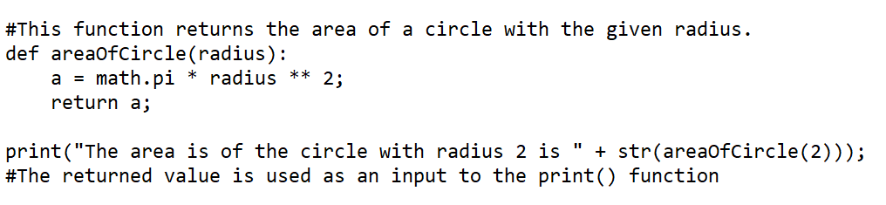
Function
name
input
use two statements to define the task
define a return value and the value returned is used in the print statement

Slide 4
Function Definition
You must define a function before you can use (call) it.
function definition
function call
input parameter in function definition – a new variable for the function to use
input argument – actual value passed into function during function call, through input parameter

Slide 5
Built-in Functions vs user defined functions
Built-in functions have been defined by Python developers. They are ready to use if we know the name, input parameter(s), the task performed, and the return value (if there is one). E.g. print() type(), str()
- https://docs.python.org/3/library/functions.html
User-defined function: a function created by you (as a developer) to complete a specific task, such as finding the area of a circle

Slide 6
Variable Scopes
The scope of a variable is where the variable can be used (accessible)
The scope of a variable is determined by the location where it is created
Local Scope
If a variable is defined (created) inside a function, it is called a local variable. It has local scope. It is accessible (can be used) only inside the function.
Global Scope
If a variable is defined (created) outside a function, it is a global variable. It has global scope. It is accessible (can be used) anywhere in the file (inside of functions as well).

Slide 7
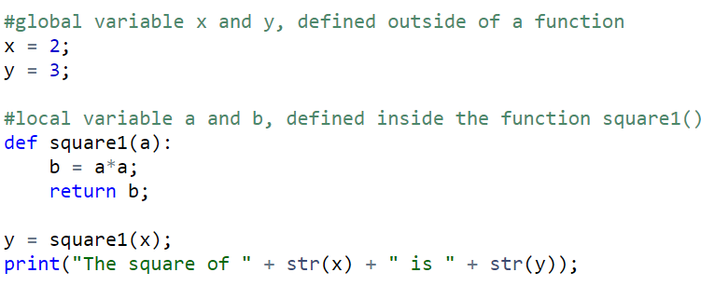
Variable Scopes
global scope (function.py)
x
y
2
3
4
Local scope (square1)
Order of Execution
global x is created and assigned value of 2
global y is created and assigned value of 3
square1() is called
local a is created and global x’s value (2) is given to a
local b is created and is given value 2*2
b’s value (4) is given to global y (y’s value is changed from 3 to 4)
print out the value of global x and y
a
b
2
4

Slide 8
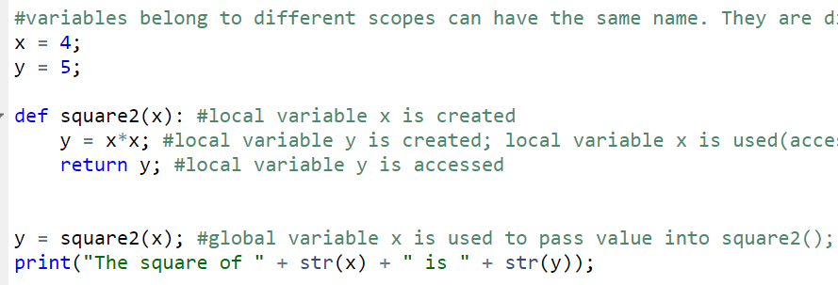
Variable Scopes
global scope (function.py)
x
y
4
5
16
Order of Execution
global x is created and assigned value of 4
global y is created and assigned value of 5
square2() is called
local x is created and global x’s value (4) is given to local x
local y is created and is given value 4*4
local y’s value (16) is given to global y (global y’s value is changed from 5 to 16)
print out the value of global x and global y
Local scope (square2)
x
y
4
16

Slide 9
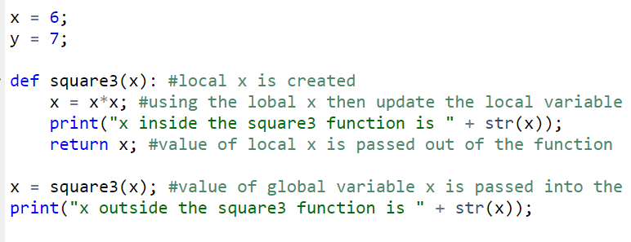
Variable Scopes
global scope (function.py)
x
y
6
7
36
Order of Execution
global x is created and assigned value of 6
global y is created and assigned value of 7
square3() is called
local x is created and global x’s value (6) is given to local x
local x’s value is updated to 36
local x’s value is passed out of function and given to global x
print out the value of global x
Local scope (square3)
x
36
6

Slide 10
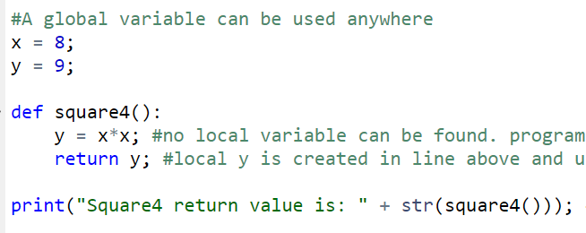
Variable Scopes
global scope (function.py)
x
y
8
9
print( …square4()..)
Order of Execution
global x is created and assigned value of 8
global y is created and assigned value of 9
square4() is called
local x is not found, thus go to an outer scope and found global x thus global x value (8) is used
local y is created and given the value 8*8
local y’s value is passed out of function and being used in the print statement
Local scope (square4)
8*8
y
64

