Slide 1
MongoDB
LVSANG

Slide 2
Agenda
What is MongoDB
Terminology and Concepts
Installing
Configure MongoDB
Some query statements in MongoDB

Slide 3
What is MongoDB
MongoDB is an open-source document database, and a NoSQL database.
MongoDB is written in c++
MongoDB stores JSON documents in a binary-encoded format called BSON
MongoDB uses dynamic schemas
MongoDB works on concept of collection and document.

Slide 4
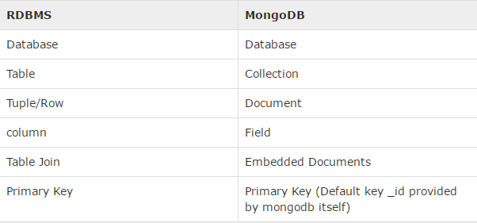
Terminology and Concepts
Notes:
RDBMS: relational database management system

Slide 5
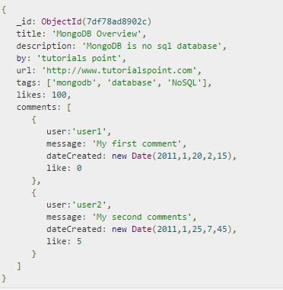
Sample document

Slide 6
Install MongoDB
Download MongoDB: https://www.mongodb.org/downloads
Install it

Slide 7
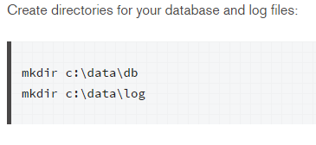
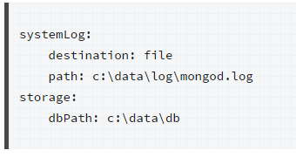
Configure MongoDB
Open an Administrator command prompt.
Create directories
Create a configuration file.

Slide 8

Configure MongoDB
Install the MongoDB service
Start the MongoDB service.
net start MongoDB
Stop or remove the MongoDB service as needed
Stop: net stop MongoDB
Remove: “C:\mongodb\bin\mongod.exe” --remove

Slide 9
Working with MongoDB
Use Mongo shell
Open command prompt and run the mongo shell with the following command: mongo
Use tool (MongoChef)
Download: http://3t.io/mongochef/download/

Slide 10
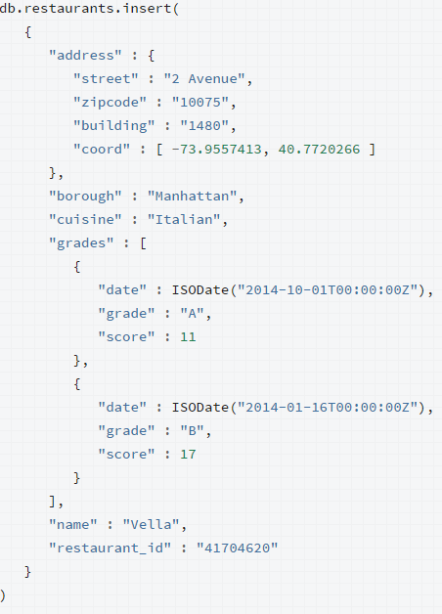
Some query statements in MongoDB
Insert Data

Slide 11



Some query statements in MongoDB
Find Data

Slide 12
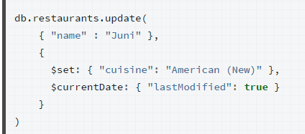
Some query statements in MongoDB
Update data

Slide 13



Some query statements in MongoDB
Remove Data

