Slide 1
AAV██AN
Side panel UI kit
For Jinshri and Vansh, designing in Canva.
—
The page you are on is the panel at 2×. Everything here is double the real value.
—
Design one state per page. The state list starts on page 9.
—
Use only the palette on page 4 and the type scale on page 5.
—
Nothing may be narrower than the panel: it is user-resizable, 320–500 CSS px.
The one rule
This is a privacy tool. Every pixel either shows what was withheld, or proves nothing was sent. If an element does neither, delete it.
Aavaran · Team Vagabonds · SIH26171 · built from the shipped panel, not from memory

Slide 2
READ THIS FIRST
Three things make a UI
look AI-generated
All three were in our panel. They are banned now. This is the whole reason we are redesigning.
1
Tiny wide-tracked UPPERCASE labels
9px letters with wide spacing, like TRY ONE OF THESE. MetaMask has zero of them. Sentence case, 24–27 px here, no extra tracking.
2
A bordered card around every list item
A list is full-bleed rows — no border, no divider, separated by space and a hover wash. A border means a genuinely distinct object.
3
A permanent hero
The logo gets one launch screen, then hands over to a 96 px sticky bar. Height belongs to content.
Also banned
—
Emoji anywhere in the interface.
—
Centred marketing microcopy. This is a tool, not a landing page.
—
Decoration that imitates information — an empty circle where an icon would go, a card announcing that nothing has happened yet.
—
Gradients, glows and stock imagery.
—
A light theme. The panel is dark only.
—
More than two accent colours on screen at once.

Slide 3
CANVAS
Sizes, in Canva px
Canva → Custom size → enter px. Or import this file and the pages are already right.
A panel state
800 × 1800
the default — use this
A very tall state
800 × 3200
run-complete, the ledger
Narrow check
640 × 1800
must still work at 320 CSS
Wide check
1000 × 1800
must still work at 500 CSS
Extension icon
1024 × 1024
ships at 128/48/32/16
The only fixed measurements
—
Side inset 36 px left and right. Never change it.
—
So the content column is 728 px wide.
—
Top bar is 96 px tall and sticks to the top.
—
A full-bleed row may touch the edges, but its text still starts at 36.
—
Spacing comes from this set only: 12 16 20 24 28 32 36 44 52.
—
Corner radius: 22 small, 32 cards, fully round for pills.
—
Every number you type must be even — it gets halved for the browser.
36
content column — 728 px
The amber strips are the inset. Nothing but a full-bleed background enters them.

Slide 4
COLOUR
The whole palette
There are no other colours. If you need one, write it down in NOTES.txt with what it means.
--void
the panel itself
#0a0a0a
--pit
recessed: inputs, code blocks
#050505
--row
row hover wash
#141414
--card
a real object
#161616
--card-2
an object on a card
#1c1c1c
--edge
hairline
#232323
--edge-2
a border meant to be seen
#333333
--ink
primary text, primary button
#ffffff
--ash
secondary text — neutral, never blue
#9b9b9b
--ash-2
tertiary text
#6a6a6a
The three accents carry meaning
--amber
something was WITHHELD. The product's output.
#ffb224
--mint
the proof held. Nothing left the machine.
#4ade80
--coral
it failed.
#ff6b6b
Never spend an accent on a control.
We made this mistake twice — a green button, then an amber one. Amber must keep meaning withheld. The primary button is white.

Slide 5
TYPE
The scale
Left column is what you type in Canva. Right is what ships. Nothing below 22.
Aavaran
80 / 40
wordmark — Archivo Black only
4 withheld
64 / 32
hero figure
A section title
42 / 21
rare — result headings
Aavaran
28 / 14
top bar name
Body copy, the default
27 / 13.5
everything unmarked
A list row
26 / 13
full-bleed rows
Secondary line
25 / 12.5
supporting text
Meta and counts
24 / 12
captions
ready
23 / 11.5
status lamp
<PII_PAN_1>
24 / 12
tokens — Geist Mono
Fonts in Canva
—
We ship Geist (UI), Geist Mono (tokens) and Archivo Black (the wordmark only).
—
Canva does not have Geist. Use Inter as a stand-in for both, and Roboto Mono for the token font.
—
Archivo Black is in Canva — use the real thing for the wordmark.
—
Layout transfers; letterforms do not. Do not judge the typeface from Canva.
—
Tracking: leave it at 0. Only the wordmark is tightened, and we do that in code.

Slide 6
COMPONENTS
Copy these, don't
reinvent them
Real shapes at real size. Duplicate them onto your page.
Primary button — white, one per screen
Run on this tab
Secondary — outline, same pill
Scan this page
Input — recessed pill
e.g. Fill in the form and submit it
Full-bleed row — no border, no divider, hover wash only
Fill in this form and submit it
›
Find the contact details on this page
›
Withheld tag — amber, always with a count
1 PAN
2 NAME
1 PHONE
Proof line — mint tick, claim in white
✓
Nothing left this machine. DevTools → Network, press Scan again: no request appears.

Slide 7
ICON
The extension icon
One 1024 × 1024 artboard. Chrome renders it at 16 px in the toolbar, so it must survive being tiny.
safe area — keep the mark inside
—
One shape. At 16 px anything else is mud.
—
It must read on both a light and a dark browser toolbar.
—
No text, no letters smaller than half the canvas.
—
Deliver the 1024 px PNG with a transparent background; the four sizes get generated.
—
Current icon is in extension/icons/ — a shield with a redaction bar across it.

Slide 8
SENDING IT BACK
How to hand it over
This part is what lets the design get built without a round of guessing. Please follow it exactly.
—
Name each Canva page exactly the state name from the pages that follow, e.g. 3-scan-result.
—
Name each element with its code hook: #run, #scan, #goal, .topbar, .entry, .tag. The list is on every state page.
—
Export PNG, 1:1, no scaling. Filename = page name.
—
Also download the whole thing as one PDF — that is the version to share.
—
Share the Canva edit link too, so exact x/y/size can be read off the position panel.
And a NOTES.txt with
—
One short paragraph per state: what changed and why.
—
Any colour that is not in the palette — hex, and what it means.
—
Any size that is not on the scale.
—
Anything you wanted to do and could not do in Canva.
Please do not change
—
The wording. Lines like “would be withheld” and “nothing was transmitted” are precise claims. Flag a bad one; don't rewrite it.
—
The state list. Every state exists because the panel reaches it.
—
Motion. Describe it in words; the springs are physics in code.
—
Token names. Use them; don't rename them.
Before you send
Shrink the page to 640 wide in your head: does anything break? Squint at it: is there more than two accent colours? Read every label: is any of it shouting in uppercase?

Slide 9

0-launch-screen
The launch screen
Shows once, then fades at 1.05 s.
#splash .mark
shown at 92% — full size in design/reference/

Slide 10
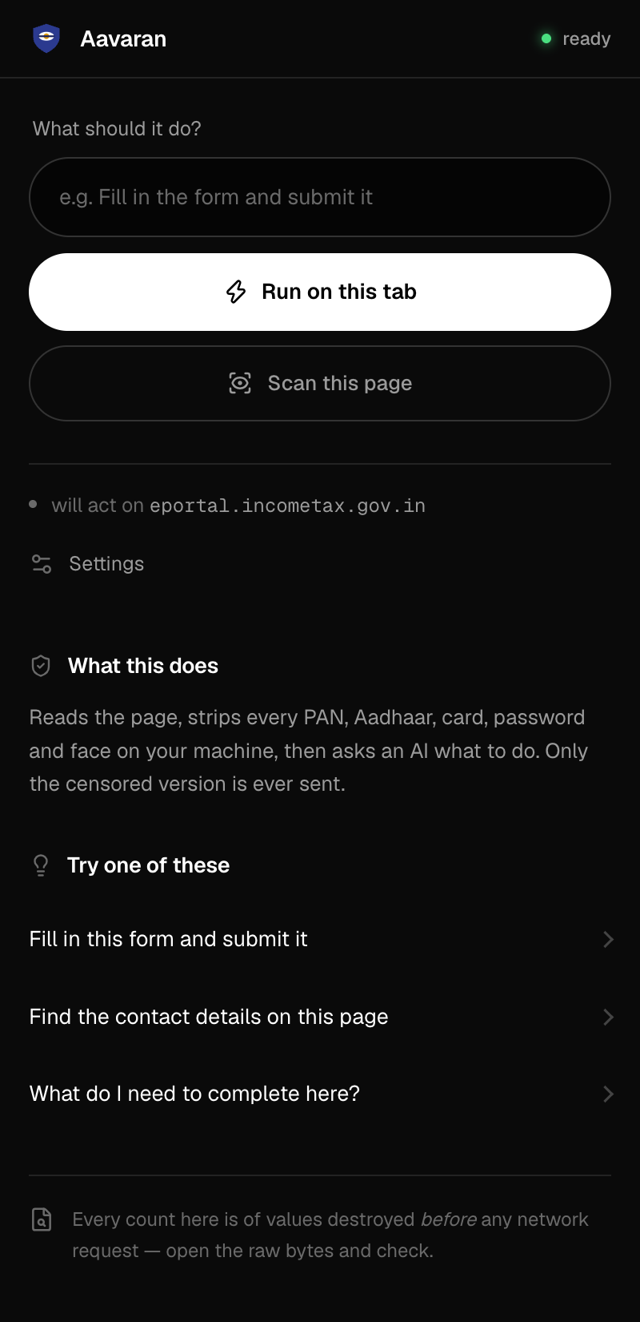
1-idle-server-ready
Idle, ready to run
The first screen anyone sees. The most important page here.
#goal #run #scan #target #settings
shown at 92% — full size in design/reference/

Slide 11
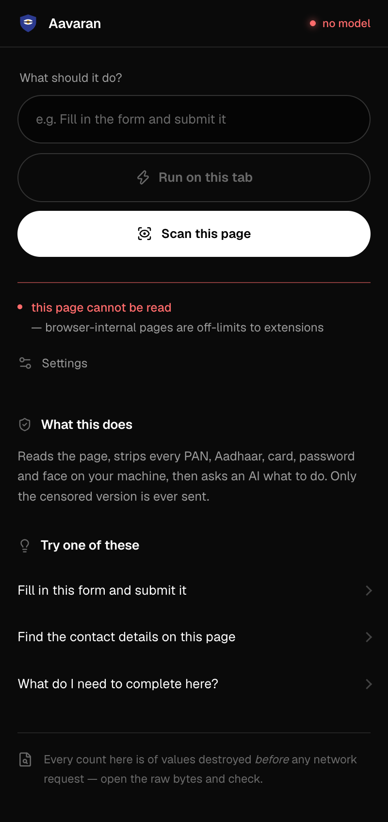
2-server-offline
Server offline
Run and Scan swap roles — the working action becomes the white one.
#lamp #serveradvice #scan
shown at 89% — full size in design/reference/

Slide 12
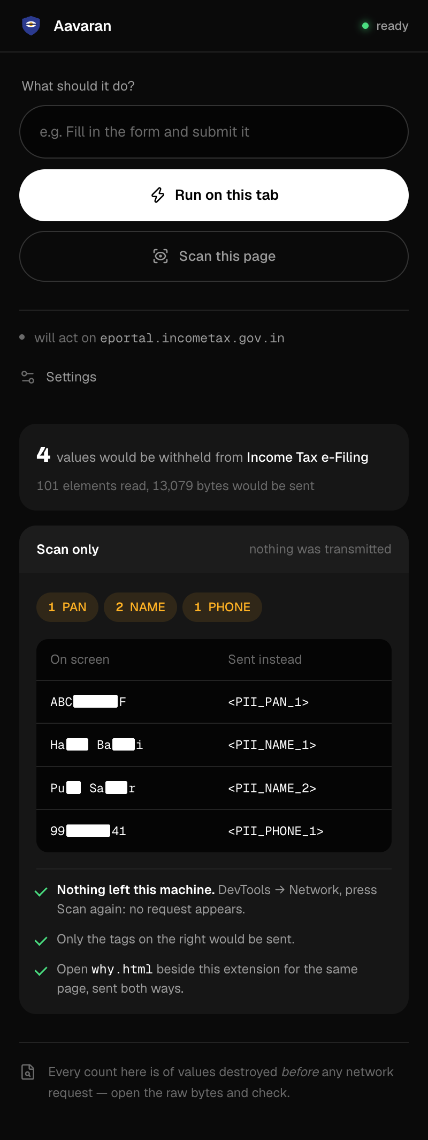
3-scan-result
Scan result
The path a sceptic presses. Withheld values, the tags, the proof.
.entry .fields .tag .proof
shown at 71% — full size in design/reference/

Slide 13
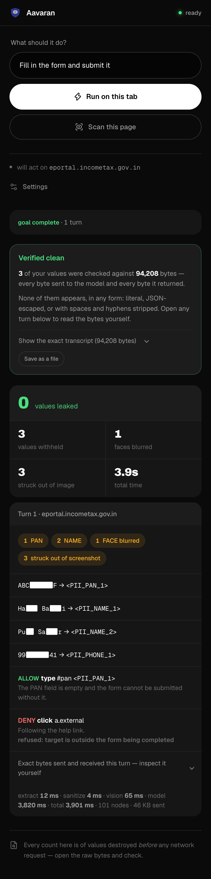
4-run-complete
Run complete
Long page — answer, totals, then the turn-by-turn ledger.
.answer .totals #ledger .turn
shown at 46% — full size in design/reference/

Slide 14
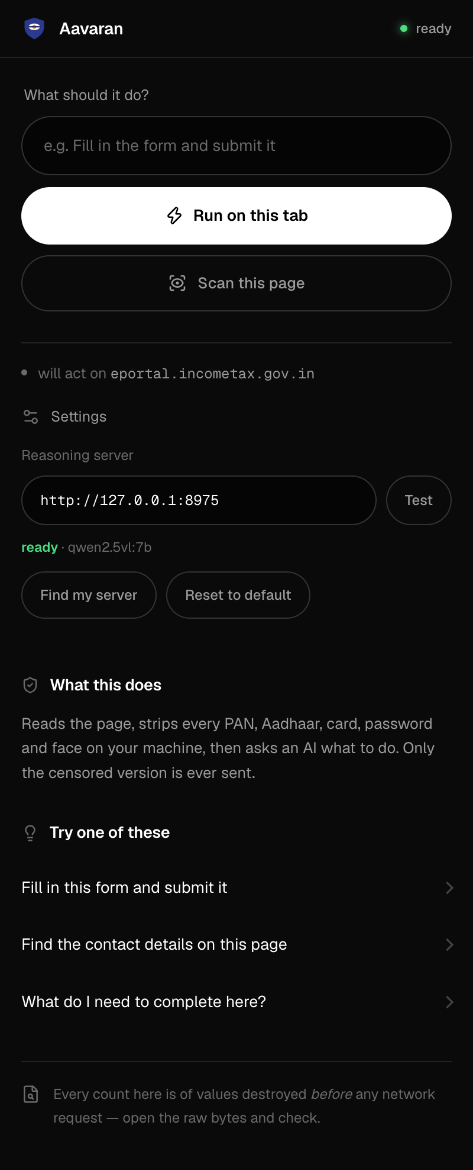
5-settings-open
Settings open
A disclosure, not a screen.
#settings #serverstatus #testsrv
shown at 76% — full size in design/reference/

Slide 15
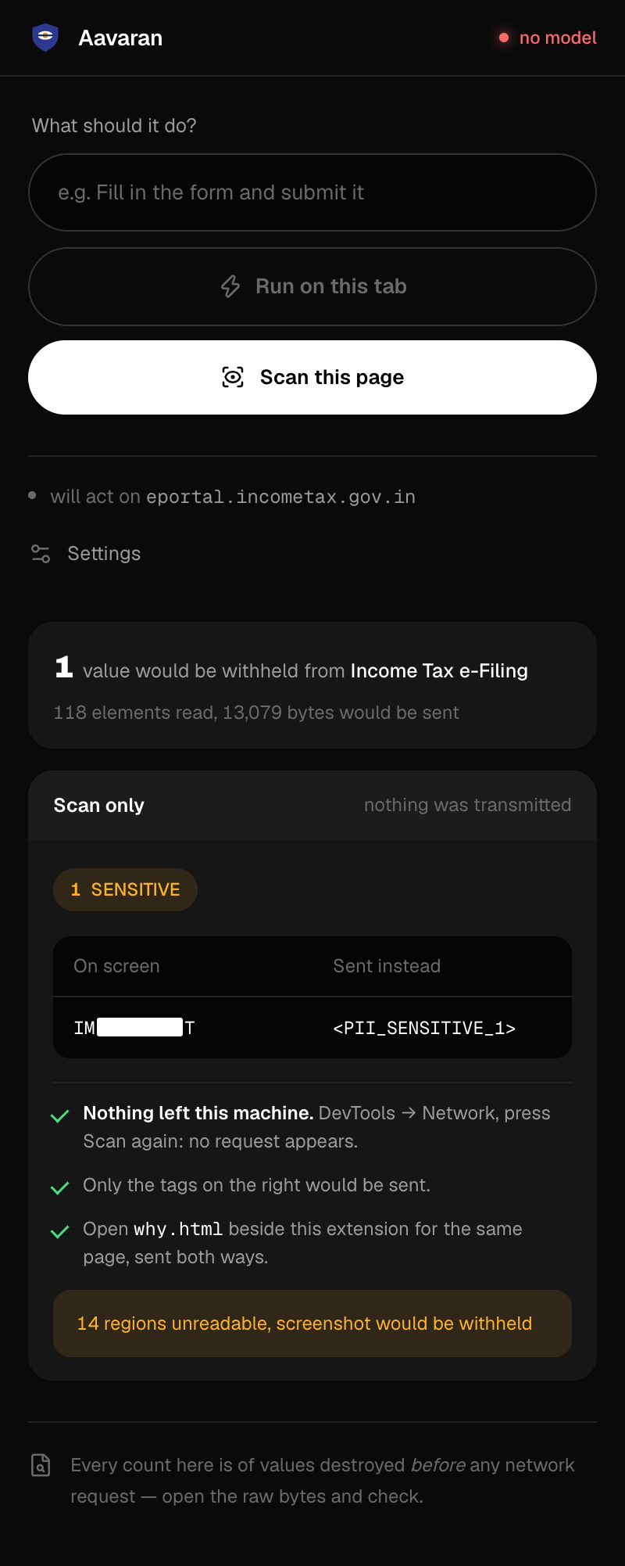
6-scan-ambiguous-field
Ambiguous field
A value we withheld but will not name a kind for.
.tag .entry
shown at 75% — full size in design/reference/

Slide 16
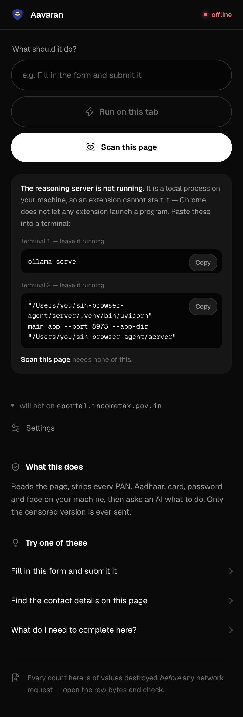
7-server-unreachable-repo
Server unreachable
Prints the exact commands, with copy buttons.
#serveradvice .cmd
shown at 64% — full size in design/reference/

Slide 17
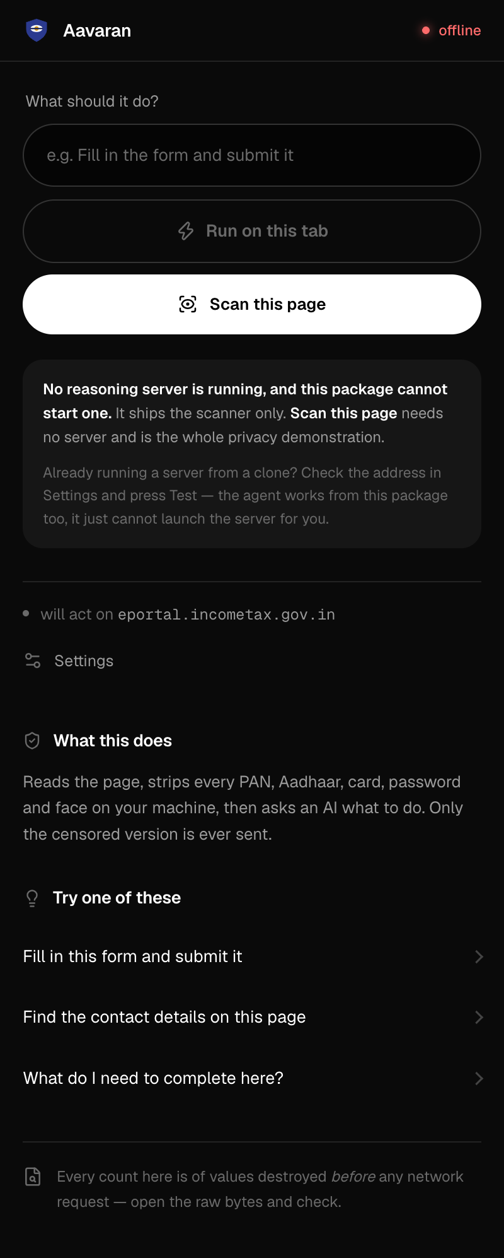
8-scan-only-package
Scan-only package
What everyone who gets the zip sees. Run is off, Scan is promoted.
#run #scan #serveradvice
shown at 76% — full size in design/reference/

Slide 18
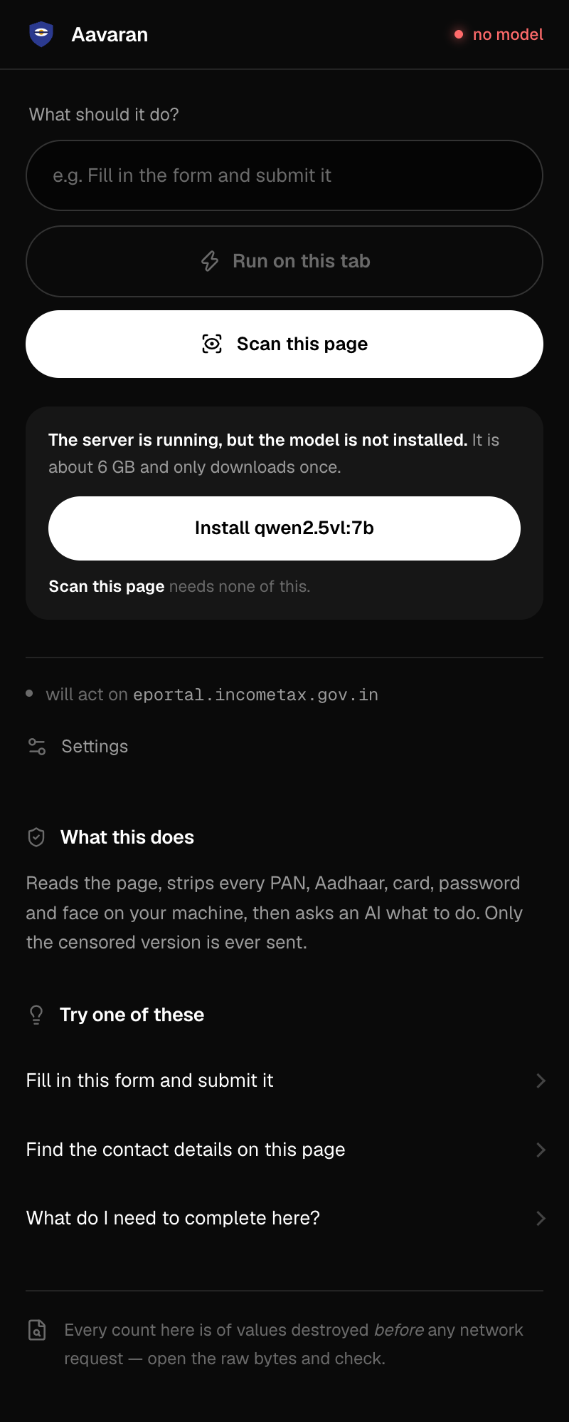
9-model-not-installed
Model missing
Offers the 6 GB download as a button.
#serveradvice .install
shown at 76% — full size in design/reference/

Slide 19
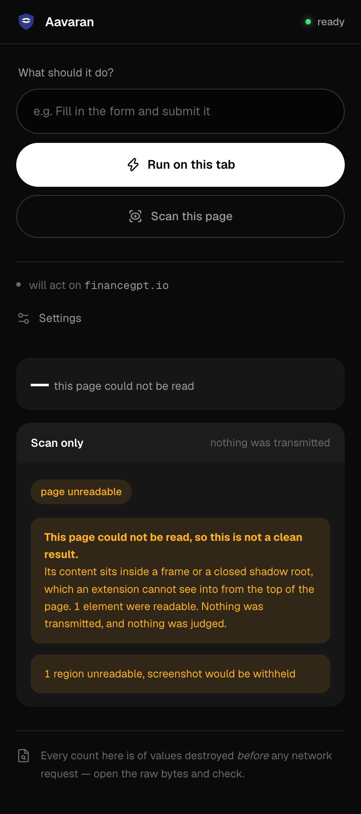
10-page-unreadable
Page could not be read
The most important honesty in the product: we refuse to say it is clean.
#empty .note
shown at 84% — full size in design/reference/

Slide 20
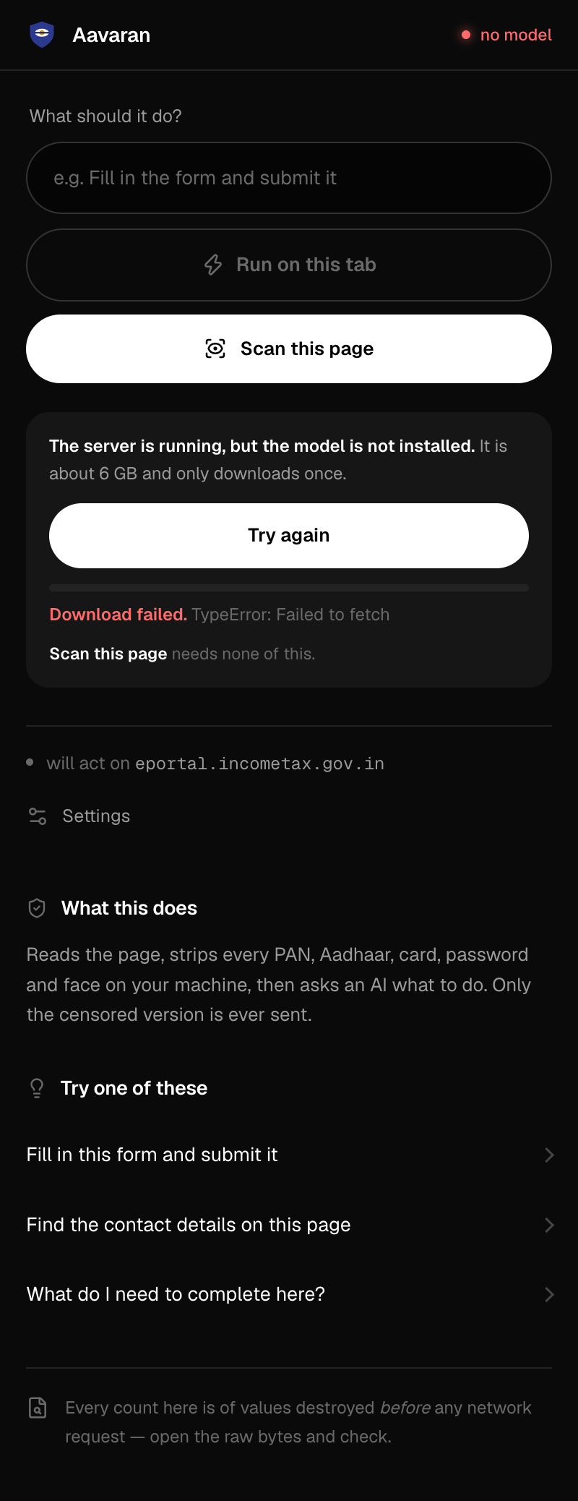
11-model-downloading
Downloading the model
Progress bar. Stalls are detected by bytes, never a deadline.
.progress
shown at 73% — full size in design/reference/

Slide 21
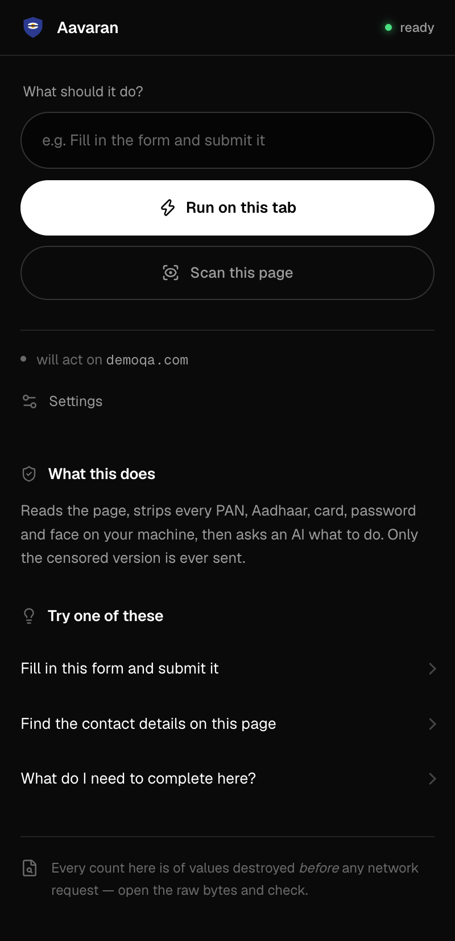
12-scan-only-but-server-up
Scan-only, server up
The package says scan-only but a server answers.
#run #scan
shown at 92% — full size in design/reference/

Slide 22
top bar ends at 96
blank canvas — 800 × 1800, inset 36

Slide 23
top bar ends at 96
blank canvas — 800 × 1800, inset 36

Slide 24
top bar ends at 96
blank canvas — 800 × 1800, inset 36

