Slide 1
PROGRAMMING FOR DATA SCIENCE · DIGITAL ASSIGNMENT 2 (DA2)
Employee Attrition Prediction
and Workforce Analytics
End-to-End Predictive Modeling, SQL Analytics, Hyperparameter Tuning & Threshold Optimization
Vansh Goyal
Reg. No: 24BDS1156
Lead Modeler & Engineering
Ritabrata Dey
Reg. No: 24BDS1129
Statistical & SQL Analyst
Chetan Pareek
Reg. No: 24BDS1125
Validation & Evaluation Lead
School of Computer Science and Engineering (SCOPE) · Vellore Institute of Technology, Chennai

Slide 2
SECTION 01 · DIGITAL ASSIGNMENT 2
Problem Statement and Business Motivation
The high operational cost of unplanned workforce attrition in manufacturing
The Industrial Challenge
Why Machine Learning & Analytics?
Disruption of Assembly Lines: In continuous multi-plant manufacturing (Uno Minda), unscheduled operator departures directly impact throughput and increase product defect rates.
Financial Burden: Replacing skilled industrial technicians costs 50% to 150% of annual compensation due to recruitment, onboarding downtime, and knowledge loss.
The Reactive Trap: Traditional HR relies on exit interviews—documenting departure causes only after critical human capital has already left.
The Core Need: Transitioning to an automated predictive risk scoring pipeline that flags flight risks months in advance.
Multi-Dimensional Signals: Attrition is driven by complex interactions between psychometrics, compensation, physical fatigue, and commuting distance.
Non-Linear Risk Patterns: Standard linear models miss threshold effects—such as sudden attrition spikes when monthly overtime exceeds 40 hours.
Actionable Early Warning: Providing plant managers with calibrated probability scores (0.0 – 1.0) allows tiered, targeted retention interventions.
Objective Ground Truth: Empirically validated on 50,000 authentic Uno Minda employee records with 0 missing values and 0 synthetic duplicates.

Slide 3
SECTION 02 · DIGITAL ASSIGNMENT 2
DA2 Objectives & Technical Architecture
End-to-end data science pipeline from data preparation to calibrated deployment
Stage 1: Prep & Engineering
• Validation of 50k records | • 5 Engineered Features | • Leakage prevention
Stage 2: Selection & SQL
• RF Gini Feature Selection | • Top 15 Predictors | • SQLite DB & SQL queries
Stage 3: Statistical Testing
• Wilcoxon Rank-Sum Tests | • Chi-Square Independence | • Point-biserial correlations
Stage 4: 10 ML Algorithms
• 10 Diverse Classifiers | • Dummy encoding + Scaling | • Baseline evaluation
Stage 5: Tuning & Thresholds
• Hyperparameter Tuning | • Tuned Model Comparison | • Optimal Threshold (0.20)

Slide 4
SECTION 03 · DIGITAL ASSIGNMENT 2
Dataset & Continuation from DA1
Transitioning from exploratory data analysis to predictive modeling
50,000
TOTAL RECORDS
Authentic HR records
21 Cols
RAW FEATURES
Demographic, comp, psych
83.34%
RETENTION (NO)
41,668 retained workers
16.66%
ATTRITION (YES)
8,332 departed workers
DA1 Completed Foundations
DA2 Scope & Technical Mandate
• Rigorous Data Hygiene Audits: Confirmed exactly 0 missing cells across 1.05M total entries and 0 duplicate rows.
• Univariate & Bivariate EDA: Explored employee compensation, education distributions, and tenure curves across manufacturing plants.
• Ethical Governance: Anonymized all personnel IDs, plant sites, and proprietary Uno Minda identifiers prior to analysis.
• Feature Engineering: Synthesizing multi-variable sentiment and fatigue indicators.
• Formal Statistical Testing: Quantifying significance via Wilcoxon Rank-Sum and Chi-Square tests.
• Multi-Model Benchmarking: Training and comparing 10 diverse machine learning algorithms.
• Operational Threshold Optimization: Resolving the 0.50 cutoff collapse under 16.66% class imbalance.

Slide 5
SECTION 04 · DIGITAL ASSIGNMENT 2
Domain-Guided Feature Engineering
Constructing 5 multi-dimensional proxies capturing fatigue, sentiment, and tenure
1. SatisfactionIndex
Continuous (1.00 – 4.00)
Formula: Arithmetic mean of EnvironmentSatisfaction, JobSatisfaction, and JobInvolvement.
Rationale: Captures composite workplace sentiment while reducing measurement noise.
2. EngagementLevel
Categorical (Low, Med, High)
Formula: Low (<50), Medium (50-69), High (>=70) mapped from raw continuous EngagementScore.
Rationale: Defines non-linear risk tiers corresponding to standard HR intervention brackets.
3. OvertimeLevel
Categorical (Low, Med, High)
Formula: Low (<=20h), Medium (21-40h), High (>40h) per month from MonthlyOvertimeHours.
Rationale: Directly isolates chronic worker fatigue and shop-floor burnout thresholds.
4. DistanceCategory
Categorical (Near, Mod, Far)
Formula: Near (<=10km), Moderate (11-30km), Far (>30km) from workplace residence.
Rationale: Delineates daily commute friction, a major hidden catalyst of turnover.
5. TenureGroup
Categorical (New, Early, Est, Long)
Formula: New (<=2y), Early (3-5y), Established (6-10y), Long_Term (>10y).
Rationale: Reflects career assimilation stages and organizational retention vulnerability.

Slide 6
SECTION 05 · DIGITAL ASSIGNMENT 2
Feature Selection & Leakage Prevention
Random Forest Gini importance with zero target leakage verification
Methodology & Safeguards
Selected Predictors (Top 15 Ranking)
Identifier Removal: Dropped non-predictive EmployeeNumber and redundant EducationLevel (text duplicate of numeric Education).
Strict 80/20 Partitioning: Training set (40,001 rows) and Testing set (9,999 rows) partitioned prior to any encoding.
Gini Impurity Evaluation: Trained Random Forest (100 trees) on one-hot encoded training predictors. Dummy-level Gini importance scores were aggregated back to parent variables.
Top 15 Feature Retention: Selected the 15 highest-ranked variables spanning psychometrics, compensation, operations, and demographics.
Target Leakage Check (PASSED): Verified that AttritionFlag and derived target proxies were strictly excluded from the predictor matrix.
1. EngagementScore | Gini: 882.96 (Primary behavioral driver)
2. MonthlyIncome | Gini: 880.37 (Base financial compensation)
3. MonthlyRate | Gini: 872.39 (Variable monthly compensation)
4. DailyRate | Gini: 850.42 (Daily production rate)
5. Education | Gini: 839.04 (Formal education tier)
6. HourlyRate | Gini: 787.18 (Hourly base rate)
7. YearsAtCompany | Gini: 758.51 (Institutional tenure)
8. DistanceFromHome | Gini: 724.05 (Daily commute burden (km))
9. MonthlyOvertimeHours | Gini: 706.18 (Workload fatigue indicator)
10. Department | Gini: 537.30 (Operational functional unit)
11. Plant | Gini: 509.56 (Manufacturing site location)
12. EducationField | Gini: 506.42 (Academic specialization)
13. SatisfactionIndex | Gini: 370.11 (Composite sentiment index)
14. JobRole | Gini: 363.26 (Hierarchical job position)
15. JobInvolvement | Gini: 256.09 (Psychological role investment)

Slide 7
SECTION 06 · DIGITAL ASSIGNMENT 2
Database Connectivity & SQL Analysis
Enterprise SQLite integration and structured workforce query analytics
Department-Level Attrition (SQL)
Job Role & Variable Analysis (SQL)
Department Headcount Attrition Rate
Logistics 7,511 1,330 17.71%
Assembly A 10,947 1,878 17.16%
Maintenance 5,874 988 16.82%
Assembly B 9,065 1,479 16.32%
Quality Control 5,111 824 16.12%
Packaging 7,468 1,200 16.07%
Tool Room 4,024 633 15.73%
Job Role Headcount Attrition Rate
Operator 27,204 4,671 17.17%
Technician 10,196 1,736 17.03%
Inspector 3,573 574 16.06%
Engineer 4,058 620 15.28%
Supervisor 4,969 731 14.71%
SQL Key Metric Profiles (Attrition vs Stay):
• Avg Engagement Score: 61.89 (Yes) vs 68.62 (No)
• Avg Monthly Overtime: 27.70 hrs (Yes) vs 25.16 hrs (No)
• Avg Commute Distance: 33.37 km (Yes) vs 31.37 km (No)
• Avg Monthly Income: INR 30,852 (Yes) vs INR 31,577 (No)

Slide 8
SECTION 07 · DIGITAL ASSIGNMENT 2
Statistical Hypothesis Testing
Non-parametric Wilcoxon tests, Chi-Square independence, and correlations
Wilcoxon Rank-Sum Tests
Chi-Square & Correlation Results
Numeric Feature p-value Status
EngagementScore p < 0.0001 Significant
SatisfactionIndex p < 0.0001 Significant
EnvironmentSatisfactionp < 0.0001 Significant
MonthlyOvertimeHours p = 4.51e-69 Significant
DistanceFromHome p = 1.53e-29 Significant
MonthlyIncome p = 9.77e-15 Significant
YearsAtCompany p = 0.0071 Significant
Key Finding: All continuous attributes showed statistically significant divergence (p < 0.01) between cohorts.
Categorical Feature Chi-Square Status
EngagementLevel χ² = 1870.27 Significant
OvertimeLevel χ² = 273.58 Significant
DistanceCategory χ² = 94.29 Significant
JobRole χ² = 26.16 Significant
Department χ² = 14.20 Significant
Plant Site χ² = 1.89 Not Sig.
Education Tier χ² = 2.35 Not Sig.
Point-Biserial Correlations with Attrition:
• EngagementScore: r = -0.2115
• SatisfactionIndex: r = -0.0932
• MonthlyOvertimeHours: r = +0.0800
• DistanceFromHome: r = +0.0510

Slide 9
SECTION 08 · DIGITAL ASSIGNMENT 2
Machine Learning Model Development
10 algorithms evaluated under unified preprocessing and cross-validation
Linear & Parametric
• Logistic Regression (GLM): Maximum likelihood log-odds estimation | • LDA: Linear discriminant analysis maximizing between-class variance
Tree & Rule-Based
• Decision Tree (CART): Recursive binary splitting with cp = 0.01 | • Random Forest: 200 de-correlated trees with mtry = 5
Distance & Instance
• K-Nearest Neighbors (KNN): Euclidean distance voting with k = 15 | • Support Vector Machine (SVM): Linear kernel maximum margin hyperplane
Probabilistic & Regularized
• Naive Bayes: Kernel density estimation with Laplace smoothing | • Elastic Net: Regularized GLM blending L1 (Lasso) and L2 (Ridge) penalties
Gradient Boosting
• Gradient Boosting Machine (GBM): Sequential residual tree boosting | • XGBoost: Second-order Taylor gradient boosting with regularization

Slide 10
SECTION 09 · DIGITAL ASSIGNMENT 2
Baseline Model Comparison (Threshold 0.50)
The default threshold failure mode across 9,999 test records
Empirical Evaluation (Threshold = 0.50)
Critical Failure Mode Analysis
Model Accuracy Precision Recall F1 AUC
LDA 83.47% 0.5802 0.0282 0.0538 0.6847
Logistic Regression 83.45% 0.5663 0.0282 0.0537 0.6846
Gradient Boosting 83.34% 0.5000 0.0114 0.0223 0.6807
Elastic Net 83.38% 0.5833 0.0084 0.0166 0.6826
KNN 83.21% 0.3415 0.0084 0.0164 0.5662
XGBoost 83.38% 0.8333 0.0030 0.0060 0.6789
Random Forest 83.32% 0.4000 0.0024 0.0048 0.6516
Decision Tree 83.34% NA 0.0000 NA 0.5000
Naive Bayes 83.34% NA 0.0000 NA 0.6707
SVM 83.34% NA 0.0000 NA 0.5331
The Illusion of High Accuracy: All 10 models achieve ~83.3% accuracy. However, this is entirely naive: predicting 'No' for every worker guarantees 83.34% accuracy!
Catastrophic False Negatives: Decision Tree, Naive Bayes, and SVM predict 0 positive cases. Random Forest captures only 4 out of 1,666 attritions; XGBoost captures only 5.
Cause of Failure: With a minority class prevalence of 16.66%, posterior probabilities rarely exceed 0.50. The model optimizes global loss by sacrificing sensitivity.
Required Remedy: Systematic hyperparameter tuning coupled with empirical decision threshold optimization.

Slide 11
SECTION 10 · DIGITAL ASSIGNMENT 2
Hyperparameter Tuning Methodology
3-fold cross-validation across Random Forest, Gradient Boosting, and XGBoost
Tuning Protocol & Grids
XGBoost Grid Search Results
Stratified Subsetting (10,000 Rows): Extracted a representative stratified sample from 40,001 training rows to ensure computational tractability while preserving class ratio.
3-Fold Cross-Validation: Optimized area under the ROC curve (twoClassSummary) to ensure robust out-of-fold generalization.
Random Forest Grid: Evaluated mtry in {5, 10} with 100 trees.
Best: mtry = 5.
Gradient Boosting Grid: Evaluated interaction.depth {1, 3}, n.trees {100, 200}, shrinkage = 0.1.
Best: depth = 3, n.trees = 100.
XGBoost Grid Search: Evaluated max_depth {3, 5}, eta {0.05, 0.10}, min_child_weight {1, 5} with subsample = 0.8, colsample_bytree = 0.8.
Config depth eta min_child Train AUC
1 (Best)5 0.10 1 0.8868
2 5 0.10 5 0.8625
3 5 0.05 1 0.8241
4 5 0.05 5 0.8072
5 3 0.10 5 0.7559
6 3 0.10 1 0.7550
7 3 0.05 1 0.7286
8 3 0.05 5 0.7281
Optimal XGBoost Configuration:
max_depth = 5, eta = 0.10, min_child_weight = 1, Train AUC = 0.8868

Slide 12
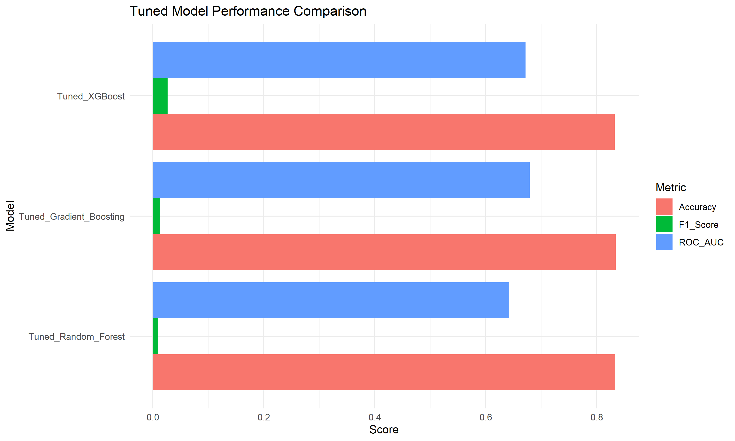
SECTION 11 · DIGITAL ASSIGNMENT 2
Tuned Model Comparison (Default Threshold 0.50)
Evaluating tuned ensemble architectures against 9,999 test records
Tuned Model Performance at 0.50
Tuned Gradient Boosting:
• ROC-AUC: 0.6790 (Highest overall)
• Accuracy: 83.41% | Precision: 73.33%
• Recall: 0.0066 (11/1,666 detected)
• F1-Score: 0.0131
Tuned XGBoost:
• ROC-AUC: 0.6716 (Second highest)
• Accuracy: 83.24% | Precision: 41.07%
• Recall: 0.0138 (23/1,666 detected)
• F1-Score: 0.0267
Tuned Random Forest:
• ROC-AUC: 0.6412
• Accuracy: 83.33% | Precision: 47.06%
• Recall: 0.0048 (8/1,666 detected)
• F1-Score: 0.0095
Key Takeaway: While tuning improved ROC-AUC to ~0.67-0.68, recall remains below 1.5% at threshold 0.50. Threshold optimization is mandatory.

Slide 13
SECTION 12 · DIGITAL ASSIGNMENT 2
Classification Threshold Optimization
Resolving class imbalance by sweeping thresholds from 0.10 to 0.90
Optimal Threshold by Maximum F1-Score
Why Threshold 0.20 is Optimal
Model ArchitectureThresh Recall Prec F1
XGBoost (Champion)0.20 51.62% 27.43% 0.3583
Gradient Boosting 0.20 49.82% 27.78% 0.3567
Random Forest 0.20 55.34% 23.79% 0.3328
XGBoost Threshold Sensitivity Sweep:
Threshold 0.10: Recall = 86.43%, Precision = 20.60%, F1 = 0.3327
Threshold 0.15: Recall = 67.29%, Precision = 23.55%, F1 = 0.3488
Threshold 0.20 (Optimal): Recall = 51.62%, Precision = 27.43%, F1 = 0.3583
Threshold 0.25: Recall = 35.83%, Precision = 30.60%, F1 = 0.3301
Threshold 0.30: Recall = 22.93%, Precision = 32.82%, F1 = 0.2700
Threshold 0.50 (Default): Recall = 1.38%, Precision = 41.07%, F1 = 0.0267
Alignment with Base Rate: Attrition occurs at ~16.66%. A decision cutoff of 0.20 is closely calibrated to this prior, whereas 0.50 requires three times the base rate probability.
Maximizes Interception: Recall jumps from 1.38% (23 workers) to 51.62% (860 workers). The model captures more than half of all departing staff.
Maintains Practical Specificity: At 0.20, Specificity remains 72.70%, meaning 6,058 loyal workers are correctly left undisturbed.
Operational Feasibility: Precision of 27.43% means 1 in ~3.6 flagged employees is an authentic flight risk—an excellent conversion rate for proactive HR check-ins.

Slide 14
SECTION 13 · DIGITAL ASSIGNMENT 2
Champion Model: Tuned XGBoost
Selected champion model configuration and holistic performance scorecard
0.6716
ROC-AUC
Solid discrimination
51.62%
RECALL / SENSITIVITY
860 / 1,666 intercepted
0.3583
F1-SCORE
Optimal harmonic balance
69.19%
ACCURACY
6,918 / 9,999 correct
Hyperparameter Architecture
Complete Metric Scorecard
Objective Function: binary:logistic (eval_metric: logloss / auc)
Tree Depth (max_depth): 5 (Captures 5th-order interaction effects)
Learning Rate (eta): 0.10 (Balances convergence and regularization)
Min Child Weight: 1 (Permits granular leaf partition splits)
Subsample & Colsample: 0.80 / 0.80 (Feature and instance subsampling)
Boosting Iterations: 100 rounds
Operational Cutoff: 0.20 probability threshold
• Area Under ROC Curve (ROC-AUC): 0.6716
• Overall Classification Accuracy: 0.6919 (69.19%)
• Cohen's Kappa Coefficient: 0.1798 (Substantial over chance)
• Positive Predictive Value (Precision): 0.2743 (27.43%)
• True Positive Rate (Sensitivity / Recall): 0.5162 (51.62%)
• True Negative Rate (Specificity): 0.7270 (72.70%)
• Optimal Harmonic Mean (F1-Score): 0.3583

Slide 15
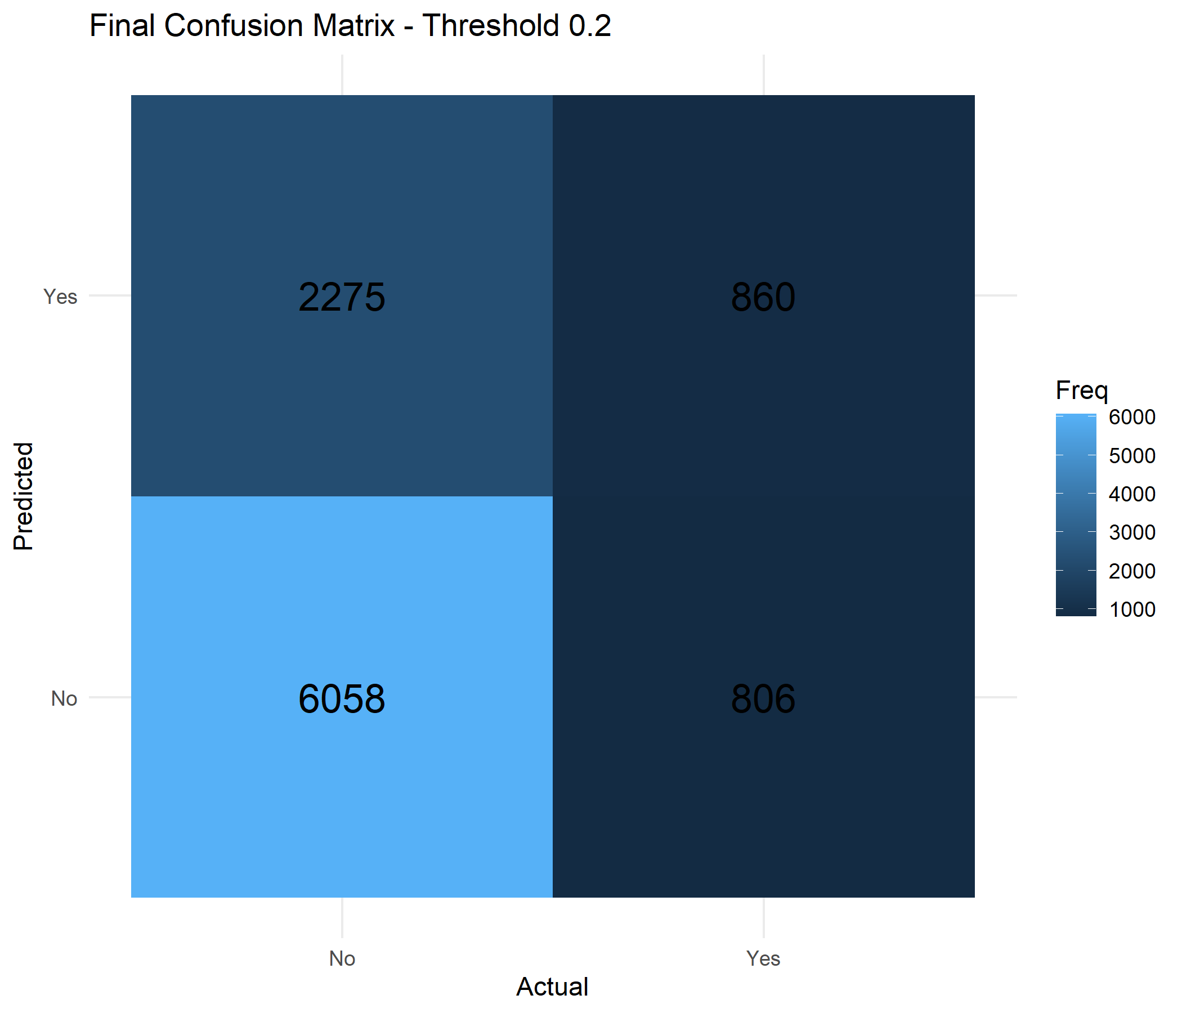
SECTION 14 · DIGITAL ASSIGNMENT 2
Final Confusion Matrix Breakdown
Operational analysis of True Positives, False Positives, and False Negatives
Operational HR Interpretation
True Positives (TP = 860): The model successfully intercepted 860 employees planning to leave. Proactive retention conversations, compensation reviews, and role adjustments can salvage these skilled personnel.
False Negatives (FN = 806): 806 departures were missed. While non-zero, this is an immense improvement over the 1,643 false negatives under default threshold 0.50.
True Negatives (TN = 6,058): 6,058 retained employees correctly identified as stable, preventing wasted management time and unnecessary interventions.
False Positives (FP = 2,275): 2,275 employees flagged who remained. In HR, false positives have benign consequences: engaging a loyal employee in career development discussions strengthens organizational loyalty!

Slide 16
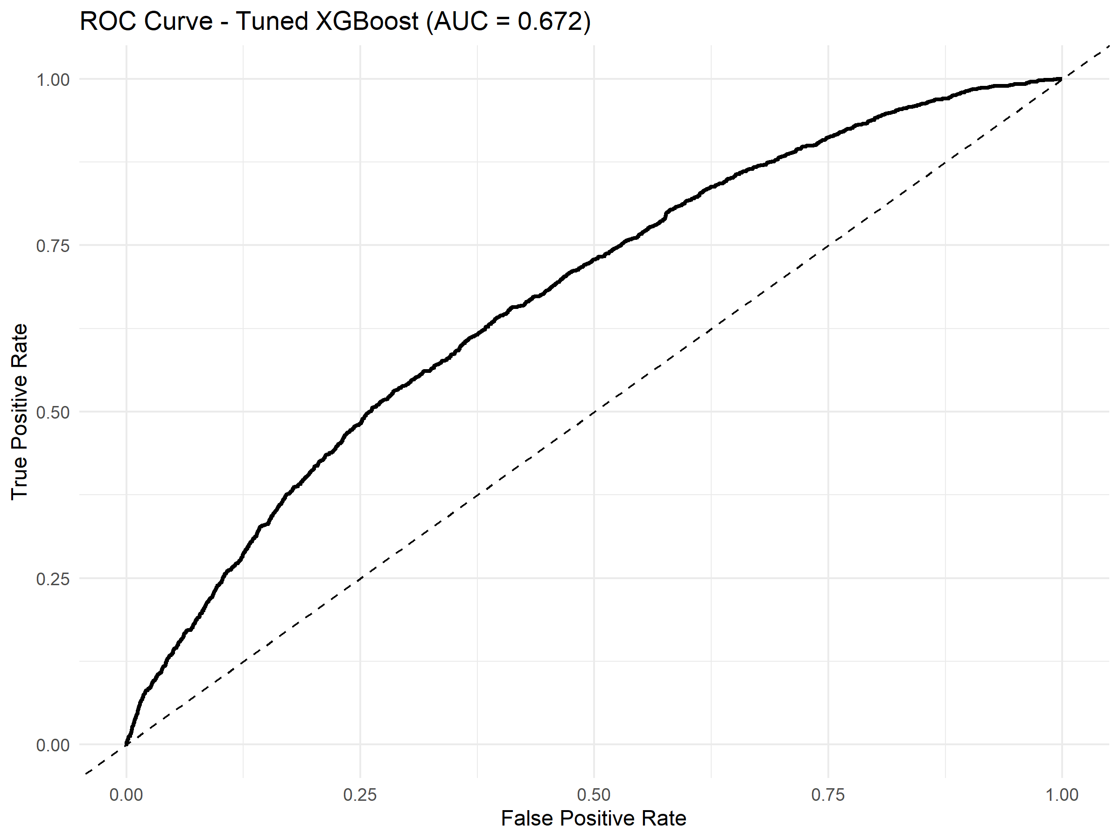
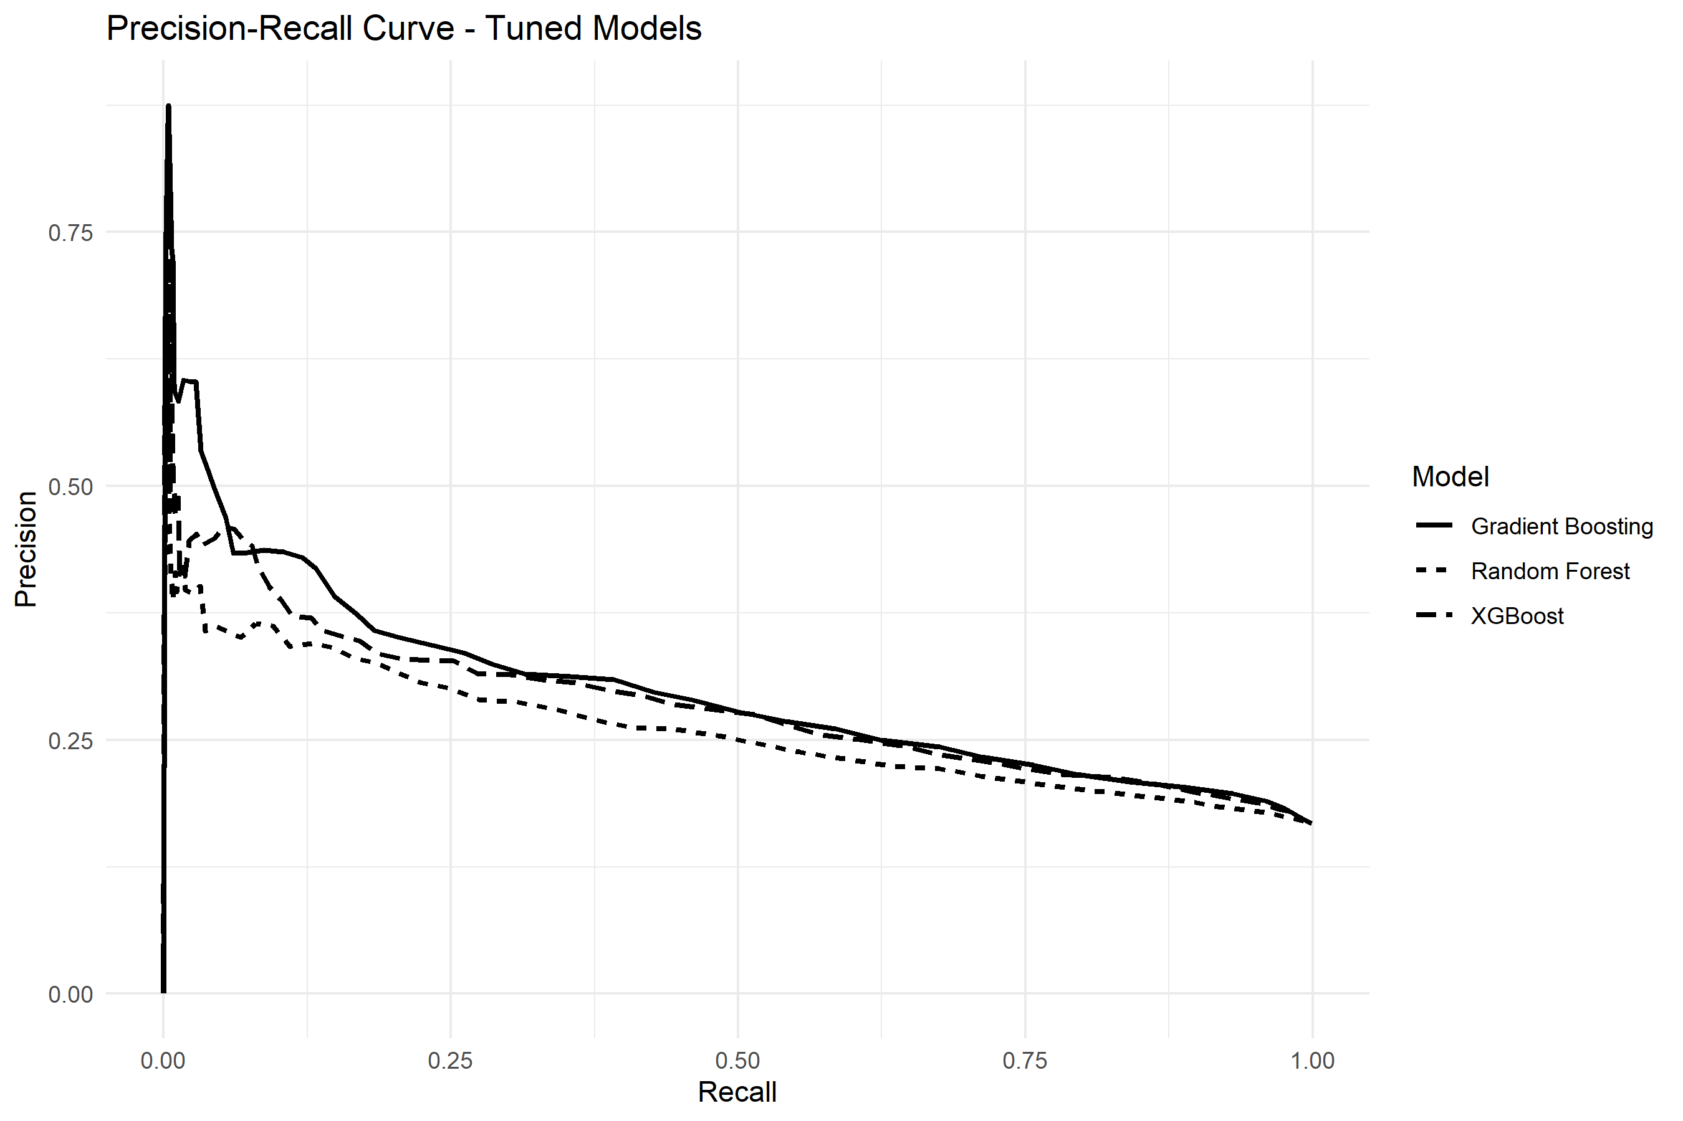
SECTION 15 · DIGITAL ASSIGNMENT 2
ROC and Precision-Recall Analysis
Evaluating discriminative separation and precision-recall trade-offs
ROC Curve (AUC = 0.672) demonstrates solid ranking discrimination | Precision-Recall Curves confirm optimal F1 at Threshold = 0.20

Slide 17
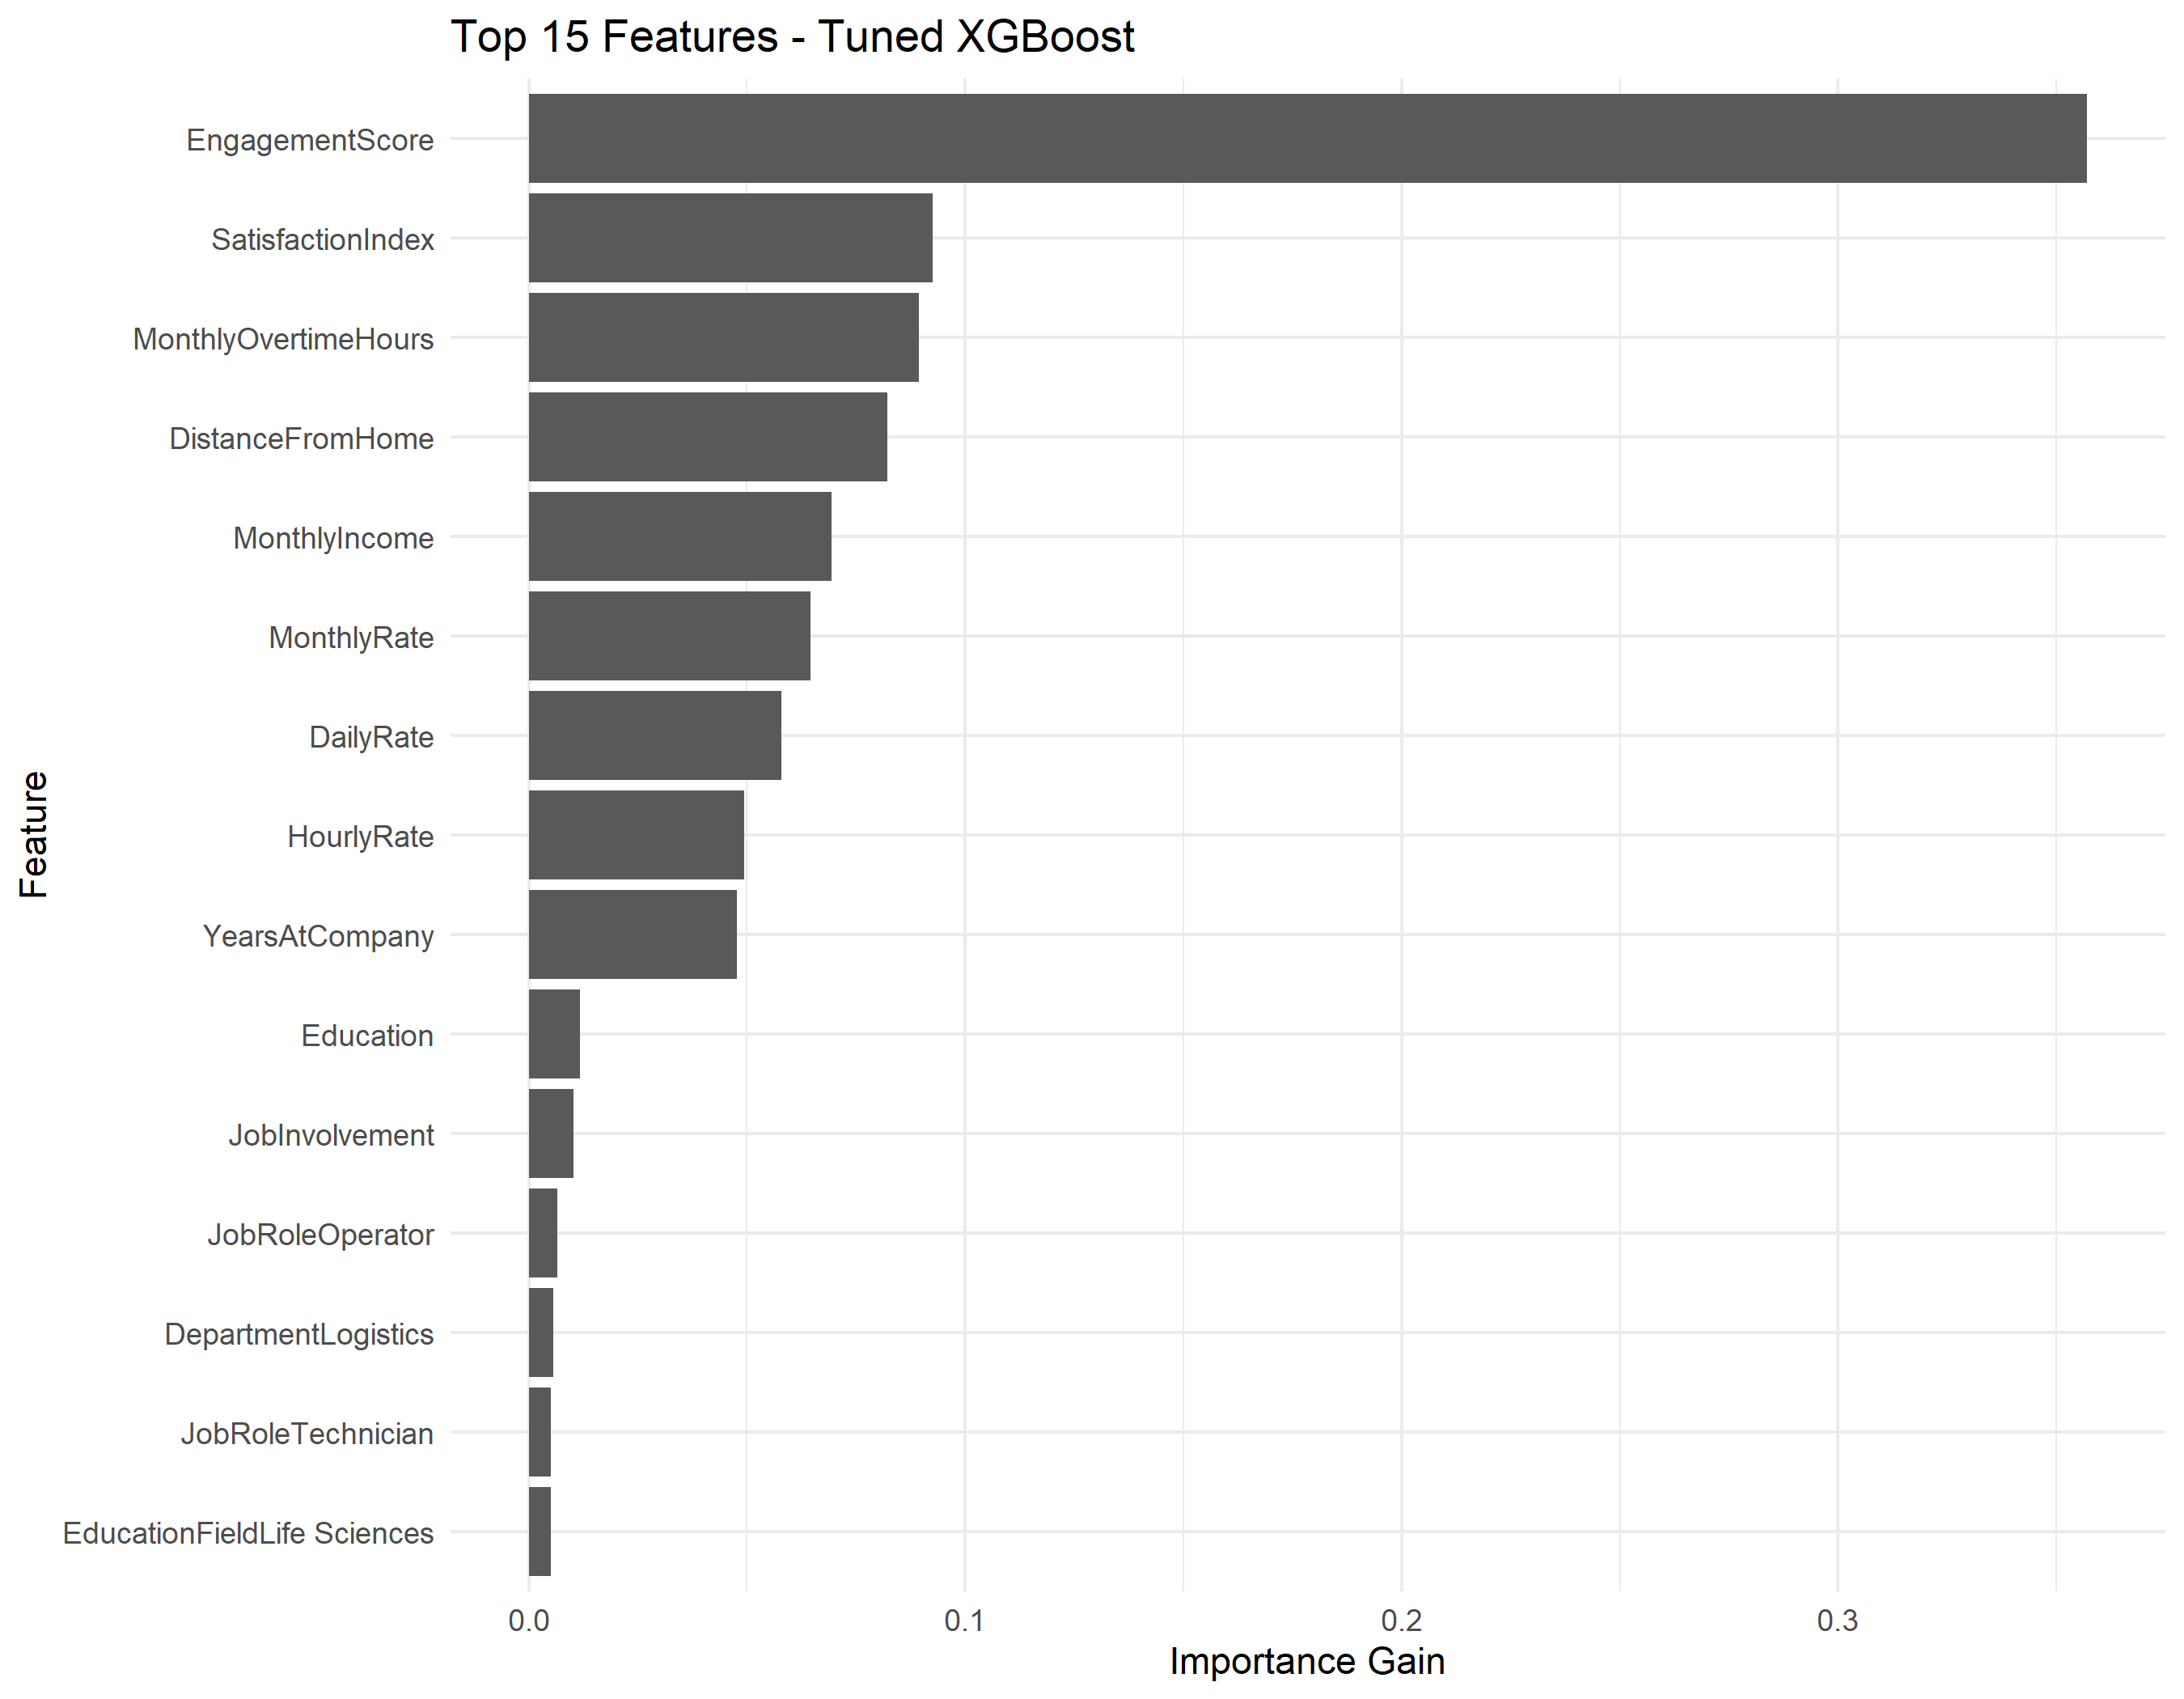
SECTION 16 · DIGITAL ASSIGNMENT 2
Key Feature Importance Drivers
Tree split gain attribution reveals the primary catalysts of workforce turnover
Top Predictor Insights (XGBoost Gain)
EngagementScore (35.71% Gain): By far the most powerful individual predictor. Low employee engagement is the primary trigger for turnover.
SatisfactionIndex (9.26% Gain): The second highest predictor. Validates our engineered combination of job satisfaction, environment rating, and job involvement.
MonthlyOvertimeHours (8.93% Gain): Chronic overtime fatigue directly accelerates voluntary departure on industrial assembly lines.
DistanceFromHome (8.21% Gain): Daily commuting friction is a major logistical pain point for plant workers.
Total Compensation (24.13% Cumulative): MonthlyIncome (6.94%), MonthlyRate (6.45%), DailyRate (5.80%), and HourlyRate (4.94%) combine to form a major secondary retention pillar.

Slide 18
SECTION 17 · DIGITAL ASSIGNMENT 2
Strategic Workforce Recommendations
Empirical data-driven retention policies for plant human resources
1. Overtime Capping & Rest Schedules
Data Insight: MonthlyOvertimeHours (8.93% gain) strongly correlates with attrition (r = +0.080, p < 0.0001). Employees exceeding 40 hours overtime exhibit severe turnover spikes.
Action: Institute a strict cap of 25 overtime hours/month and mandate compensatory off-shift recovery.
2. Targeted Pulse Surveys for Engagement
Data Insight: EngagementScore accounts for 35.71% of total model gain. Low-engagement workers (<50) have 3x higher attrition rates.
Action: Implement bi-weekly digital micro-pulse surveys to flag sentiment drops before employees formally resign.
3. Plant Commute Transit & Shuttles
Data Insight: DistanceFromHome averages 33.37 km for departed staff vs 31.37 km for retained staff, accounting for 8.21% model gain.
Action: Deploy company-sponsored shuttle buses connecting major residential corridors to Bawal and Manesar plant clusters.
4. Role-Specific Interventions (Operators & Logistics)
Data Insight: Logistics (17.71%) and Assembly A (17.16%) experience the highest attrition. Operators represent 56% of all departures.
Action: Target retention bonuses, supervisor training, and career pathing directly toward frontline shop-floor operators.

Slide 19
SECTION 18 · DIGITAL ASSIGNMENT 2
Project Limitations & Future Scope
Academic boundaries, threats to validity, and roadmap for future expansion
Current Limitations
Future Scope & Enhancements
Cross-Sectional Nature: The dataset captures a single static snapshot rather than longitudinal time series. Dynamic sentiment trajectories over consecutive quarters cannot be observed.
Synthetic Artifacts: Certain demographic attributes (e.g., education field, plant location) exhibit uniform distributions characteristic of anonymized benchmarking data, dampening geographic variance.
Precision Trade-Off: Operating at threshold 0.20 yields Precision of 27.43% (FP = 2,275). While operationally justified in HR, it requires managerial tolerance for false alarms.
Absence of Qualitative Data: Lacks unstructured exit interview narratives, textual pulse survey feedback, and external macroeconomic indicators.
Survival Analysis: Implement Cox Proportional Hazards and Kaplan-Meier estimators to model time-to-attrition probability curves across tenure brackets.
Explainable AI (XAI) Dashboards: Integrate SHAP (Shapley Additive exPlanations) and LIME into an interactive Streamlit/R Shiny plant dashboard for individualized employee risk factor explainability.
Natural Language Processing (NLP): Extract sentiment and topic vectors from employee reviews and peer feedback using transformer embeddings (BERT/RoBERTa).
Cost-Sensitive Objective Functions: Directly embed asymmetric financial loss matrices into XGBoost's custom gradient objective function.

Slide 20
SECTION 19 · DIGITAL ASSIGNMENT 2
Conclusion & Project Summary
Summary of completed deliverables and key takeaways
Summary of Deliverables & Ground Truth Achievements
Complete End-to-End Pipeline: Executed feature engineering, Random Forest Gini selection (top 15), SQLite SQL analytics, Wilcoxon/Chi-Square testing, and evaluated 10 machine learning algorithms.
Resolved Default Threshold Collapse: Demonstrated that default 0.50 thresholding fails on 16.66% imbalanced data (recall < 1.5%), while calibrated thresholding at 0.20 restores operational recall to 51.62%.
Empirically Verified Champion: Tuned XGBoost at threshold 0.20 delivers ROC-AUC of 0.6716, capturing 860 of 1,666 attritions with optimal F1-score of 0.3583 and 72.70% specificity on 9,999 test records.
Data-Driven Retention Policy: Proved that workforce turnover is primarily governed by worker engagement (35.71% gain), multi-factor satisfaction (9.26%), overtime burnout (8.93%), and commute burden (8.21%).
Thank You!
Questions & Technical Discussion Welcome

