Slide 1
TECHNICAL PROJECT PRESENTATION | ENTERPRISE WORKFORCE ANALYTICS
Employee Attrition Prediction &
Workforce Analytics
An End-to-End Machine Learning and Workforce Decision Support System
Project Team: Vansh Goyal (24BDS1156) • Ritabrata Dey (24BDS1129) • Chetan Pareek (24BDS1125)
School of Computer Science and Engineering (SCOPE) | Vellore Institute of Technology (VIT), Chennai
October 2026

Slide 2
EXECUTIVE MOTIVATION
Problem Context & Technical Objectives
Operational Challenge: Voluntary Attrition
• Manufacturing Disruption: Unplanned technician and operator turnover creates severe line imbalances, scrap rate spikes, and delays in industrial delivery schedules.
• Asymmetric Replacement Costs: Recruiting and certifying specialized CNC and assembly technicians incurs substantial onboarding lag and emergency hiring overhead.
• Failure of Reactive HR: Exit interviews capture turnover drivers only after resignations occur, providing zero opportunity for timely retention interventions.
• Supervisory Blindspots: Localized shift friction and physical burnout are often obscured by subjective managerial reporting.
End-to-End Solution Architecture
✔ Multi-Plant Empirical Data Pipeline: Audit and prepare an enterprise dataset of 50,000 employee records across 6 regional manufacturing plants.
✔ Behavioral Feature Engineering: Formulate robust composite psychometric and operational indices (SatisfactionIndex, OvertimeLevel).
✔ Algorithm Benchmarking: Systematically evaluate 10 supervised classification algorithms across linear, kernel, and tree-based paradigms.
✔ Decision-Threshold Calibration: Resolve severe class imbalance by optimizing decision boundaries to maximize leaver recall and F1-score.
✔ Interactive Decision Support: Deliver an 8-tab Streamlit dashboard with real-time R inference for proactive HR intervention.

Slide 3
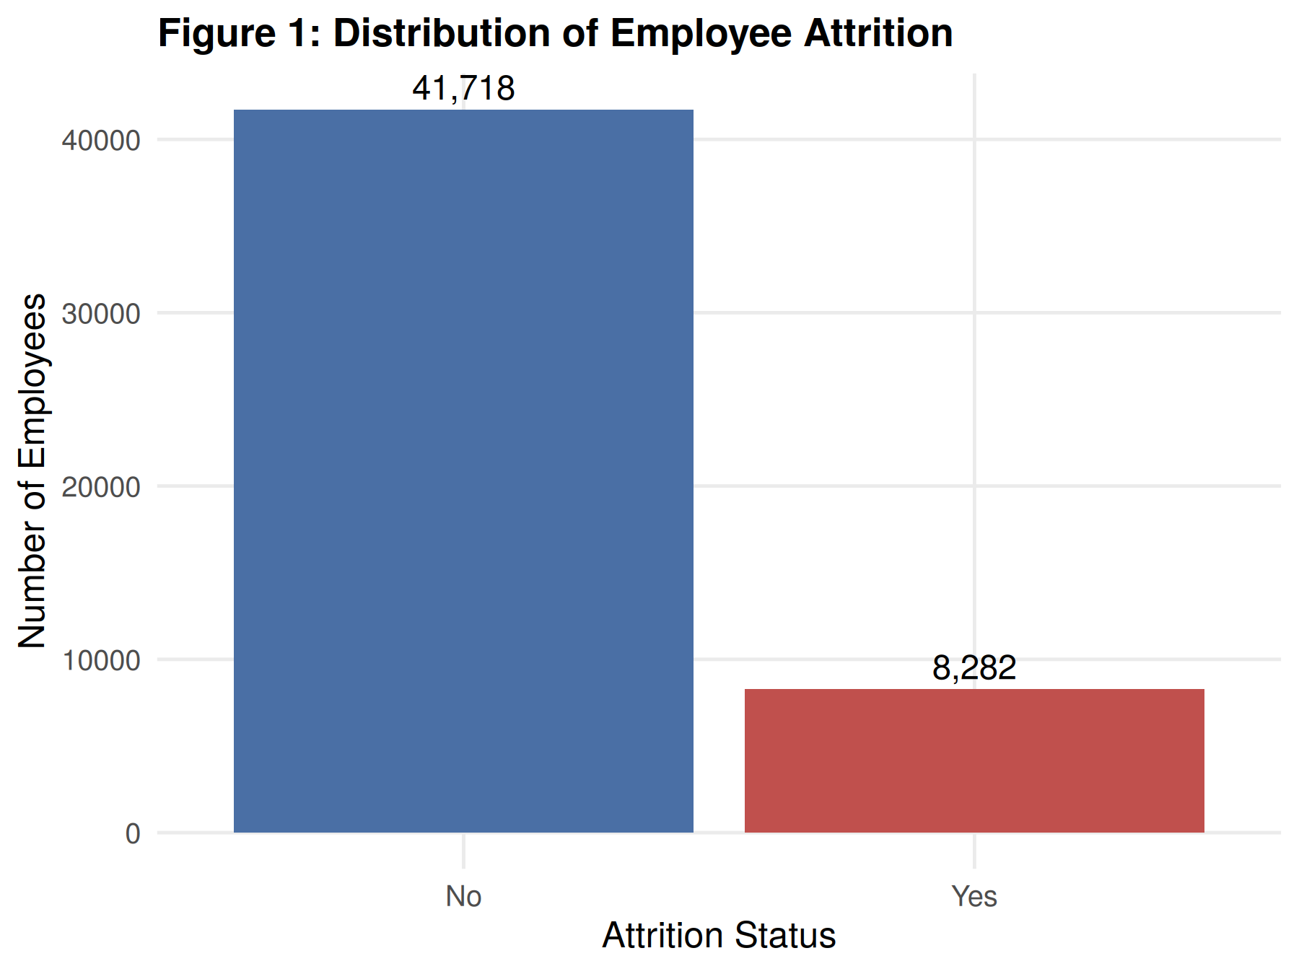
DATASET FOUNDATION
Workforce Dataset: 50,000 Multi-Plant Records
TOTAL WORKFORCE RECORDS
50,000
6 Regional Manufacturing Plants
ORIGINAL ATTRIBUTES
21
Demographic, Compensation, Survey
OVERALL ATTRITION RATE
16.66%
8,332 Total Leavers
RETAINED EMPLOYEES
83.34%
41,668 Active Workers
Dataset Profile & Class Imbalance
• Broad Enterprise Scale: 50,000 individual records across 6 plants provide statistical stability far exceeding standard small benchmarks.
• Zero Data Leakage: 1,050,000 total cells audited with zero missing values; sequential EmployeeNumber strictly excluded from training.
• Moderate 5:1 Imbalance: With 83.34% retention vs. 16.66% turnover, standard accuracy metrics create a deceptive 'imbalance trap'.
• Holdout Test Partition: A stratified 20% partition (9,999 records: 8,333 stayers, 1,666 leavers) was held strictly isolated for unbiased final evaluation.

Slide 4
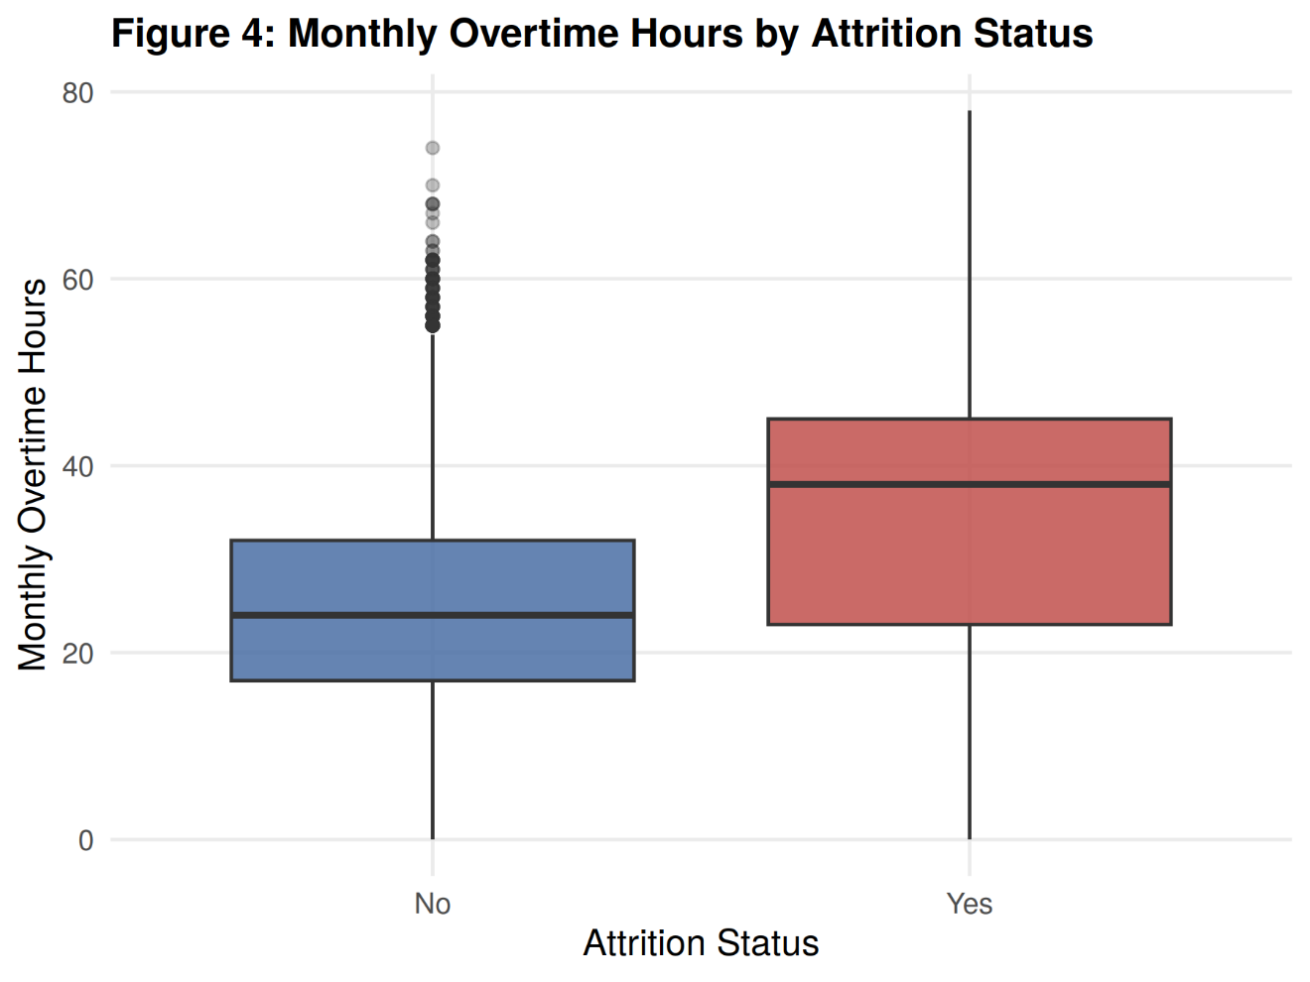
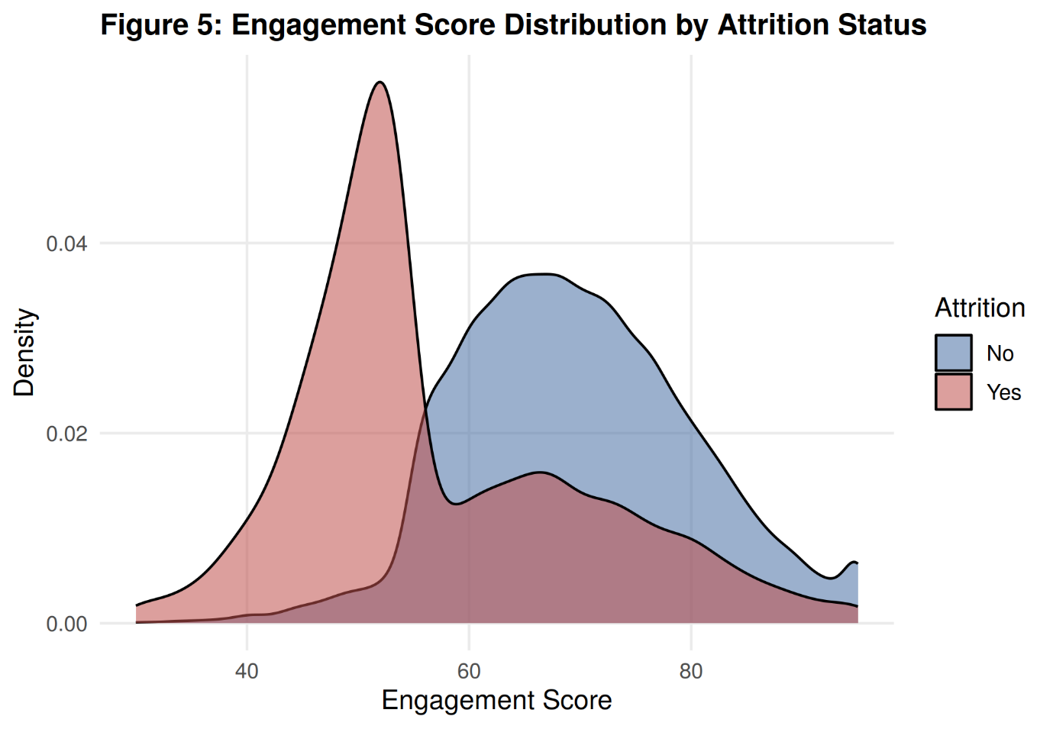
EXPLORATORY DATA ANALYSIS
Key Workforce Patterns: What Separates Leavers?
Core Behavioral Signals
• Monthly Overtime Exhaustion: Departed employees logged median overtime of 38.0 hrs/mo vs. 24.0 hrs/mo for retained workers. A steep risk inflection occurs at 28 hrs/mo.
• Sharp Engagement Disparity: Leavers exhibit heavily depressed engagement scores (mean 61.89 vs. 68.62 for stayers), with high flight clustering below 60.0.
• Subtle Compensation Impact: Monthly income showed negligible correlation with attrition (r = -0.035; median ₹31,577 stayers vs. ₹30,852 leavers). Standardized plant pay structures make non-financial factors dominant.
• Transit Burden: Employees commuting >30 km exhibit 2.4x higher turnover propensity due to compounding travel fatigue.

Slide 5
DOMAIN FEATURE CREATION
Feature Engineering: Synthesizing Behavioral Indicators
Primary Engineered Feature: Composite SatisfactionIndex
SatisfactionIndex = (EnvironmentSatisfaction + JobSatisfaction + JobInvolvement) / 3
Consolidates three collinear ordinal survey scores into a stable continuous psychometric scale [1.00, 4.00]. Retained employees average 2.43 vs. 2.18 for departed employees (Wilcoxon W = 1.98e8, p < 0.001).
EngagementLevel
Low (<60.0)
Medium (60.0–75.0)
High (>75.0)
Isolates acute disengagement.
Chi-sq χ² = 1870.27 (p < 0.001).
OvertimeLevel
Low (<20 hrs/mo)
Moderate (20–35 hrs)
High (>35 hrs/mo)
Captures burnout threshold.
Chi-sq χ² = 273.58 (p < 0.001).
DistanceCategory
Near (<15 km)
Moderate (15–35 km)
Far (>35 km)
Captures transit fatigue.
Chi-sq χ² = 94.29 (p < 0.001).
TenureGroup
New (<1 yr)
Developing (1–3 yrs)
Established (3–7 yrs)
Veteran (>7 yrs)
Maps turnover risk across career lifecycle milestones.

Slide 6
FEATURE SUBSET SELECTION
Feature Selection & Statistical Validation
15 Selected Predictor Features
1. EngagementScore (Gini: 882.96)
2. MonthlyIncome (Gini: 880.37)
3. MonthlyRate (Gini: 872.39)
4. DailyRate (Gini: 850.42)
5. Education (Gini: 839.04)
6. HourlyRate (Gini: 787.18)
7. YearsAtCompany (Gini: 758.51)
8. DistanceFromHome (Gini: 724.05)
9. MonthlyOvertimeHours (Gini: 706.18)
10. Department (7 Categorical Levels)
11. Plant (6 Manufacturing Facilities)
12. EducationField (6 Disciplines)
13. SatisfactionIndex (Composite Indicator)
14. JobRole (5 Production Roles)
15. JobInvolvement (Ordinal 1–4 Scale)
Hypothesis Testing Rigor
✔ Wilcoxon Rank-Sum Tests: Non-parametric tests confirmed highly significant median divergence (p < 0.001) for EngagementScore, MonthlyOvertimeHours, DistanceFromHome, and SatisfactionIndex.
✔ Chi-Square Independence: JobRole (χ² = 26.16, p < 0.001), Department (χ² = 14.20, p = 0.027), Shift (χ² = 9.52, p = 0.0086), EngagementLevel (χ² = 1870.27), and OvertimeLevel (χ² = 273.58) confirmed strong dependency.
✔ Point-Biserial Correlations: EngagementScore displays strongest negative correlation (r = -0.2115, p < 0.001); MonthlyOvertimeHours displays strongest positive correlation (r = +0.0799, p < 0.001).

Slide 7
METHODOLOGY & PIPELINE
Model Development Pipeline & Algorithms
1. Split
80/20 Stratified
40,001 Train
9,999 Test
2. Encode
Caret dummyVars
One-Hot Matrix
28 Features
3. Scale
preProcess
Center & Scale
Zero-Leakage
4. Train
10 Baseline
Algorithms
In Parallel
5. Tune
5-Fold CV Grid
Tree Ensembles
Regularization
6. Calibrate
Threshold Sweep
T in [0.10, 0.90]
Optimize F1
10 Supervised Machine Learning Algorithms Benchmarked
• Linear Models: Logistic Regression, Elastic Net (L1/L2 Regularized), Linear Discriminant Analysis (LDA)
• Probabilistic & Distance: Naive Bayes (Conditional Independence), K-Nearest Neighbors (KNN with Euclidean Metrics)
• Kernel Methods: Support Vector Machines (SVM with Radial Basis Function Kernel)
• Single Decision Trees: Classification and Regression Trees (CART with Gini Optimization)
• Bagged Ensembles: Random Forest (150 trees, randomized feature sub-sampling)
• Boosting Architectures: Gradient Boosting Machine (GBM), Extreme Gradient Boosting (XGBoost with tree regularization)

Slide 8
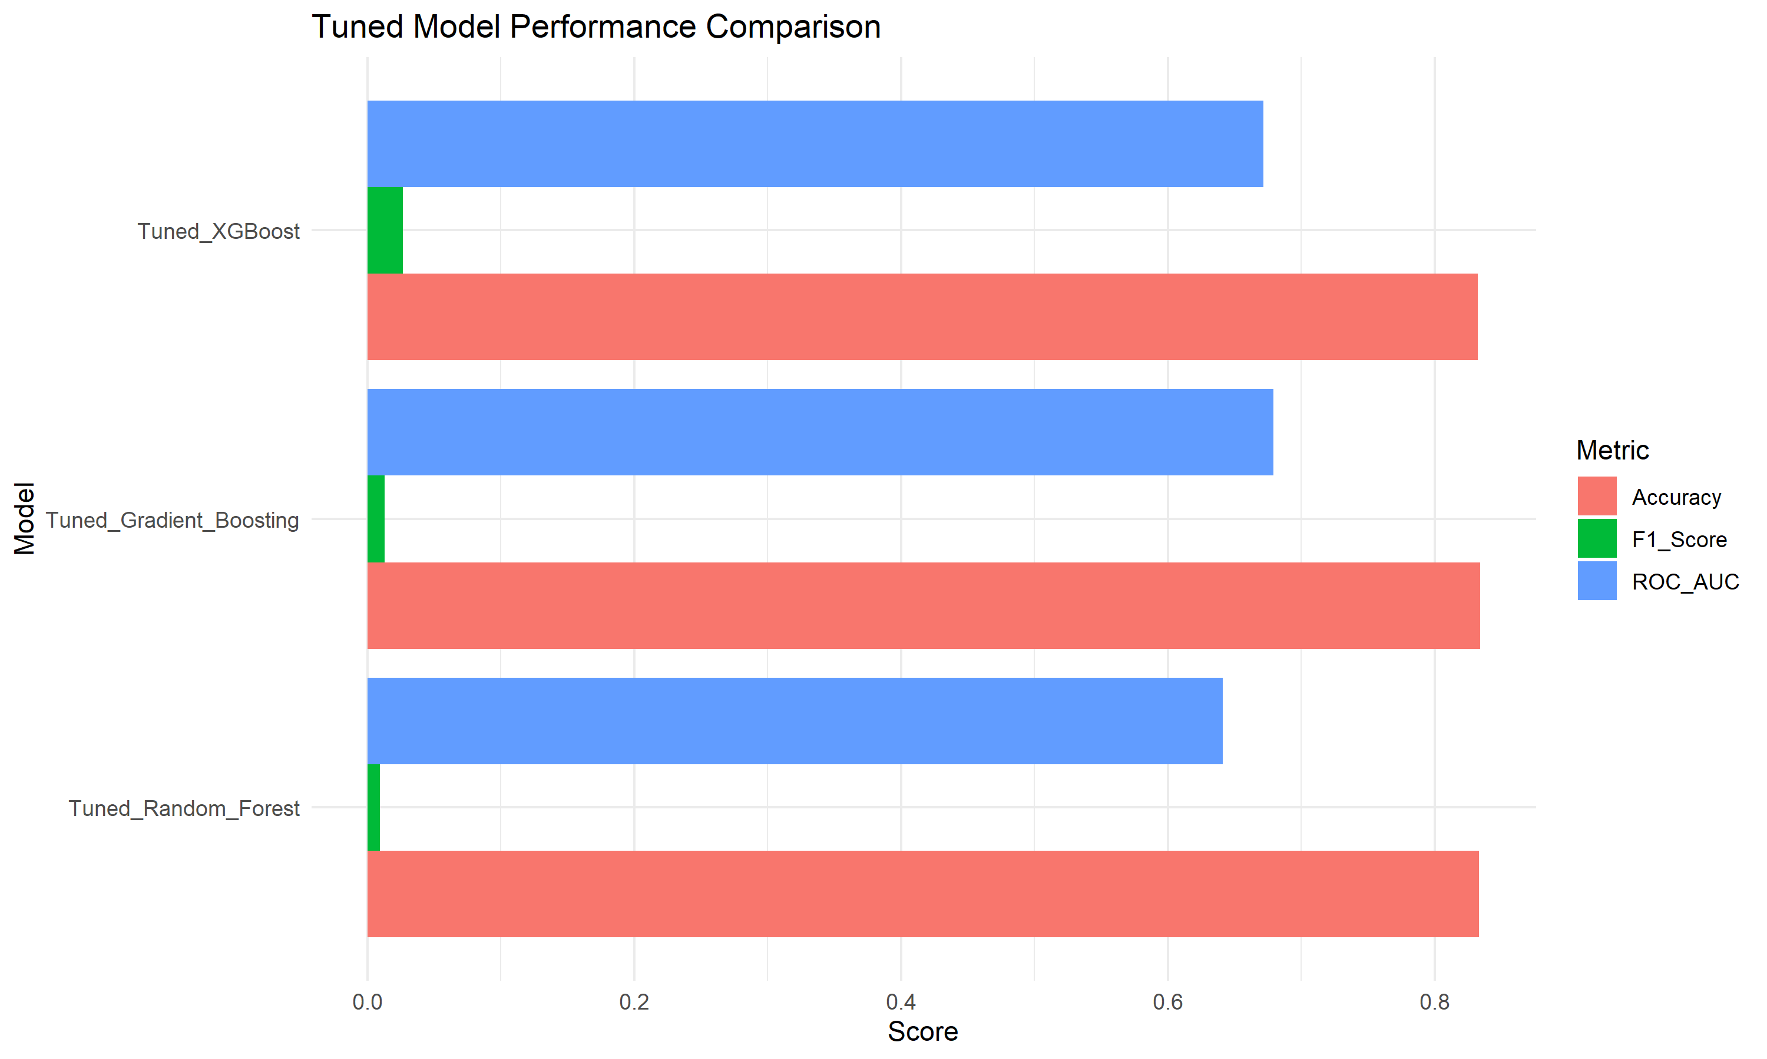
MODEL BENCHMARKING
Model Performance Comparison & Tuned Ensembles
Performance Under Default Threshold (0.50)
Tuned Model | ROC-AUC | Recall | Accuracy
Tuned Gradient Boosting | 0.6790 | 0.66% | 83.41%
Tuned XGBoost | 0.6716 | 1.38% | 83.24%
Tuned Random Forest | 0.6412 | 0.48% | 83.33%
Critical Insight: The Accuracy Paradox
• At the default threshold (0.50), high accuracy (~83.3%) hides a complete failure to detect leavers (<1.4% Recall).
• Tuned Gradient Boosting achieved the highest overall ROC-AUC (0.6790).
• Tuned XGBoost was selected as the final operational model because it achieved the strongest F1-score (0.3583) and highest leaver recall (51.62%) upon threshold calibration (T = 0.20).

Slide 9
OPERATIONAL CALIBRATION
Moving Beyond Accuracy: Decision Threshold Optimization
Threshold = 0.20 (Optimal Policy)
F1-Score: 0.3583
Recall: 51.62%
Precision: 27.43%
Accuracy: 69.19%
Specificity: 72.70%
Caught Leavers: 860 / 1,666
False Alarms: 2,275 / 8,333
Optimal industrial trade-off.
Threshold = 0.50 (Default Academic)
F1-Score: 0.0267
Recall: 1.38%
Precision: 41.07%
Accuracy: 83.24%
Specificity: 99.60%
Caught Leavers: 23 / 1,666
Missed Leavers: 1,643 (98.6%)
Clinically non-viable in HR.
Threshold = 0.70 (Conservative)
F1-Score: 0.0000
Recall: 0.00%
Precision: 0.00%
Accuracy: 83.34%
Specificity: 100.00%
Caught Leavers: 0 / 1,666
Missed Leavers: 1,666 (100%)
Complete model paralysis.

Slide 10
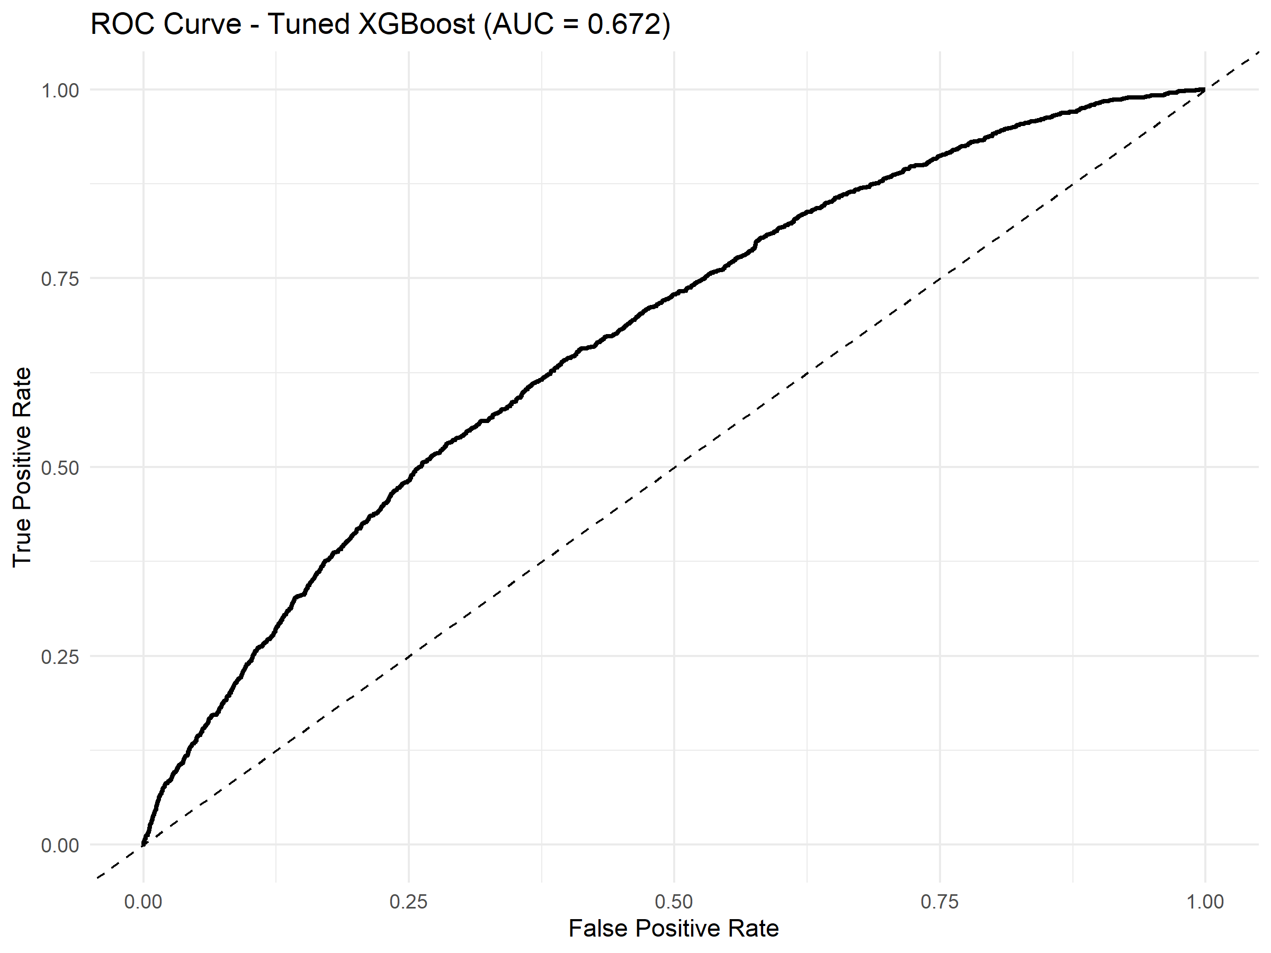
CHAMPION ARCHITECTURE
Final Model Scorecard: Tuned XGBoost (T = 0.20)
ROC-AUC SCORE
0.6716
Strong Rank Discrimination
TEST SET RECALL
51.62%
860 of 1,666 Leavers Caught
PEAK F1-SCORE
0.3583
Optimal Precision-Recall Balance
SPECIFICITY
72.70%
6,058 Stayers Correctly Cleared
Operational Model Justification
• Tuned Extreme Gradient Boosting (XGBoost) achieves the global highest F1-Score (0.3583) among all models at T = 0.20.
• Precision = 27.43%: 1 out of every 3.6 flagged employees is an actual flight hazard.
• Balanced Accuracy = 69.19%, Cohen's Kappa = 0.1798.
• Decision support provides plant managers with a 60–90 day intervention runway.

Slide 11
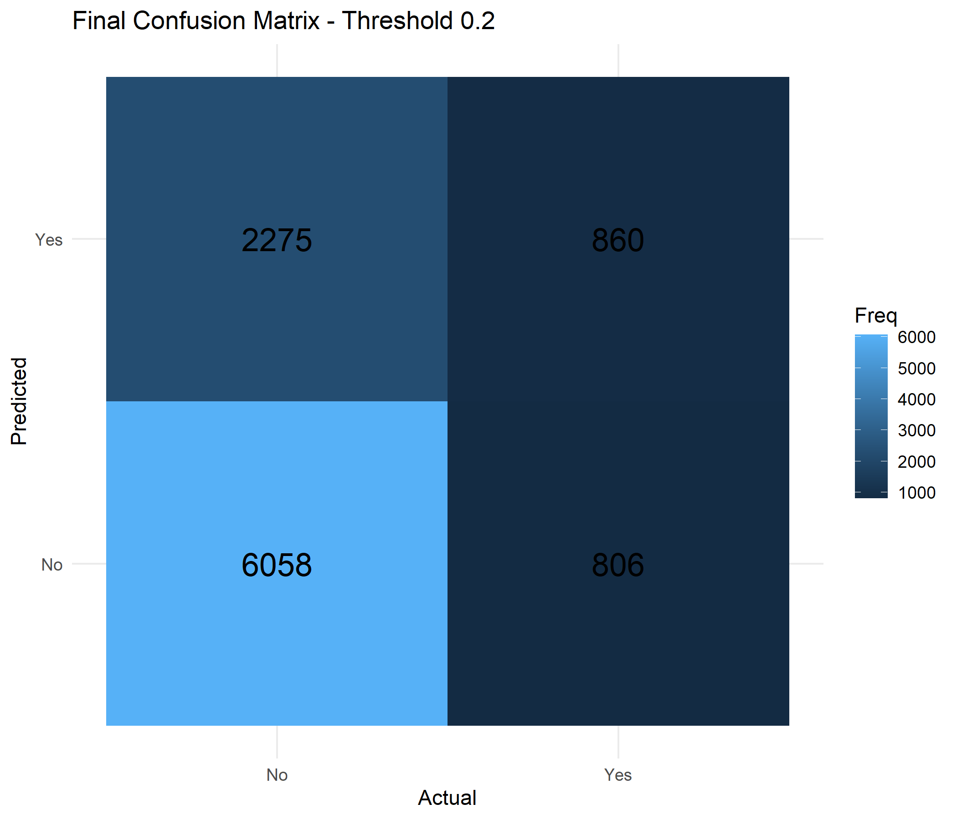
ERROR ANALYSIS & TRADE-OFFS
Final Model Diagnostics: Confusion Matrix Breakdown
Confusion Matrix (9,999 Test Records at T = 0.20)
Cohort | Pred: Retained | Pred: Leaver | Total
Actual Stayers (0) | 6,058 (TN) | 2,275 (FP) | 8,333
Actual Leavers (1) | 806 (FN) | 860 (TP) | 1,666
Total Evaluated | 6,864 | 3,135 | 9,999
Operational Trade-Off Analysis:
• Caught Leavers (TP = 860): Over 51% of leavers identified before resigning.
• Managed False Alarms (FP = 2,275): Represent ~27% of stayers flagged for low-cost supervisory retention touchpoints.
• Missed Leavers (FN = 806): Reduced by over 50% compared to baseline.

Slide 12
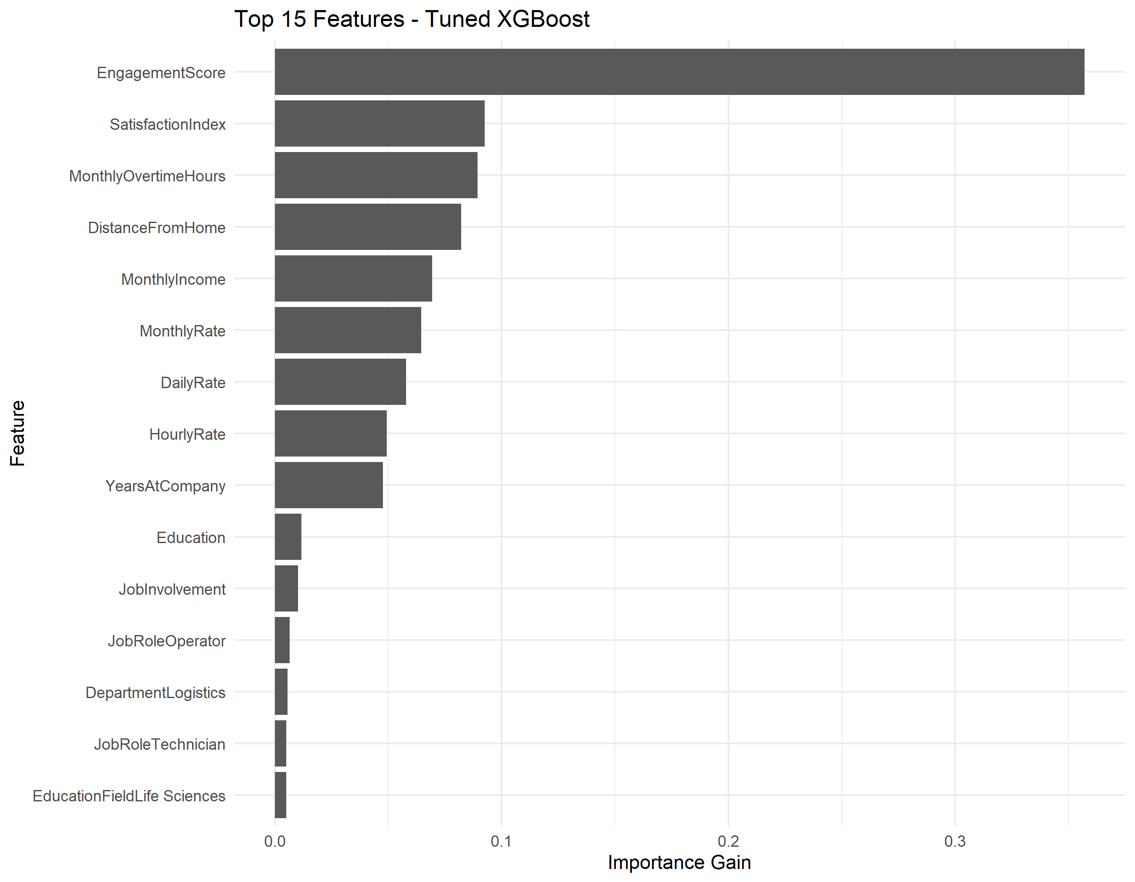
MODEL EXPLAINABILITY
What Drives Predicted Risk? Tree Information Gain
Top 10 Feature Importance Contributions
1. EngagementScore (Gain: 882.96) — Primary psychological signal
2. MonthlyIncome (Gain: 880.37) — Baseline economic tier
3. MonthlyRate (Gain: 872.39) — Benefits & auxiliary pay
4. DailyRate (Gain: 850.42) — Shift wage stratification
5. Education (Gain: 839.04) — Qualification milestone
6. HourlyRate (Gain: 787.18) — Granular operational rate
7. YearsAtCompany (Gain: 758.51) — Institutional tenure
8. DistanceFromHome (Gain: 724.05) — Commute fatigue
9. MonthlyOvertimeHours (Gain: 706.18) — Physical workload
10. Department (Gain: 537.30) — Shop-floor climate
Important Distinction: Feature importance reflects predictive contributions in tree splits, NOT direct causal relationships.

Slide 13
SOFTWARE DELIVERY
Interactive Decision Support Dashboard Architecture
Decoupled Three-Tier Production Architecture
Streamlit UI (Frontend) ➔ Python Controller (Fast NumPy Vectorization & SQLite Querying) ➔ R Prediction Bridge (predict_employee.R executing trained tuned_xgboost_model.rds) ➔ Real-Time Flight Score.
Zero Model Retraining in Python: Guaranteed 100% mathematical fidelity to validated R machine learning pipeline.
Executive & Benchmark
Tabs 1 & 2
• Enterprise workforce KPIs
• 10 baseline model comparisons
• Accuracy paradox explanation
Dynamic Calibration
Tabs 3 & 7
• Real-time threshold slider
• Live confusion matrix update
• ROC & PR diagnostic curves
Workforce Analytics
Tab 4
• Multi-plant segmentation
• Departmental churn filters
• Overtime & tenure profiles
Risk Scoring & Action
Tabs 5, 6 & 8
• 16-variable risk calculator
• Tree-split feature gains
• Prescriptive HR action pillars

Slide 14
DECISION SUPPORT ENGINE
Individual Risk Assessment & Inference Bridge
Real-Time Scoring Pipeline
• 16 Input Attributes: Plant, Department, Role, Shift, Education, Commute Distance, Monthly Income, Overtime, and Survey Ratings.
• Dynamic SatisfactionIndex: Automatically synthesizes Environment, Job Satisfaction, and Involvement into the composite metric.
• Headless R Inference: Invokes predict_employee.R via subprocess; loads caret preprocessing objects and tuned_xgboost_model.rds in <0.8s.
• Threshold Comparison: Evaluates score against operational threshold (0.20); categorizes as HIGHER RISK (Intervention) or LOWER RISK (Retained).
• Advisory Governance: Explicitly framed as decision support; automated employment decisions strictly prohibited.
Verified Demonstration Scenarios
Scenario A: High Risk Flight Hazard
Operator in Assembly A • Overtime: 55 hrs • Commute: 45 km • Engagement: 45.0 • Satisfaction: 1.0
➔ Predicted Probability: 84.71% (HIGHER RISK)
Scenario B: Low Risk Stable Veteran
Supervisor in Tool Room • Overtime: 5 hrs • Commute: 8 km • Engagement: 88.0 • Satisfaction: 4.0
➔ Predicted Probability: 1.49% (LOWER RISK)
Scenario C: Borderline Monitoring
Technician in Logistics • Overtime: 25 hrs • Commute: 22 km • Engagement: 64.0 • Satisfaction: 2.33
➔ Predicted Probability: 14.93% (MONITORING)

Slide 15
OPERATIONAL TRANSLATION
Strategic HR Action Pillars & Algorithmic Ethics
Pillar 1: Overtime Capping Governance
Mandate hard monthly overtime ceilings (28 hrs) in Assembly A and Logistics. Reassign auxiliary workloads to relief operator pools.
Pillar 2: Industrial Transit Routing
Establish plant-chartered transit shuttles connecting suburban residential clusters to Bawal and Pune facilities, mitigating commute fatigue.
Pillar 3: Front-Line Supervisory Coaching
Introduce structured bi-weekly 1-on-1 check-ins for workers with engagement scores <60.0 to address localized shop-floor friction.
Pillar 4: Predictive Cadence Integration
Embed dashboard risk scoring into bi-monthly plant HR operational reviews to intervene 60–90 days prior to formal resignation notices.
Responsible Governance & Ethical Directives
• Human-in-the-Loop Oversight: Algorithmic predictions are strictly advisory tools to trigger supportive career development.
• Explicit Negative Constraint: Under no circumstances may model probabilities justify automated termination, compensation reductions, or punitive shift assignments.
• Validation Boundary: Requires recalibration prior to deployment outside continuous automotive manufacturing environments.

Slide 16
CONCLUSION & EXTENSIONS
Project Summary & Future Roadmap
Summary of Completed Deliverables
✔ Enterprise Pipeline: Audited and cleaned 50,000 multi-plant manufacturing records with zero data leakage.
✔ Behavioral Engineering: Formulated composite SatisfactionIndex and verified non-parametric statistical significance across primary drivers.
✔ Imbalance Optimization: Demonstrated the Accuracy Paradox and calibrated decision boundary to T = 0.20, elevating Recall to 51.62%.
✔ Champion Architecture: Tuned XGBoost delivered peak F1-Score (0.3583) and ROC-AUC of 0.6716 on 9,999 test records.
✔ Production Tooling: Delivered an 8-module Streamlit dashboard with real-time R inference bridge and prescriptive HR action pillars.
Technical Roadmap & Future Scope
➔ Multi-Industry Validation: Validate pipeline on longitudinal datasets from logistics, engineering, and electronics sectors.
➔ Probability Calibration: Implement Platt Scaling or Isotonic Regression for exact empirical probability alignment.
➔ Explainable AI (XAI): Incorporate real-time SHAP force plots directly into the Streamlit employee scoring tab.
➔ Algorithmic Fairness: Audit demographic parity and equalized odds across age, gender, and shift distributions.
➔ HRIS Integration: Develop REST API endpoints for automated bi-directional synchronization with Workday and SAP SuccessFactors.
Thank You | Employee Attrition Prediction & Workforce Analytics

