Slide 1

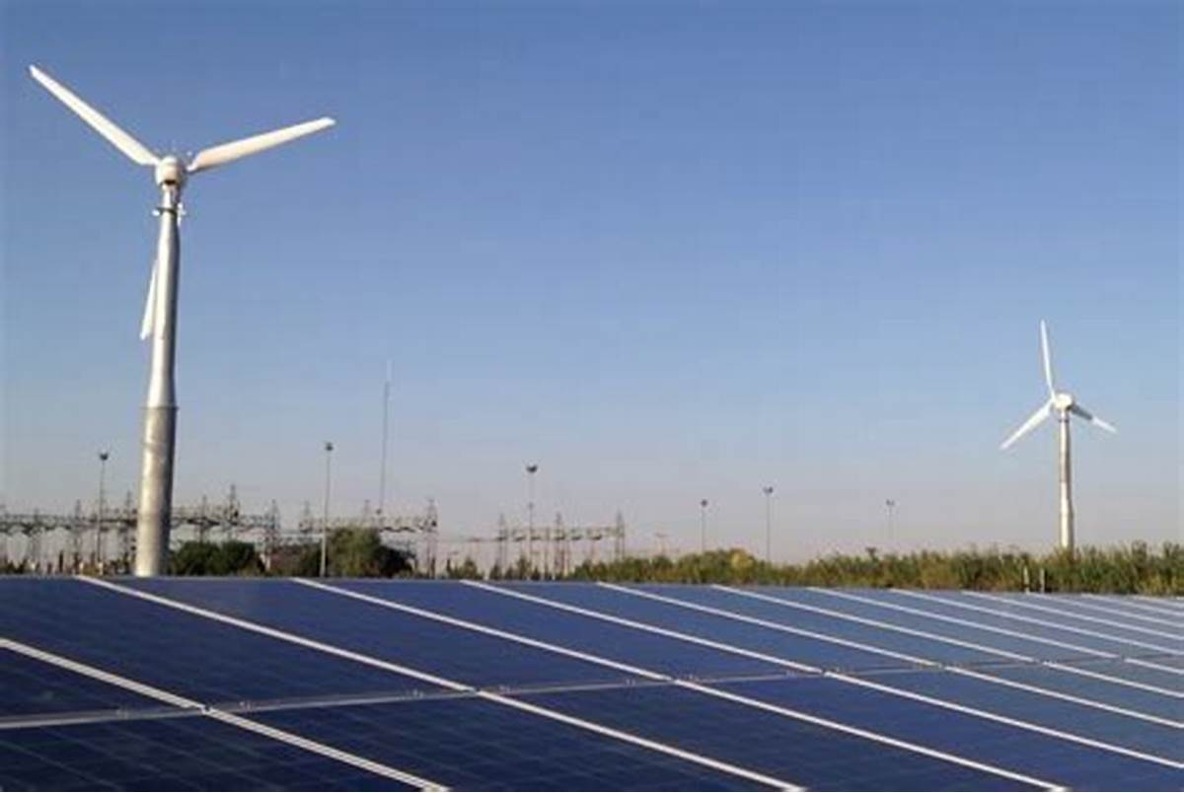
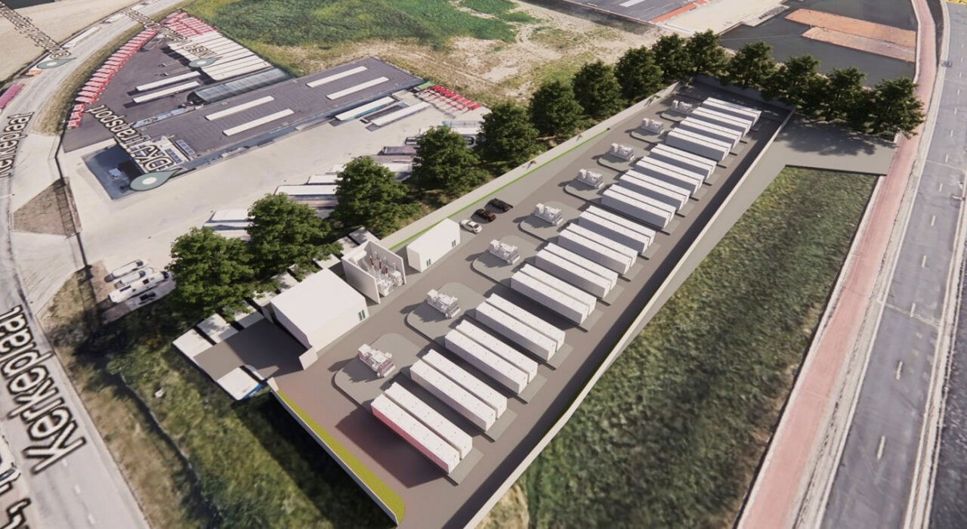
REVIEW OF
WIND
PROJECTS
UNDER VARIOUS ISTS SCHEMES OF SECI
Solar Energy Corporation of India Limited
17.11.2025

Slide 2
ISTS WIND POWER PROJECTS – YoY PROGRESS & PROJECTIONS

Slide 3
ISTS WIND POWER PROJECTS – TRANCHE-WISE PROGRESS
*In T-I, PPA was signed between WPD and PTC
** T-XV was cancelled due to abnormally high tariff quoted by bidders

Slide 4
ISTS WIND POWER PROJECTS – YoY PROGRESS & PROJECTIONS
Tranche | Total Capacity Tendered (MW) | Total capacity awarded (MW) | PPA Signed Capacity (MW) | PPA Effective Date | Original SCD | Capacity Commissioned till date (MW) | Capacity Under Implementation (MW) | Cancelled / Terminated (MW) | Disputed Capacity (MW) | Capacity not likely to come up (MW) | Tariff (INR/kWh)
I | 1000 | 1049.9 | 1049.9 | 21-07-2017 | 05-10-2018 | 999.9 | 0 | 50 | 0 | 0 | 3.46
II | 1000 | 1000 | 1000 | 02-01-2018 | 03-05-2019 | 760.1 | 0 | 239.9 | 0 | 0 | 2.64 - 2.65
III | 2000 | 2000 | 2000 | 24-05-2018 | 24-11-2019 | 950.2 | 0 | 0 | 1049.8 | 0 | 2.44 – 2.45
IV | 2000 | 2000 | 2000 | 30-08-2018 | 28-02-2020 | 724.0 | 0 | 573 | 703.0 | 0 | 2.51 – 2.52
V | 1200 | 1190 | 1190 | 22-01-2019 | 22-07-2020 | 621.5 | 0 | 393.5 | 175 | 0 | 2.76 – 2.77
VI | 1200 | 1200 | 1075 | 15-09-2019 | 15-03-2021 | 973 | 0 | 102 | 0 | 0 | 2.82 – 2.83
VII | 1200 | 480 | 280 | 18-10-2019 | 18-04-2021 | 180 | 0 | 100 | 0 | 0 | 2.79 – 2.83
VIII | 1800 | 440.8 | 440.64 | 21-05-2020 | 21-11-2021 | 250.71 | 0 | 0 | 189.93 | 0 | 2.83 – 2.84
IX | 2500 | 970 | 970 | 31-03-2021 | 31-03-2023 | 862 | 108 | 0 | 0 | 0 | 2.99 – 3.00
X | 1200 | 1200 | 1200 | 10-09-2021 | 10-03-2023 | 750 | 0 | 0 | 450 | 0 | 2.77-2.78
XI | 1200 | 1200 | 1200 | 30-06-2022 | 30-12-2023 | 54.6 | 245.4 | 0 | 900 | 120 | 2.69-2.70
XII | 1200 | 1100 | 800 | 29-03-2023 | 29-03-2025 | 0 | 800 | 0 | 0 | 0 | 2.89-2.94
XIII | 1200 | 600 | 600 | 26-06-2023 | 26-06-2025 | 0 | 100 | 0 | 500 | 100 | 2.90-2.95
XIV | 1200 | 690 | 500 | 16-11-2023 | 16-11-2025 | 0 | 500 | 0 | 0 | 200 | 3.18-3.24
XV | 1300 | In line with MNRE letter dated 16.02.2024, SECI tender for 1300 MW Wind Tranche-XV stands cancelled. |  |  |  |  |  |  |  |  | -
XVI | 1350 | 1175 | 1175 | 13-06-2024 | 13-06-2026 | 0 | 1175 | 0 | 0 | 0 | 3.60-3.70
XVII | 500 | 50 | 50 | 01-03-2025 | 01-03-2027 | 0 | 50 | 0 | 0 | 0 | 3.81-3.82
XVIII | 600 | 300 | PPA yet to be signed
Total | 23650 | 16695.7 | 15580.5 |  |  | 7126.01 | 2978.4 | 1458.4 | 3967.73 | 420.0

Slide 5
TRANCHE-WISE REALISTIC FIGURES OF PROJECT CAPACITIES LIKELY TO BE COMMISSIONED FROM THE TOTAL AWARDED CAPACITY
Tranche | PPA Capacity (MW) | Capacity Commissioned till date (MW) | Likely to be commissioned (MW) | Tariff/ SCD / Max Timeline | Project-wise status
IX | 970 | 862 | 108 | 2.99-3.0 INR/kWh SCD for JSW/270 MW – (Actual start date of LTA plus 60 days) | Vena (160 MW, fully commissioned on 29.10.2024) JSW (540 MW, fully commissioned on 31.03.2025) JSW (270 MW) 108 MW – By Oct’2025
X | 1200 | 750 | 0 | 2.77-2.78 INR/kWh SCD for Viento - 09.10.2024 Maximum timeline for commissioning is 06.07.2025. | Adani (300 MW, under litigation) Ayana (300 MW, fully commissioned) Viento (150 MW, under litigation) JSW (150 MW, fully commissioned) JSW (300 MW, fully commissioned)
XI | 1200 | 54.6 | 125.4 | 2.69-2.70 INR/kWh SCD for Sembcorp – 26.01.2026 SCD for Others – 26.07.2025; Max. time for commissioning with LD is 22.04.2026. | Sembcorp (180 MW, 54.6 MW Commissioned) 21 MW: Sept’25 104.4 MW Oct’25 Renew (300 MW), Anupavan (150 MW), Adani (450 MW), Azure (120 MW) - under litigation/ not likely to come up

Slide 6
TRANCHE-WISE REALISTIC FIGURES OF PROJECT CAPACITIES LIKELY TO BE COMMISSIONED FROM THE TOTAL AWARDED CAPACITY [Contd…]
Tranche | PPA Capacity (MW) | Capacity Commissioned till date (MW) | Likely to be commissioned (MW) | Tariff/ SCD/ Max Timeline | Project-wise status
XII | 800 | 0 | 800 | 2.89-2.94 INR/kWh SCD – 23.01.2026 | JSW (300 MW, under implementation) NTPC (200 MW, under implementation) Torrent (300 MW, under implementation)
XIII | 600 | 0 | 0 | 2.9-2.95 INR/kWh SCD – 02.12.2025 | SJVN (100 MW, under implementation) Scatec (300 MW, under litigation) O2 (200 MW, under litigation /DRC)
XIV | 500 | 0 | 300 | 3.18-3.24 INR/kWh SCD – 27.12.2025 | Apraava (300 MW, under implementation) SJVN (200 MW, under implementation)
XVI | 1175 | 0 | 1175 | 3.6-3.7 INR/kWh SCD – 19.06.2026 | Torrent (100 MW, under implementation) Powerica (50 MW, under implementation) JSW (1025 MW, under implementation)
XVIII | 100 | 0 | 50 | 3.81-3.82 INR/kWh SCD – 01.03.2027 | Powerica (50 MW, under implementation) Adyant (50 MW, tariff not adopted by CERC)
TOTAL | 6545 | 1666.6 | 2558.4

Slide 7
Wind Power Projects Impacted due to delay in GNA/Connectivity
Sl. No. | Tranche/ Scheme Name | Bidder/ SPV Name | Interconnection Point/ Pooling Substation | RE Project Capacity, MW | Original SCD (as per PPA) | Revised SCD | Expected Connectivity/ GNA effectiveness date | Capacity delayed due to transmission (in MW) | Commissioned but under TGNA, MW
1 | SECI IX-Blended | JSW | 230 kV Karur S/S | 170 | 15-07-2023 | Actual date of GNA effectiveness + 60 days | 31-03-2026* | 170 | 168
2 | SECI Wind-XI | Green Infra | 400/220 kV Gadag S/S | 180 | 30-12-2023 | 01.07.2025 | 31-03-2026* | 180 | 54.6
3 | SECI Wind-XII | JSW | 400/220 kV Solapur S/S | 300 | 29-03-2025 | 23.01.2026 | 31-03-2026* | 300
4 | SECI Wind-XII | Torrent | 400/220 kV Koppal-II S/S | 300 | 29-03-2025 | 23.01.2026 | 27-12-2025# | 300
5 | SECI Wind-XIV | Apraava | Vijayapura/ Bijapur GSS | 300 | 16-11-2025 | 27.12.2025 | 17-01-2027$ | 300
*Expected COD date of Narendra –Pune Line, which may be further extended.
#Timeline may be extended.
$SPV transfer took place in Jan 2025.

Slide 8
DISCUSSION POINTS
CONNECTIVITY DELAY
As per CERC notification dated 20.06.2025, any extension in the Scheduled Commissioning Date (SCD) shall not exceed six months at a time and can be granted a maximum of two times, specifically for extensions beyond 30.06.2025.
However, in the case of M/s Apraava’s 300 MW wind power project under SECI Tranche-XIV, the delay in operationalization of GNA exceeds two years.
In accordance with the MoP order dated 09.06.2023 and provisions of the PPA, the Competent Authority to grant extensions beyond 30.06.2025 is the Ministry of New and Renewable Energy (MNRE). Accordingly, M/s Apraava’s request for extension of the SCD beyond 30.06.2025 has been submitted to MNRE vide letter/emails dated 23.05.2025 and 08.07.2025 for necessary directions.

Slide 9
Tranche-wise Progress Status (Wind)

Slide 10
Tranche – 1 (Tariff: Rs. 3.46 /kWh)
Effective date of PPA: 21.07.2017
Sr. No. | WPD | PPA Capacity (MW) | Commissioned Capacity (MW) | Remarks
1 | Mytrah Vayu (Sabarmati) Private Limited | 250 | 250 | -
2 | Green Infra Renewable Energy Limited | 249.9 | 249.9 | -
3 | Wind One Renergy Private Limited | 50 | 50 | -
4 | Wind Two Renergy Private Limited | 50 | 50 | -
5 | Wind Three Renergy Private Limited | 50 | 50 | -
6 | Wind Four Renergy Private Limited | 50 | 0 | Project stands cancelled.
7 | Wind Five Renergy Private Limited | 50 | 50 | Under litigation.
8 | Ostro Kutch Wind Private Limited | 250 | 250 | -
9 | Adani Green Energy (MP) Limited | 50 | 50 | -
 | Total | 1049.9 | 999.9
Note: PPAs under this Tranche signed between WPD and M/s PTC Ltd
Back

Slide 11
Tranche – 2 (Tariff: Rs. 2.64-2.65/kWh)
Effective date of PPA: 19.12.2017 – 02.01.2018
Sr. No. | WPD | PPA Capacity (MW) | Commissioned Capacity (MW) | Remarks
1 | ReNew Power Private Limited | 250 | 230.1 | 19.9 MW stands cancelled.
2 | Haroda Wind Energy Private Limited | 50 | 0 | Projects stand cancelled.
3 | Khatiyu Wind Energy Private Limited | 50 | 0
4 | Vigodi Wind Energy Private Limited | 50 | 0
5 | Ravapar Wind Energy Private Limited | 50 | 0
6 | Inox Clean Energy Limited | 50 | 30 | 20 MW stands terminated.
7 | Greenko Wind Power Private Limited | 200 | 200 | -
8 | Sembcorp Green Infra Private Limited | 250 | 250 | -
9 | Adani Wind Energy Kutchh One Limited | 50 | 50 | -
 | Total | 1000 | 760.1
Back

Slide 12
Tranche – 3 (Tariff: Rs. 2.44-2.45/kWh)
Effective date of PPA: 24.05.2018
Sr. No. | WPD | PPA Capacity (MW) | Commissioned Capacity (MW) | Remarks
1 | ReNew Wind Energy (AP2) Private Limited | 400 | 300 | Under litigation to the extent of 100 MW project capacity.
2 | Sembcorp Green Infra Pvt Limited | 300 | 300 | -
3 | Inox Green Energy Services Limited | 200 | 0 | Under litigation
4 | Torrent Power Limited | 499.8 | 0 | Under litigation
5 | Alfanar Energy Private Limited | 300 | 300 | -
6 | Adani Green Energy (MP) Limited | 250 | 0 | Under litigation
7 | Betam Wind Energy Private Limited | 50.2 | 50.2 | -
 | Total | 2000 | 950.2
Back

Slide 13
Tranche – 4 (Tariff: Rs. 2.51-2.52/kWh)
Effective date of PPA: 30.08.2018
Sr. No. | WPD | PPA Capacity (MW) | Commissioned Capacity (MW) | Remarks
1 | Continuum Power Trading (TN) Private Limited | 250 | 88 | Under litigation to the extent of 126 MW. 124 MW stands cancelled.
2 | Sprng Renewable Energy Private Limited | 300 | 300
3 | Avikiran Solar India Private Limited | 285 | 165.9 | Under dispute to the extent of 2.1 MW. 117 MW stands cancelled.
4 | Vivid Solaire Energy Private Limited | 200 | 168 | 32 MW stands cancelled.
5 | Inox Green Energy Services Limited | 100 | 0 | Under litigation
6 | Adani Wind Energy Kutchh Two Limited | 300 | 0 | Project stands cancelled.
7 | Mytrah Vayu (Brahmaputra) Private Limited | 300 | 0 | Under litigation
8 | ReNew Wind Energy (TN) Private Limited | 265 | 0 | Under litigation
 | Total | 2000 | 721.9
Back

Slide 14
Tranche – 5 (Tariff: Rs. 2.76-2.77/kWh)
Effective date of PPA: 22.01.2019
Sr. No. | WPD | PPA Capacity (MW) | Commissioned Capacity (MW) | Remarks
1 | Torrent Solargen Limited | 115 | 115 | -
2 | Adani Wind Energy Kutchh Four Limited | 300 | 0 | Project stands cancelled.
3 | Netra Wind Private Limited | 300 | 206.5 | 93.5 MW stands cancelled.
4 | Sitac Kabini Renewables Private Limited | 300 | 300 | -
5 | Boreas Renewable Energy Private Limited | 175 | 0 | Under litigation.
 | Total | 1190 | 621.5
Back

Slide 15
Tranche – 6 (Tariff: Rs. 2.82-2.83/kWh)
Effective date of PPA: 15.09.2019
Sr. No. | WPD | PPA Capacity (MW) | Commissioned Capacity (MW) | Remarks
1 | Adani Wind Energy Kutchh Three Limited | 250 | 250 | -
2 | Ostro Kannada Power Pvt Ltd | 300 | 199.5 | 100.5 MW stands cancelled.
3 | Powerica Limited | 50.6 | 50.6 | -
4 | Adani Wind Energy MP One Private Limited | 324.4 | 324.4 | -
5 | Morjar Windfarm Development Pvt. Ltd. | 150 | 148.5 | 1.5 MW stands cancelled.
6 | Zenataris Renewable Energy Private Limited | 125 | 0 | WPD failed to execute PPA.
 | Total | 1200 | 973
Back

Slide 16
Tranche – 7 (Tariff: Rs. 2.79-2.83/kWh)
Effective date of PPA: 18.10.2019
Sr. No. | WPD | PPA Capacity (MW) | Commissioned Capacity (MW) | Remarks
1 | Betam Wind Energy Private Limited | 200 | 0 | WPD failed to execute PPA.
2 | Ostro Energy Private Limited | 50 | 50
3 | Sprng Wind Energy Private Limited | 100 | 0 | Project stands cancelled.
4 | Adani Wind Energy Kutchh Five Limited | 130 | 130 | -
 | Total | 480 | 180
Back

Slide 17
Tranche – 8 (Tariff: Rs. 2.83-2.84/kWh)
Effective date of PPA: 21.05.2020
Sr. No. | WPD | PPA Capacity (MW) | Commissioned Capacity (MW) | Remarks
1 | Apraava Energy Private Limited | 250.71 | 250.71 | -
2 | Tunga Renewable Energy Private Limited | 189.93 | 0 | Under litigation
 | Total | 480.8 | 250.71
Back

Slide 18
Tranche – 9 (Tariff: Rs. 2.99-3.00/kWh)
Effective Date of PPA: 31.03.2021 for 700 MW and 15.07.2021 for 270 MW
Sr. No. | WPD | PPA Capacity (MW) | Commissioned Capacity (MW) | Remarks
1 | Vena Energy Vidyuth Private Limited | 160 | 160 | -
2 | JSW Renew Energy Limited | 540 | 540 | -
3 | JSW Renew Energy Limited | 270 | 162 | Under execution (Revised SCD is 30.11.2025)
 | Total | 970 | 862
Back

Slide 19
Tranche – 10 (Tariff: Rs. 2.77-2.78/kWh)
Effective Date of PPA: 10.09.2021
Sr. No. | WPD | PPA Capacity (MW) | Commissioned Capacity (MW) | Remarks
1 | Adani Renewable Energy Seven Limited | 300 | 0 | Under litigation
2 | Ayana Renewable Power Six Private Limited | 300 | 300 | -
3 | Viento Renewables Private Limited | 150 | 0 | Under litigation
4 | JSW Renew Energy Two Limited | 150 | 150 | -
5 | JSW Renew Energy Two Limited | 300 | 300 | -
 | Total | 1200 | 750
Back

Slide 20
Tranche – 11 (Tariff: Rs. 2.69-2.70/kWh)
Effective Date of PPA: 30.06.2022
Sr. No. | WPD | PPA Capacity (MW) | Commissioned Capacity (MW) | Remarks
1 | ReNew Naveen Urja Private Limited | 300 | 0 | Under litigation.
2 | Green lnfra Wind Energy Limited | 180 | 54.6 | Under execution (Revised SCD is 26.07.2025)
3 | Anupavan Renewables Private Limited | 150 | 0 | Under litigation.
4 | Adani Renewable Energy Holding Fifteen Limited | 450 | 0 | Under litigation.
5 | Two Wind Energy Private Limited | 120 | 0 | No progress FC not achieved (Due Date 26.01.2024) Revised SCD is 26.07.2025
 | Total | 1200 | 54.6
Back

Slide 21
Tranche – 12 (Tariff: Rs. 2.89-2.94/kWh)
Effective date of PPA: 29.03.2023
Sr. No. | WPD | PPA Capacity (MW) | Commissioned Capacity (MW) | Remarks
1 | Halvad Renewables Private Limited | 300 | 0 | WPD failed to execute PPA.
2 | JSW Renew Energy Three Limited | 300 | 0 | Financial Closure achieved. Under execution. (Revised SCD is 23.01.2026)
3 | NTPC Renewable Energy Limited | 200 | 0 | Financial Closure achieved. Under execution. (Revised SCD is 23.01.2026)
4 | Torrent Saurya Urja 2 Private Limited | 300 | 0 | Financial Closure achieved. Under execution. (Revised SCD is 23.01.2026)
 | Total | 1100 | 0
Back

Slide 22
Tranche – 13 (Tariff: Rs. 2.9-2.95/kWh)
Effective date of PPA: 26.06.2023
Sr. No. | WPD | PPA Capacity (MW) | Commissioned Capacity (MW) | Remarks
1 | SJVN Green Energy Limited | 100 | 0 | No progress FC not achieved (Due Date 26.01.2024) Revised SCD is 02.12.2025
2 | Scatec India Renewables One Private Limited | 300 | 0 | Under litigation
3 | Teq Green Power XI Private Limited | 200 | 0 | Under dispute in DRC FC not achieved (Due Date 26.01.2024) Revised SCD is 02.12.2025
 | Total | 600 | 0
Back

Slide 23
Tranche – 14 (Tariff: Rs. 3.18-3.24/kWh)
Effective date of PPA: 16.11.2023
Sr. No. | WPD | PPA Capacity (MW) | Commissioned Capacity (MW) | Remarks
1 | Green Prairie Energy Private Limited | 190 | 0 | WPD failed to execute PPA.
2 | Apraava Energy Private Limited | 300 | 0 | FC not achieved (Due Date 16.06.2024) Revised SCD is 27.12.2025 WPD’s request for extension in FC and SCD is under review (referred to MNRE)
3 | SJVN Green Energy Limited | 200 | 0 | No progress FC not achieved (Due Date 16.06.2024) Revised SCD is 27.12.2025
 | Total | 690 | 0
Back

Slide 24
Tranche – 16 (Tariff: Rs. 3.6-3.7/kWh)
Effective date of PPA: 13.06.2024
Sr. No. | WPD | PPA Capacity (MW) | Commissioned Capacity (MW) | Remarks
1 | Torrent Solar Power Private Limited | 100 | 0 | Under execution (Revised SCD is 19.06.2026)
2 | JSW Renew Energy Eight Limited | 700 | 0
3 | JSW Renew Energy Four Limited | 150 | 0
4 | JSW Renew Energy Four Limited | 175 | 0
5 | Powerica Limited | 50 | 0
 | Total | 1175 | 0
Back

Slide 25
Tranche – 17 (Tariff: Rs. 3.81-3.82/kWh)
Effective date of PPA: 01.03.2025
Sr. No. | WPD | PPA Capacity (MW) | Commissioned Capacity (MW) | Remarks
1 | Powerica Limited | 50 | 0 | Under execution. (Revised SCD is 01.09.2027)
2 | Adyant Renewables Private Limited | 50 | 0 | Tariff not adopted by CERC.
 | Total | 100 | 0
Back

Slide 26
ISTS WIND POWER PROJECTS – Terminated Capacity
Status | Tranche | WPD | State | PPA Capacity (MW) | Commissioned Capacity (MW) | Terminated (MW)
CAPACITY NOT INSTALLED BY WPD | I | Wind Four Renergy Pvt Ltd (SPV of M/s Inox) | Gujarat | 50 | 0 | 50
 | II | ReNew Power Pvt Ltd | Gujarat | 250 | 230.1 | 19.9
 | II | Inox Clean Energy Ltd (SPV of M/s Inox) | Gujarat | 50 | 30 | 20
UNILATERALLY TERMINATED | II | Haroda Wind Energy Pvt Ltd (SPV of M/s Inox) | Gujarat | 50 | 0 | 50
 | II | Khatiyu Wind Energy Pvt Ltd (SPV of M/s Inox) | Gujarat | 50 | 0 | 50
 | II | Vigodi Wind Energy Pvt Ltd (SPV of M/s Inox) | Gujarat | 50 | 0 | 50
 | II | Ravapar Wind Energy Pvt Ltd (SPV of M/s Inox) | Gujarat | 50 | 0 | 50
CAPACITY NOT INSTALLED BY WPD | IV | Adani Wind Energy Kutchh Two Ltd | Gujarat | 300 | 0 | 300
 | IV | Avikiran Solar India Pvt Ltd | Gujarat | 285 | 165.9 | 117
 | IV | Vivid Solaire Energy Pvt Ltd | Tamil Nadu | 200 | 168 | 32
 | IV | Continuum Power Trading (TN) Pvt Ltd | Gujarat | 250 | 88 | 124
 | V | Adani Wind Energy Kutchh Four Ltd | Gujarat | 300 | 0 | 300
 | V | Netra Wind Private Limited | Gujarat | 300 | 206.5 | 93.5
 | VI | Morjar Windfarm Development Pvt Ltd | Gujarat | 150 | 148.5 | 1.5
 | VI | Ostro Kannada Power Pvt Ltd | Karnataka | 300 | 199.5 | 100.5
UNILATERALLY TERMINATED | VII | Sprng Wind Energy Pvt Ltd | Madhya Pradesh | 100 | 0 | 100
TARIFF NOT ADOPTED BY CERC | XVII | Adytant Renewables Pvt Ltd | Maharashtra | 50 | 0 | 50
TOTAL |  |  |  | 2785 | 1236.5 | 1508.4
Back

Slide 27
ISTS WIND POWER PROJECTS – Disputed Capacity – Part 1 of 2
Sl No. | Status | Tranche | PPA-signing Entity | PPA Capacity (MW) | Original/ Last Revised SCD | Status of LD | Petition/ Appeal No. and Date of filing and stage
1 | UNILATERALLY TERMINATED AND UNDER LITIGATION WITH EXPIRED PROJECT TIMELINES | III | Adani Green Energy (MP) Ltd | 250 | 24.11.2019/ Nil | Recovered | Appeal No. 299/ 2024 in APTEL/ 26.06.2024/ Hearing ongoing
2 |  | III | ReNew Wind Energy (AP2) Pvt Ltd | 100 | 24.11.2019/ 31.08.2021 | Stayed by CERC | Petition No. 56/MP/2022 in CERC / 06.02.2022/ Hearing ongoing
3 |  | III | Torrent Power Ltd | 499.8 | 24.11.2019/ Nil | Recovered | Appeal No. 152/2024 in APTEL / 01.04.2024/ Hearing ongoing
4 |  | IV | Mytrah Vayu (Brahmaputra) Pvt Ltd | 300 | 29.02.2020/ 28.08.2020 | Recovered | Appeal No. 29/2024 in APTEL / 16.01.2024/ Hearing ongoing
5 |  | IV | ReNew Wind Energy (TN) Pvt Ltd | 265 | 29.02.2020/ Nil | Recovered | Appeal No. 691/2023 in APTEL / 19.06.2023/ Hearing ongoing
6 |  | V | Boreas Renewable Energy Pvt Ltd | 175 | 22.07.2020/ 22.12.2020 | Recovered | Appeal No. 109/2025 in APTEL / 19.03.2025/ Hearing ongoing
7 |  | X | Adani Renewable Energy Seven Ltd | 300 | 10.03.2023/ 11.06.2023 | Recovered | Petition No. 4/MP/2024 in CERC / 13.11.2023/ Hearing ongoing
8 |  | X | Viento Renewables Pvt Ltd | 150 | 10.03.2023/ 09.10.2024 | In process of recovering LD | Petition No. 356/MP/2024 in CERC / 11.07.2025/ Hearing ongoing
9 | UNILATERALLY TERMINATED AND UNDER LITIGATION BUT PROJECT TIMELINES NOT LAPSED | XI | Adani Renewable Energy Four Ltd | 450 | 30.12.2023/ 26.07.2025 | Not recovered | Petition No. 348/MP/2023 in CERC / 19.10.2023/ Hearing ongoing
10 |  | XI | ReNew Naveen Urja Pvt Ltd | 300 | 30.12.2023/ 26.07.2025 |  | Petition No. 169/MP/2024 in CERC / 17.04.2024/ Hearing ongoing
11 |  | XI | Anupavan Renewables Pvt Ltd | 150 | 30.12.2023/ 26.07.2025 |  | Petition No. 178/MP/2025 in CERC / 29.11.2024/ Hearing ongoing
12 |  | XIII | Scatec India Renewables One Pvt Ltd | 300 | 26.06.2025/ 02.12.2025 |  | Petition No. 26/MP/2024 in CERC / 24.01.2024/ Order reserved
 |  |  | TOTAL | 3239.8

Slide 28
ISTS WIND POWER PROJECTS – Disputed Capacity – Part 2 of 2
Sl No. | Status | Tranche | PPA-signing Entity | PPA Capacity (MW) | Disputed Capacity (MW) | Original/ Last Revised SCD | Status of LD | Petition/ Appeal No. and Date of filing and stage
13 | SEEKING EXTENSION IN PROJECT TIMELINES | III | Inox Green Energy Services Ltd | 200 | 200 | 24.11.2019/ 31.08.2022 | Recovered | Petition No. 307/MP/2024/ CERC/ 03.09.2024/ Hearing ongoing
14 |  | IV | Inox Green Energy Services Ltd | 100 | 100 | 29.02.2020/ 31.08.2022 | Recovered | Petition No. 308/MP/2024/ CERC/ 03.09.2024/ Hearing ongoing
15 |  | IV | Avikiran Solar India Pvt Ltd | 285 | 2.1 | 29.02.2020/ 17.03.2022 | Recovered | Petition No. 180/MP/2024/ CERC/ 30.04.2024/ Hearing ongoing
16 |  | IV | Continuum Power Trading (TN) Pvt Ltd | 250 | 38 | 29.02.2020/ 21.12.2022 | Recovered | SLP No. 15096-15097/2024/ SCI/ 10.07.2024 Hearing Ongoing.
17 |  | VIII | Tunga Renewable Energy Pvt Ltd | 189.93 | 189.93 | 21.11.2021/ 05.09.2022 | Not Recovered | Petition No. 339/MP/2024/ CERC/ 14.11.2022/ Hearing ongoing
 |  |  | TOTAL | 1024.93 | 530.03
Disputed Capacity => 3239.8 MW + 530.03 MW = 3769.83 MW
Back

Slide 29
ISTS WIND POWER PROJECTS – Not coming up/ Not likely to come up
Sl No. | Tranche | PPA-signing Entity | PPA Capacity (MW) | Original/ Last Revised SCD
1 | XI | Two Wind Energy Private Limited | 120 | 30.12.2023/ 26.07.2025
2 | XIII | Teq Green Power XI Pvt Ltd | 200 | 26.06.2025/ 02.12.2025
3 | XIII | SJVN Green Energy Ltd | 100 | 26.06.2025/ 02.12.2025
4 | XIV | SJVN Green Energy Ltd | 200 | 16.11.2025/ 27.12.2025
 |  | TOTAL | 620
Terminated + Disputed + Capacity not coming up=> 5898 MW
Back

Slide 30
Typical Project Progress Format Submitted by WPDs

Slide 31

PROJECT BRIEF – TORRENT POWER LIMITED- TRANCHE-XII
Project Name | Details
Site Location | 300 MW SECI Xll, Todkibad, Karnataka
WTG Configuration | S114_140M HLT_3.0
Capacity | 3MW
Machines (Nos) | 100
WTG Supplier/OEM | Suzlon Energy Ltd
Details of EPC including Land Aggregator | Suzlon Gujarat Wind Park Ltd

Slide 32
PRESENT STATUS FOR PROJECT DEVELOPMENT
APPROVAL & CLEARANCES | STATUS
Land Required / Acquired | 100/37
MOD Application Date | NA
MOD Approval Status | NA
SNA Application Date | 28-03-2023
SNA Approval Status | GO enhancement from 2.1 MW to 3 MW for 200 MW needs to be done
Order of Supply of WTG | YES
WTGs fully received at site / in transit | Not yet dispatch
WTG Foundation completed / In Progress | Soil test work in progress. Foundation casting to start from the month of Dec 2024
WTG Erection completed / In Progress | Not Yet
GRID | STATUS
Connectivity Application Date | 18-05-2023
As per CTU connectivity start date | 23-01-2026
GNA Status | Final Grant of connectivity Received
Con-4 Application Date & status | Tentative CON-TD data submitted on NSWS portal
Dynamic VAR Compensation status | Order Placed
Trial Run Status (In process/Completed) | 0%
PSS status | PSS land & EPC Vendor finalised
As per CTU evacuation system planning | Land work in Progress
Commissioning plan | 23-01-2026

Slide 33
PRESENT STATUS FOR PROJECT DEVELOPMENT
ELECTRICAL BoP(EHV) | STATUS
RoW Agreement (Required / Acquired) | 0%
Excavation (Completed / In process) | 6%
EHV Foundation (Completed / In process) | 7.36%
EHV Erection completed | 0%
Stringing (Required / Completed/ In process) | 0%
EQUIPMENT SUPPLY | STATUS
EHV tower Material | 0%
Anchor Cages / Stub | 12%
PSS –Power Transformer | 0%
EHV-Al-59 Moose Conductor | 0%
EHV Hardware and Insulator | 0%
RESOURCES | STATUS
WTG subcontractor's mobilization | Yes
EHV Foundation subcontractors mobilization | 0%
EHV Erection subcontractor's mobilization | 0%
PSS Civil contractor mobilization | 0%
ELECTRICAL BoP(USS & 33KV) | STATUS
USS Readiness | 0%
33kv line Work | 0%
ELECTRCAL BoP (PSS) | STATUS
Land Acquisition | Done
Execution | 0%
Control room Construction | 0%
220KV & 33KV Gantry & Structures | 0%
220KV Equipment foundation | 0%
Transformer Erection | 0%
CIVIL BoP | STATUS
Soil Test | 100/38
Excavation | 100/06
WTG Foundation | 100/00
WTG Erection completed | 100/00
WTG Pre commission | 100/00

Slide 34
COMMISSIONING PLAN: SUBMITTED BY WPD
WTGs already erected and ready for commissioning | WTGs erected however not ready for commissioning or under process of pre-commissioning | FTC application already filed for capacity | Additional FTC application proposed to be filed for Capacity | Pending point w.r.t. FTC if, any | Status of Dynamic VAR Compensation | Trial Run Status (Completed /under process)
- | - | - | - | - | - | -
- | - | - | - | - | - | -
- | - | - | - | - | - | -
Quarter-wise Commissioning Target:
S. No. | Month | Capacity
1 | Sept’ 25 | 75 MW
2 | Oct’ 25 | 75 MW
3 | Nov’ 25 | 75 MW
4 | Dec’ 25 | 75 MW
CRITICAL ISSUES – Shared by WPD Land acquisition is constraint. Bay coordinates pending. EHV line survey half pending due to coordinates awaited

Slide 35
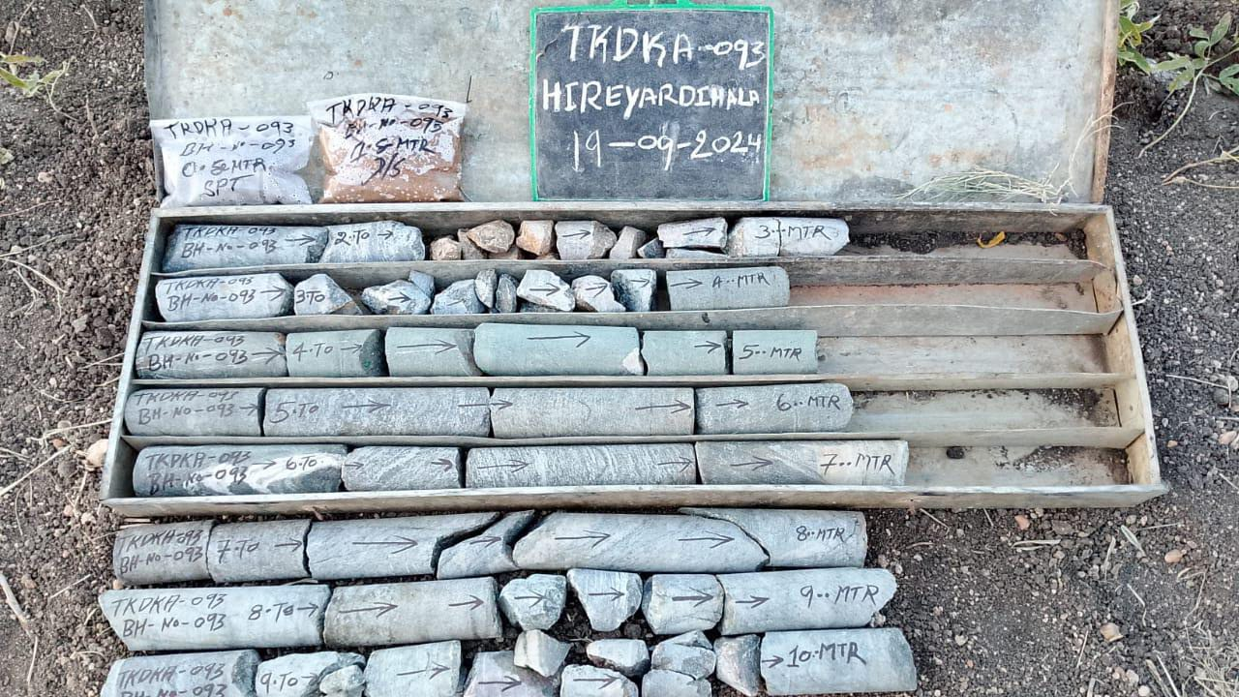
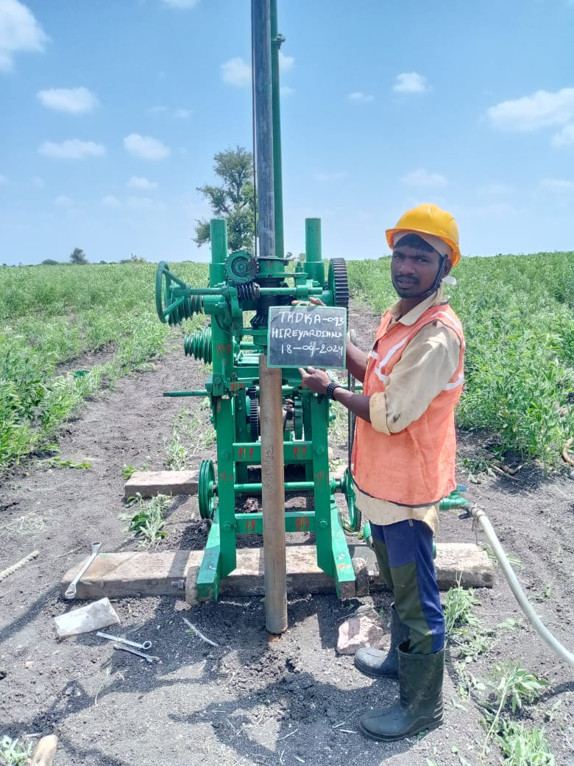
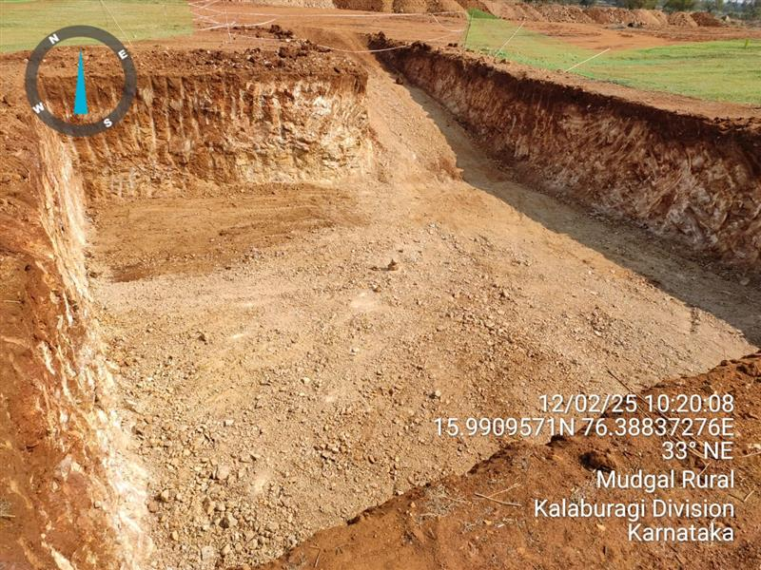
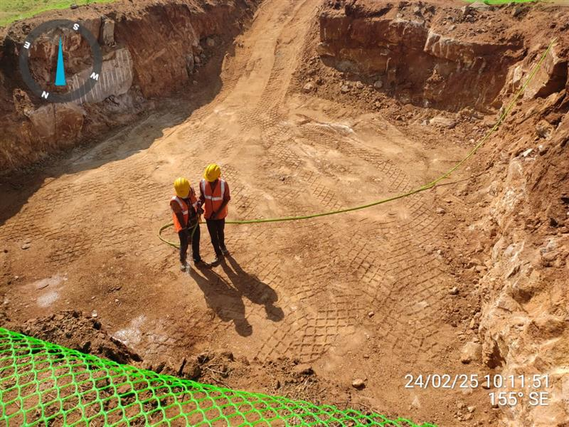
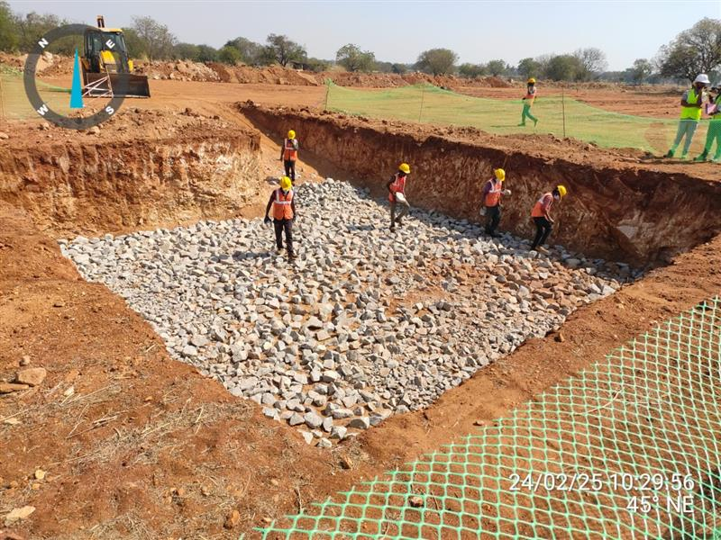
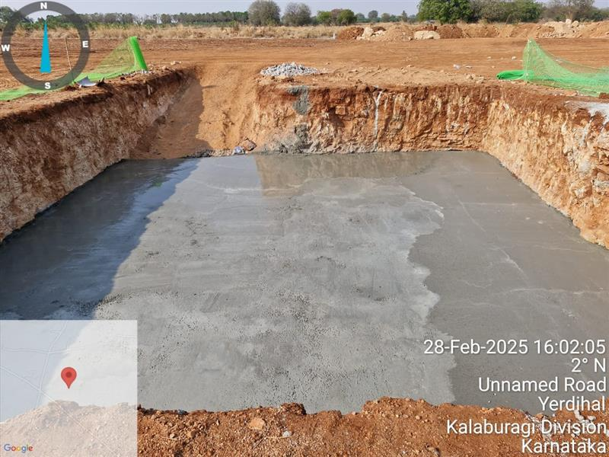
SITE PHOTOGRAPHS

Slide 36
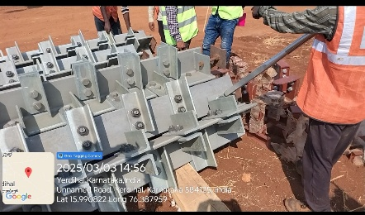
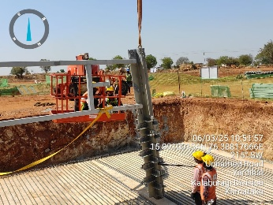
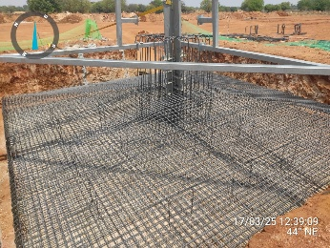
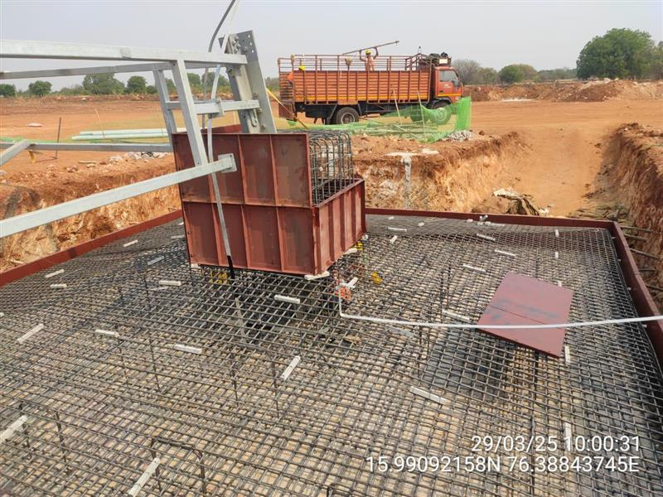
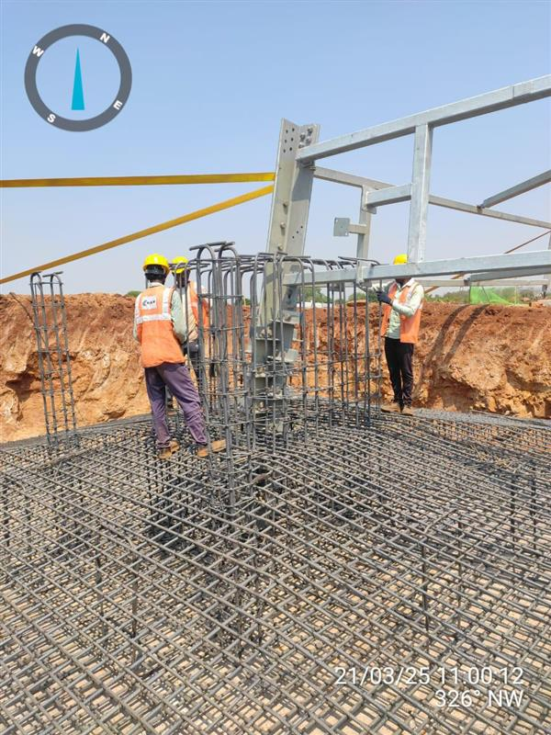
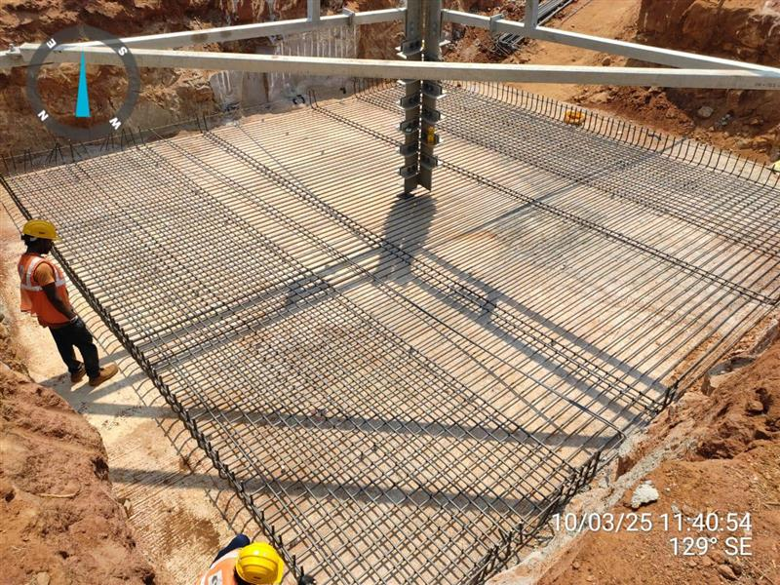
SITE PHOTOGRAPHS

Slide 37
Change In law cases(WIND)
S.No. | WPD | Tranche | PPA Capacity | Actual Commissioned Capacity | Date of CERC order | COD | Status
1 | Powerica Ltd | VI | 50.6 | 50.6 | 05-04-2023 | 18-08-2022 | Annuity Started in Oct 2023, Closed
2 | JSW Future Energy Ltd | X | 300 | 300 | 11-04-2022 | 15-09-2024 | draft claim final, 01.07.2025, Letter sent to DISCOM
3 | Torrent Power Limited | V | 115 | 115 | 09-01-2024 | 14-07-2023 | Draft claim finalised
4 | Ayana Renewable Power Six Pvt Ltd | X | 300 | 300 | 11-04-2022 | 19-02-2024 | response sought
5 | Vena Energy Vidyuth Pvt. Ltd. | XI | 160 | 160 | 12-01-2024 | 01-10-2024 | documents sought for GST
 |  |  |  |  |  |  | draft claim final for BCD
6 | Ostro Energy Private Limited | VII | 50 | 50 | 26-12-2023 | 05-12-2022 | carrying cost claim under evaluation
7 | Ostro Energy Private Limited | VI | 300 | 199.5 | 19-05-2024 | 09-09-2022 | documents under evaluation
8 | JSW Future Energy Ltd | X | 150 | 150 | 11-04-2022 | 14-11-2024 | Documents and clarifications sought
9 | Sitac Kabini Renewables Private Limited | V | 300 | 300 | 20-02-2025 | 31-05-2023 | documents sought
10 | Srijan Energy Systems Private Limited | VI | 150 | 148.5 | 03-01-2025 | 16-06-2023 | documents sought

Slide 38
MIS Update as on 08.12.2025
Sr. No. | Actions pending in Wind Division | Timeline | Status (as on 08.12.2025) | Concerned official
1 | SECI project 50 MW for NDMC | ongoing | Subsequent to report by NIWE, Configuration revision to be reviewed by Projects Team to optimise the CUF, Title search report under process, will be initiated once the GO is received | Anita/Prashant/Ashutosh Shandilya
2 | CIL Claims settlement | ongoing | 1) As per requirement, Meetings are being called on case to case basis and discussions are undergoing with Finance divison and consultant, 2) currently 7 cases are live 3) Ostro Energy Pvt. Ltd. GST claim finalised and Carrying cost claim under evaluation | Anita/Ashutosh Shandilya
3 | Apraava T-XIV 300 MW SCoD extension | ongoing | Committee meeting discussion held at CTU office, Minutes are awaited | Dileep
4 | Meeting with CSPDCL for Tunga project | ongoing | Hearing scheduled on 10.11.2025 has been deleted, next date of hearing to be informed in due course | Anita/Aditee/EMD
5 | Approval for NDA for availing OEMs wind turbine model data. | ongoing | Signed NDA received from Sany and NDA expected within a week from Envision, NDA under discussion with suzlon, AEP assessment with NIWE under finalisation, Revised Budgetary quotation received from Sany, and expected to be received this week from Envision, Inox | Anita/Aditee/Ashutosh Shandilya
6 | 600 MW/ 1200 MWh BESS project for market operation under VGF scheme in AP | completed | Title search report under process, as the advanced possession is awaited | Anita
7 | 100 MW ISTS Connected Solar power project at Chitradurga, karnataka for DRDO | ongoing | Meeting held with CTUIL and the issues regarding connectivity expressed by CTU and the same is under discussion | Anita

Slide 39
THANK YOU

