Slide 1
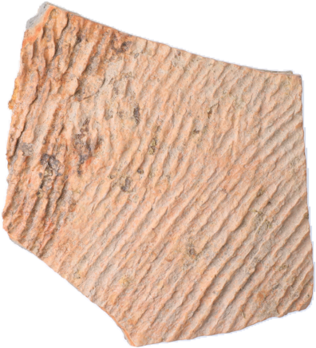
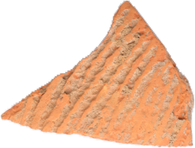
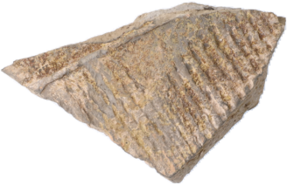
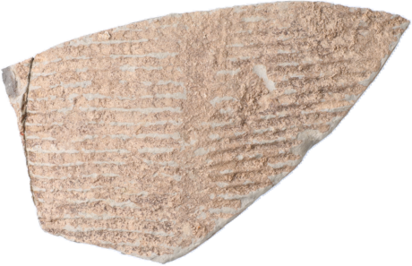
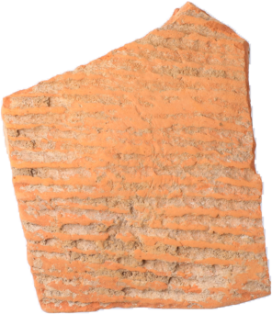
SherdMatch
AI-Based Archaeological
Pottery Fragment Matching
From a plan to a working, evaluated system: appearance + fracture-edge geometry on the Daxinzhuang-18K benchmark
PRT LLT · 21CSE451T
Review 2
Vansh Agrawal · RA2311026010120
CINTEL · Section AC-1
Faculty: Dr Nithyashri J
Notes:
Introduce yourself and the project. SherdMatch is the name of the system built for the AI-based pottery fragment matching topic presented at Review 1. Review 1 was the plan; Review 2 shows what was built, the results, and an honest answer to the research question.

Slide 2
PROGRESS SINCE REVIEW 1
From plan to evidence
REVIEW 1
REVIEW 2
Data: Daxinzhuang-18K found on Zenodo; only the needed parts fetched (range requests, CRC-checked)
Pipeline: segmentation, CLAHE, contours, colour/LBP/ResNet-50/DINOv2 features
Geometry: complementary-curvature edge matcher with Kabsch + ICP alignment
Model: logistic-regression fusion, compared with RF and SVM
Evaluation: leak-free vessel-grouped CV, bootstrap CIs, ablations
Prototype: Gradio demo with ranked candidates and fit preview
Dataset named, schema to verify, pipeline planned, no results
Data acquired and verified, pipeline built, 5 experiments, working demo
124
111
real sherds in the test set
expert-confirmed joins
16
5
model configurations compared
experiments run (E1–E5)
Notes:
Review 1 ended with 'planned methodology, no experimental results yet'. Everything on this slide now exists and is public on GitHub.

Slide 3
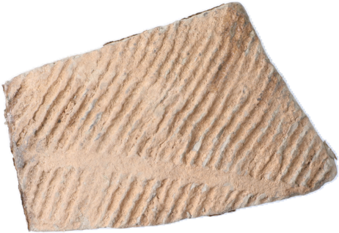
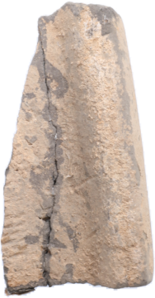
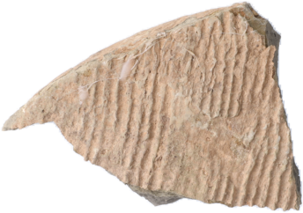
DATASET
Daxinzhuang-18K, verified
1.46%
Real photos
36,532 photos · 17,635 records
metadata + photo segmentation
of the 7,626 sherd pairs are joins: extreme class imbalance
Gold standard
124 sherds · 111 expert joins + poses
main train / test set
33
Simulated
50,736 synthetic break pairs
geometry sanity check (2,212 used)
vessel groups (2–11 sherds each), used to split train/test
Refit sheet
251 expert joining groups
ground truth, raw-photo test (next)
Zenodo 21553799 · Ji et al., 2026 · CC-BY 4.0
Notes:
Explain the four parts and what each was used for. Stress the imbalance: 1.46% of pairs are joins, so accuracy is meaningless and we use ranking metrics.

Slide 4
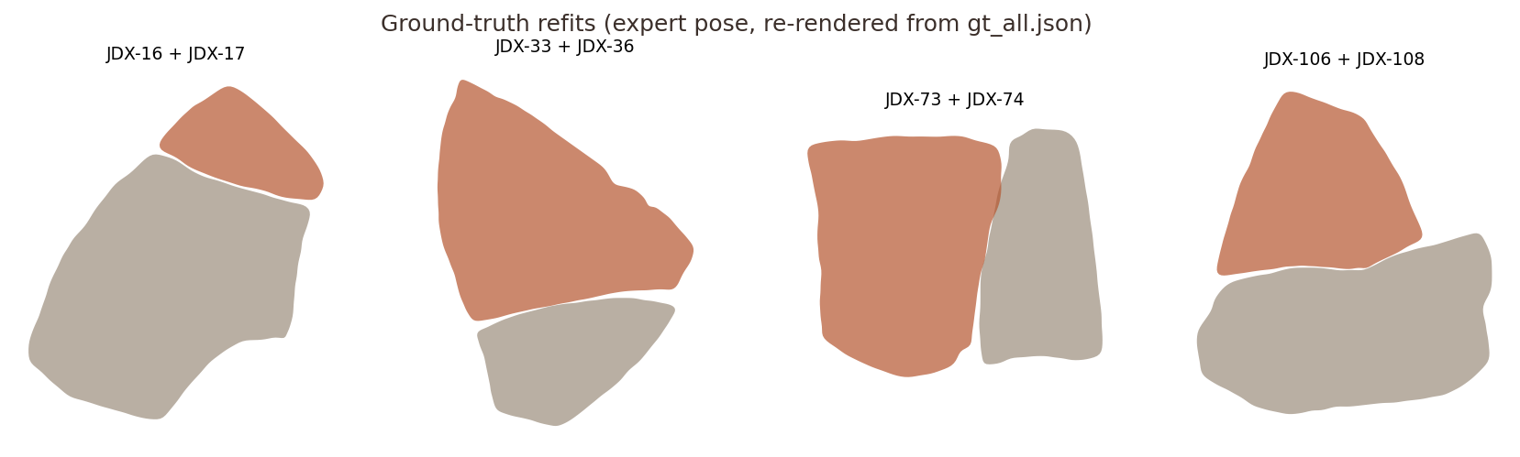
METADATA UNDERSTANDING
What pixels cannot
tell us
PHOTO ID ≠ SHERD ID
USED FOR
Sherd JD00001 → photos JD_00001 (exterior) + JD_00002 (interior). Mapping by number would pair the wrong photos. Fixed via the Exterior_Photo column.
Vessel groups → leak-free folds
Notes (spalling) explain errors
Layer, part → future priors
Only 547 of 17,635 records typed: too sparse as a label
POSE CONVENTIONS VERIFIED
Expert joins re-rendered with our own pose code. Visible gaps along the joints are edge erosion, the central obstacle for geometry.
Gold: recentre on alpha centroid, rotate, place. Simulated: image centre, opposite sign. Verified: true pairs touch 75–170 px with ≤7% overlap.
Notes:
Two real pitfalls found in the metadata. The photo-ID bug would have silently paired wrong photos. The pose conventions differ between gold and simulated data; both were verified by checking that true partners touch without overlapping.

Slide 5
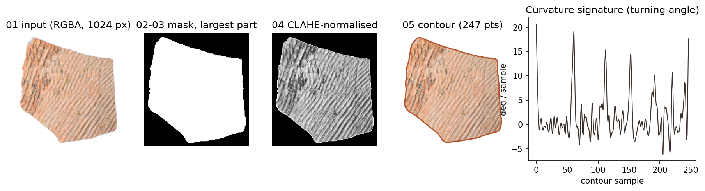
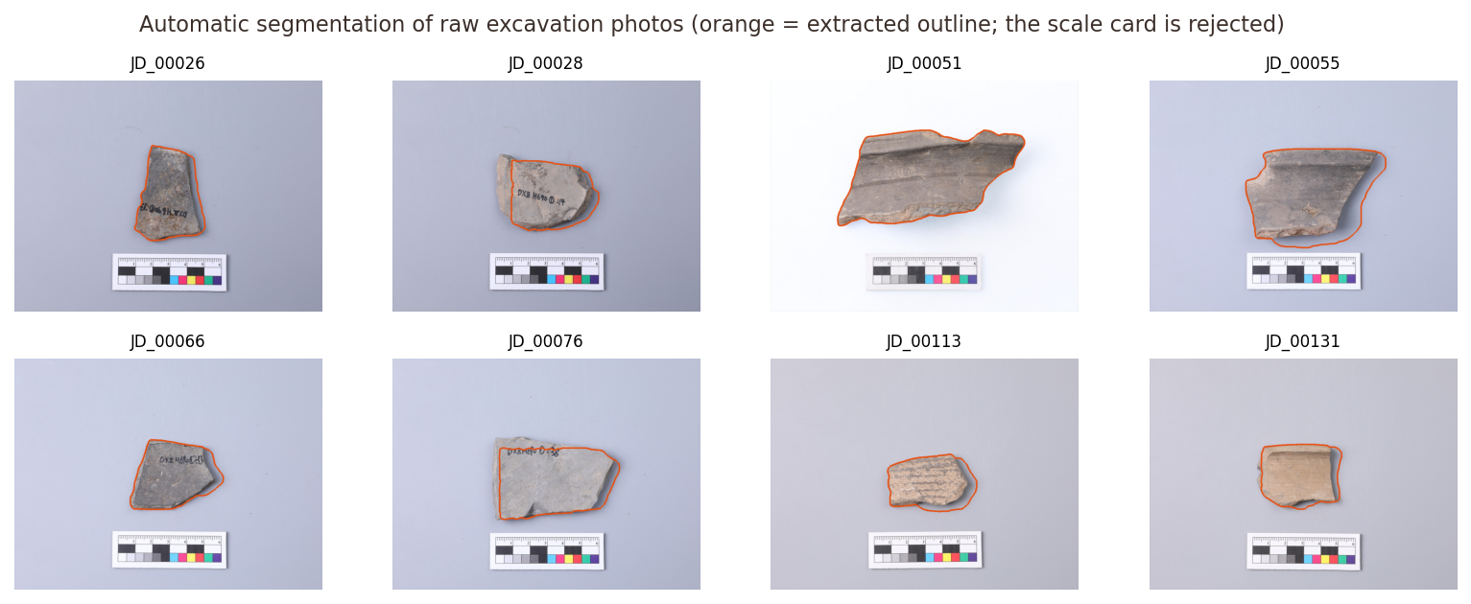
THE PROCESS, IMPLEMENTED
Preprocessing pipeline
Scale kept fixed: edge lengths must match
Raw photos: Otsu → card filter → GrabCut
Remaining error: light edges cut, shadows kept
Notes:
Walk through the five steps on one sherd. Then the raw photos: the scale card is rejected by a rectangularity filter, GrabCut refines the mask. Mention the remaining errors honestly.

Slide 6
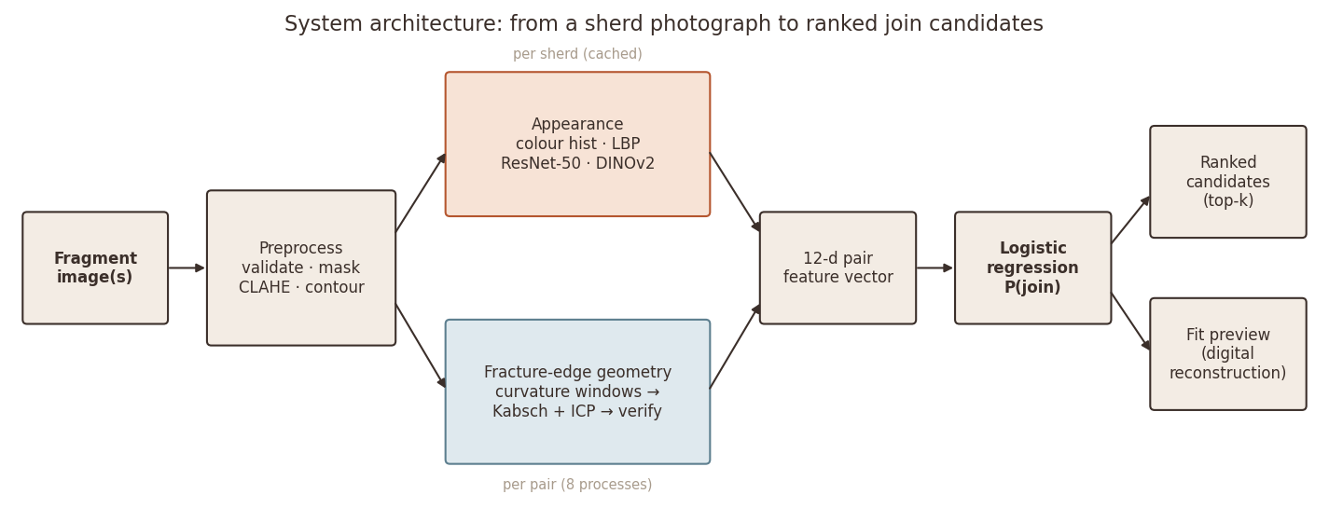
MODEL SELECTION
Two cues, one
interpretable classifier
PATTERN TO RECOGNISE
Does sherd pair (A, B) join? Used as ranking: sort the gallery by P(join).
LOGISTIC REGRESSION
P(join) = σ(wᵀz + b)
12 standardised pair features
class-balanced, L2 (C = 1)
4 appearance: colour histogram, LBP texture, ResNet-50, DINOv2
8 geometry: contact, contact fraction, overlap, rmse, fit score, stripe-angle gap (+confidence), area ratio
Notes:
The selected model is a pairwise classifier. Appearance and geometry features of a pair go into a class-balanced logistic regression; its probability ranks the gallery.

Slide 7
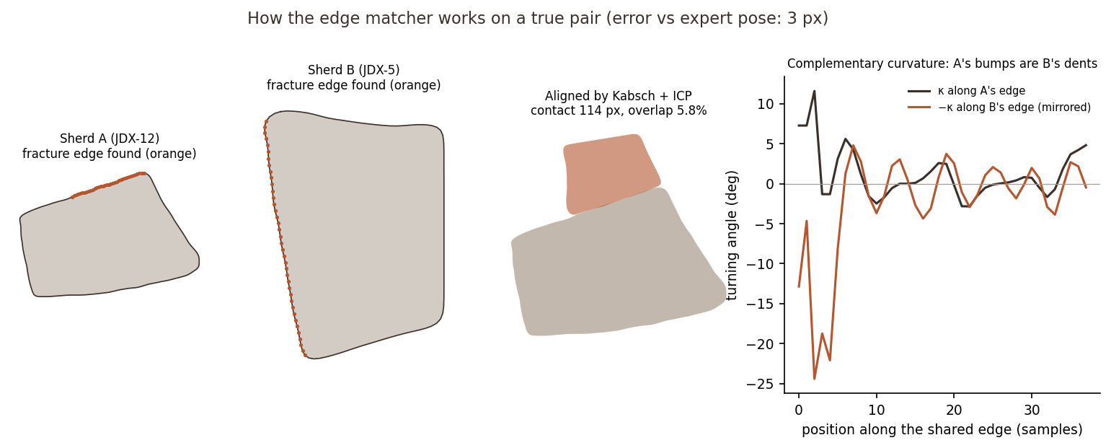
FRACTURE-EDGE GEOMETRY
Complementary curvature matching
01 Signature
02 Seeds
03 Align
04 Verify
turning angle every 3 px
A vs reversed −B windows
Kabsch, then ICP
contact ↑ overlap ↓ stripes agree
Notes:
Key idea: at a join the two outlines run in opposite directions and A's bumps are B's dents. We compare A's curvature with B's reversed and negated curvature, align with Kabsch, refine with ICP, and reject fits that overlap.

Slide 8
JUSTIFICATION
Why logistic regression
DATA SIZE
111 positives fit a 13-parameter model; non-linear models and deep nets overfit
INTERPRETABILITY
Signed weight per cue: experts can see why a sherd was suggested
COST AND RESULT
Milliseconds to train; best Hit@5 and Hit@10 of all classifiers
Notes:
Justification is worth the most marks. LR wins on ranking, is interpretable, and suits 111 positives. RF has similar F1 but ranks worse; SVM is worst. A deep Siamese network would need thousands of real joins.

Slide 9
EXPERIMENTAL SETUP
Leak-free evaluation
VALIDATION
METRICS AND WHY
EXPERIMENTS
5-fold GroupKFold over the 33 vessel groups
No vessel in both train and test
Each query ranked against all 123 others
F1 threshold from inner CV on training pairs
Hit@k: what the expert checks
MRR, mAP: rank quality
P / R / F1, PR-AUC: pair decisions
Accuracy is misleading at 1.46% positives
Bootstrap 95% CIs (5,000×)
E1 image-only vs fusion
E2 LR vs RF vs SVM
E3 ablation of every cue
E4 geometry on synthetic breaks
E5 pose accuracy on real joins
E6 raw photos (next step)
Notes:
Leak-free protocol: whole vessels are held out, so the model cannot win by memorising a vessel's colour. Thresholds are chosen on training folds only. Accuracy is reported but ignored: all-'no join' gives 98.5%.

Slide 10
RESULTS (E1)
Better than image-only retrieval
72%
of sherds have a true partner in the top 10
+17.7 pts
Hit@10 vs image-only (95% CI +9.7 to +26.6)
+15.3 pts
Hit@5 vs image-only (95% CI +5.6 to +25.0)
Notes:
Headline: the proposed model finds a true partner in the top 10 for 72% of sherds vs 54% for the image-only plan. The gain is significant at top-5 and top-10.

Slide 11
TESTING THE HYPOTHESIS
Does geometry pull its weight?
Hit@1
-6.5
95% CI -12.1 to -1.6
significant
Hit@5
+3.2
95% CI -2.4 to +9.7
not significant
Hit@10
+4.0
95% CI -2.4 to +10.5
not significant
Adding geometry to learned appearance: H1 only partly supported
Red = the cue helped (removing it hurts). Green = removing it helps.
Notes:
The honest part. Compared with learned appearance alone, geometry adds a non-significant +3 to +4 points at top-5/10 and loses 6.5 points at top-1. The ablation shows the orientation cue hurts. We kept the pre-specified model rather than cherry-picking the best ablation.

Slide 12
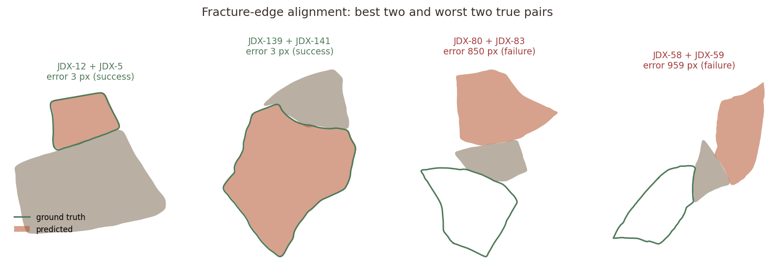
DIAGNOSIS (E4, E5)
The bottleneck is the edge,
not the matcher
47%
17%
At the expert pose, true partners touch along 87 px (median)
The best wrong pose found by ICP touches along 129 px
On worn edges, maximising contact chooses wrong fits
clean synthetic breaks aligned within 50 px
real eroded sherds aligned within 50 px
Notes:
Why geometry under-delivers: the same matcher recovers about half of clean synthetic breaks but under a fifth of real ones. At the expert pose real partners touch along 87 px; the best wrong fit touches 129 px. Maximising contact prefers wrong fits on worn edges.

Slide 13
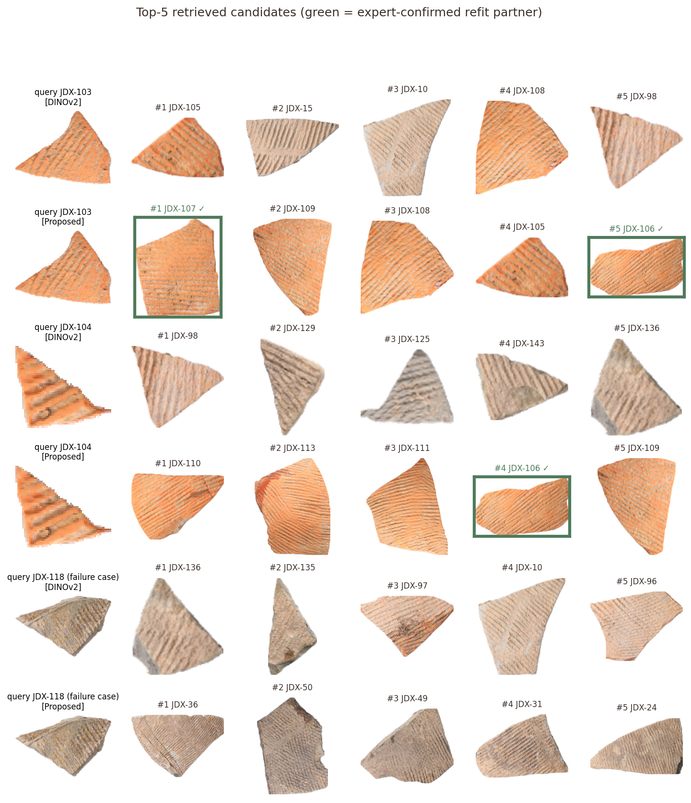
RESULTS ANALYSIS
Where it fails, and why
11%
7×
of wrong top-1 picks are from the same vessel: the confusion is between vessels of one ware
more same-vessel sherds in the top 5 than chance
0.44→0.71
3.4×
Hit@5, smallest vs largest third of sherds
PR-AUC over chance (precision 0.37, recall 0.23, F1 0.29)
Accuracy is 91.6%, but predicting 'no join' for everything already scores 92.8% on these test pairs, so it is not a useful measure here.
Notes:
Error analysis. Most wrong top-1 picks are look-alike sherds from other vessels of the same ware. The top-5 still contains 7x more same-vessel sherds than chance. Small sherds are hardest. Pair-level precision is modest, so this is a ranking aid, not an automatic verdict.

Slide 14
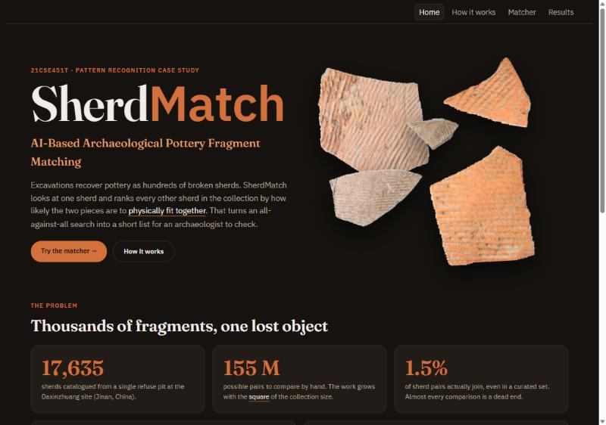
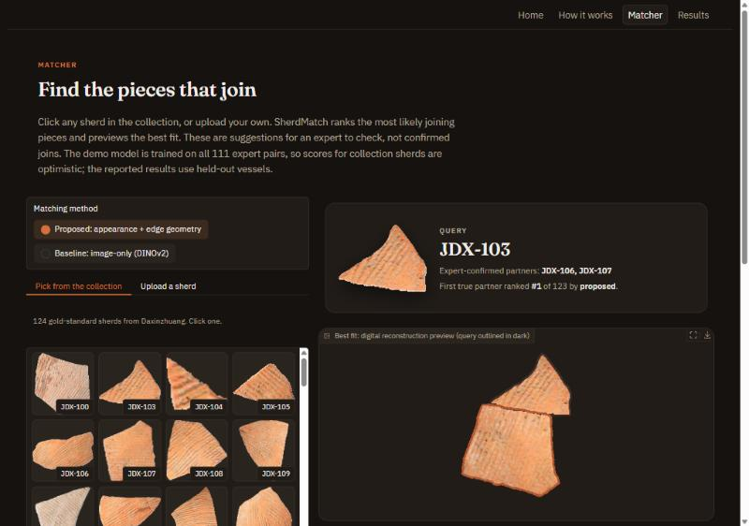
PROTOTYPE
SherdMatch web app
HOME: the problem, the approach, the headline results
MATCHER: click a sherd, get ranked joins and a fit preview
4 pages: Home · How it works · Matcher · Results | JDX-103: true partner ranked #1, vs #28 with image-only | python app.py · github.com/vansh070605/SherdMatch
Notes:
Live demo. Start on Home to frame the problem, then open Matcher: pick JDX-103; its expert partner comes first and the fit preview shows the joint. Switch to the image-only baseline: the same partner drops to rank 28. Upload a raw photo to show segmentation.

Slide 15
INFERENCE
What the evidence supports
USEFUL TRIAGE TOOL
H1 PARTLY SUPPORTED
CLAIMS WE DO NOT MAKE
An expert checking 10 suggestions finds a partner for 72% of sherds
Better than image-only, but the gain comes from fusing appearance cues
Not an automatic reconstruction
Not 'geometry is useless': 3-D and thickness untested
One site, one ware
EDGES ARE THE BOTTLENECK
COLOUR MATTERS MOST
2-D outline geometry fails on eroded edges, not on clean ones
Vessels fired unevenly: colour identifies the vessel better than shape
Notes:
Summarise the inference: practical triage tool, hypothesis partly supported, geometry limited by edge erosion, colour is the strongest cue. Mention the claims we do not make.

Slide 16
LIMITATIONS & FUTURE SCOPE
What comes next
LIMITATIONS
Interior view + edge-band colour
LOW
2-D outlines miss thickness and wall curvature
Max-contact pose choice fails on worn edges
Only 111 positives: wide confidence intervals
Exterior view only; one site and ware
Raw-photo masks: shadows, light edges
independent evidence across the joint
Learned pose scoring
MEDIUM
train on expert vs false ICP poses
Contrastive fine-tuning
MEDIUM
better vessel grouping
Multi-piece assembly
HIGH
erosion-aware simulation → full reconstruction
Notes:
Limitations and realistic next steps, ordered by effort.

Slide 17
REFERENCES
Sources and code
Ji, D., et al. (2026). Daxinzhuang-18K: A large-scale 2D benchmark for pottery sherd retrieval and reassembly. Zenodo. doi:10.5281/zenodo.21553799
Freeman, H., & Garder, L. (1964). Apictorial jigsaw puzzles. IEEE Trans. Electronic Computers, EC-13(2), 118–127.
Huang, Q.-X., et al. (2006). Reassembling fractured objects by geometric matching. ACM TOG, 25(3), 569–578.
Pinho, M., Mota, G., & da Costa, G. (2025). A deep learning approach to assist in pottery reconstruction from its sherds. Heritage, 8(5), 167.
Yu, X., et al. (2026). Mitigating spurious features by contrastive learning in pottery sherd recognition. npj Heritage Science, 14, 135.
Oquab, M., et al. (2024). DINOv2: Learning robust visual features without supervision. TMLR.
He, K., et al. (2016). Deep residual learning for image recognition. CVPR.
Kabsch, W. (1976). Acta Cryst. A32, 922–923 · Besl, P., & McKay, N. (1992). IEEE TPAMI 14(2), 239–256.
Full list (23 references): Review 2 case study report, Section 16.
Code, results, report
github.com/vansh070605/
SherdMatch
Thank you
Questions?
Notes:
Close and invite questions.

