Slide 1
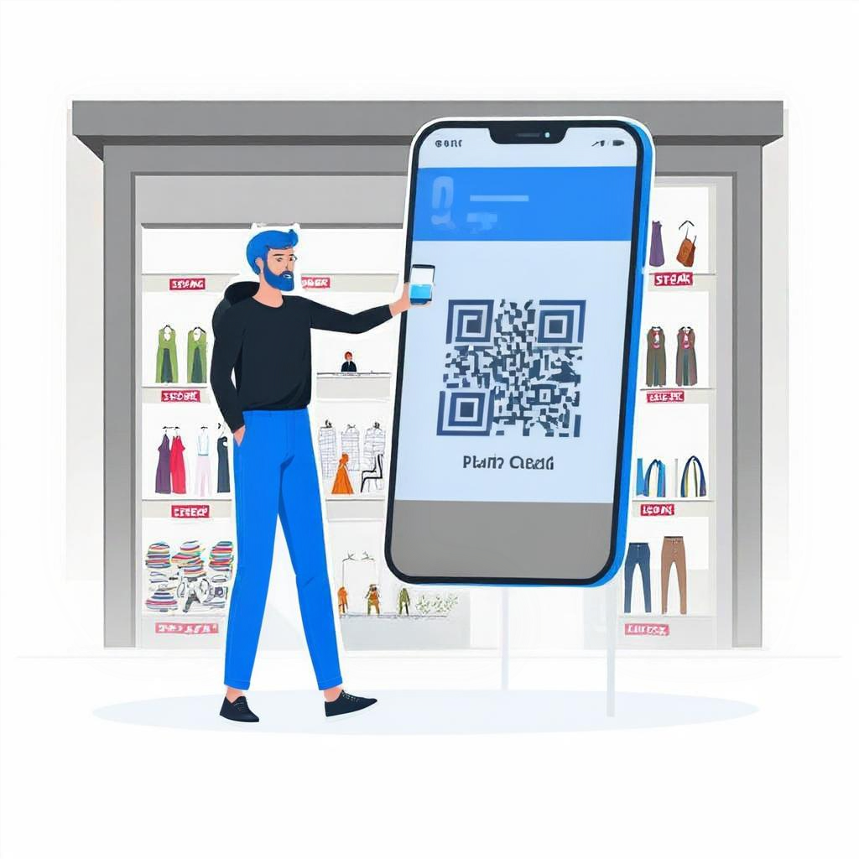
Scan & Print
Automated Web-Based Printing Solution: A QR code interface for document upload, cost calculation, online payment, and instant printing without human assistance.
by Vansh, Shiv, Sharandeep, Yaduvendra

Slide 2
Project Abstract
Overview
Key Objectives
Approach
This project provides an automated web-based printing solution. Users access an interface via a QR code, upload files, and receive an instant page count with
calculated costs. After secure online payment, the system sends a command directly to the printer, enabling fast, hands-free printing and enhancing user convenience and operational efficiency.
The project aims to streamline the printing process by enabling users to upload documents through a QR code interface, automatically calculate print costs, securely handle payments, and directly send print commands to the printer, ensuring a fully automated and efficient service
The project uses a web application where users upload documents via a QR code. The system automatically counts pages, calculates costs, and processes secure online payments. After payment, the document is sent directly to the printer for automatic printing, offering a seamless and efficient experience with minimal manual intervention

Slide 3

Project Goals and Objectives
Automated Printing Process
1
After payment, the document is printed without human intervention, enhancing speed and efficiency
2
Dynamic Costing System
Unlike standard per-page pricing, this system adapts to document complexity, such as color printing or special formatting, ensuring a personalized cost estimate for every user.
User-Friendly Experience
3
The goal is to make the user experience as simple and straightforward as possible while maintaining functionality

Slide 4

Alignment with UN Sustainable Development Goals (SDGs)
SDG 9: Industry,
Innovation& Infrastructure
SDG 4 :Quality Education
It fosters technological innovation by automating the printing process, modernizing the industry infrastructure
The system provides affordable and efficient printing solutions for educational institutions, improving access to resources
SDG 8 :Decent Work and
Economic Growth
SDG 3:Good Health and Well-Being
The project boosts business productivity by automating printing, reducing labor costs and enhancing efficiency
By reducing manual tasks, the project promotes a less stressful, more efficient work environment, supporting mental well-being

Slide 5





Methodology and Approach
User-Friendly Interface
Users access the web application through a QR code, upload documents, and receive real-time page count and cost estimates
Automated Processing
The system calculates the printing cost based on the document's content, processes payment securely, and ensures smooth transactions
Instant Printing
Once payment is confirmed, the document is automatically sent to the printer for immediate output without manual intervention
Scalable and Secure
The platform uses cloud-based processing for scalability and ensures user data is protected through encryption and secure payment gateways

Slide 6




Expected Outcomes and Impact
Efficiency and Time-Saving
Cost Transparency and Convenience
Increased Productivity
Significant increase in renewable energy capacity, reducing reliance on fossil fuels.
The real-time cost calculation and secure payment options provide clear pricing, enhancing convenience and trust
By automating the printing process, businesses and institutions can improve operational efficiency and allocate resources more effectively

Slide 7

Key Project Deliverables
QR Access & File Upload
Users scan a QR code to access the web interface, upload files, and receive an instant page count and cost estimate.
Payment Processing
Users pay via a secure online gateway; once confirmed, the system proceeds with printing.
Printer Integration
After payment, the backend sends a print command directly to the printer for hands-free operation.
Security
data is secured with HTTPS, and files are deleted post-print.

Slide 8

Next Steps and Conclusion
1
Scalability Enhancement
2
Mobile Application
Development
Optimize the cloud-based system to handle increased user volume and ensure fast processing speeds
Develop a mobile app version to expand accessibility and improve user experience
3
User Feedback
Gather user feedback to identify any pain points and refine the interface and functionality

