Slide 1
Project Presentation of Industry Oriented Hands on Experience (22CS422)
On
2D Game Asset
Vansh Jindal
2211981450
Supervised By
Gaurav Vara ,CEO
ZenVara Infotech LLP
Department of Computer Science and Engineering,
Chitkara University, Punjab

Slide 2
Introduction
This presentation summarizes the work completed during an internship as a 2D Game Artist at Zenvara Infotech LLP. The primary objective was to gain practical experience by designing visually appealing and functional game assets for mobile and casual games.
Key Projects
Bubble Spinner Game
Sea Animal Merge Game
Find IT
2

Slide 3
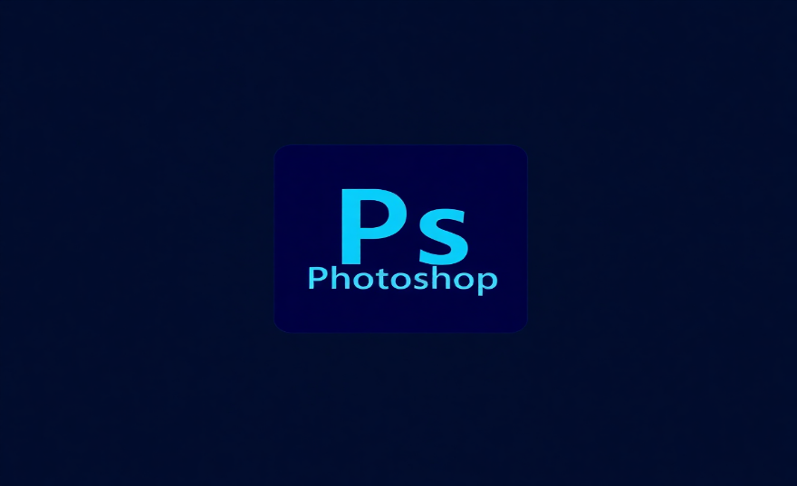
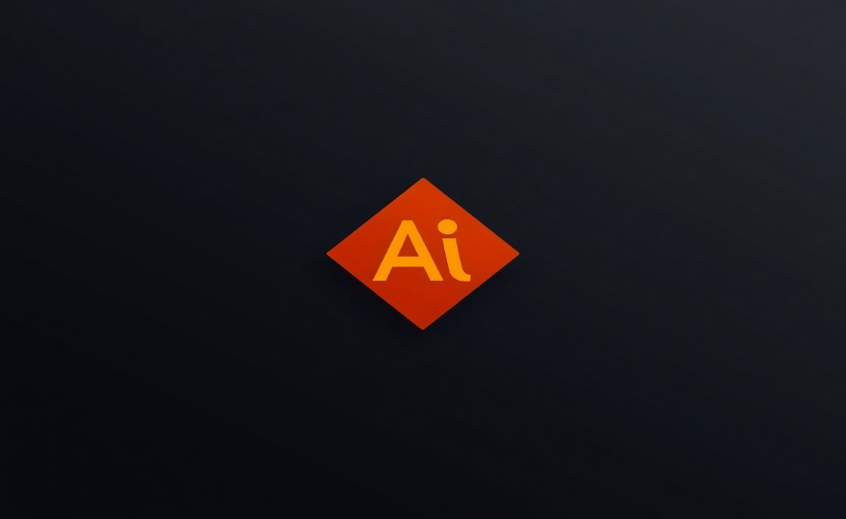
Technologies & Tools
The project utilized industry-standard tools to create high-quality raster and vector assets, ensuring feasibility and creative freedom.
Adobe Photoshop Adobe Illustrator
Used for creating raster graphics, detailed Used for creating vector-based assets,
textures, and visual effects for game elements. scalable UI designs, and characters with clean lines.
3

Slide 4
Project Requirement Analysis
Project 1: Bubble Spinner
Design colorful bubbles and spinning elements
Create a smooth and visually attractive UI
Maintain consistency in colors and shapes
Project 2: Sea Animal Merge Game
Design cute sea animals (fish, turtles, etc.)
Create visuals for merge progression
Maintain a playful and engaging underwater theme
4

Slide 5
Asset Creation Workflow
The design process followed a structured workflow, from initial concept to final asset delivery for game implementation.
Understand Game Requirement
Create Initial Design / Concept Sketch
Design in Illustrator/Photoshop
Refine & Improve Design
Finalize Asset
Export & Deliver for Implementation
5

Slide 6
Key Takeaways
Enhanced Creativity
Improved creative thinking and design skills through practical application.
Industry Workflow
Learned the standard industry workflow for game asset creation and collaboration.
Technical Proficiency
Gained hands-on experience with Adobe Photoshop & Illustrator in a professional context.
Design Principles
Developed a better understanding of color theory, composition, and art style consistency.
6

Slide 7
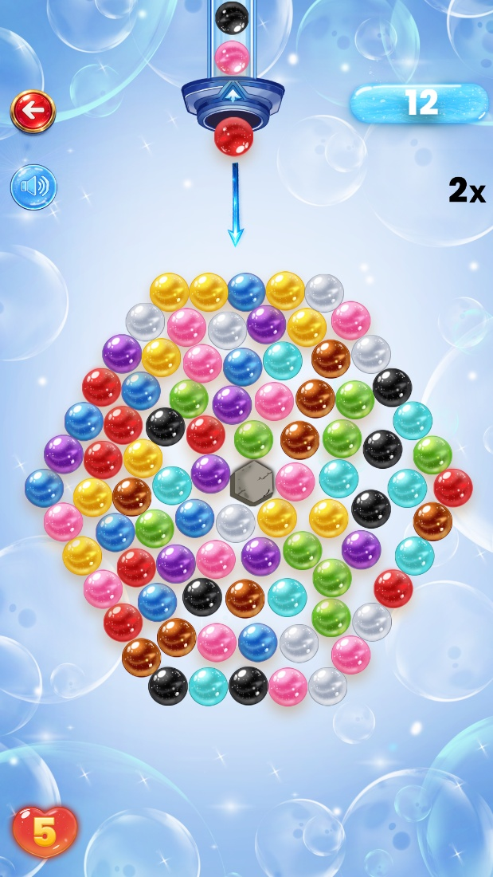
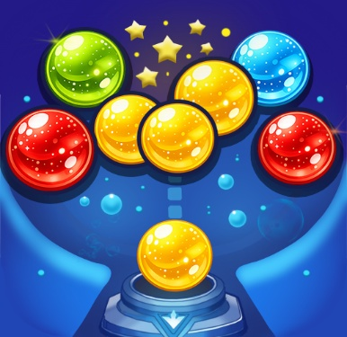
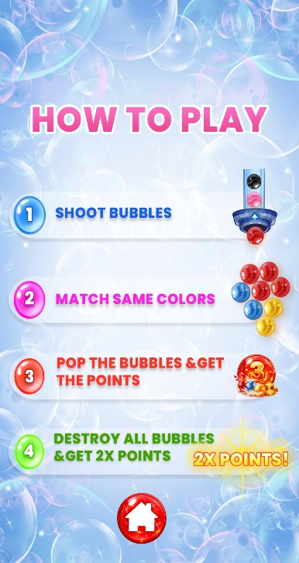
Project Output: Bubble Spinner
Assets created for Bubble Spinner focused on a vibrant and energetic feel. This included the main gameplay screen, UI elements, 'How to Play' instructions, and the 'Game Over' screen, all designed for a satisfying player experience.
7

Slide 8
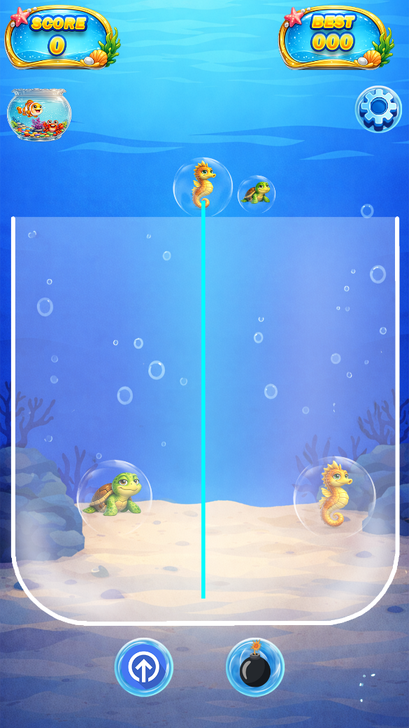
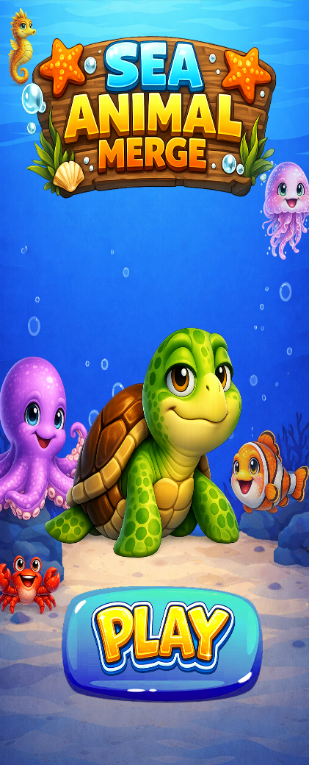
Sea Animal Merge Game
The visual design for Sea Animal Merge involved creating cute and appealing sea creatures. The art style maintained a consistent and playful underwater theme to engage players, focusing on progression-based visuals as animals merge.
8

Slide 9
Acknowledgements
Expressing sincere gratitude to the following for their invaluable support and guidance throughout the internship:
Dr. Parthasarathy P.K.
Head of the Game Design Department, for his guidance, support, and encouragement.
Zenvara Infotech LLP
For providing the opportunity to work as a 2D Artist and gain practical exposure.
Chitkara University
For providing the platform to enhance skills and knowledge through this internship program.
9

Slide 10
Thank You
10

