Slide 1
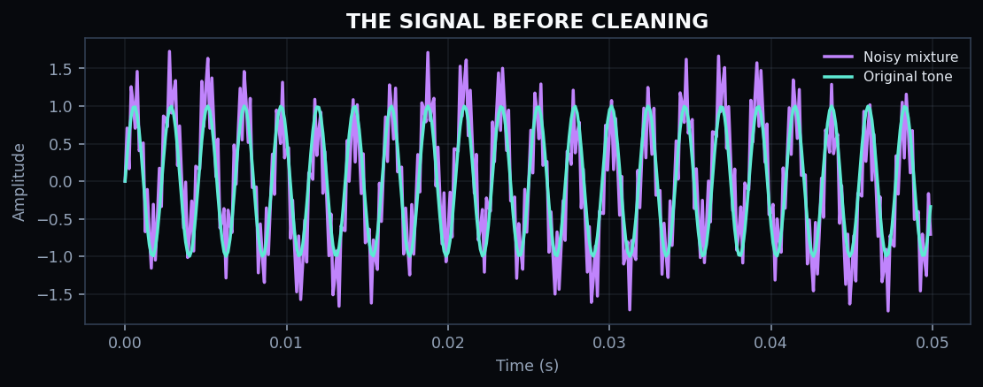
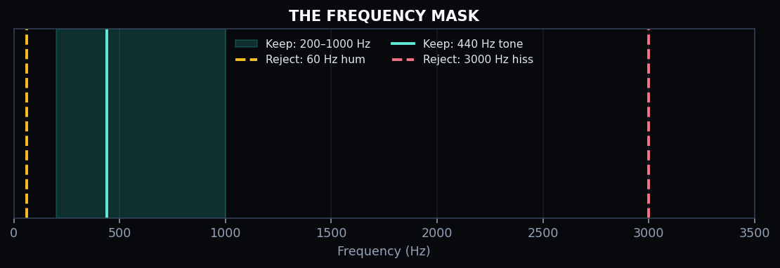
SIGNAL PROCESSING / GROUP PROJECT
CLEANING
NOISY AUDIO
WITH FOURIER TRANSFORMS
From a mixed waveform to a clearer 440 Hz tone.
PRESENTED BY [GROUP MEMBERS] • [CLASS / SECTION]
SIGNAL LAB / FOURIER TRANSFORM
01 / 11
Notes:
Introduce the project as a demonstration of basic digital signal processing. Replace the group member placeholder before presenting.

Slide 2
THE STORY
A tiny journey through
signal processing.
01 THE PROBLEM
02 BUILD THE SIGNAL
03 FIND THE FREQUENCIES
04 FILTER THE SPECTRUM
05 REBUILD + COMPARE
KEY IDEA
Find the unwanted frequencies. Remove them. Listen to the difference.
SIGNAL LAB / FOURIER TRANSFORM
02 / 11
Notes:
Use this as the agenda: problem, signal construction, FFT, filtering, reconstruction, and result.

Slide 3
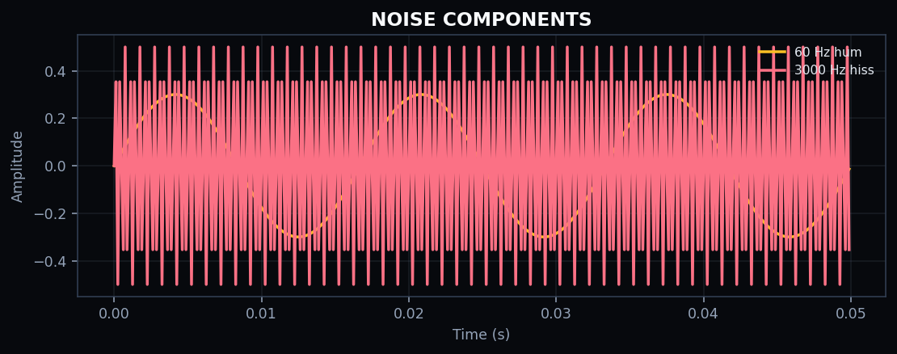
01 / THE PROBLEM
What does noise look like?
A clean sound can be mixed with unwanted frequencies.
01
60 Hz hum — a low electrical buzz.
02
3000 Hz hiss — a high-frequency layer.
03
440 Hz tone — our target sound.
TARGET: 440 Hz
HUM: 60 Hz
HISS: 3000 Hz
SIGNAL LAB / FOURIER TRANSFORM
03 / 11
Notes:
Explain hum, hiss, and target tone in simple language.

Slide 4
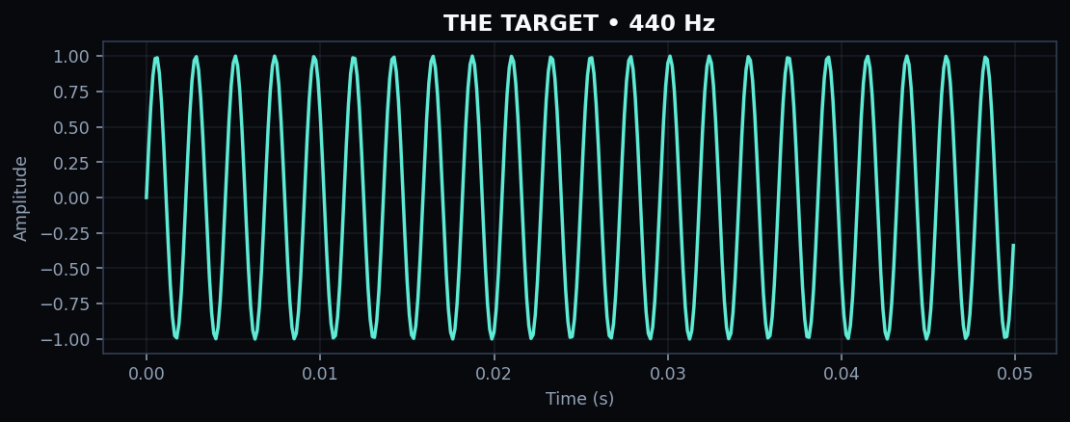
02 / BUILD THE SIGNAL
Three waves. One mixture.
The code generates a controlled 2-second example.
CLEAN TONE • 440 Hz
NOISE LAYERS • 60 Hz + 3000 Hz
Sampling rate: 8,000 Hz / Duration: 2 seconds / 16,000 samples
SIGNAL LAB / FOURIER TRANSFORM
04 / 11
Notes:
Explain that the clean tone is 440 Hz, and two known sine waves are added as noise.

Slide 5
02 / MIX
The original tone gets buried
Adding the two noise components creates a more complicated waveform.
clean_signal
+
noise_hum
+
noise_hiss
=
noisy_signal
The challenge:
separate the frequencies again.
SIGNAL LAB / FOURIER TRANSFORM
05 / 11
Notes:
Point out how the combined waveform looks more complicated because the signals are added together.

Slide 6
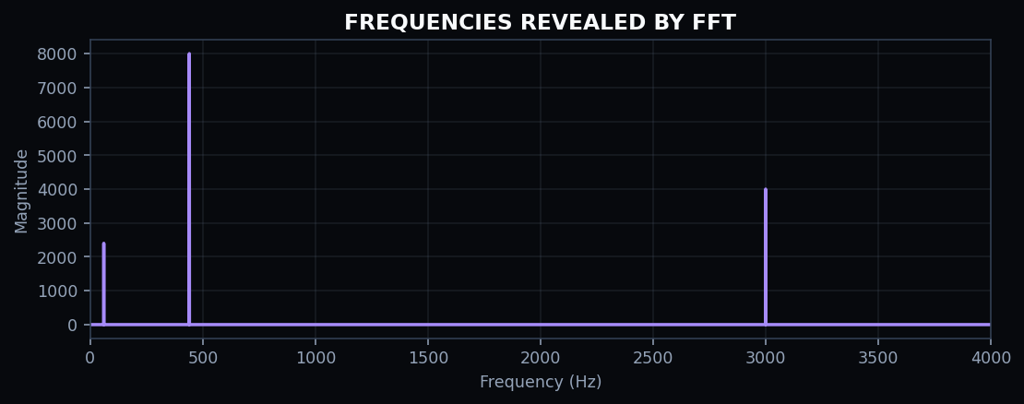
03 / FFT
Look at sound in frequency space
FFT = Fast Fourier Transform.
01
60 Hz peak → hum
02
440 Hz peak → target tone
03
3000 Hz peak → hiss
Like separating a chord into its individual notes.
SIGNAL LAB / FOURIER TRANSFORM
06 / 11
Notes:
FFT reveals the frequency components in the mixed signal. The peaks correspond to the three frequencies.

Slide 7
04 / FILTER
Keep the frequencies we want
The code keeps the 200–1000 Hz band and zeros out the rest.
KEEP
200–1000 Hz
REJECT
60 Hz hum
REJECT
3000 Hz hiss
440 Hz falls inside the pass band, so it remains.
SIGNAL LAB / FOURIER TRANSFORM
07 / 11
Notes:
The frequency mask keeps 200 to 1000 Hz, so the 440 Hz target passes while 60 Hz and 3000 Hz are removed.

Slide 8
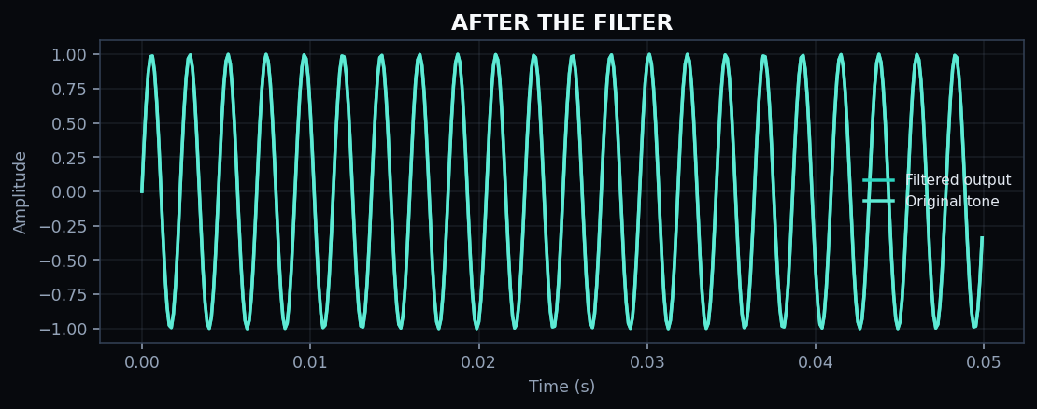
05 / RECONSTRUCT
Back to the time domain
IFFT rebuilds a waveform from the filtered spectrum.
01
The filtered output resembles the original tone.
02
The hum and hiss components are suppressed.
03
The result can now be compared in the time domain.
FILTERED SPECTRUM → IFFT → CLEANED SIGNAL
SIGNAL LAB / FOURIER TRANSFORM
08 / 11
Notes:
IFFT transforms the edited spectrum back into a time-domain waveform.

Slide 9
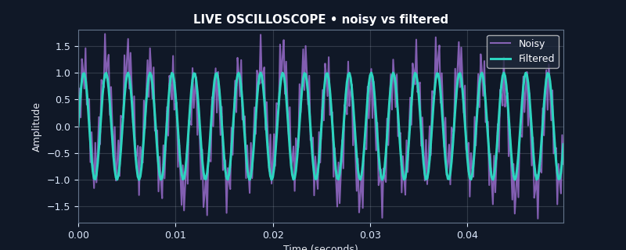
LIVE DEMO
Hear the difference with your eyes
Animated 50 ms window: noisy mixture vs filtered output.
PURPLE = NOISY
TEAL = FILTERED
Run the slide show to view the moving waveform.
SIGNAL LAB / FOURIER TRANSFORM
09 / 11
Notes:
Pause and let the animation run. Purple represents the noisy signal and teal the filtered signal.

Slide 10
06 / TAKEAWAY
What worked —
and what to remember.
RESULT
WHY
LIMIT
440 Hz is preserved.
It lies inside 200–1000 Hz.
Real sounds may overlap in frequency.
FFT finds the frequency content. Masking removes selected bands. IFFT reconstructs the output.
SIGNAL LAB / FOURIER TRANSFORM
10 / 11
Notes:
Explain that this example is controlled; real audio can contain overlapping desired and unwanted frequencies.

Slide 11
THANK YOU
QUESTIONS?
FFT / FREQUENCY MASK / IFFT
SIGNAL LAB / FOURIER TRANSFORM
11 / 11
Notes:
Invite questions from the audience.

