Slide 1
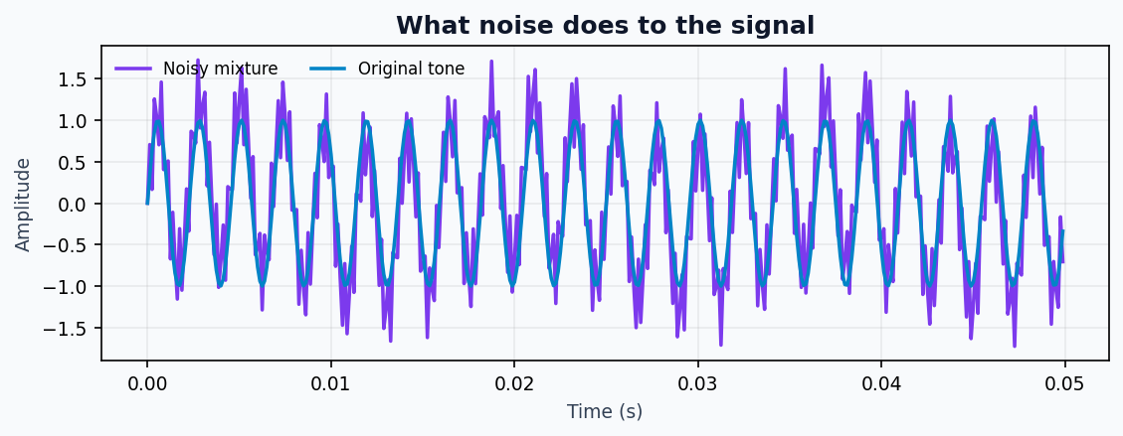
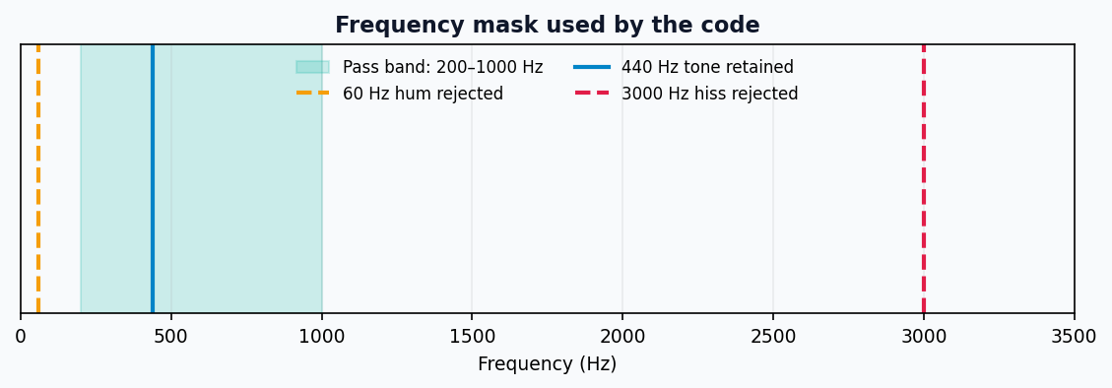
SIGNAL PROCESSING / GROUP PROJECT
Cleaning Noisy Audio
with Fourier Transforms
From a mixed waveform to a clearer 440 Hz tone
Presented by: [Group members] • Class: [Class/Section]
AUDIO SIGNAL CLEANING • GROUP PROJECT
01
Notes:
Introduce the project. Explain that the demo uses a synthetic tone, not a real recording. Replace the group-member placeholder before presenting.

Slide 2
ROADMAP
What we’ll explain
A short, presentation-friendly path from the problem to the result.
01
Problem
What hum and hiss do to audio
02
Signal setup
A 440 Hz tone plus two noises
03
FFT
Move from time to frequency
04
Filtering
Keep 200–1000 Hz; reject outside
05
IFFT + result
Rebuild and compare the waveform
AUDIO SIGNAL CLEANING • GROUP PROJECT
02
Notes:
Explain the roadmap in one sentence. This slide is also the slide plan for the group.

Slide 3
01 • THE PROBLEM
Why does audio sound noisy?
Unwanted frequencies can mask the sound we want to hear.
LOW-FREQUENCY HUM
HIGH-FREQUENCY HISS
TARGET SOUND
A 60 Hz component adds a slow electrical buzz.
A 3000 Hz component adds a sharper, high-pitched layer.
The clean 440 Hz tone is the musical note A.
Goal: preserve the target tone while removing the two unwanted components.
AUDIO SIGNAL CLEANING • GROUP PROJECT
03
Notes:
Describe hum and hiss in plain language. Emphasize that 440 Hz is the target tone.

Slide 4
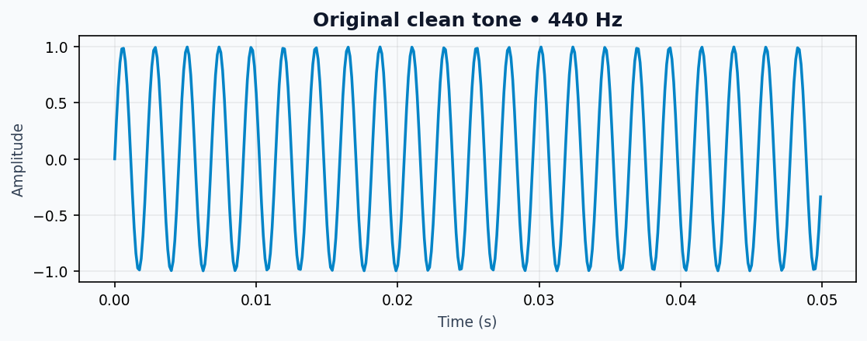
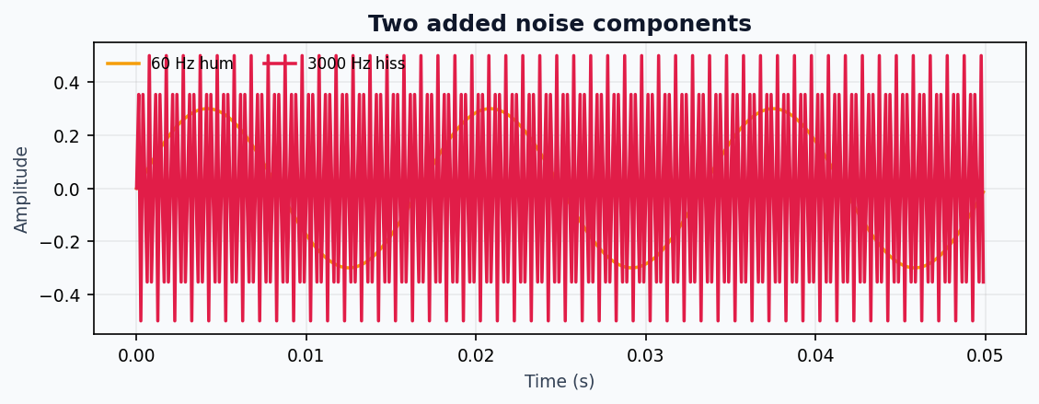
02 • BUILD THE TEST SIGNAL
One clean tone + two noise sources
The code creates a controlled example so each frequency is known.
CLEAN
HUM
HISS
440 Hz sine wave
60 Hz • amplitude 0.3
3000 Hz • amplitude 0.5
AUDIO SIGNAL CLEANING • GROUP PROJECT
04
Notes:
Explain the controlled test: sampling at 8 kHz for 2 seconds, with three known sine-wave components.

Slide 5
02 • THE MIXED WAVEFORM
Adding noise changes the wave
The observed signal is the sum of all three sine waves.
• Sampling rate: 8,000 samples per second
• Duration: 2 seconds
• Total samples: 16,000
• Noise is deliberately strong enough to see
noisy_signal = clean_signal + noise_hum + noise_hiss
AUDIO SIGNAL CLEANING • GROUP PROJECT
05
Notes:
Point to the irregular-looking purple mixture. The code adds the clean signal and both noise components sample by sample.

Slide 6
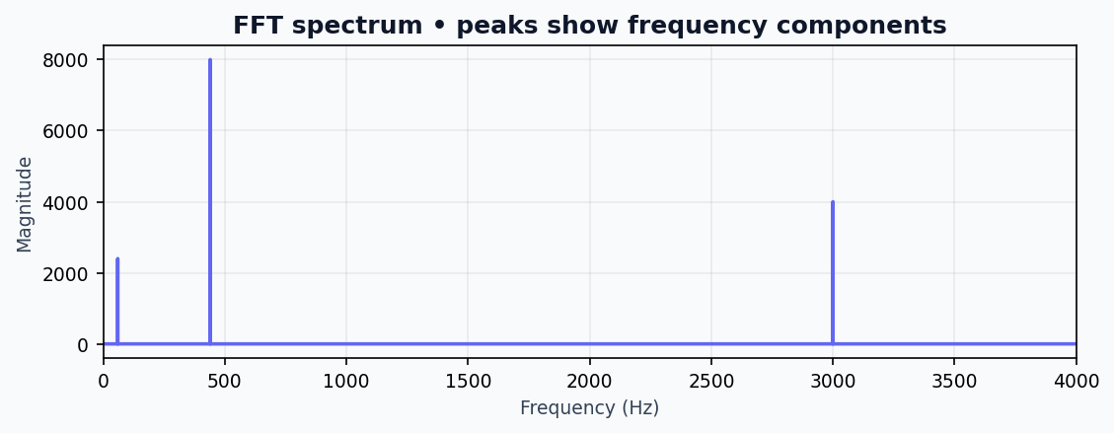
03 • FOURIER TRANSFORM
FFT: inspect the frequencies
The Fast Fourier Transform shows which frequencies are present.
• Peak near 60 Hz → hum
• Peak near 440 Hz → desired tone
• Peak near 3000 Hz → hiss
• FFT turns a time signal into frequency information
Think of FFT as separating a chord into its notes.
AUDIO SIGNAL CLEANING • GROUP PROJECT
06
Notes:
FFT stands for Fast Fourier Transform. It reveals the frequencies making up the signal; peaks correspond to the components.

Slide 7
04 • SPECTRAL FILTERING
Keep the band that contains our tone
The code zeros out FFT bins outside 200–1000 Hz.
PASS BAND
200–1000 Hz
REJECT
60 Hz hum
REJECT
Because 440 Hz is inside the pass band, the target tone is retained.
3000 Hz hiss
AUDIO SIGNAL CLEANING • GROUP PROJECT
07
Notes:
The mask keeps frequencies from 200 to 1000 Hz. This includes 440 Hz but excludes 60 Hz and 3000 Hz.

Slide 8
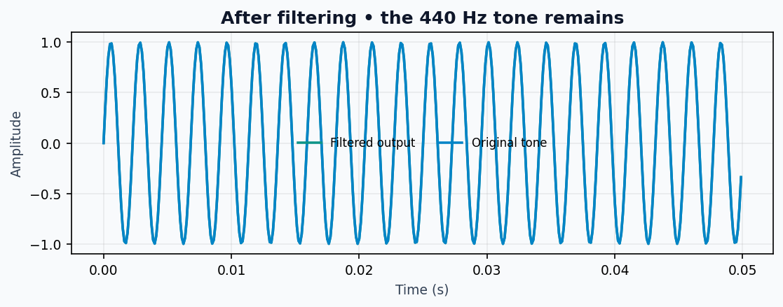
05 • RECONSTRUCT
IFFT: return to the time domain
After masking unwanted frequency bins, the inverse FFT rebuilds the signal.
• The filtered wave is much closer to the original 440 Hz tone.
• The 60 Hz and 3000 Hz components are outside the kept band.
• The output is converted back to a real-valued waveform.
filtered_spectrum → IFFT → cleaned_signal
AUDIO SIGNAL CLEANING • GROUP PROJECT
08
Notes:
IFFT converts the filtered spectrum back into a time-domain waveform so we can inspect the output.

Slide 9
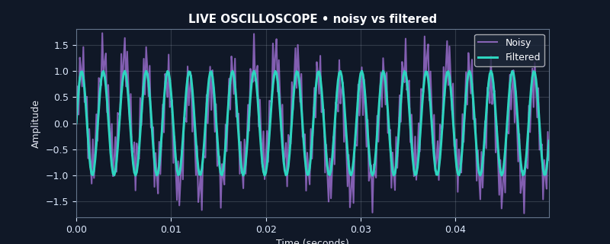
LIVE DEMONSTRATION
Watch the noisy and filtered waves
The embedded GIF animates a 50 ms window across the signal.
PURPLE
Noisy mixture
TEAL
Filtered output
Tip: run the slideshow to see the animation. If your PowerPoint viewer freezes GIFs, open the GIF separately.
AUDIO SIGNAL CLEANING • GROUP PROJECT
09
Notes:
Pause briefly and let the animated waveform run. Purple is the noisy signal; teal is the filtered output.

Slide 10
06 • RESULTS & TAKEAWAY
What worked — and what to remember
A simple frequency mask is effective when the target and noise occupy different bands.
RESULT
WHY IT WORKS
LIMITATION
The 440 Hz tone is preserved while the 60 Hz hum and 3000 Hz hiss are suppressed.
The desired tone lies inside the 200–1000 Hz pass band.
Real audio has many overlapping frequencies; a hard cutoff can distort sounds near the edges.
Conclusion: FFT identifies frequency content, masking removes selected bands, and IFFT reconstructs the filtered signal.
AUDIO SIGNAL CLEANING • GROUP PROJECT
10
Notes:
Explain the limitation: this ideal example has separated frequencies. Real recordings can have speech and noise overlapping in frequency.

Slide 11
THANK YOU
Questions?
FFT • Frequency mask • IFFT
AUDIO SIGNAL CLEANING • GROUP PROJECT
11
Notes:
Invite questions. Ask the audience what might happen if the wanted sound were outside the 200–1000 Hz range.

