Slide 1


Report

Slide 2
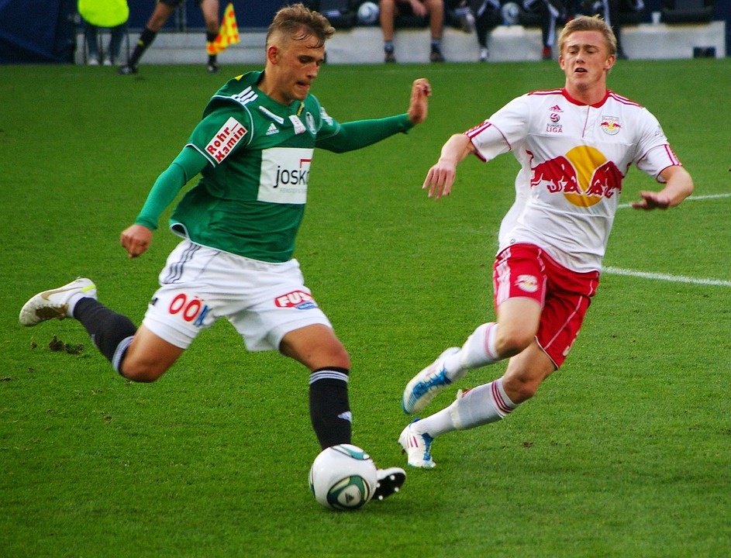
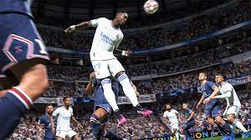
FIFA is International Federation of Association Football. In this league various players around the globe show their talent and potential.

Slide 3
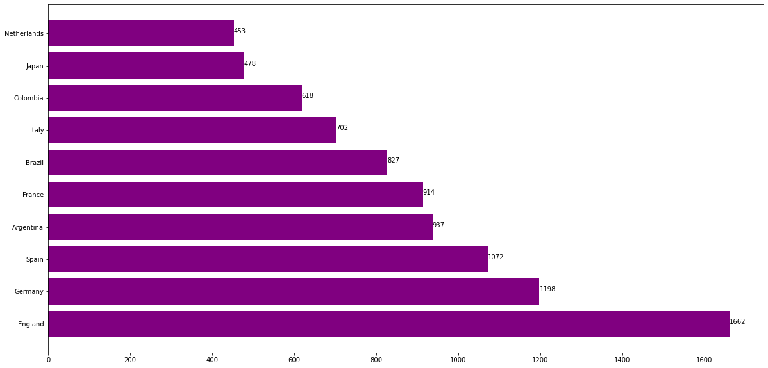
164 countries participate in FIFA. Among which the top 10 nations with maximum players in federation is shown in the graph :
As we can see from the graph the maximum players counting 1662 are from England only, followed by other countries. Till now Brazil is the most successful country with 5 titles.

Slide 4
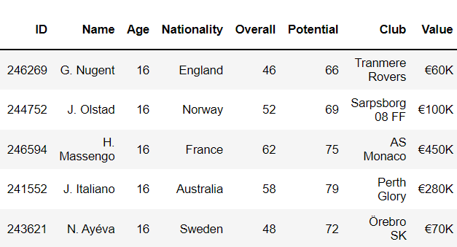
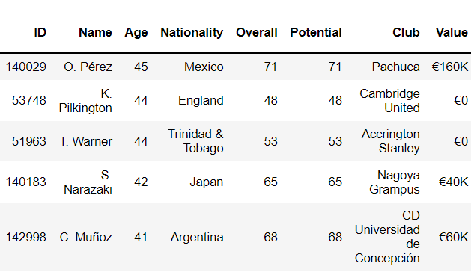
FIFA has lower age limit of 16. No player younger than that can play. However, there is no upper limit of age, and players are allowed to have the freedom of calling their career off.
youngest players eldest players
There are 42 newcomers with age 16
22 are aged above 40 according to the dataset
Mr O. Perez is the eldest still playing player

Slide 5
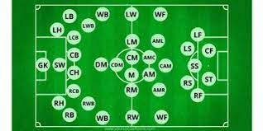
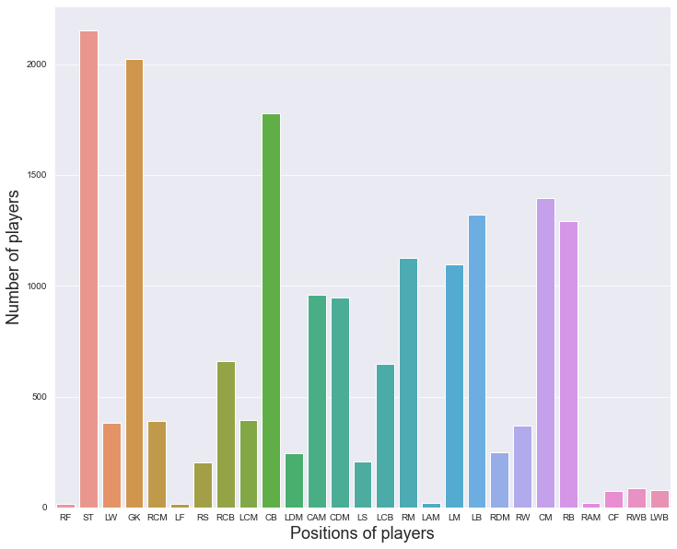
Each Football team has 11 players and among these players, 1 is a goalkeeper. Be it the offensive or defensive team, the player’s responsibility is to score a goal for the team and stop the opposing team from scoring a goal. Following diagram shows various positions of the players on a football field .
The no. of players acquiring the Various positions in the game is shown through the graph (some positions are merged and displayed as one because of low distance between their positions).
Striker’s (SK) position is acquired by most players which shows majority players are
Having attacking position as their playing style.
Followed by Goalkeeper’s (GK) position, many players start their journey in FIFA as goalkeeper.
While very few players play at Left forward and Right forward positions

Slide 6
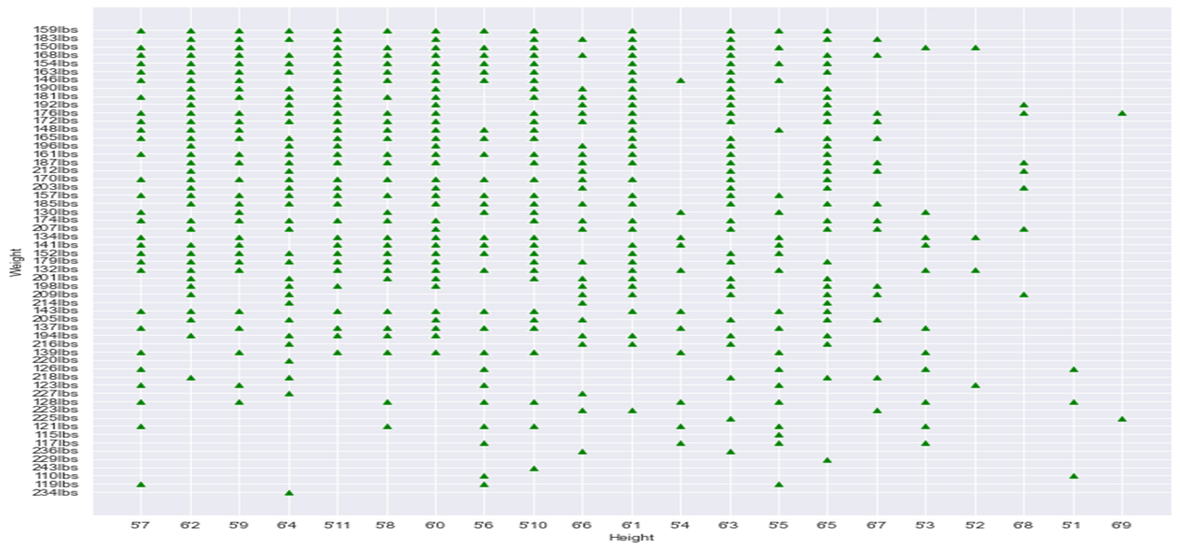
Player’s Height to Weight graph is :
Mr. T. Holý from Czech is the tallest player with height 6’9 and weighs 225 lbs
While Mr. A. Akinfenwa from England is the heaviest player with weight 243 lbs
(according to the data set)

Slide 7
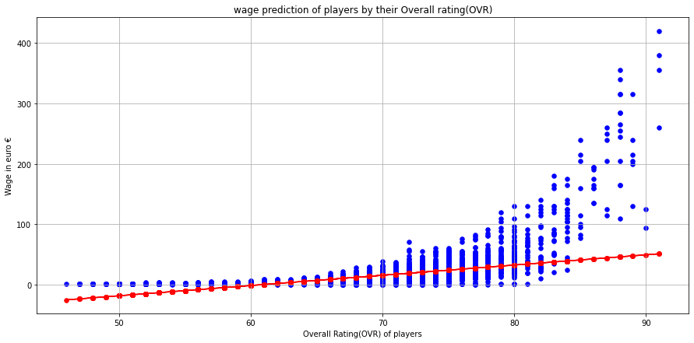
Here is the wage prediction by training 1/3 data with overall rating and performance of players.
On x-axis the OVR is taken
and on y-axis the actual wages of players is given.
The red line shows the predicted wage over every player’s OVR
Comparing both the actual and predicted shows that the wages for top OVR are higher than expected.

Slide 8
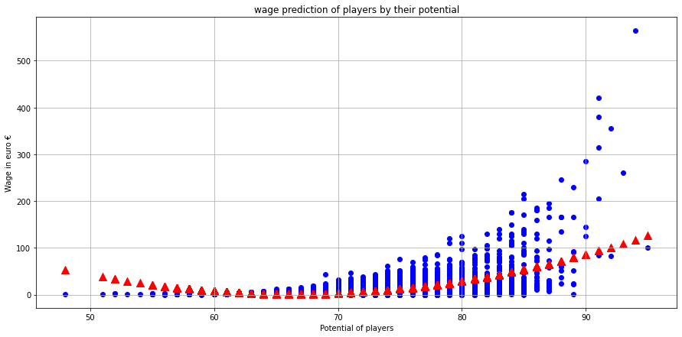
Here is another prediction of wages upon training with 1/3 data set of actual wages for given Potential values of players
The red triangles shows the predicted data over the blue dots (actual data)

Slide 9
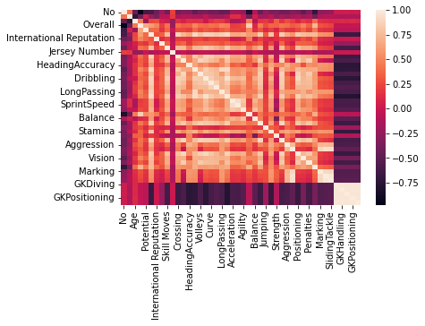

The correlation graph relates every aspects of the dataset with other one, showing their relation in form of heat map.
Varying the range from 0 to 1 casted upon their actual range to compare it with other fields giving an idea of the whole data relation

Slide 10
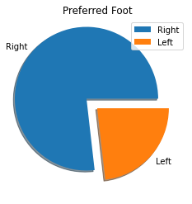
In this graph the ratio of players with their preferred foot playing is shown in which is about 10 : 3
It means 10 out of 13 players use their Right foot
And 3 out of 13 players use their Left foot

