Slide 1
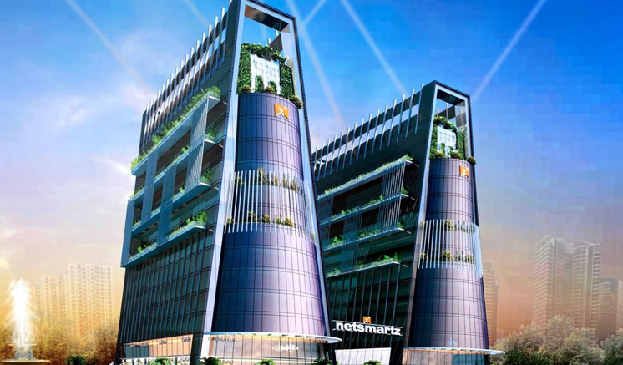
Angular

Slide 2
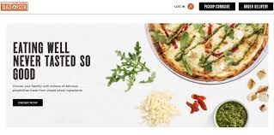
Project Overview
"The 'Pizza Delivery Website' utilizes the MEAN Stack for seamless pizza selection and ordering. It features a robust cart system and an admin dashboard with a monthly revenue calculator. With user-friendly design, it offers potential for user accounts, order tracking, and payment integration, enhancing the overall experience."

Slide 3
Authentication
Register - User has to create a account on our portal.
Login - User has to login for ordering the Pizza
Logout - User can logout from his/her account whenever it is not in use.
Authorization -
Some functionalities are only be performed by admin like
Adding item
Updating Item
Deleting item

Slide 4
Functionalities
CRUD Operations are applied on -
Users - It contains email, password and role.
Items - It contains particular item details like price and category.
Orders - It contains the cart system like number of pizzas or type of pizzas

Slide 5
Thank You

