Slide 1

Angular

Slide 2
Project Overview
"Doraemon Explorer Hub" is an Angular-powered project offering a dynamic exploration of the Doraemon universe. It encompasses three core components: character profiles, showcasing beloved personalities; gadgets section, displaying iconic futuristic tools; and a gallery, housing a collection of nostalgic imagery. Users can immerse themselves in Doraemon's world through interactive interfaces, gaining insights into the characters' traits, exploring the functionalities of gadgets, and reliving memorable moments through the gallery. With a user-friendly design and seamless navigation, this hub provides a comprehensive and enjoyable experience for fans of all ages, serving as a digital gateway to the whimsical realm of Doraemon.

Slide 3
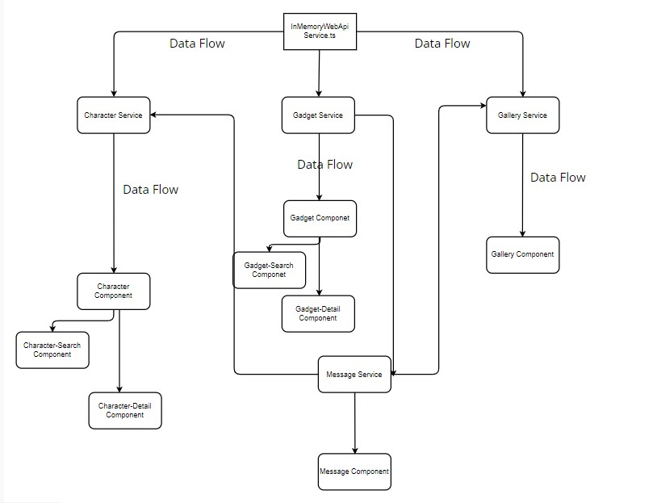
Project with Data Flow

Slide 4
Structure with Functionalities
Components -
Character - Component - Add, Delete and Search functionalities are present in this componet.
Character - detail Component - Update functionality is present in this component.
Gadget - Component - Add, Delete and Search functionalities are present in this componet.
Gadget - detail Component - Update functionality is present in this component.
Gallery - Componet
Character-Search Component
Gadget - Search Component
Services -
InMemoryDataService (InMemoryWebApi) - Server
Character Service - Applying methods for character component to make request to the server
Gadget Service - Applying methods for gadget component to make request to the server
Gallery Service - Applying methods for gallery component to make request to the server

Slide 5
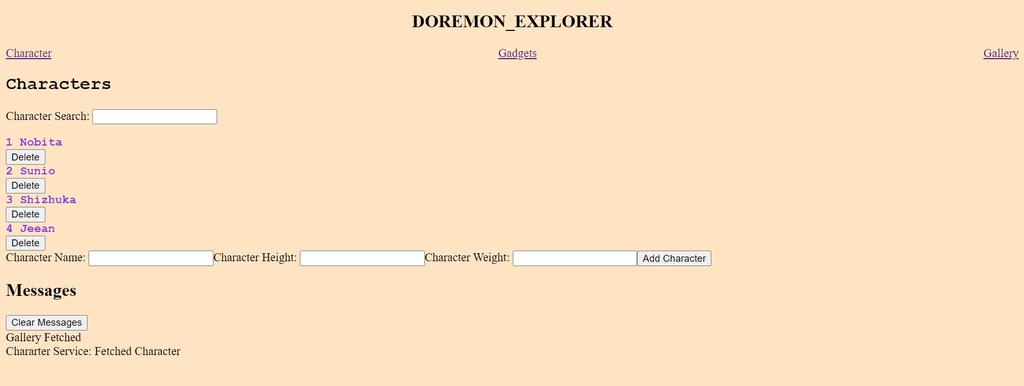
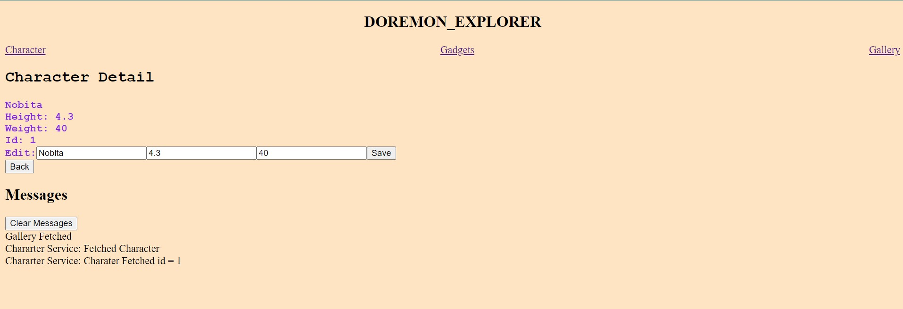
Output
Chararcter Component
Characters-detail Component

Slide 6
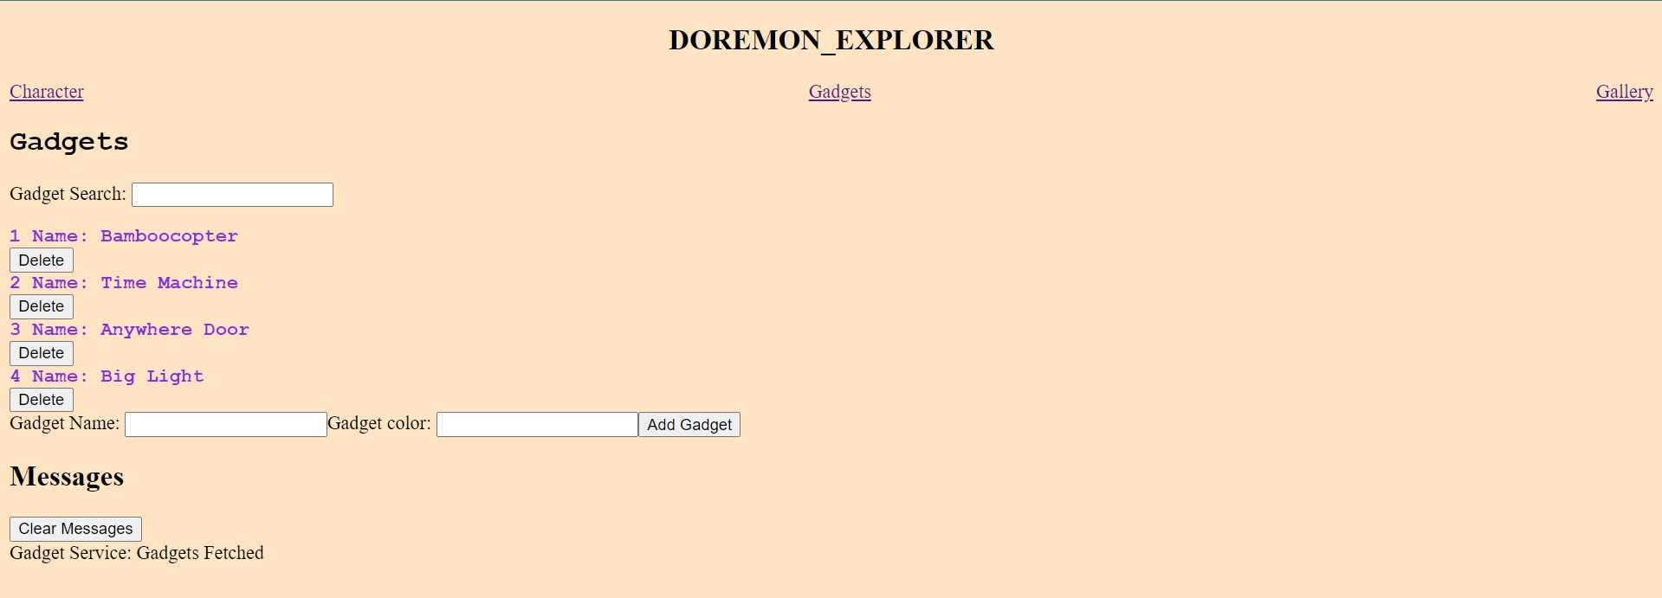
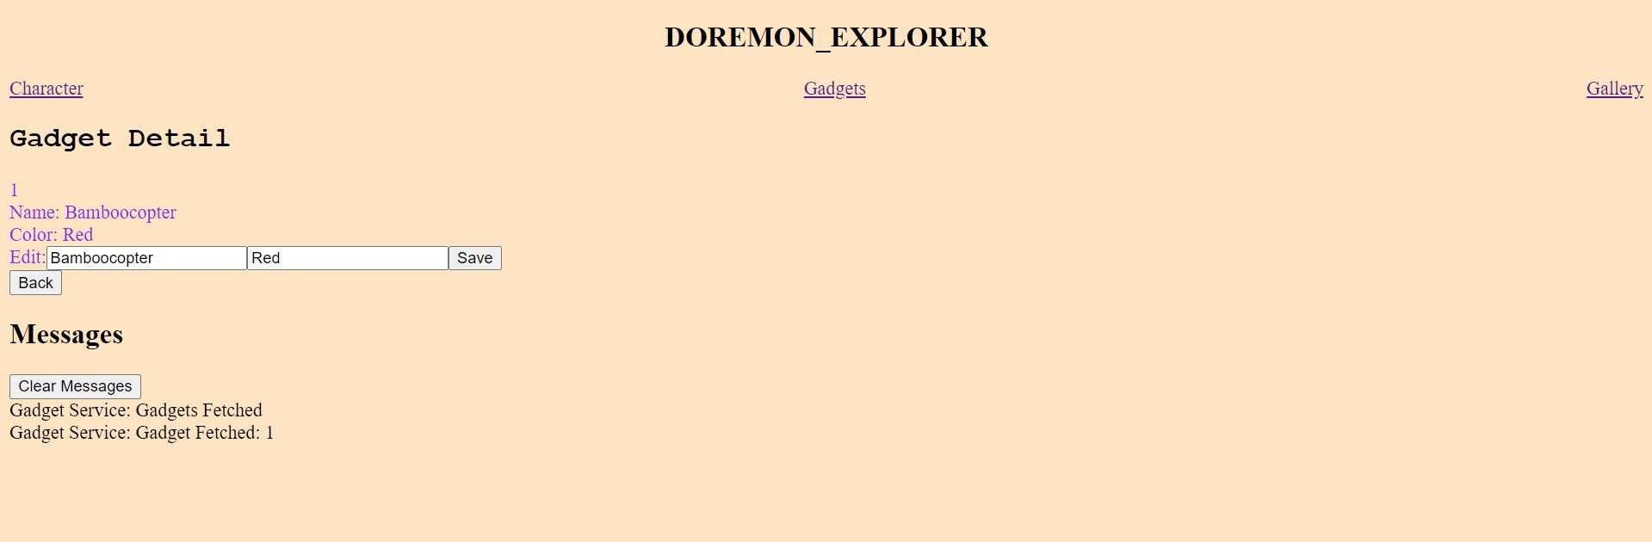
Output
Gadget Component
Gadget-detail Component

Slide 7
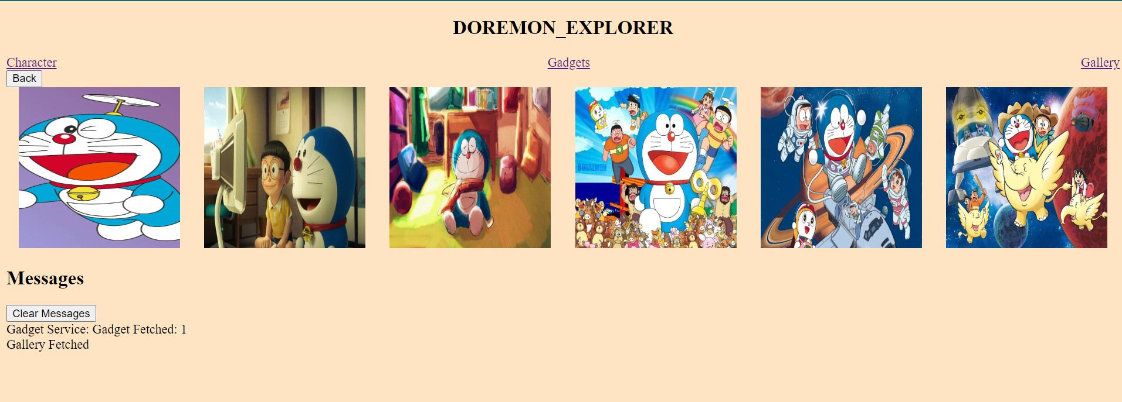
Output
Gallery Component

Slide 8
Thank You

