Slide 1
Introduction

Slide 2
Name – Dr. Garima Singh
Contact: 7505500249
E-Mail: garima.singh@thapar.edu

Slide 3
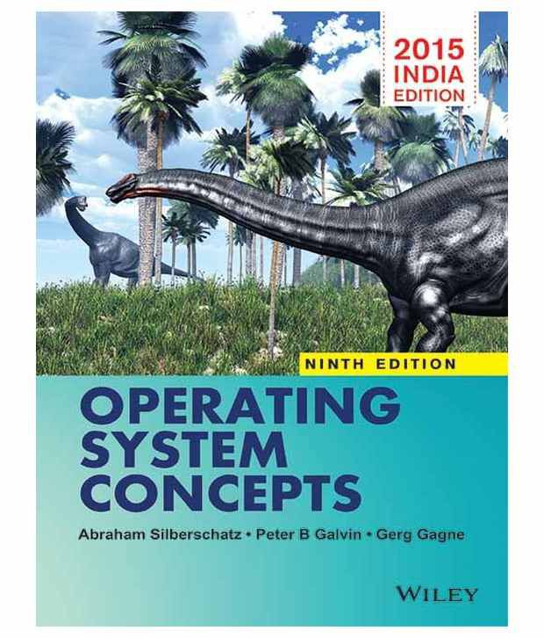

Slide 4
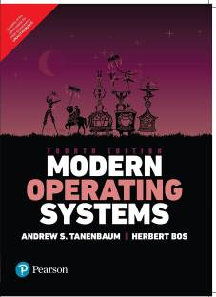

Slide 5
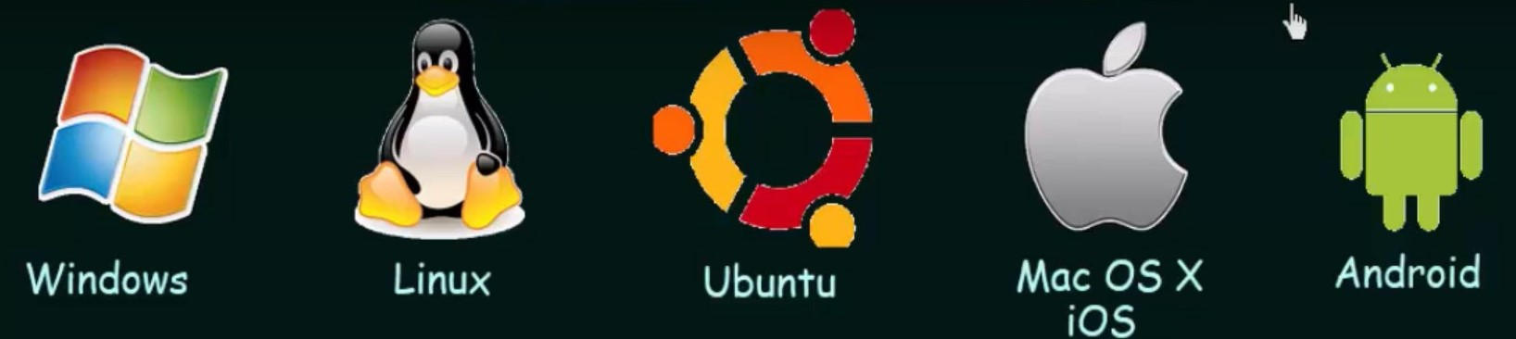

Slide 6
Introduction
System software: System software is software designed to provide a platform for other software. Examples of system software include operating systems like macOS, Linux, Android and Microsoft Windows, computational science software, game engines, search engines and software as service applications.
Application software: Meant to enable the user to carry out some specific set of tasks or functions. Like web browser, Microsoft excel, Microsoft word.

Slide 7
What is an Operating System?
Operating system is a “System Software”.
Operating system acts as an intermediatory/interface between a computer user and the computer hardware for convenient and efficient use.
It provides basis for application programs such that on it other application programs can be installed.
Resource manager: Manage system resources in an unbiased fashion both h/w and s/w.

Slide 8

Four Components of a Computer System

Slide 9
Abstract Views of an Operating System
Computer system can be divided into four components:
  Hardware: Provides basic computing resources for the system: CPU, memory, I/O devices
  Operating system: Controls and coordinates use of hardware among various applications and users
  Application programs: Define the ways in which the system resources are used to solve the computing problems of the users
    Word processors, compilers, web browsers, database systems, video games
  Users: People, machines, other computers

Slide 10
Operating System’s Goals
Convenience + Efficiency
  Make the computer system convenient to use.
  Ensures use of the computer hardware in an efficient manner.
  Primary Goal: Convenience
  Secondary Goal: Efficiency

Slide 11
Operating System
Some operating system are designed to be convenient (personal computer and android), others to be efficient (mainframe, supercomputer) and some are combination of both.

Slide 12
Operating System
OS is a resource allocator/resource manager.
  Manages all resources, in unbiased fashion so that it can operate the computer system fairly and efficiently.
  Decides between numerous and conflicting requests for efficient and fair resource use.
OS is a control program.
  Manages the execution of user programs to prevent errors and improper use of the computer.

Slide 13
Functionalities of Operating System
Resource Governor/Manager
Processor Management/Process Management
I/O Management/Device Management
Storage Management/File management
Memory Management
Security & Privacy
Job Accounting
Error detection aids

Slide 14
Functionalities of Operating System
Resource Manager: Operating System manages all the Resources those are attached to the system like memory, processor and all the Input output Devices.
Process Management : The Operating System also Treats the Process Management means all the Processes those are given by the user or the Process those are System ‘s own Process are Handled by the Operating System
Memory Management: Operating System also Manages the Memory of the Computer System means Provide the Memory to the Process and Also Deallocate the Memory from the Process. And also defines that if a Process gets completed then this will deallocate the Memory from the Processes.

Slide 15
Functionalities of Operating System
Processor Management: In multiprogramming environment, the OS decides which process gets the processor when and for how much time. This function is called process scheduling.
Storage Management: Operating System also Controls the all the Storage Operations means how the data or files will be Stored into the computers and how the Files will be accessed by the users etc
Device Management: An Operating System manages device communication via their respective drivers. It Keeps tracks of all devices.
  Decides which process gets the device when and for how much time.
  Allocates the device in the efficient way.
  De-allocates devices.

Slide 16
Functionalities of Operating System
Security: The operating system uses password protection to protect user data and similar other techniques. it also prevents unauthorized access to programs and user data.
Job accounting: It is function available on every i5/OS™ system that can be used to track usage of system resources.
Error detecting aids: The operating system constantly needs to be aware of possible errors. Errors may occur in the CPU and memory hardware (such as a memory error or a power failure), in I/O devices (a connection failure on a network, or lack of paper in the printer), and in the user program (such as an arithmetic overflow, an attempt to access an illegal memory location, or a too-great use of CPU time). For each type of error, the operating system should take the appropriate action to ensure correct and consistent computing.

Slide 17
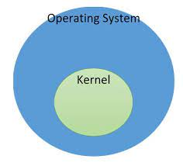
Parts of Operating System
The one program running at all times on the computer” is the kernel.
Everything else is either
  a system program (ships with the operating system) , or
  an application program.

Slide 18

Computer System Organization
Computer-system operation
  A modern general purpose computer system consists of one or more CPUs and a number of device controllers connected through a common bus that provides access to the shared memory.

Slide 19
Computer System Organization
Each device controller is in charge of a particular device type.
The device controllers and the CPU can execute in parallel competing for memory cycles.
To ensure orderly access to the shared memory, a memory controller is provided whose function is to synchronize access to main memory.

Slide 20
Computer Startup
Bootstrap program: The initial program that runs when a computer is powered up and rebooted.
  Typically stored in ROM, generally known as firmware.
  It must know how to load OS and start executing that system.
  To accomplish this goal, It must locate and Load into memory the operating system kernel and starts execution.

Slide 21
Interrupt
Interrupt: The occurrence of an event is usually signaled by an interrupt from the hardware or software.
Hardware may trigger an interrupt at any time by sending a signal to cpu, usually by the way of system buses.
System call (monitor call): Software may trigger an interrupt by executing a special operation called system call.

Slide 22
Interrupt Handling
When the cpu is interrupted, it stops what it is doing and immediately transfers execution to the fixed location.
The fixed location usually contains the starting address where the service routine of the interrupt is located.
The interrupt service routine executes
On completion, the cpu resumes the interrupted computation.

Slide 23
Interrupt Handling
Interrupt transfers control to the interrupt service routine generally, through the interrupt vector, which contains the addresses of all the service routines.
Interrupt architecture must save the address of the interrupted instruction
A trap or exception is a software-generated interrupt caused either by an error or a user request
An operating system is interrupt driven.

Slide 24

Interrupt Timeline

Slide 25
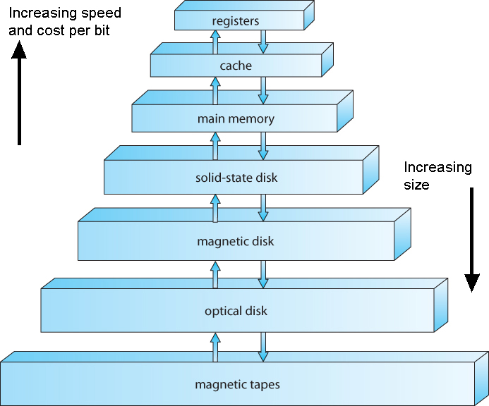
Storage-Device Hierarchy

