Slide 1
Assessing Neighborhoods of Canada
By Vanshaj Jain

Slide 2
Introduction
This project has been created to help people in exploring better facilities in and around their neighborhood. By using this project, we can make smart and effective decisions on selecting preferred neighborhood out of numbers of other neighborhoods in Scarborough, Toronto.

Slide 3
Aim of the Project
Aim of this project is to analyze features for migrants of Scarborough to search the most preferable neighborhood by a comparative analysis. The features include affordable housing prices and better school rating, crime rates of that area, weather conditions, water resources and excrement conveyed in sewers and recreational facilities.

Slide 4
Problems which the project tried to solve
This project helps in providing better preferences among different neighborhoods in Scarborough, Toronto. 1) A sorted list of houses with their prices arranged in ascending or descending order. 2) A sorted list of schools with their location, rating, fees and reviews.

Slide 5


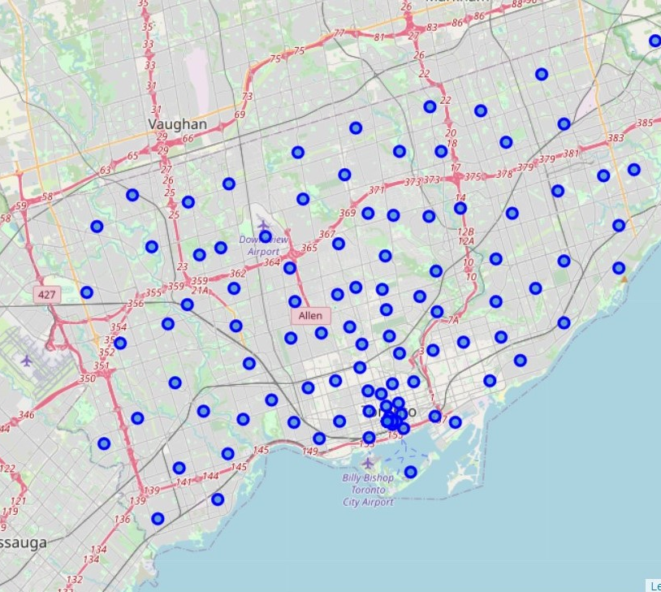

Map of Scarborough
This map of scarborough was was generated using Foursquare API.
Blue dots indicate all the neighborhoods of Scarborough.

Slide 6
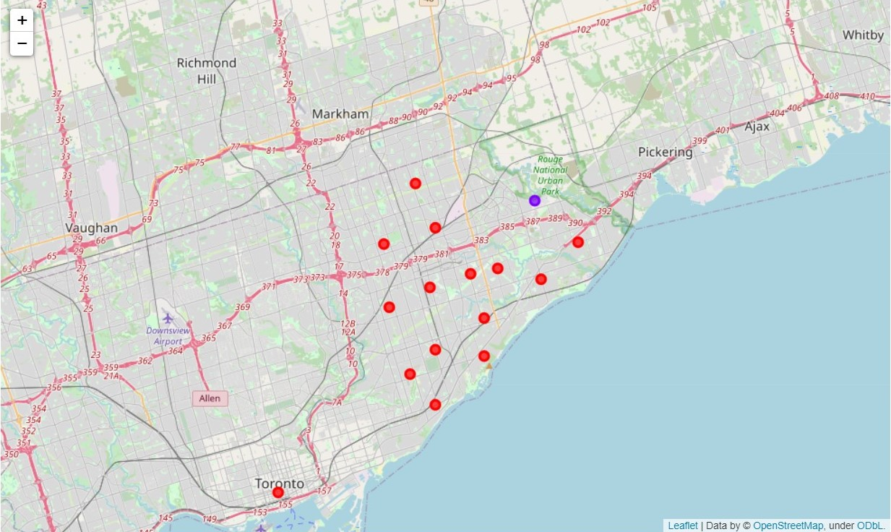
Map of Scarborough showing clusters of neighborhoods

Slide 7
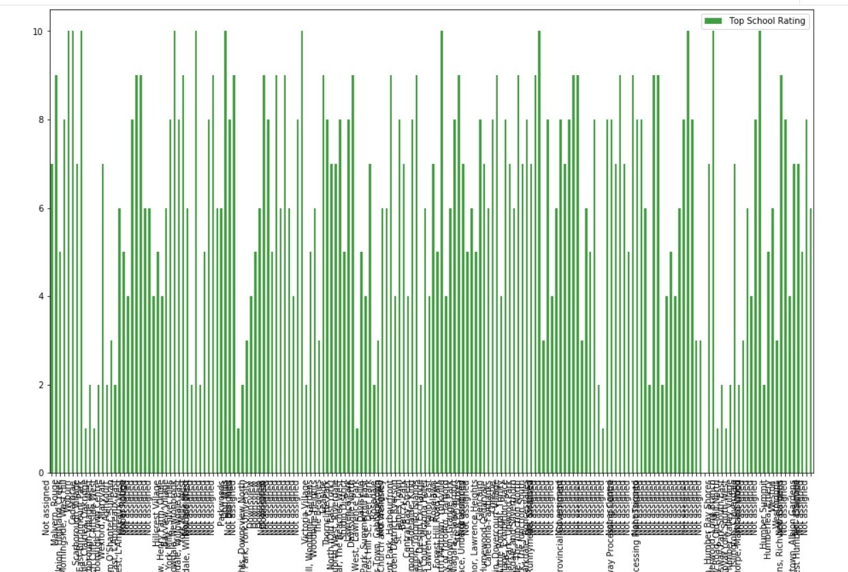
Result Section
This graph is a box plot showing school names against their rating.
Rating of school shows the overall quality of a school

Slide 8
Conclusion
This project has been useful – 1) To form clusters of neighbourhoods in the city of Scarborough, Canada.
2) To find out schools and their ratings.
Ideas include : 1) Using K means Algorithm to cluster Data.
2) Using Foursquare API to gather location data
3)To use a box plot to visualize ratings against school names.

