Slide 1
Implementation and visualization of the procedure NFA into DFA
John Cameron
Jordano Baer

Slide 2
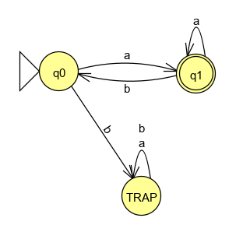
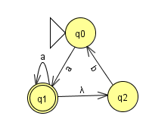
Differences NFA and DFA
NFA permits λ-transitions
NFA is able to have undeclared or undefined transitions
NFA may contain transitions to different states after receiving a single input (can be in multiple states at once)
Two automatas are equivalent if and only if they both accept the same language
Original NFA
Equivalent DFA

Slide 3
NFA-to-DFA
Important factors that the algorithm should be aware about during the conversion process:
Is a trap state required?
What is the initial state?
What are the final states?
Does the original NFA contain λ-transitions?
How will the algorithm know when it is done?
Is there a λ-transition from initial state to final state?

Slide 4
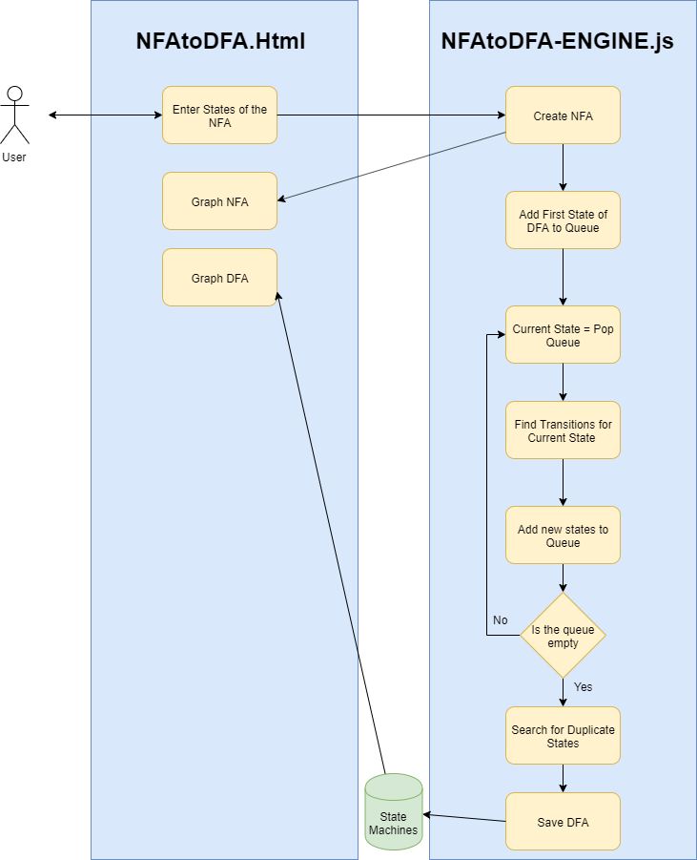
Software Architecture

Slide 5
Pseudocode
User enter the original NFA
The initial state of the DFA is the closure of the initial state of the original NFA
Add the new states of the DFA to a queue
While the queue is not empty, find the transitions to the new states (If there’s a new state, add it to the queue )
Pop the next state from the queue
After the queue is empty, create the graph of the DFA
The new transitions for the DFA are created by the union operation with the closure of the transitions from the original NFA for the current state in
the DFA.

Slide 6
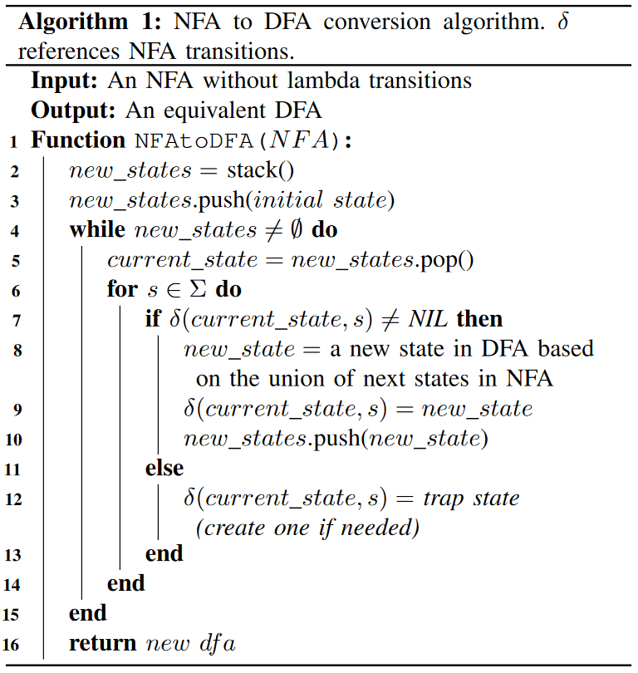
Conversion algorithm is based off the NFA and DFA equivalence theorem

Slide 7
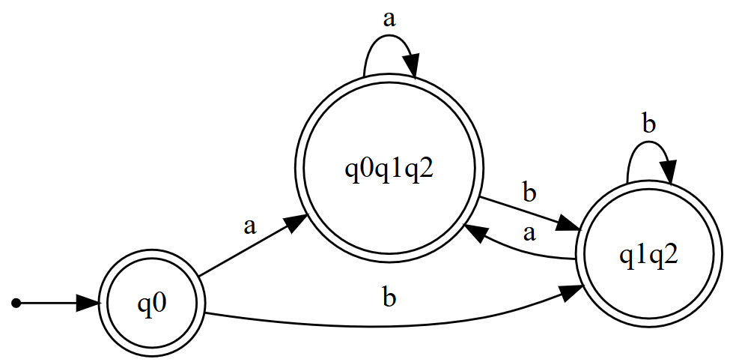
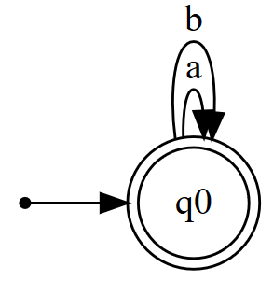
Minimization
Search for states that have the same transitions for every input in the alphabet
If both states are final or not final, replace state1 with state2 in the DFA
Delete state2
If the initial state is marked to be removed, select the other state instead

Slide 8
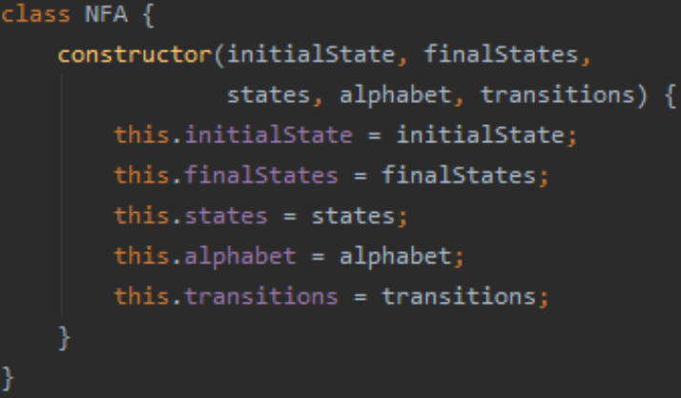
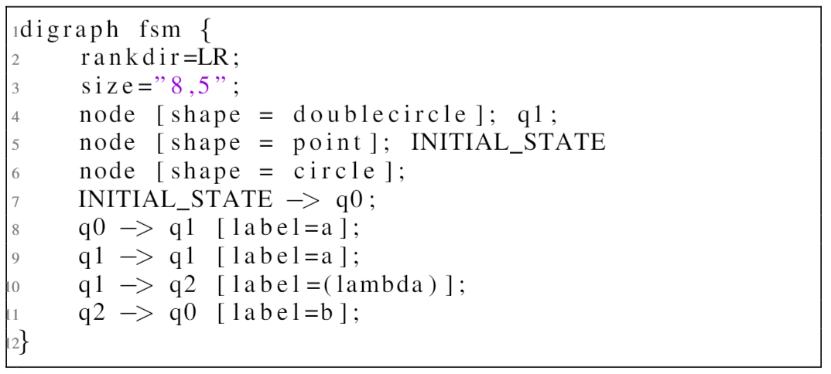
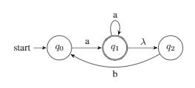
Visualization
Convert our Standard NFA into the digraph format accepted by the Graphviz library
Custom NFA
VIZ library digraph format
(Saved in text file)

Slide 9
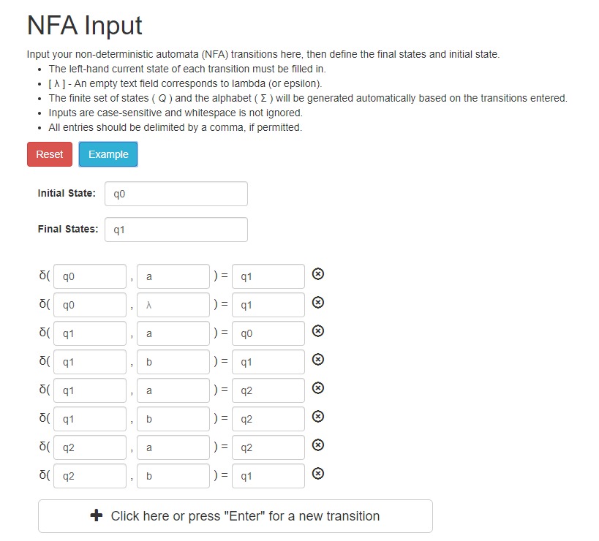
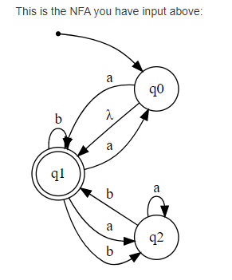
Example

Slide 10
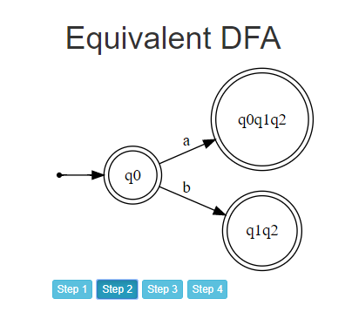
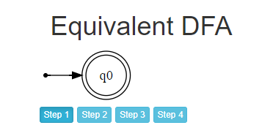
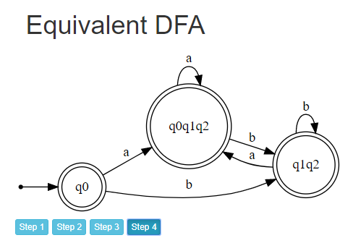
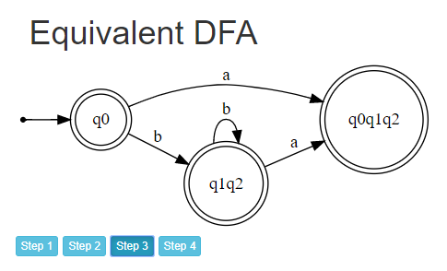
NFA-to-DFA Procedure

Slide 11
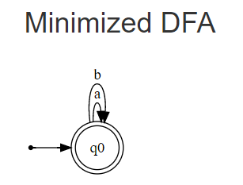
Reduction
Complete DFA
Reduced DFA

Slide 12
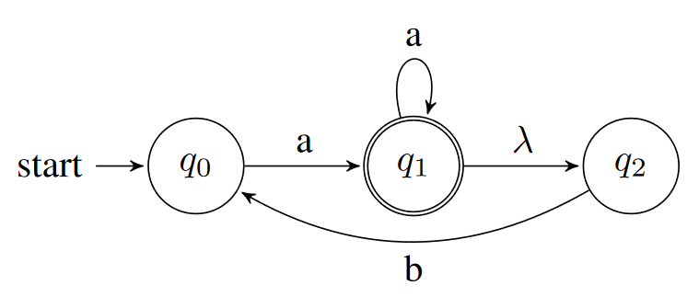
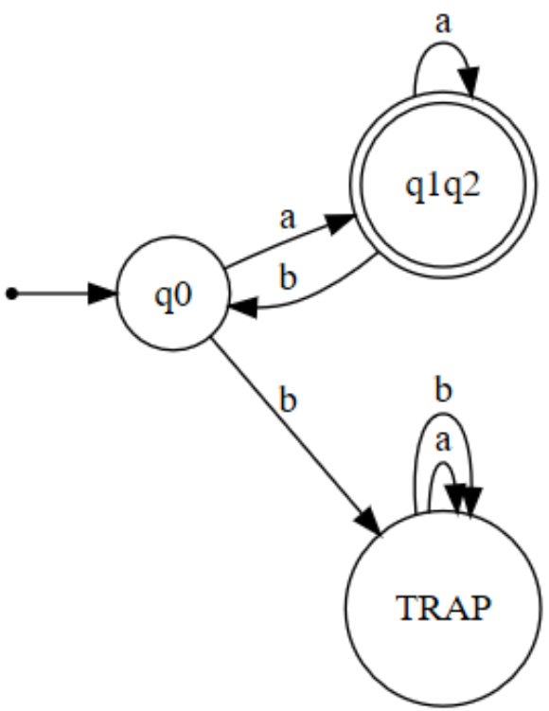

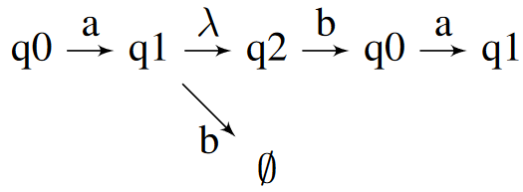
Testing for Implementation Correctness
Multiple NFAs were used to test the correctness of our implementation
We know that the conversion process is successful if the DFA accepts the same language as the NFA

Slide 13
References
Linz, Peter. An Introduction to Formal Languages and Automata. Jones & Bartlett Learning, 2012.
“Vis.js Community Edition *.” Visjs.org, https://visjs.org/
“JFLAP.” JFLAP, http://www.jflap.org/

Slide 14
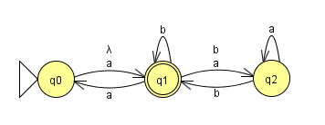
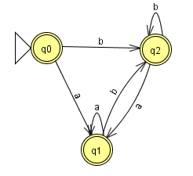
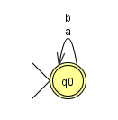
Demonstration
Worksheet #4

Slide 15
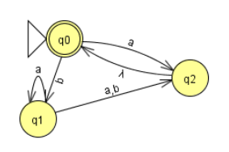
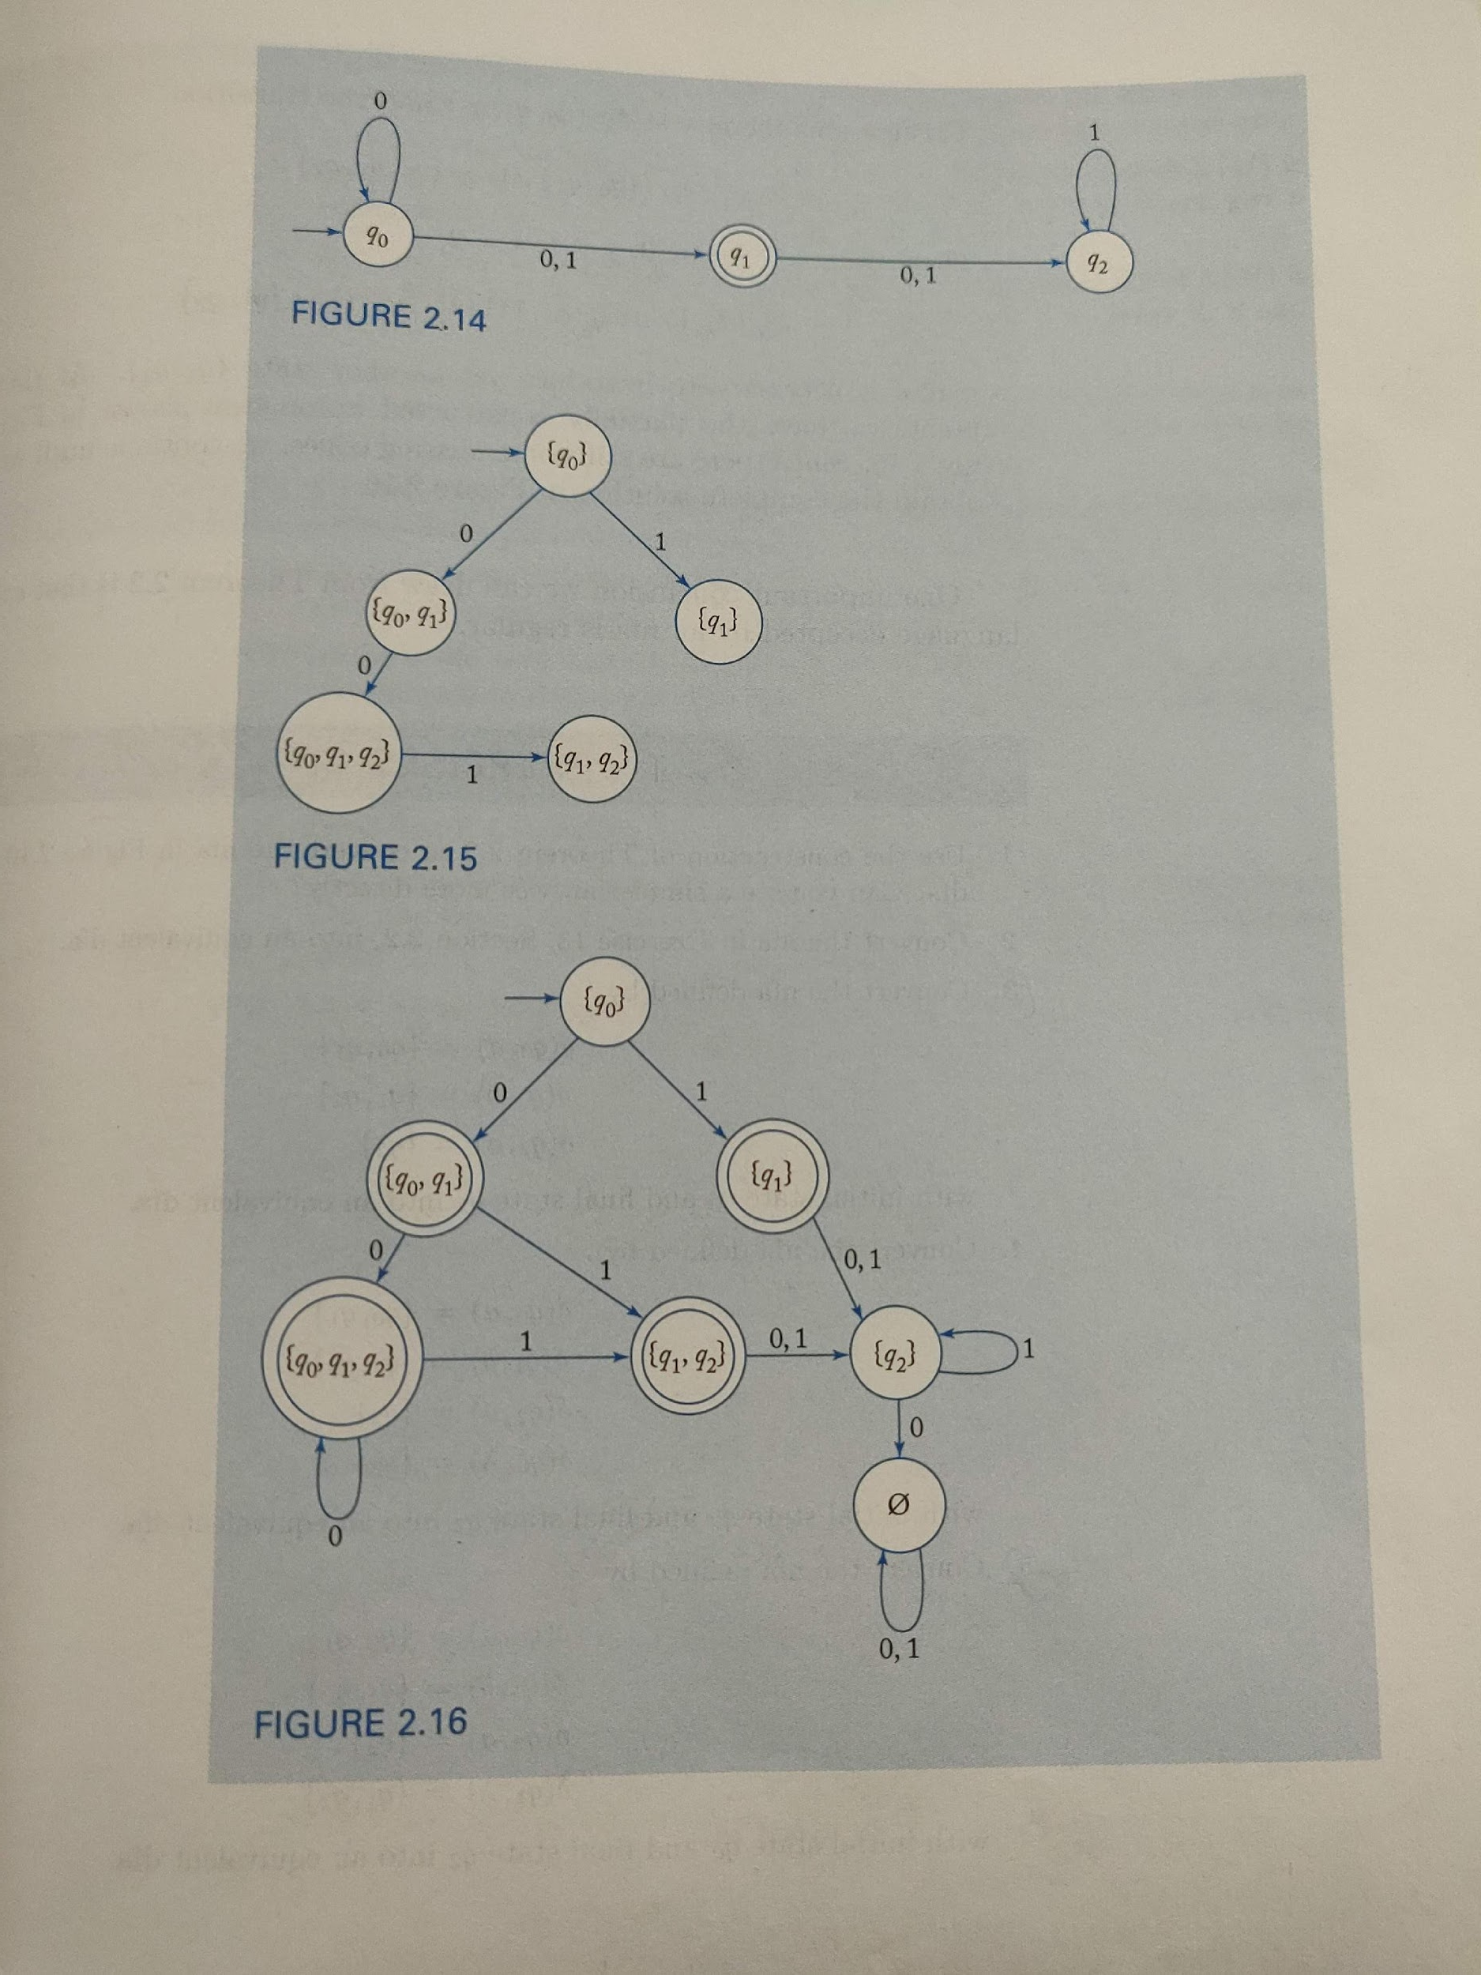
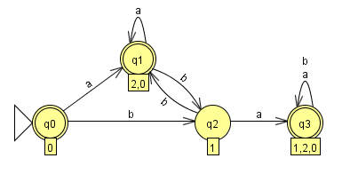
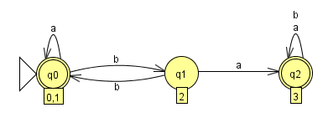
Textbook Page 63
Homework 2

