Slide 1

Introduction to React JS
Welcome to Day 1 of understanding the basics of React JS! This presentation will guide you through the fundamental concepts of this powerful JavaScript library, making complex ideas easy to grasp for everyone.
Vc
by Vansh chauhan

Slide 2
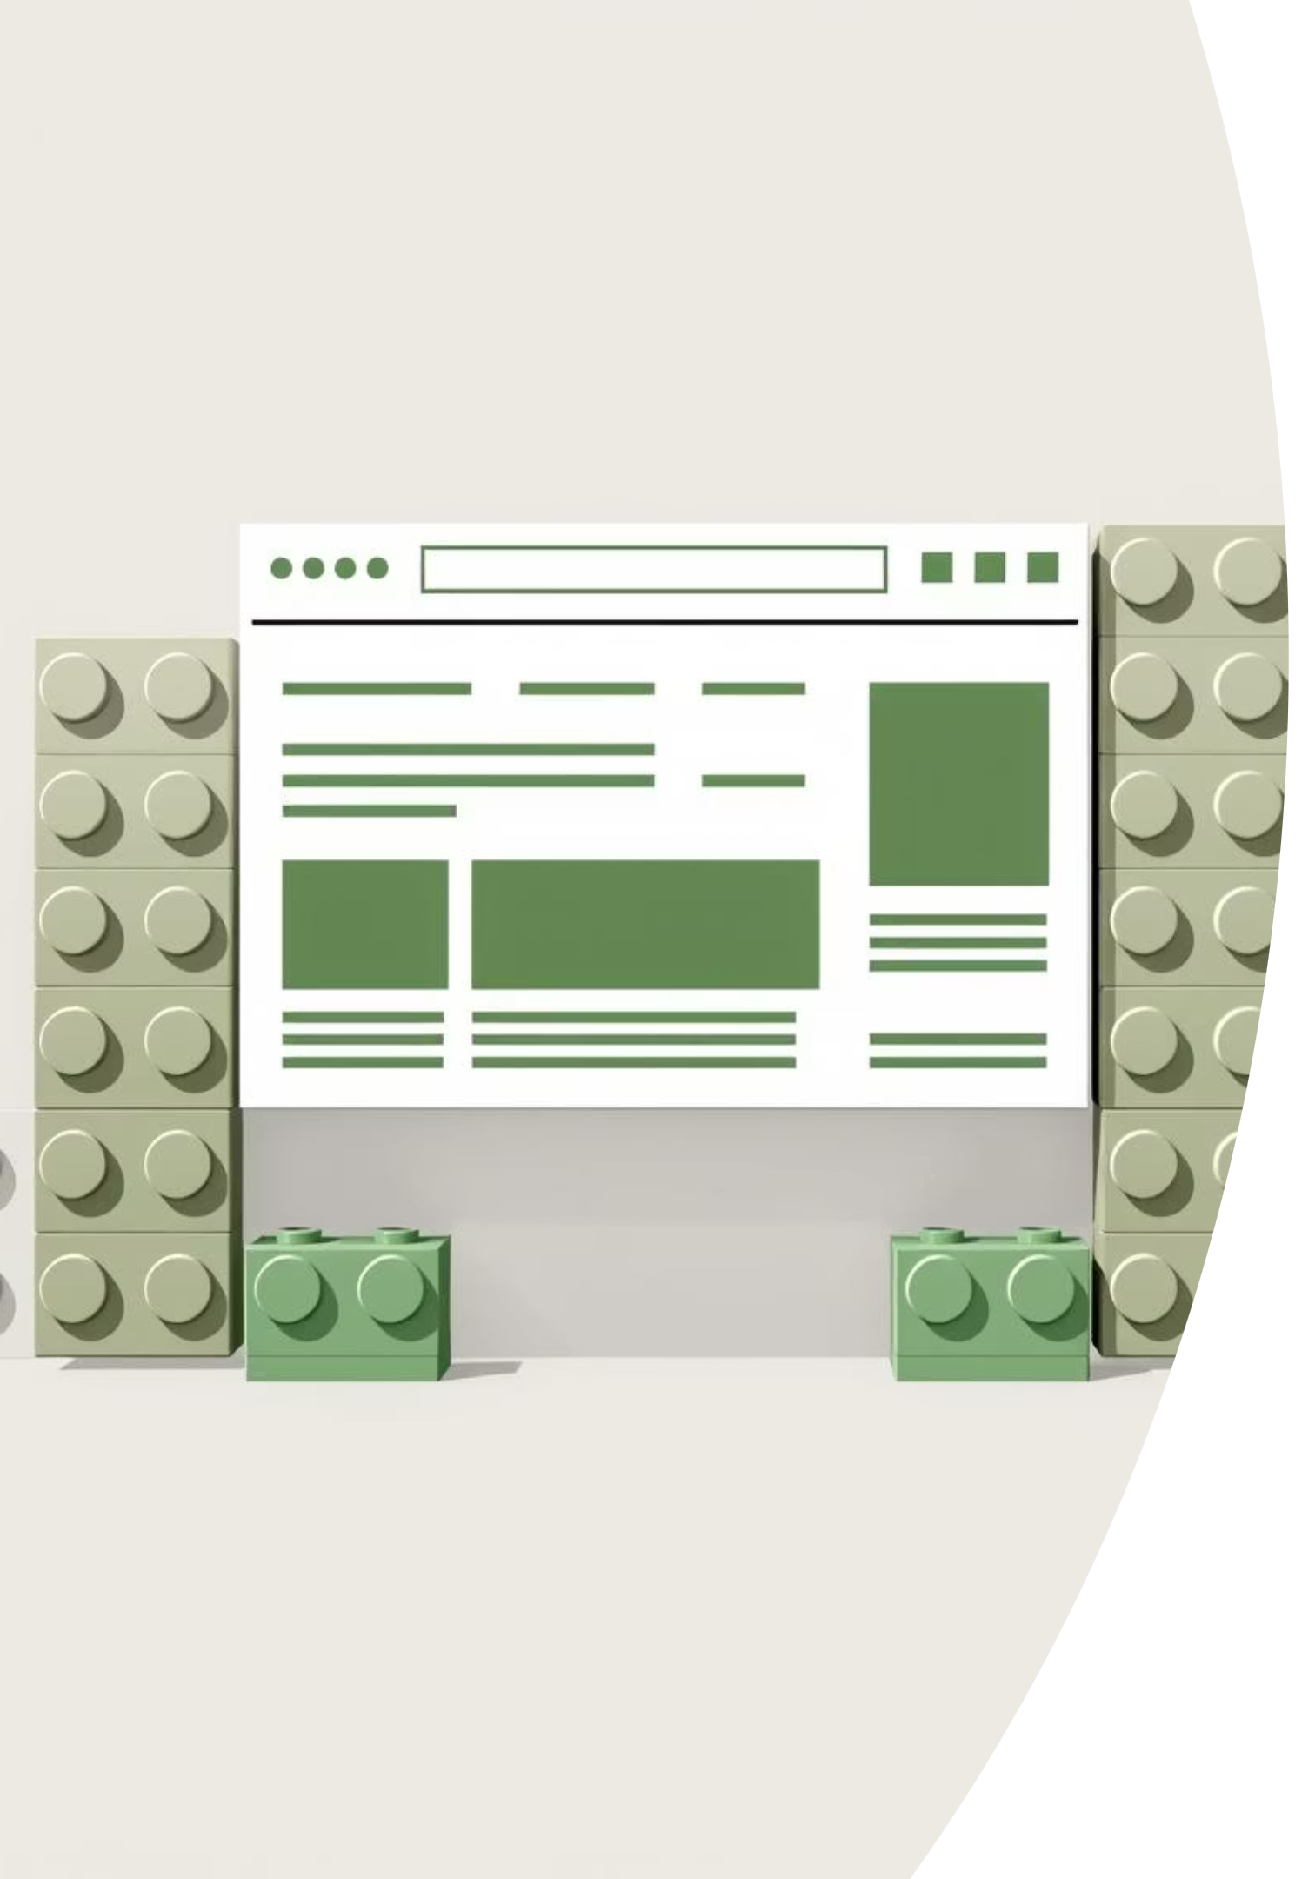




What is React JS?
JavaScript Library
React JS is a JavaScript library specifically designed for building user interfaces (UIs).
Created by Meta
It was developed by Facebook (now Meta) in 2013 to address their UI development needs.
Single-Page Apps
React is primarily used for creating single-page applications (SPAs), offering a fluid user experience.
Component-Focused
Its core strength lies in components, which are reusable UI pieces, much like LEGO blocks for building websites.

Slide 3
Why Choose React JS?
1
Reusable Components
2
Fast Performance (Virtual DOM)
React's components save significant time and effort. Imagine a "Like Button" that can be used across an entire social media platform without rewriting code.
React uses a Virtual DOM, which updates only the changed parts of your UI, leading to incredibly fast performance. For instance, a like counter updates instantly without reloading the entire page.
3
Large Community & Job Demand
4
Mobile Compatibility (React Native)
React boasts a massive global community, providing extensive support and resources. Its widespread adoption by many companies also ensures high job demand for React developers.
With React Native, you can apply your React skills to build native mobile applications for iOS and Android, leveraging the same codebase for both web and mobile.

Slide 4
Library vs. Framework
Library (React)
Framework (Angular)
A library is a collection of pre-written code that you call and use when needed. It offers more flexibility, allowing you to control the flow of your application, much like ordering food à la carte from a menu.
A framework, on the other hand, provides a structured environment where the framework itself calls your code. It imposes stricter rules, guiding your development process like a ready-made house where you fill in the rooms.
Think of React as a toolbox; you pick and choose the tools you need for your specific task.
With a framework, the restaurant decides the course, offering a fixed menu you follow.

Slide 5




How Does React Work? (Virtual DOM)
The traditional method of updating the Real DOM (the actual HTML structure of a webpage) can be slow and inefficient. React solves this problem by introducing the Virtual DOM.
Changes Occur
Virtual DOM Update
When something changes in your application, like clicking a "Like" button, React detects this change.
React first updates its lightweight copy, the Virtual DOM, which is much faster to manipulate.
Diffing Process
Real DOM Update
React then compares the updated Virtual DOM with the previous version of the Virtual DOM to identify exactly what has changed (this is called "diffing").
Finally, React efficiently updates only the necessary parts of the Real DOM, ensuring a smooth and instant user experience, just like a "Like" button updating instantly on Facebook.

Slide 6
React Components: Building Blocks of UI
What is a Component?
Types of Components
In React, a component is a self-contained, reusable piece of user interface (UI). Think of it as a modular unit that encapsulates its own logic and appearance. Examples include buttons, headers, navigation bars, or entire cards.
React primarily uses two types of components:
Functional Components: These are simpler, modern, and preferred for their conciseness and ease of use. They are essentially JavaScript functions that return JSX.
Components allow developers to break down complex UIs into smaller, manageable, and independent parts, making development more organised and efficient.
Class Components: These are older and more complex, based on ES6 classes. While still supported, functional components with Hooks are now the recommended approach for new development.

Slide 7
JSX: JavaScript + HTML Mix
What is JSX?
Why Use JSX?
JSX stands for JavaScript XML. It's a syntax extension for JavaScript that allows you to write HTML-like code directly within your JavaScript files. This might seem unusual at first, but it's a core part of React development.
JSX makes your React code much easier to read and write. It provides a more intuitive way to describe the UI structure, as it closely resembles the HTML you're already familiar with. This blend of JavaScript and HTML simplifies the development process.
const heading = <h1>Hello, React!</h1>;
As you can see in the example above, the code looks like standard HTML, but it's actually JavaScript. React then processes this JSX to efficiently render your UI.

Slide 8
Setting Up a React App
Ways to Set Up:
Demo: Create React App
Create React App (Recommended): This is the official and most recommended way to set up a new React project. It provides a complete development environment with all the necessary tools and configurations pre-set, allowing you to focus directly on coding your application.
To start a new React project using Create React App, you simply open your terminal or command prompt and run the following command:
npx create-react-app my-app
This command will create a new folder named 'my-app' with a pre-configured React project structure, including essential files and folders like 'src' for your source code and 'public' for static assets.

Slide 9
Your First React Component
Let's create a simple functional component and render it to the screen. This demonstrates how React takes your component code and displays it in the web browser.
Simple Functional Component:
Rendering the Component:
function Greeting() { return <h1>Welcome to React!</h1>;}
ReactDOM.render(<Greeting />, document.getElementById('root'));
This line of code takes our Greeting component and tells React to render it inside the HTML element with the ID 'root' in your webpage. The output will be "Welcome to React!" displayed on your screen.
This code defines a functional component named Greeting. It's a simple JavaScript function that returns a piece of JSX, which in this case is an H1 heading containing the text "Welcome to React!".

Slide 10

Recap & Q&A
React is a JavaScript Library
It's specifically designed for building dynamic and interactive user interfaces.
Components are Reusable Pieces
React's core strength lies in its modular, reusable UI components, simplifying development.
Virtual DOM Ensures Speed
The Virtual DOM makes React applications fast and efficient by updating only necessary parts of the UI.
JSX Blends HTML and JavaScript
JSX is a syntax extension that allows you to write HTML-like code directly within your JavaScript.
Thank you for joining this introduction to React JS. We hope this session has clarified the fundamental concepts. Now, let's open the floor for any questions you may have.

