Slide 1
Indian Institute of Information Technology Una
Chat Analyser
By- Vansh Dawra
(22360)

Slide 2
Outline
01
Introduction
02
Motivation
03
Project Objectives
04
Innovation in the Project
05
Current Solution
06
Work Progress and
Demonstration

Slide 3
INTRODUCTION
The way we talk toe ach other online have changes so much that traditional ways of analysisng language doesn’t work efficiently .
An Chat analyser is a sophisticated software tool that performs various functions to analyze textual conversations or chats automatically. Here are some of the key tasks it typically performs:
Message Parsing
Keyword Extraction
Statistics providing
Sentiment analysis

Slide 4
Motivation
Efficient Analysis: The vast volume of text data from conversations poses a challenge. Manual analysis is time-consuming, error-prone, and impractical for large datasets.
Demand for Insights: There's a growing demand for insights from chat data among businesses, organizations, and individuals. These insights drive decision-making, improve customer service
Complexity of Textual Data: Textual data is complex due to its unstructured nature, language variability, and nuances like sarcasm and slang..
Advancements in AI and NLP: Recent advancements in AI and NLP enable the automation of textual data analysis with greater accuracy and efficiency. These technologies unlock valuable insights from chat data at scale.

Slide 5
Project Objectives
Develop a robust Automatic Chat Analyzer software capable of efficiently processing and analyzing large volumes of textual conversations from various digital platforms.
Implement advanced natural language processing (NLP) techniques and machine learning algorithms to extract meaningful insights from chat data, including sentiment analysis, topic modeling, keyword extraction, and entity recognition.
Design an intuitive user interface for the Automatic Chat analyser, allowing users to interact with the software easily, customize analysis parameters, and visualize insights.
Ensure the reliability and accuracy of analysis results by leveraging reputable data sources, rigorous testing procedures, and continuous refinement of algorithms.

Slide 6
INNOVATION IN THE PROJECT
Multimodal Analysis: Explore innovative approaches to incorporate not only text but also other modalities such as images, voice messages the analysis,
2. Contextual Understanding: Develop algorithms that can capture and interpret the context of conversations, including historical interactions, user profiles, and external factors such as current events or trends, to provide more contextually relevant insights.
3. Emoji Analysis: Able to recognize emojis and provide stats for them too.
4. Searching Messages : Messages can be searched by the name of sender, by specific keywords , by specific dates like Januarary , specific times like 13:00-14:00 .

Slide 7
CURRENT SOLUTIONS
Here are some well-known products and companies offering automatic chat analysis solutions:
Customer Service Focused
LivePerson: https://www.liveperson.com/ A robust platform with intent recognition, sentiment analysis, and a focus on conversational AI for efficient customer support.
Zendesk: https://www.zendesk.com/ Their 'Answer Bot' utilizes AI to understand customer queries, provide self-service solutions, and seamlessly route conversations to human agents when needed.
Ada: https://ada.cx/ Specializes in automating customer support interactions, offering sentiment analysis, intent classification, and proactive issue identification.

Slide 8



CURRENT SOLUTIONS
Sales and Marketing Focused
Drift: https://www.drift.com/ Emphasizes conversational marketing and sales. Their chatbots use advanced targeting and personalization to engage website visitors and qualify leads, with analysis tools to track their effectiveness
ManyChat: https://manychat.com/ Popular for automating conversations on Facebook Messenger, with analysis and segmentation tools that are useful for targeted marketing campaigns

Slide 9
Work Progress And Demonstration
The Working of the the program is First read the whole file line by line
Then based on the available pattern , find out the sender name, time of message , data of message and recognize end of message
It checks for any emoji or url present in the message too
Based on different data collected , it can be used for various types of searches , sorting , analysis using database management libraries.

Slide 10
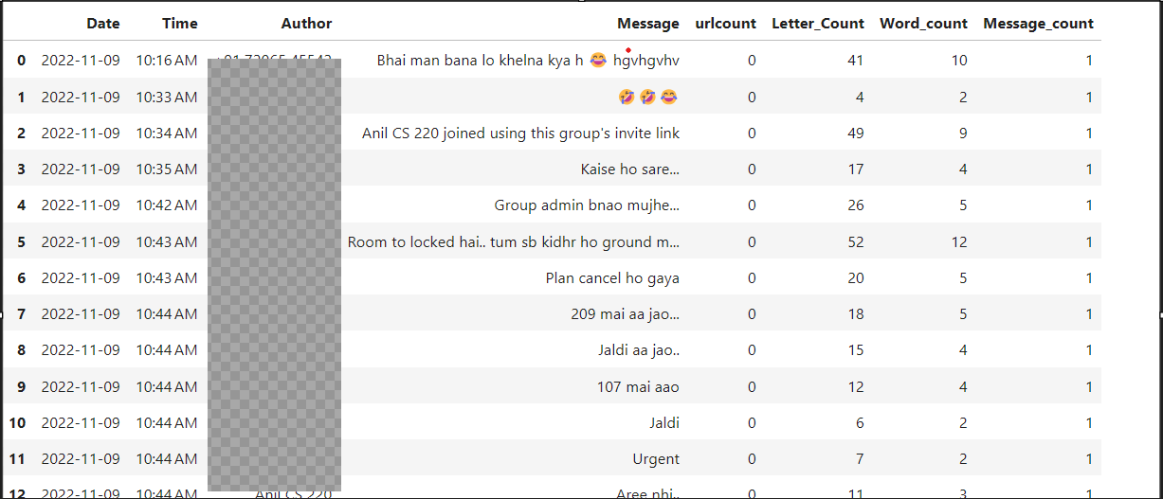


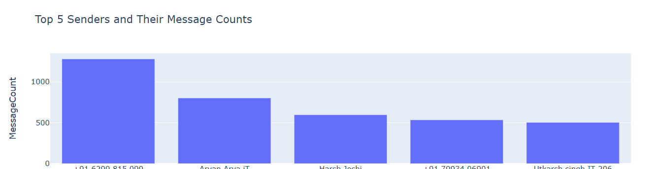
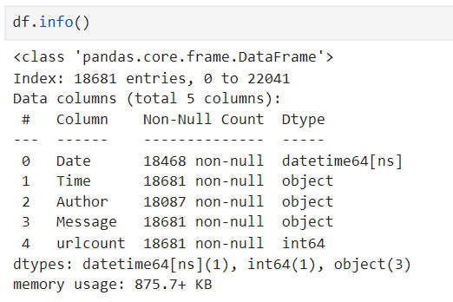

Slide 11
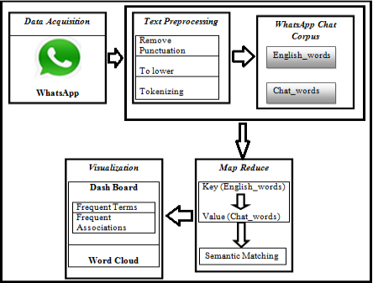

Slide 12
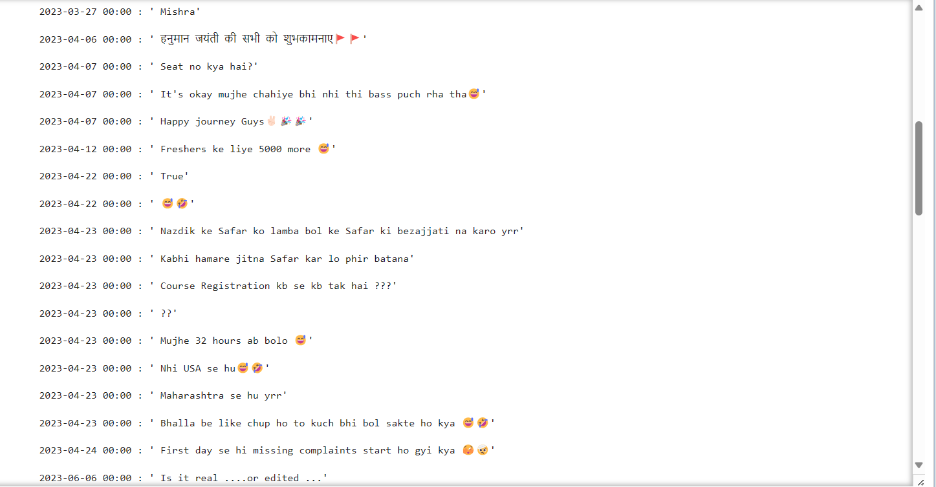
List Of messages send by Sender named- ‘Shreyash’
NOTE: “Permission to show the message list in PPT granted by ‘Shreyash’.”

Slide 13
Thank You Questions and Answers
Contact Details:
Name- Vansh Dawra
Email-22360@iiitu.ac.in
Mobile Number- +91 6378661815

