Slide 1
Prediction of Adverse Drug Reactions in Pharmacovigilance
Group 7
19CE018 Vansh Desai
19CE129 Aman Shah

Slide 2
PREAMBLE
Project Definition
Project Description
Motivation behind the project
Major Features
Development Environment
Contribution
UI (Flow Chart)
Challenges faced by us
References

Slide 3
Project Definition
This project is a research work which contains information about all COVID vaccinations.
In this project we predict ADR(adverse drug reaction) of any particular patient by feeding the data about their disease, medicine, other physical conditions.
This is a case study of pfizer vaccine which includes all data of its research work and experiments.
We try to predict ADRs of several patience through Machine Learning(ML).

Slide 4
Project Description
Adverse drug reactions (ADR), defined as 'appreciably harmful or unpleasant reaction[s], resulting from an intervention related to the use of a medicinal product' by Edwards et alaffect millions of people worldwide.
The project's goal is to build predictive models that can predict ADR outcomes given patient demographics and drug prescription information with good accuracy. These models include supervised machine learning models logistic regression, support vector machine, as well as ensemble models random forest and gradient boosted tree. These models can then be used predict outcomes on an individual basis.

Slide 5
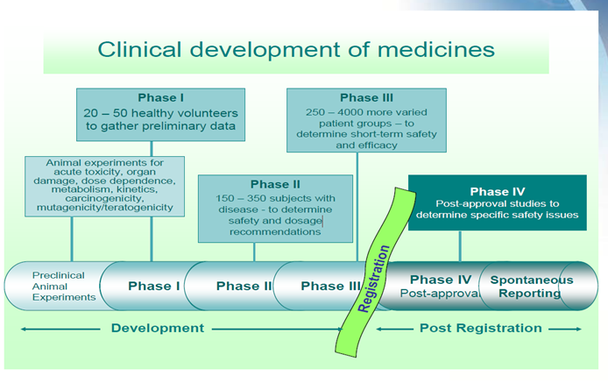

Slide 6
Motivation behind the project
ADRs are a huge burden of financial resources and labor.
It was estimated by Lazarou et althat more than 100,000 die from ADRs annually.Moreover, Sultana et al found that around $30.1 billion are spent annually on ADRs in the U.S., and nearly half of these costs can be prevented based on a study by Bates et al.
The unnecessary high financial costs and labor spent on ADRs provide strong motivation to learn more about ADRs and be able to predict the probability of ADRs accurately.
And in these conditions where corona vaccines are very difficult to find scientist start recording their data for others to know the research work done by them.

Slide 7
Continued….
As in these conditions people get infected easily and the virus spread in the body very rapidly so there was less time and it was difficult to find vaccine, so in these conditions scientist record their experiment and share their data so that others can start their research from where others have left this can save a lot of time, money and resources.

Slide 8
Major Features
This project is all about prediction of adverse reaction of covid-19 vaccine. We downloaded three excel files from VARS for data symptoms and vaccines and we generated a relation between them through primary key patient_id. Our project has all the records of covid-19 vaccines till date which are accurate and are recorded by worlds best doctors.
We used Machine learning to build this project our data was stored in microsoft excel later on through panda we called every data in google colab and this is how using above softwares we build this project.
Our main space for working was google colab where we used python as our language and with this it makes our project a perfect example of python+machine learning projects.

Slide 9
Continued….
About the data
this is a excel file of data set which we have converted into panda the size of data sets is approx. 8640 rows X 40 columns with null values
In VAERS there is a two data set first in information of patience and second is a symptoms of patience we made primary relation between there two data set with the help of VAERS_id and make a combined data set.

Slide 10
Continued….
Removing null values
to get an accurate prediction the first important step is to remove null values.

Slide 11
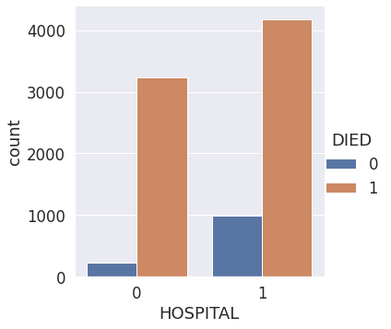
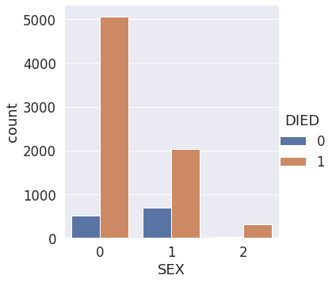

Slide 12
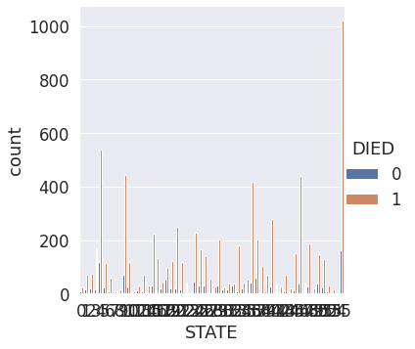

Slide 13
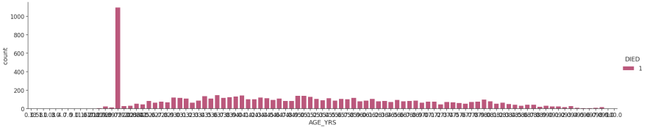

Slide 14
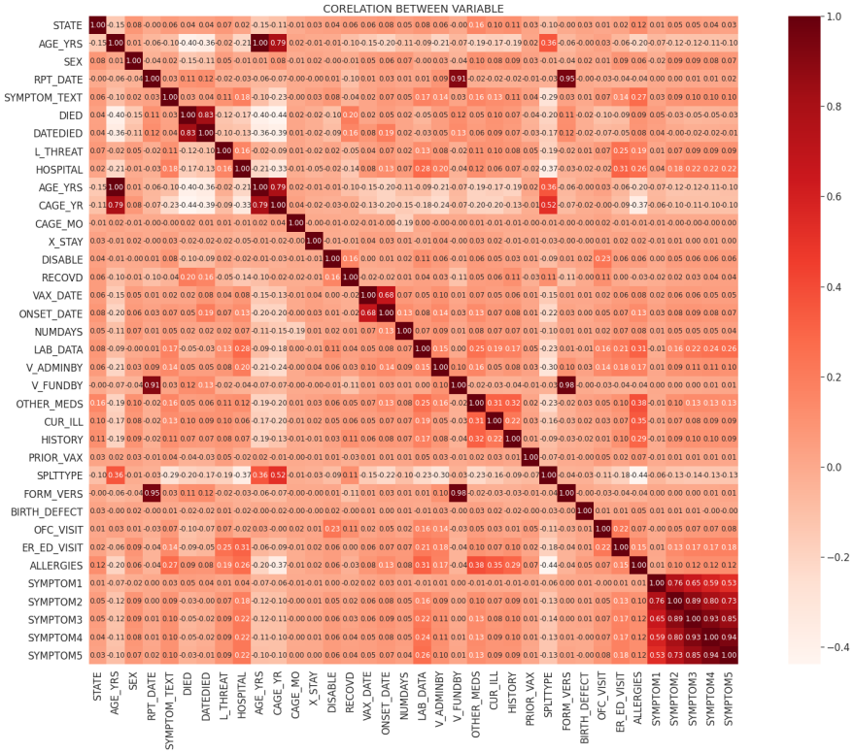

Slide 15
Colaboratory or “Colab”
Colab notebooks allow you to combine executable code and rich text in a single document, along with images, HTML, LaTeX and more. When you create your own Colab notebooks, they are stored in your Google Drive account.
Colaboratory, or "Colab" for short, allows you to write and execute Python in your browser, with
Zero configuration required
Free access to GPUs
Easy sharing

Slide 16
Microsoft Access
Microsoft Access is a database management system (DBMS) from Microsoft that combines the relational Microsoft Jet Database Engine with a graphical user interface and software-development tools. It is a member of the Microsoft 365 suite of applications, included in the Professional and higher editions or sold separately.
Microsoft Access stores data in its own format based on the Access Jet Database Engine. It can also import or link directly to data stored in other applications and databases

Slide 17
Challenges faced by us
As there were thousands of data each data came with many null values and therefore it was very difficult to remove those values.
After removing those values it was difficult to replace those values with the new values as this is a project related to the medical field now we have to choose our data wisely.
The input to this transformer should be an array-like of integers or strings, denoting the values taken on by categorical (discrete) features. The features are encoded using a one-hot encoding scheme. This creates a binary column for each category and returns a sparse matrix or dense array depending on the sparse parameter.

Slide 18
Continued…
Correlation is an indication about the changes between two variables.
We have discussed Pearson’s Correlation coefficients and the importance of Correlation too. We can plot correlation matrix to show which variable is having a high or low correlation in respect to another variable.

Slide 19
References
Edwards IR, Aronson JK. Adverse drug reactions: definitions, diagnosis, and management. Lancet. 2000;356:1255-9.
Lazarou J, Pomeranz BH, Corey PN. Incidence of adverse drug reactions in hospitalized patients: A meta-analysis of prospective studies. Journal of the American Medical Association. 1998;279(15):1200-5.
Sultana J, Cutroneo P,Trifiro G. Clinical and economic burden of adverse drug reactions. J Pharmacol Pharmacother. 2013;

Slide 20
Thank You

