Slide 1
VERITASXR
A DUAL-PATHWAY CNN FOR CHEST RADIOGRAPHS
RSNA · 26,684
3 SEEDS
4.22M PARAMETERS

Slide 2
Does a purpose-built architecture beat ImageNet transfer learning on 18,677 images?
A CONFIDENT WRONG ANSWER IS WORSE THAN NONE
01
Does every component of it earn the parameters it costs?
Pneumonia is a leading cause of death in children and the elderly, and the chest radiograph is the first-line investigation. Reading one reliably needs a radiologist, and demand far exceeds supply. Most deployed models return a label and a probability — and nothing that says this is a case I do not understand.
02
Does disagreement between the two pathways work as an uncertainty signal?
03

Slide 3
Literature survey
Eleven studies, 2022–2026. Each metric is that paper's own headline figure on its own dataset — not comparable across rows.
Paper
Year
Authors
Algorithm
Reported performance
Reference
Expert-level detection of pathologies from unannotated chest X-rays via self-supervised learning (CheXzero)
2022
Tiu, Talius, Patel, Langlotz, Ng, Rajpurkar
Contrastive image–text pretraining; ViT-B/32, zero-shot
Mean AUC 0.889 on CheXpert; matches 3 radiologists
Nat. Biomed. Eng. 6:1399
doi.org/10.1038/s41551-022-00936-9
A deep CNN for pneumonia detection in X-ray images with attention ensemble
2024
An, Chen, Shao
EfficientNetB0 + DenseNet121 ensemble with self-attention fusion
Acc 95.19% · AUC 0.9564 · F1 96.06%
Diagnostics 14(4):390
doi.org/10.3390/diagnostics14040390
Pneumonia detection based on RSNA dataset and anchor-free deep learning detector
2024
Wu, Zhang, Wang, Ding, Cao, Liu et al.
Anchor-free detector; ResNet-50 + 5-level FPN, focal loss
AP 51.5 · AR10 96.6 — the same RSNA data this project uses
Sci. Rep. 14:1929
doi.org/10.1038/s41598-024-52156-7
Enhancing pediatric pneumonia diagnosis through masked autoencoders
2024
Yoon, Kang
Masked-autoencoder pretraining on adult CXR, fine-tuned on paediatric
Acc 95.89% · AUC 0.996 binary; 3-class acc 93.86%
Sci. Rep. (2024)
doi.org/10.1038/s41598-024-56819-3
Binary classification of pneumonia using a modified CLAHE algorithm
2025
Buriboev, Abduvaitov, Jeon
Adaptive CLAHE preprocessing + 3-block CNN
Acc 98.7% · AUC 0.992 · F1 97.9% (single dataset)
Sensors 25(13):3976
doi.org/10.3390/s25133976
PELM: a deep learning model for early detection of pneumonia
2025
Yanar, Hardalaç, Ayturan
Ensemble of CNN backbones across NIH, CheXpert, PadChest, Kaggle
Acc 96% · AUC 0.91 · F1 95% (44,836 images)
Appl. Sci. 15(12):6487
doi.org/10.3390/app15126487
RepViT-CXR: channel replication for vision transformers in CXR classification
2025
Ahmed
Grey-to-3-channel replication to reuse an ImageNet-pretrained ViT
Acc 99.0% · AUC 0.990 (paediatric); 99.9% on TB-CXR
arXiv:2509.08234
arxiv.org/abs/2509.08234
Benchmarking uncertainty and its disentanglement in multi-label CXR classification
2025
Baur, Samek, Ma
13 uncertainty-quantification methods on ResNet and ViT (MIMIC-CXR-JPG)
No single winner: strengths are method- and architecture-specific
UNSURE 2025 (MICCAI)
arxiv.org/abs/2508.04457
Diagnostic accuracy of AI in chest radiography for pneumonia and lung cancer
2025
Essa
Meta-analysis pooling 15 studies (2017–2025)
Pooled sensitivity 88% · specificity 90% · SROC AUC ≈ 0.95
Eur. J. Radiol. Open 15:100701
doi.org/10.1016/j.ejro.2025.100701
Pediatric pneumonia detection: transfer learning vs custom CNNs
2025
Roy Choudhury
ResNet50 / DenseNet121 / EfficientNet-B0, frozen vs fine-tuned, vs CNNs from scratch
Fine-tuned ResNet50: acc 99.43% · AUC 0.9993; fine-tuning beats frozen by 5.5 pp
arXiv:2601.00837
arxiv.org/abs/2601.00837
Pneumonia detection from enhanced chest X-rays based on a Double SGAN model
2026
Xu, Zhang
Double SGAN augmentation + ResNet18 with spatial attention
Acc 95.83% · AUC 0.993 vs 0.892 on real data alone
Sci. Rep. (2026)
doi.org/10.1038/s41598-026-39785-w

Slide 4
THE GAP, AND THE HYPOTHESIS
Three patterns run through those eleven papers. Reported accuracy is near saturation — 95–99% — but almost always on one small, single-source, often paediatric dataset. Pretraining, not architecture, moves the numbers: fine-tuning beats a frozen backbone by 5.5 points, and self-supervised pretraining reaches radiologist level without labels. Uncertainty is unsettled — a 2025 benchmark of 13 methods finds no single winner, and most studies report none.
So: can a compact dual-pathway CNN earn useful accuracy and a free uncertainty signal in one forward pass — and survive the replication these papers rarely report?
Measured over three seeds, the answer splits. The uncertainty works — AUROC 0.7747, no ensemble. The accuracy does not follow.

Slide 5
DATASET AND PROTOCOL
26,684
70 / 15 / 15
3 SEEDS
RSNA Pneumonia Detection Challenge. Adult radiographs from multiple sites, boxed by one to three board-certified radiologists. 22.5% positive, and the hard middle class — abnormal but not pneumonia — is 44% of the data.
Split by patient into 18,677 / 4,001 / 4,006, stratified on the three-class label so the middle class stays proportional. A leakage test asserts no patient crosses splits, and fails when a leak is injected.
Every model reads one config: same loss, optimiser, learning rate, schedule, augmentation and early stopping. Three seeds each, so no claim rests on one run.

Slide 6
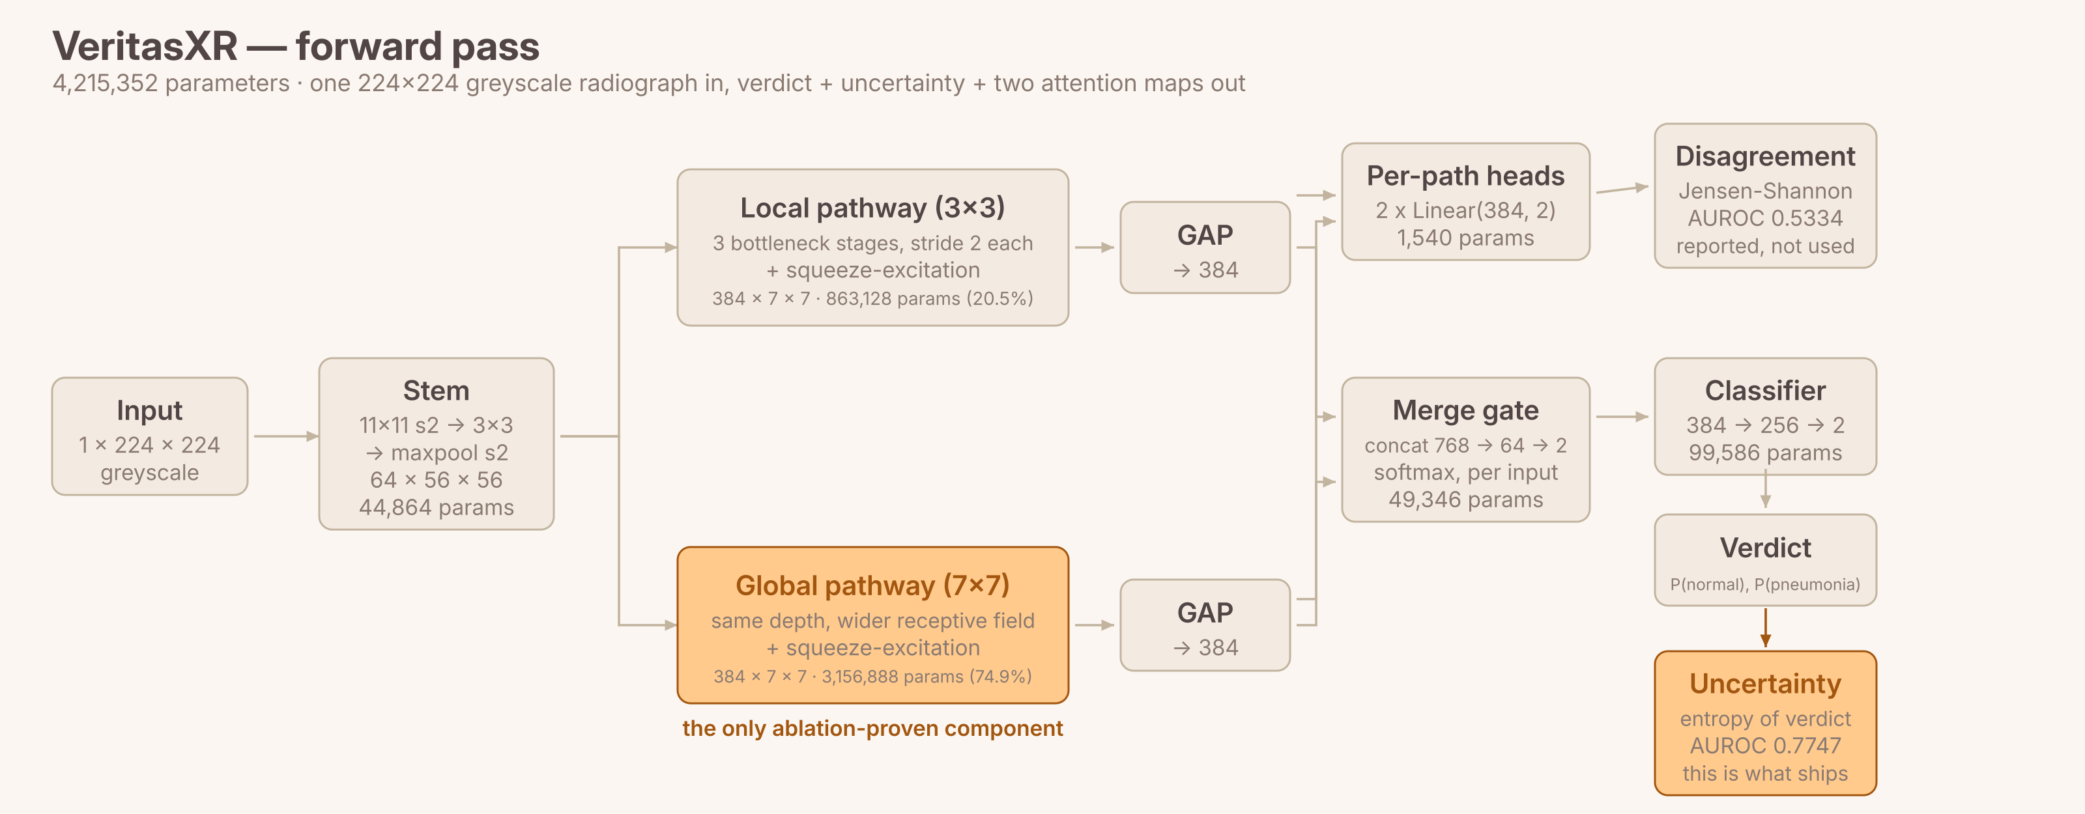
Architecture
One stem, two kernel scales, three outputs — 4,215,352 parameters
Two branches read a shared stem and differ only in kernel size: 3x3 sees local opacity texture, 7x7 sees whole-lung structure. A gate predicted from the image blends them. The next three slides take one component at a time.

Slide 7
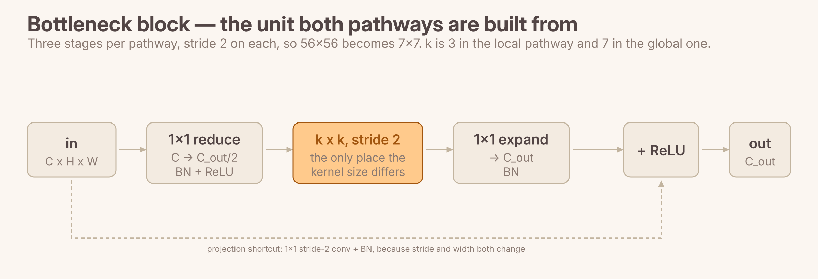
Inside a pathway
A wide stem, then three bottleneck stages that halve the map each time
Stem — 44,864 params
Bottleneck — the unit both pathways repeat
Why it matters — 17.0M to 4.2M params
Conv 11x11 stride 2, then 3x3, then maxpool, to 64 x 56 x 56. Wide on purpose: radiographic signal is diffuse texture, not the sharp edges a 3x3 first layer is tuned for.
1x1 reduce, k x k at half width, 1x1 expand, plus a projection shortcut. Three stages per pathway take 56x56 down to 7x7.
The first version stacked three full-width k x k convolutions. At k=7 and 256 channels that one choice held 59% of the model and ran 4-5x slower than bigger baselines.

Slide 8
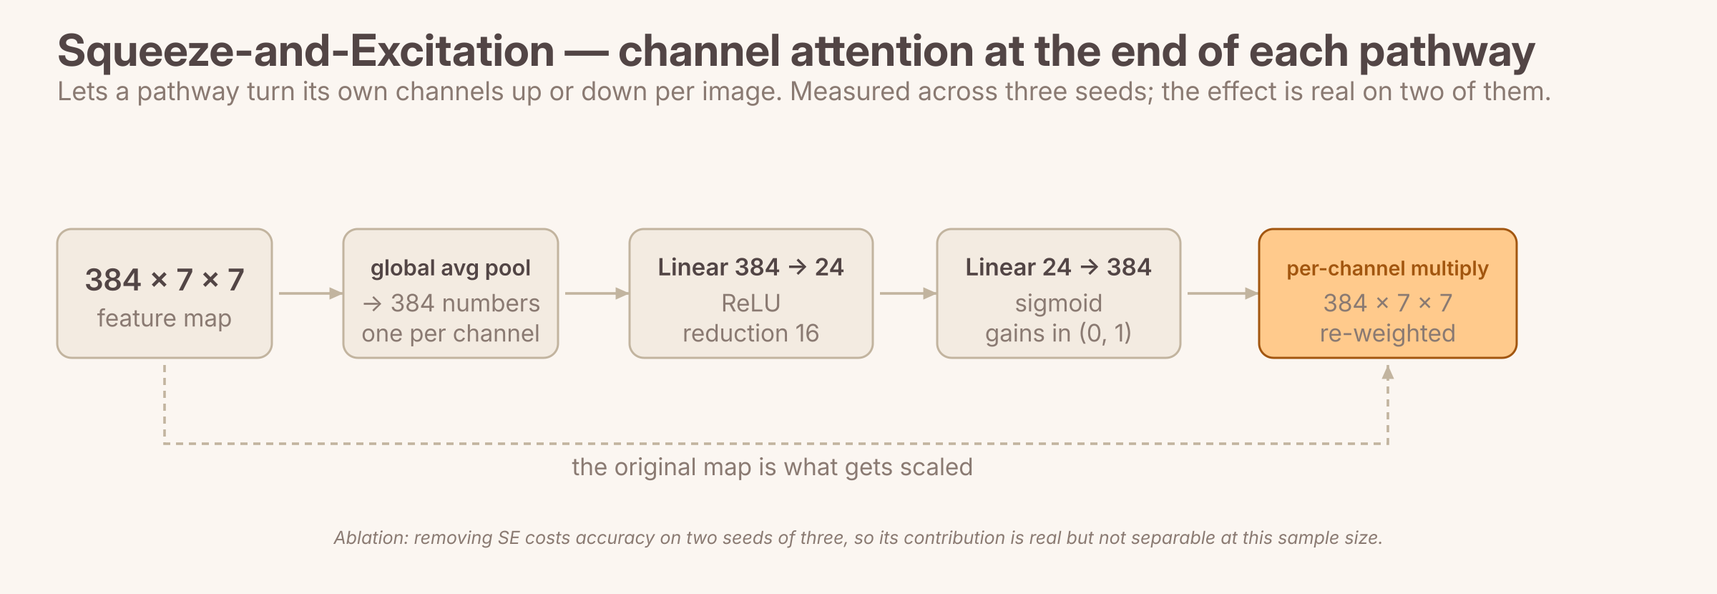
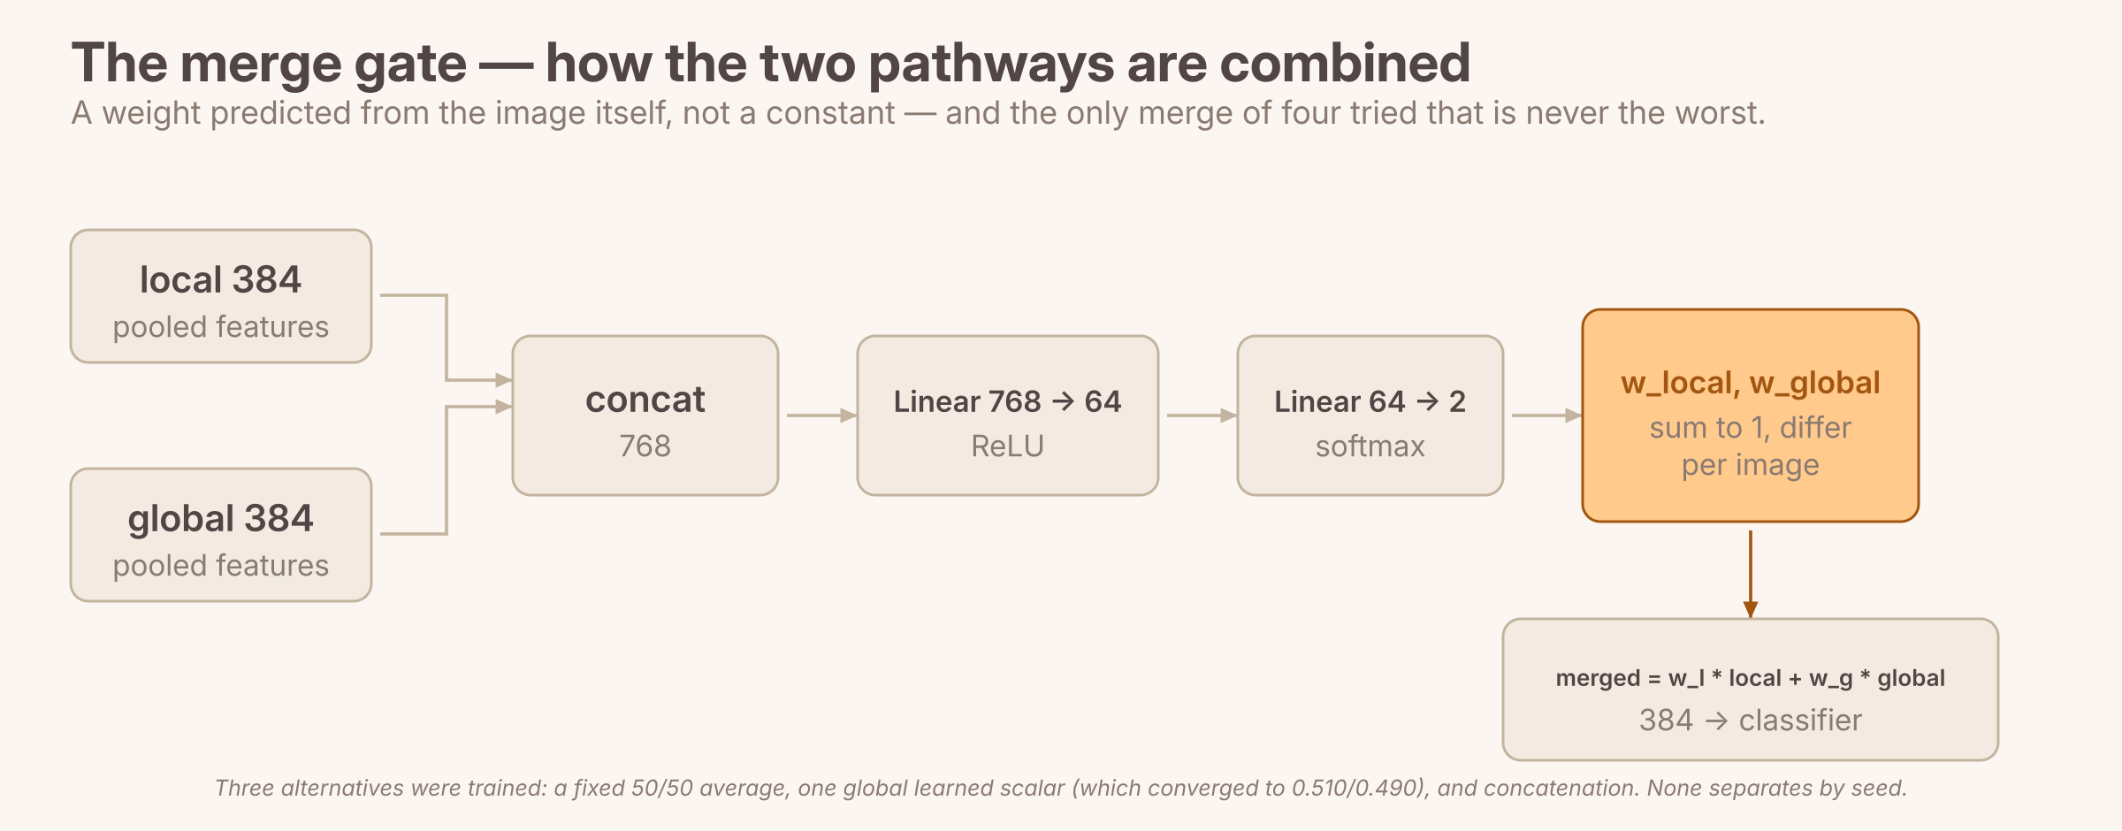
Attention, and how the pathways combine
Both were trained with and without, across three seeds. Here is what each contributes.
Squeeze-and-Excitation
The merge gate — 49,346 params
Pool each of 384 channels to one number, learn a gain for each through 384 -> 24 -> 384 with a sigmoid, multiply the map by it. Removing it costs accuracy on two seeds of three — real, but not separable at this sample size.
Concatenate both pooled vectors to 768, predict two weights that sum to 1, blend. Of the four merges trained it is the only one never ranked worst, and it replaced a global scalar that had converged to 0.510 / 0.490 — an average with extra steps.

Slide 9
0.5334
Pathway disagreement — Jensen-Shannon divergence between the two heads. This is chance. Both heads train on the same labels with the same loss, so they converge toward each other.
THE UNCERTAINTY OUTPUT
0.7747
Predictive entropy of the merged verdict. The signal that ships, and what the demo's triage bands are read from.
The architecture is named for pathway disagreement. Two independent heads, one per pathway, make that disagreement measurable at all — the previous version merged before the head, which makes it unobservable by construction.
Measured against the model's own errors, it scores chance. Predictive entropy is what ships instead, and the negative result is reported rather than dropped.
0.7675
Entropy and disagreement combined — worse than entropy alone. The rejected signal adds nothing.

Slide 10
How it compares, and why
4,006 test radiographs · 22.5% positive · AUPRC and AUROC are mean ± SD over three seeds
Model
Params
AUPRC
AUROC
it/s
Why it lands here
EfficientNet-B0
4.01M
0.6993 ± 0.0033
0.8781
3.66
ImageNet features plus compound scaling. Best accuracy at the smallest pretrained size, and the best calibrated (ECE 0.0343).
DenseNet121
6.96M
0.6872 ± 0.0034
0.8728
2.11
The CheXNet backbone; dense connections reuse features. Slowest of the four — concatenation makes it memory-bandwidth bound, not parameter bound.
ResNet50
23.51M
0.6747 ± 0.0072
0.8675
5.04
5.6x EfficientNet's parameters and still third, with the highest seed variance of any model. On 18,677 images more capacity buys instability.
VeritasXR
4.22M
0.6410 ± 0.0039
0.8531
7.94
The only model here with no pretraining — that single difference is worth 5–9% relative AUPRC. Fastest of the five, and it ships a measured uncertainty (entropy, AUROC 0.7747 against its own errors) in the same forward pass: no ensemble, no repeated passes.
HOG + linear SVM
6,085 feat
0.3823 ± 0.0010
0.7283
—
Hand-crafted gradient histograms cannot represent diffuse opacity texture. The control that shows the deep models are earning their place.
• The ordering is significant, not noise: a paired bootstrap run per seed, Holm-corrected, separates every pair on every seed. The gap to the pretrained models is 0.034–0.058 AUPRC.
• The cause is pretraining, not architecture or capacity — and not the shared learning rate either. Retrained at 1/3x and 3x, the model most handicapped by the shared rate was DenseNet121, a baseline; tuning each model widens the gap.

Slide 11
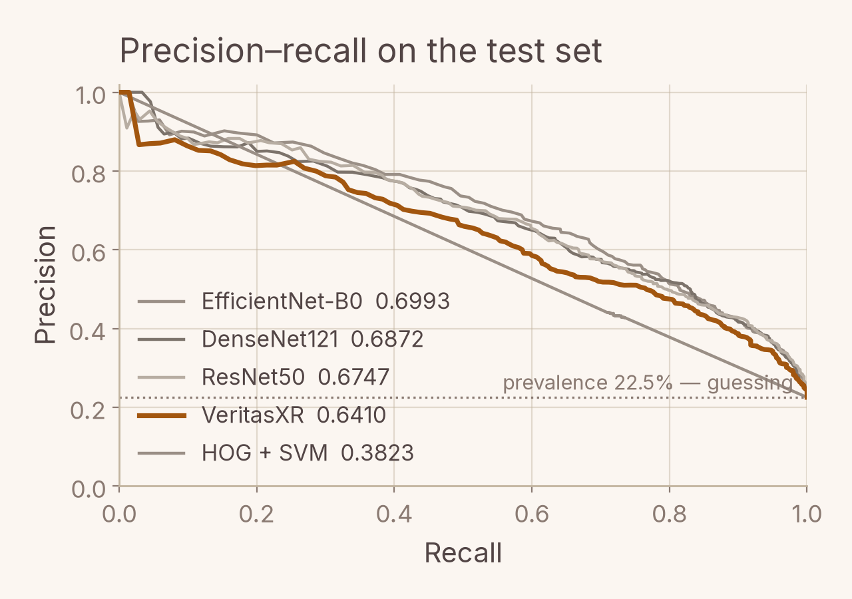
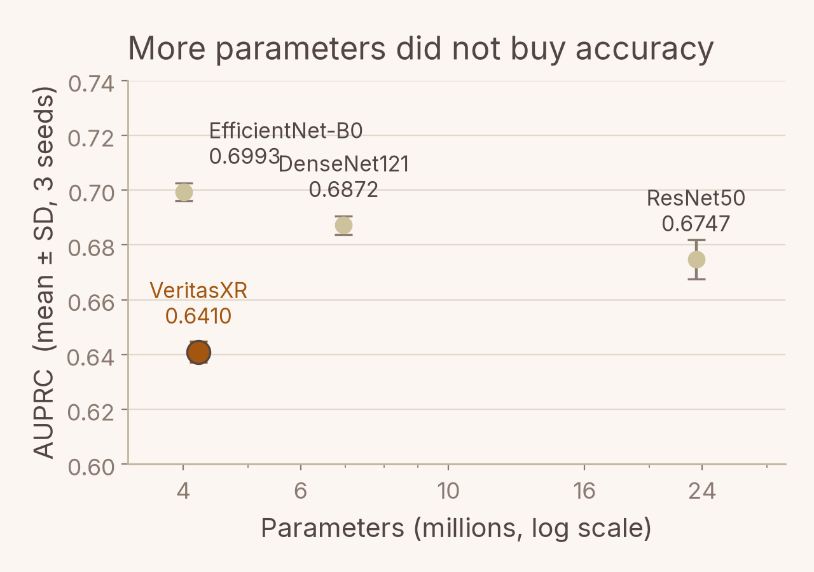
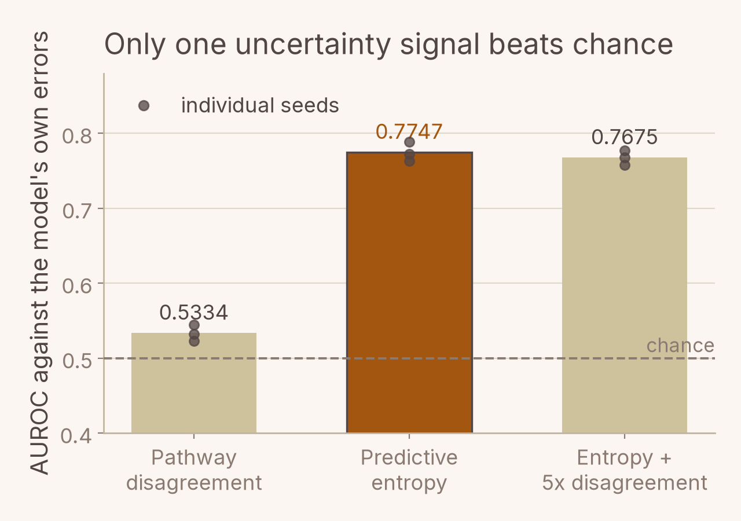
The same result, in three pictures
Every curve and point is read from the run artefacts, not retyped
VeritasXR tracks the pretrained models closely until recall ≈ 0.3, then falls behind — and sits far above the classical control throughout.
ResNet50 carries 5.6x EfficientNet-B0's parameters and lands below it. Size is not what separates these models.
The signal the architecture is named for sits on the chance line. Predictive entropy, free in the same pass, clears it by 0.27.
One story, three ways: the gap to transfer learning is real and holds on every seed, it is not explained by model size, and the uncertainty that works is the one the architecture did not set out to use.

Slide 12
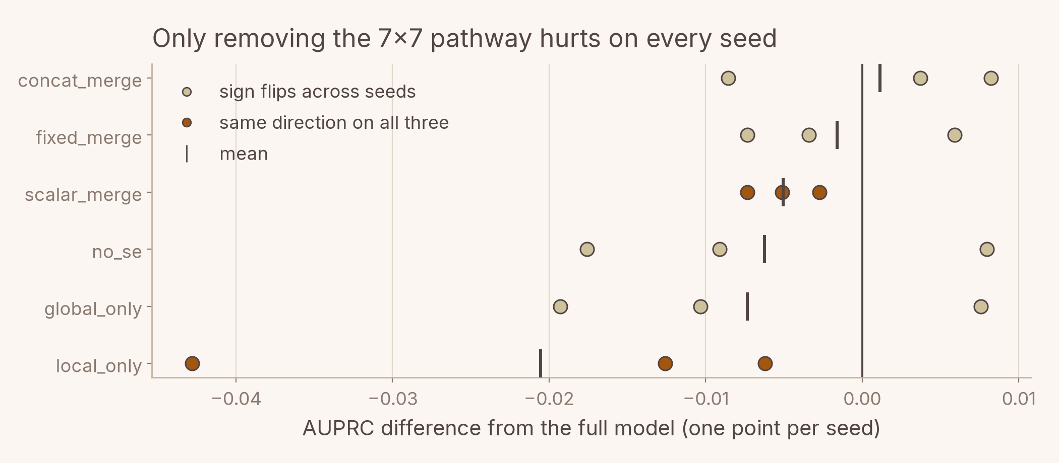
Does each component earn its parameters?
Seven variants, three seeds each. One result survives replication.
Variant
Params
AUPRC
Δ vs full
concat_merge
4,264,310
0.6422
+0.0011
full
4,215,352
0.6410
baseline
fixed_merge
4,166,006
0.6394
−0.0016
scalar_merge
4,166,008
0.6360
−0.0051
no_se
4,177,672
0.6348
−0.0062
global_only
3,302,108
0.6337
−0.0073
local_only (3x3 branch alone)
1,008,348
0.6205
−0.0205
• Only the 7x7 global pathway survives. Removing it costs accuracy on every seed — the one component in this model that replicates.
• Everything else changes sign with the seed. Squeeze-excitation, the merge gate and the merge strategy each help on one seed and hurt on another.
• global_only separates on seed 0 and then reverses on seed 1. Any of these would have looked meaningful from a single run.

Slide 13
WHAT THE THIRD SEED CORRECTED
01
A 12x calibration win for VeritasXR — Second, not first: ECE 0.0440 against EfficientNet-B0's 0.0343. One temperature fitted on validation puts it last.
02
The cheap 3x3 branch beats the expensive 7x7 — Reverses across seeds. Seed 0 caught global_only at its worst and local_only near its best.
03
Pathway disagreement measures uncertainty — AUROC 0.5334 against the model's own errors, over the full test set on three seeds. Chance.
A fourth: p < 0.0001 across all paired tests became p = 0.014 at its weakest once the test ran per seed. Each of these was a clean, attractive result from a single run. Catching all four is what three seeds and a per-seed paired test are for.

Slide 14
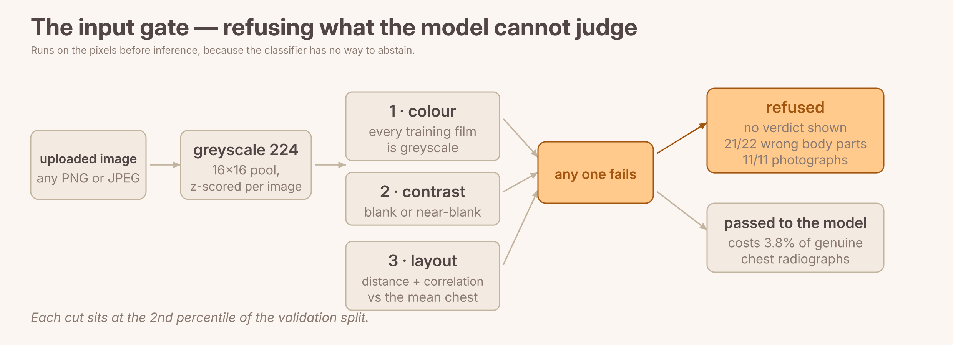
Refusing what the model cannot judge
The classifier has no way to abstain, so the refusal happens on the pixels before it
Measured on the deployed model
• 4 of 7 photographs: highest-confidence band
• A flat white field: 68% pneumonia
• A radiograph of a foot: P = 0.911
What it is given
Turned away
Radiographs of the wrong body part (22)
95% (21/22)
Ordinary photographs (11)
100%
Rotated, inverted, noise, flat field
99.8–100%
Genuine chest radiographs — the cost
3.8%
A 16x16 layout template fitted on the training split: three cuts — colour, contrast, and distance and correlation against the mean chest — each at the 2nd validation percentile. The one that still gets through is a horse hoof. Passing is not evidence an image is a chest radiograph, only that nothing obvious says otherwise.

Slide 15
SMALL, FAST, MEASURED
A 4.22M CNN from scratch — and a study that checked its own claims.
7.94 it/s — fastest
RUNS IN-BROWSER
NEXT LEVER: PRETRAINING

