Slide 1
CYCLISTIC BIKE-SHARE
How Do Members and Casual Riders Use Cyclistic Differently?
Vansh Dhiman
Junior Data Analyst | March 2026

Slide 2
Today's Agenda
01
Business Task
02
Data Overview
03
Key Findings
What problem are we solving?
Where did the data come from?
What did the data reveal?
04
Recommendations
05
Next Steps
What should Cyclist do?
How do we move forward?

Slide 3
Business Task
"Analyze how annual members and casual riders use Cyclistic bikes differently to design a targeted marketing strategy that converts casual riders into annual members."
The Problem
The Opportunity
The Goal
Annual members are significantly more profitable than casual riders
Casual riders already know and use Cyclistic — they just need to convert
Design data-backed marketing to convert casual riders into members

Slide 4
Data Overview
~5.5M
12
13
12 mo
Total Ride Records
CSV Files Merged
Data Columns
Data Period
Source
Motivate International Inc. — public license
Period
March 2025 to February 2026
Tool
Python (Google Colab) — Pandas, Matplotlib, Seaborn
Key Columns
ride_id, started_at, ended_at, member_casual, station names
Privacy
No personally identifiable information — riders cannot be tracked
Cleaned
Removed negative ride lengths and rides over 24 hours

Slide 5
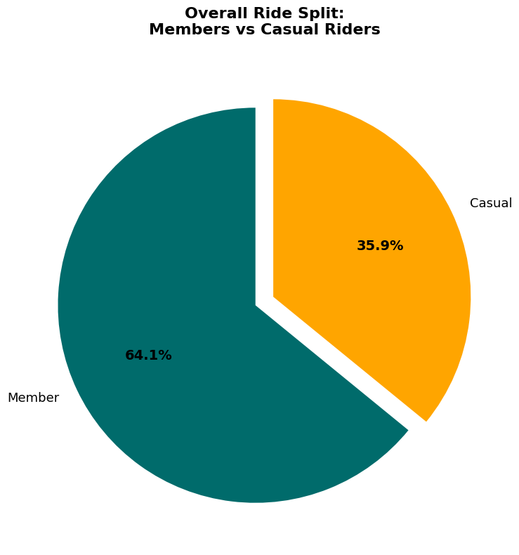
Finding 1 | Who Is Riding?
65.10%
Annual Members
34.90%
Casual Riders
Casual riders represent a large and reachable conversion opportunity

Slide 6
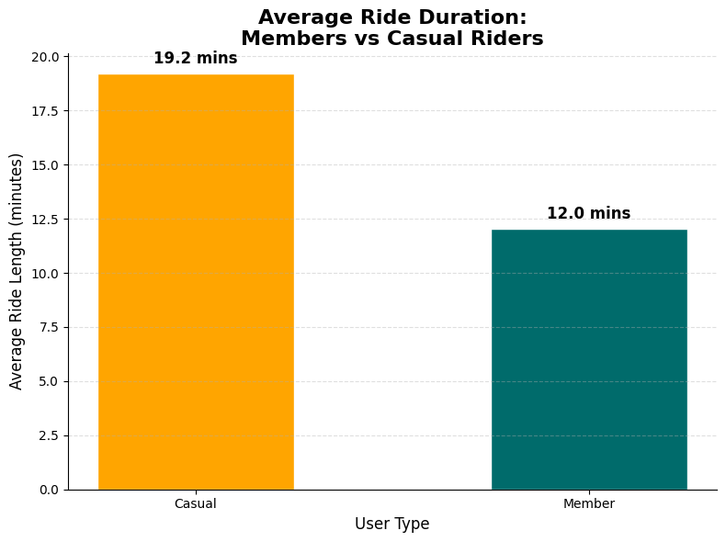
Finding 2 | Casual Riders Take Longer Trips
Key Insight
Casual riders ride nearly 2x longer on average than annual members
What It Means
Casual riders use bikes for leisure and exploration — not routine commuting

Slide 7
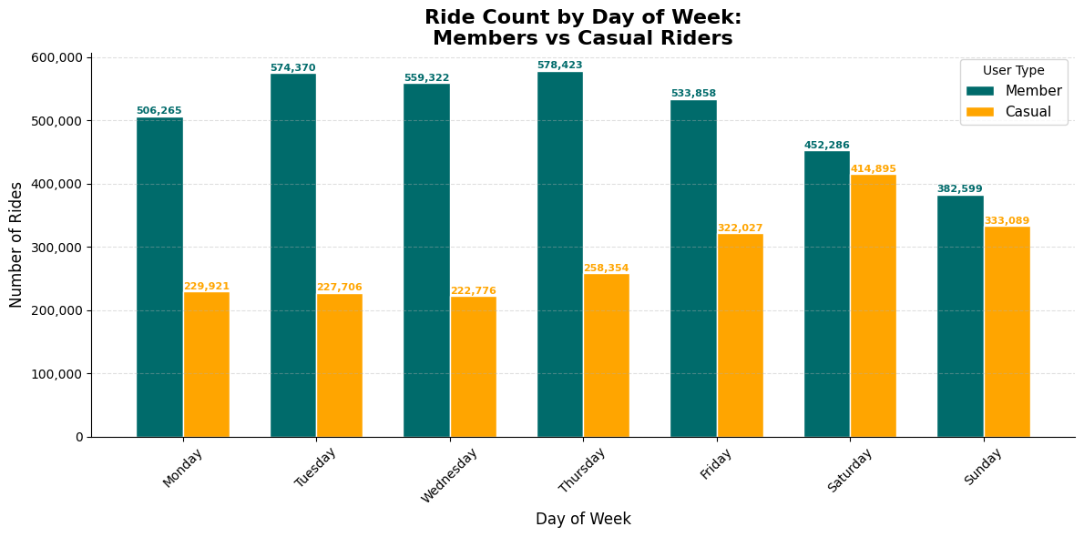
Finding 3 | Members Ride Weekdays, Casual Riders Ride Weekends
Members
Peak day:
Thursday
Commuter behavior
Casual Riders
Peak day:
Saturday
Leisure behavior

Slide 8
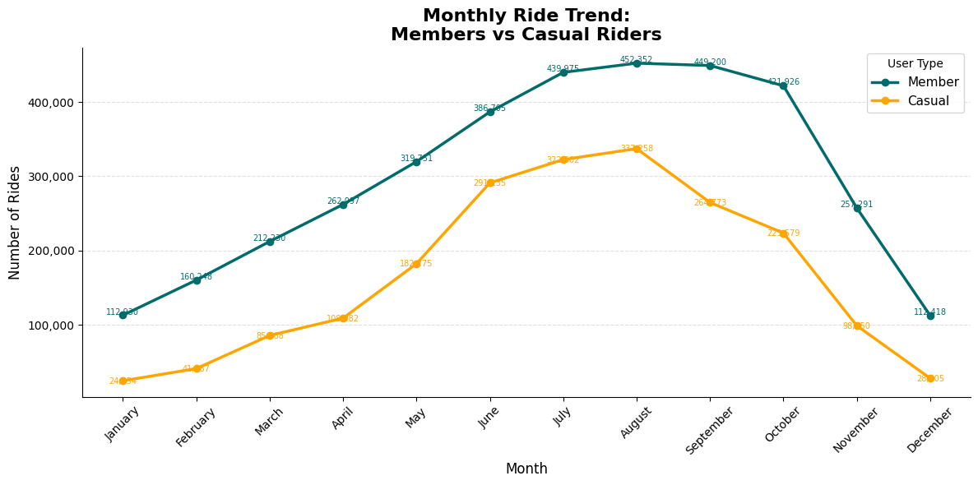
Finding 4 | Casual Riders Are Highly Seasonal
Members
Remain relatively consistent year round — commuting is routine
Casual
Drop sharply in winter — leisure riding is weather-sensitive
Spring = Best time to run membership promotions!

Slide 9
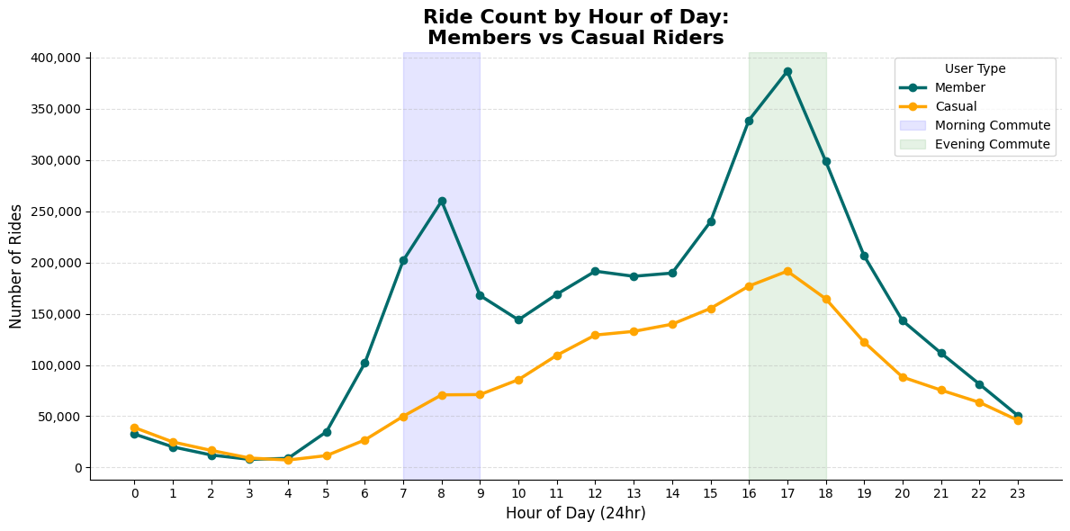
Finding 5 | Evening Is Peak Time for Everyone
Morning Peak
7am — 9am
Members only
Evening Peak
4pm — 7pm
Both groups

Slide 10
Findings 6 & 7 | Where and When Riders Are
TOP CASUAL STATION
TOP MEMBER STATION
DuSable Lake Shore Dr
& Monroe St
Kingsbury St
& Kinzie St
~30,000 rides
~28,000 rides
Leisure / Tourism area
Office / Business district

Slide 11
Top 3 Recommendations
01 Station-Based Campaign
02 Saturday Membership Drive
03 Spring Re-Engagement Campaign
Finding: DuSable Lake Shore Dr is #1 casual station with 30k rides
Action: QR code posters + geo-targeted digital ads at top casual stations
Outcome: Reaches highest casual rider concentration at point of use
Finding: Casual riders peak on Saturdays and weekends are nearly equal
Action: Friday evening push notifications with weekend discount offer
Outcome: Converts riders at their peak motivation moment
Finding: Casual ridership rebounds strongly in March/April
Action: Email + in-app promotion before summer peak season
Outcome: Converts casual riders before they spend money on single rides all summer

Slide 12
Next Steps
Immediate
Present findings to executive team for campaign approval
Short Term
Launch pilot campaign at DuSable Lake Shore Dr station
Medium Term
A/B test Saturday drive vs Spring campaign — measure conversion rate
Data Gap
Collect demographic data and survey casual riders on membership barriers
Track
Report monthly conversion rate after campaign launch to stakeholders

Slide 13
Thank You
Vansh
Junior Data Analyst — Marketing Analytics Team
vanshdhiman090@gmail.com

