Slide 1
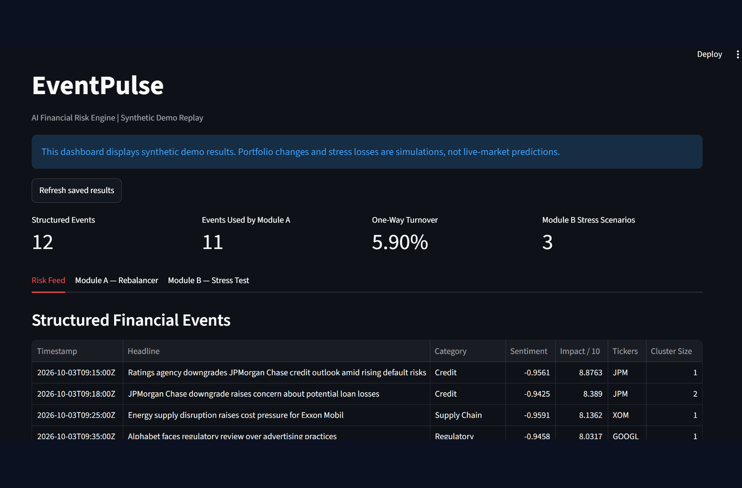
S&P GLOBAL & CRISIL CAMPUS HACKATHON 2026
EventPulse
From headlines to events
to impact to action.
An AI financial-risk intelligence prototype that turns public news and filings into structured signals for portfolio rebalancing and scenario-based stress testing.
PRETRAINED NLP
EVENT ROUTING
RISK SIMULATIONS
Vansh Goyal
89 tests passed | 2 downstream modules
LIVE INGESTION
SYNTHETIC REPLAY
IIIT Delhi
GDELT + SEC EDGAR
Reproducible demo
EventPulse | Public-source ingestion; synthetic replay results are clearly labelled
1

Slide 2
EVENTPULSE
PROBLEM & APPROACH
02 / 07
The gap is not sentiment - it is turning text into decisions.
Unstructured information becomes useful when events, entities, confidence and downstream rules share one contract.
01 / INPUT OVERLOAD
EVENTPULSE APPROACH
News is unstructured
Different feeds use different schemas, timestamps and levels of detail.
01
INGEST
GDELT + SEC EDGAR
Optional Alpha Vantage
02 / DUPLICATE COVERAGE
02
UNDERSTAND
FinBERT + NER + event router
Embeddings + semantic clusters
Same event, many reports
Counting repeated headlines as independent evidence can exaggerate a story.
03
STRUCTURE
Canonical FinancialEvent
Provenance + confidence + impact
03 / ACTION GAP
Signals stop at a score
04
SIMULATE
Module A: weights
Module B: stress scenarios
A sentiment label alone does not identify a holding or trigger a stress scenario.
S&P Global & Crisil Campus Hackathon 2026 | Synthetic demo results are simulations
2

Slide 3
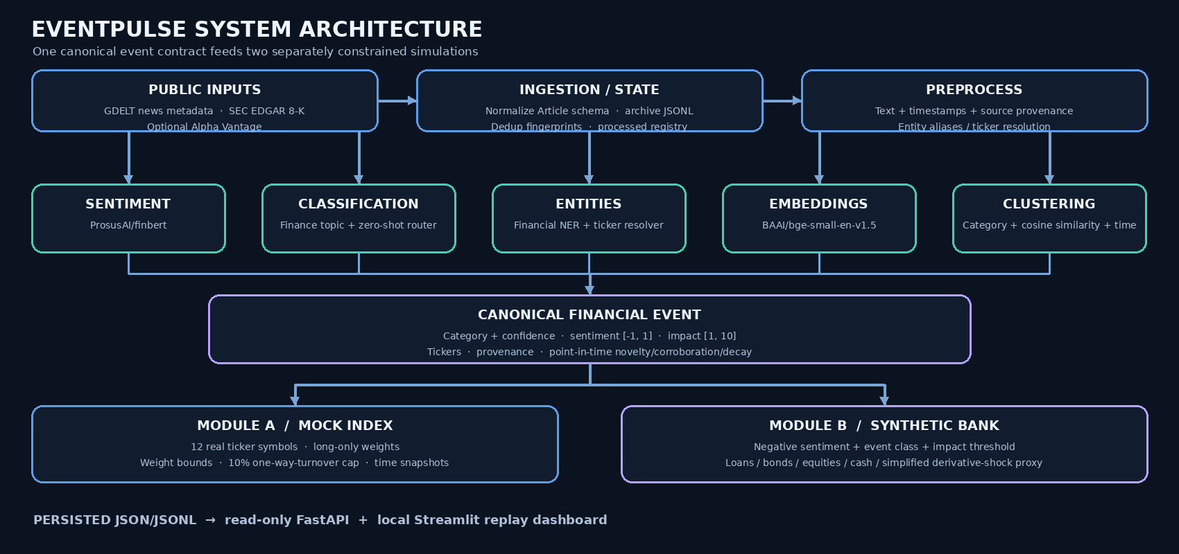
EVENTPULSE
SYSTEM DESIGN
03 / 07
One event contract powers both risk modules.
Sources -> NLP -> structured signals -> two constrained simulations. Historical impact training is optional, not active.
Full Mermaid source: architecture.md | Diagram: docs/architecture.svg
3

Slide 4
EVENTPULSE
IMPLEMENTATION HIGHLIGHTS
04 / 07
Specialized models. Explicit routing. Interpretable rules.
Each component has one role; downstream decisions remain inspectable.
COMPONENT
WHAT IT DOES
WHY IT FITS
FinBERT
Financial sentiment
Signed score in [-1, 1]
Financial-domain language rather than generic sentiment.
ProsusAI/finbert
Financial NER
Entity mentions
Organization / person / location
Helps connect company names to ticker-resolution logic.
whataboutyou-ai/financial_bert
Finance-topic model
Pretrained financial topic
Mapped to EventPulse labels
Provides a domain-specific first classification signal.
leonas5555/finnews-topic-single-classify
Zero-shot + router
Compares candidate event labels
Router considers agreement and score margin
Adds task-specific label descriptions without training a new classifier.
ModernBERT-base-zeroshot-v2.0
+ EventClassifierRouter
BGE embeddings
Normalized text vectors
Cosine similarity + time/ticker rules
Groups semantically related reports; embeddings alone do not prove same event.
BAAI/bge-small-en-v1.5
IMPACT SCORE | ACTIVE PATH
Severity + sentiment strength + breadth + confidence + novelty -> heuristic score 1-10
No accepted historical impact-model artifact is included; the 1-10 score is not a calibrated probability or return forecast.
S&P Global & Crisil Campus Hackathon 2026 | Synthetic demo results are simulations
4

Slide 5
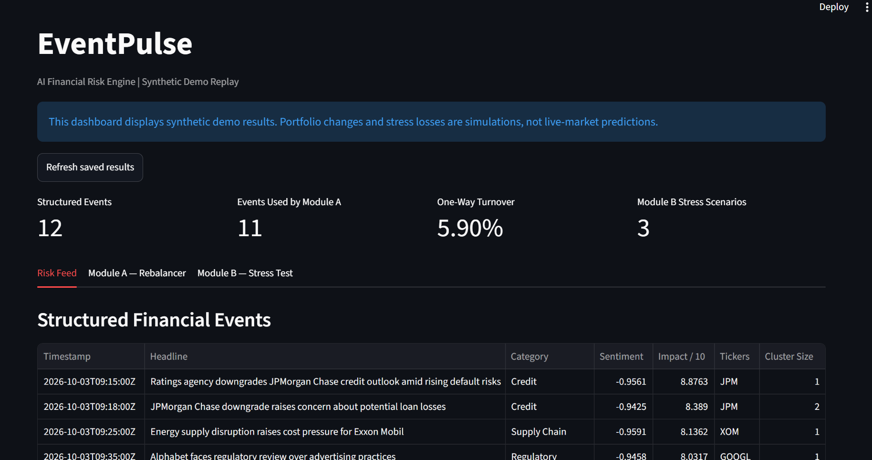
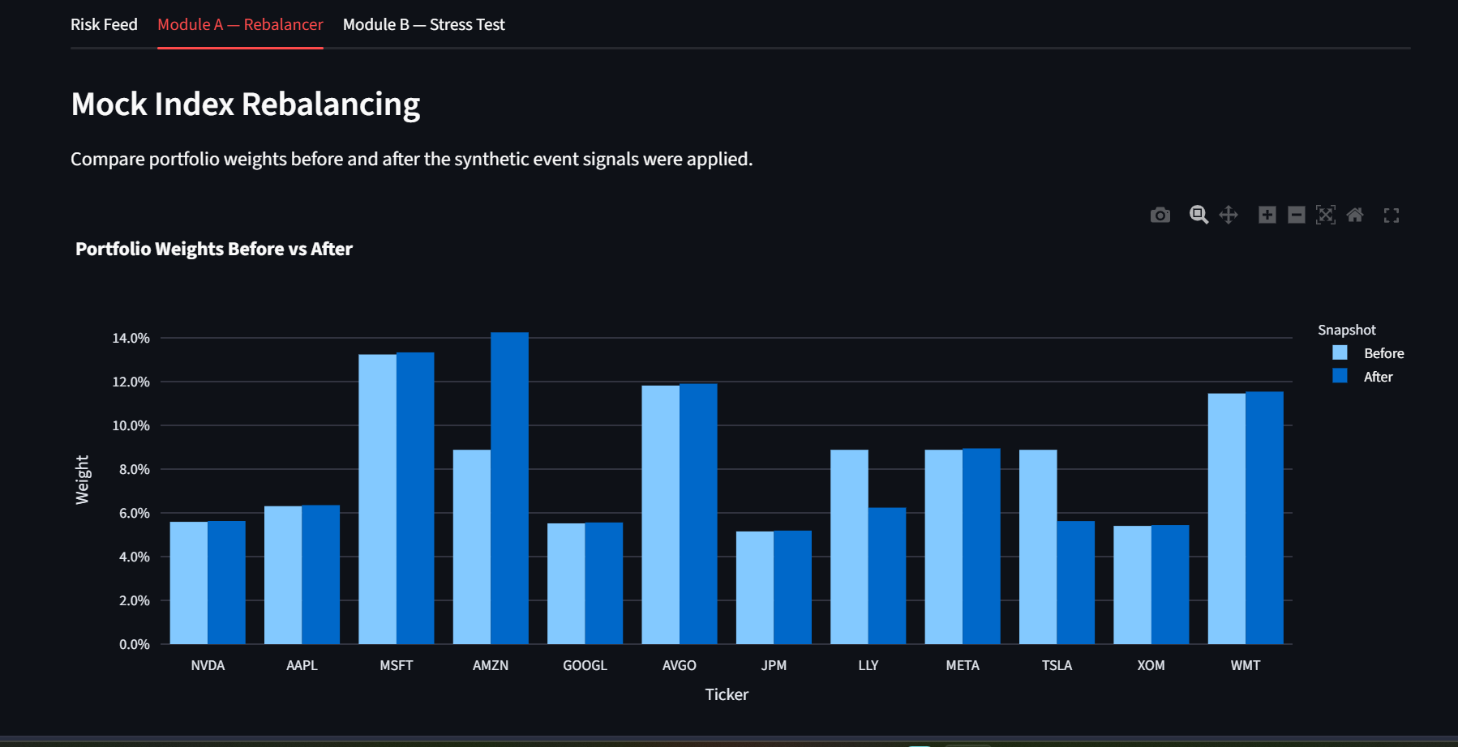
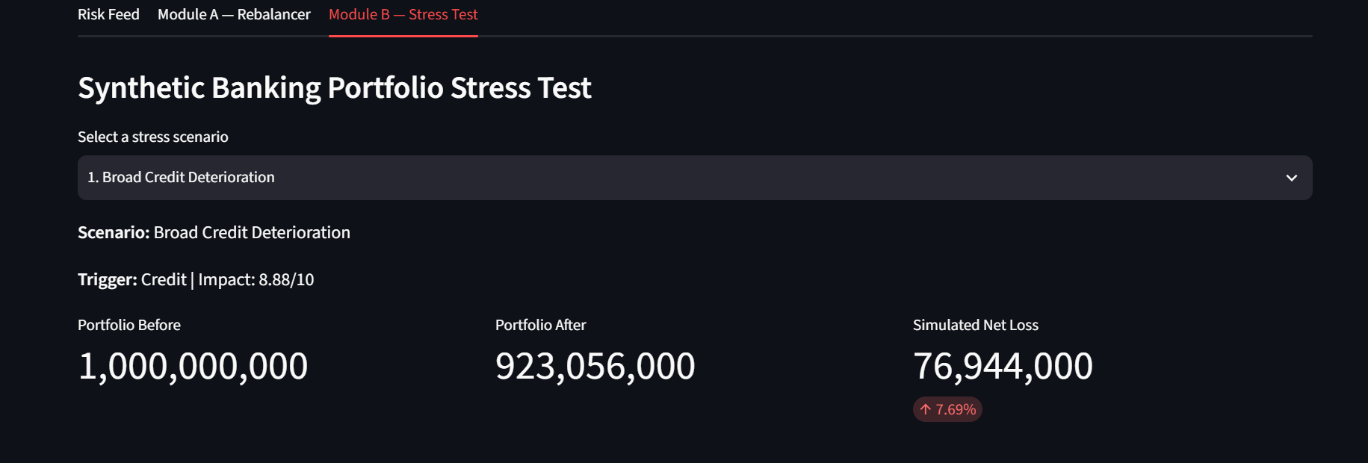
EVENTPULSE
WORKING DASHBOARD
05 / 07
A working dashboard exposes the pipeline end to end.
The Streamlit interface reads the saved synthetic replay and makes both downstream modules inspectable.
MODULE A / Before–after portfolio weights
RISK FEED / 12 structured events
Headline, category, sentiment, impact, ticker and cluster context in one view.
MODULE B / USD 1B portfolio; $76.944M simulated loss
Captures show the current UI; headlines, weights and shocks are synthetic.
S&P Global & Crisil Campus Hackathon 2026 | Synthetic demo results are simulations
5

Slide 6
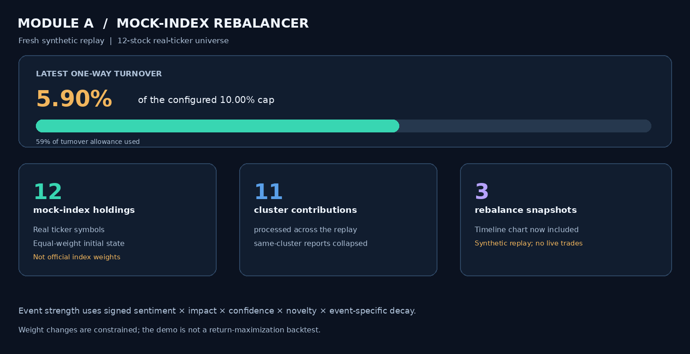
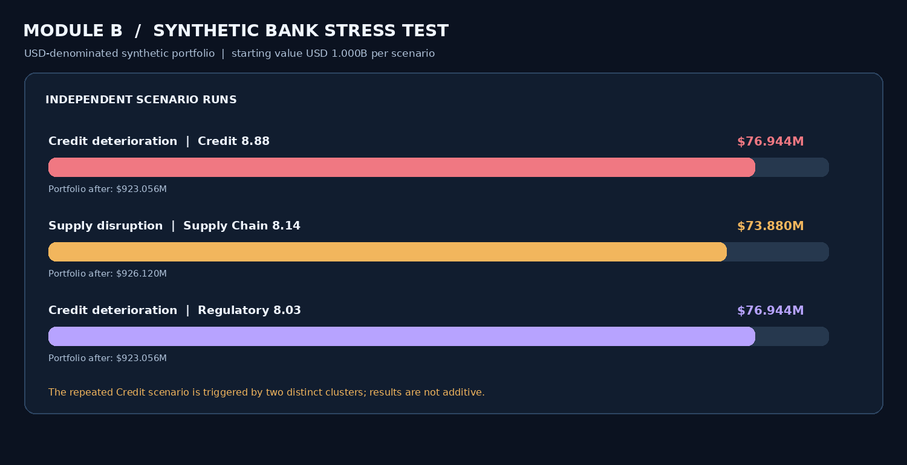
EVENTPULSE
KEY RESULTS & DOMAIN IMPACT
06 / 07
From event triage to constrained risk actions.
One event contract connects analyst triage, portfolio review and bank scenario analysis; all replay metrics are synthetic.
12
12
11
5.90%
3
synthetic articles
structured events
replay contributions
one-way turnover
stress results
MODULE A | 12-stock index; 3 snapshots; 5.90% turnover vs 10% cap
MODULE B | Three independent stress results; position-level attribution
89 tests passed (1 dependency deprecation warning). Live smoke: SEC 10 records; GDELT HTTP 429.
S&P Global & Crisil Campus Hackathon 2026 | Synthetic demo results are simulations
6

Slide 7
EVENTPULSE
LIMITATIONS & FUTURE WORK
07 / 07
Build toward decision-grade risk intelligence.
Future work targets stronger evidence, financial realism and resilient event processing.
CURRENT LIMITATIONS
ENGINEERING ROADMAP
Synthetic 12-headline replay; no real-news benchmark or naive-baseline gains measured.
Outcome-linked impact learning
01
Build point-in-time event–issuer–market outcome labels; learn impact scores and calibrate confidence without look-ahead leakage.
Impact (1–10) is a heuristic; no accepted trained or calibrated impact model is included.
02
Financially realistic portfolio controls
The index and bank portfolio are simulated. Derivative exposure uses a return-shock proxy, not pricing or Greeks.
Add transaction costs, liquidity and concentration constraints; model correlated shocks and derivative Greeks/collateral.
Public feeds can throttle; GDELT returned HTTP 429 in the last recorded live smoke test.
Resilient, explainable event intelligence
03
Improve issuer/ticker resolution and cross-source corroboration; add source backoff/cache, analyst review and traceable decisions.
EventPulse | From a reproducible prototype toward calibrated decision support
7

