Slide 1
Wearable-Based Blood Glucose Level Estimation
History-aware machine learning prototype
Engineering review • Vansh Goyal • 05 Sep 2026
BGL Wearable Estimation • Engineering Review • 1
Notes:
Open by saying this is a research/engineering prototype. The goal is to investigate whether wearable-style physiological measurements plus historical context can estimate BGL. Do not present it as a clinically validated device.

Slide 2
Problem Statement
Why estimate BGL from wearable-style signals?
Blood glucose is normally measured using glucose-specific sensing methods; the project investigates whether non-invasive wearable-derived physiological signals contain useful information.
The engineering challenge is not just fitting a regressor — it is determining whether apparent accuracy survives realistic validation.
Target: Blood Glucose Level (BGL).
Current work focuses on model development, history construction, and methodological reliability rather than clinical deployment.
BGL Wearable Estimation • Engineering Review • 2
Notes:
Explain the distinction between the engineering research question and a clinical claim. The project is testing feasibility on the supplied dataset, not replacing a clinical glucose measurement.

Slide 3
Project Objective
TARGET
Current BGL
HISTORY
250 previous observations
MODEL
CatBoost
Build a reproducible pipeline from raw wearable-style records to BGL estimation.
Test whether historical physiological context improves over isolated-observation models.
Separate within-dataset performance from unseen-participant generalization.
Audit unusually strong results before treating them as reliable.
BGL Wearable Estimation • Engineering Review • 3
Notes:
The most important objective is methodological: build a model and also determine what the metrics actually mean.

Slide 4
Dataset Overview
RAW ROWS
16,969
DUPLICATES REMOVED
272
CLEAN ROWS
16,697
AGE GROUPS
13
Source workbook contains BGL, physiological variables, diabetic status and an Age field used in the project as a group/participant proxy.
The dataset description says records combine true and synthetic records; non-diabetic BGL is described as having limited variation.
Important limitation: Age is not independently established as a unique participant identifier, and the dataset has no timestamp column in the working dataframe.
BGL Wearable Estimation • Engineering Review • 4
Notes:
Mention that 16,969 is the raw workbook size and 16,697 is after the project's 272 duplicate removals. The dataset provenance is a limitation because the source describes a mixture of true and synthetic records.

Slide 5
Input Features
Diastolic BP
Systolic BP
Heart Rate
Body Temperature
SPO2
Primary 250-row model: 5 physiological variables × 2 statistics = 10 features.
Statistics: past-only rolling mean and rolling standard deviation.
Sweating and shivering were used in earlier point-in-time experiments but are not part of the primary 250-row rolling feature vector.
Current BGL is never used to construct its own primary features.
BGL Wearable Estimation • Engineering Review • 5
Notes:
Clarify that the final rolling model uses ten engineered features. The earlier experiments included a broader nine-feature point-in-time set and several derived features.

Slide 6
End-to-End Architecture
Raw Excel
Cleaning
Past-only
250-row features
History-based
dataset
CatBoost
regression
BGL
prediction
Audit +
evaluation
Validation is performed on held-out rows in the legacy experiment and on held-out participant groups in the stronger audit design.
The two-stage regime experiment is retained as analysis, not as the primary model.
BGL Wearable Estimation • Engineering Review • 6
Notes:
Walk left to right. Stress that evaluation design sits outside the model itself and can change the interpretation of the same algorithm.

Slide 7
Data Preprocessing
Strip column whitespace
Remove 272 duplicates
Encode D/N: D→1, N→0
Keep original row order
No scaling for tree models
The pipeline does not sort by Age because the dataset's row order is part of the temporal sequence being investigated.
A derived block analysis later showed that the same Age appears in many separated blocks — an unresolved structural issue.
BGL Wearable Estimation • Engineering Review • 7
Notes:
Explain why sorting by Age is not automatically correct. Sorting could change the sequence itself. The real unresolved question is whether the original row order represents time/session order and whether blocks should be boundaries.

Slide 8
The 250-Row Rolling Window
Past-only physiological history
t-250 … t-2 t-1 | t (prediction)
Implementation: shift each physiological series by one observation, then apply a 250-observation rolling mean/std within the Age group.
The current row is therefore excluded from its own rolling features.
First usable row requires 250 previous observations; adjacent predictions have heavily overlapping windows.
BGL Wearable Estimation • Engineering Review • 8
Notes:
The key detail is shift(1). We explicitly audited a representative row: model rolling mean matched the manually computed past-only mean exactly. Do not say the window is session-aware; it is currently Age-group-aware.

Slide 9
Why Historical Context?
1 row
50 rows
100 rows
150–250 rows
single snapshot
short history
longer context
long regime context
Reported legacy validation RMSE improved monotonically as the window increased: 16.35 → 12.52 → 10.38 → 8.54 → 7.88.
This is evidence that the supplied dataset contains strong sequential structure — but not proof that the structure is clinically meaningful.
The persistence baseline reinforces this caution.
BGL Wearable Estimation • Engineering Review • 9
Notes:
The important story is not simply '250 is better'. It is that BGL in this dataset is highly persistent and long blocks exist. That can make history-based prediction easier.

Slide 10
Train / Validation / Test Strategy
LEGACY ROW SPLIT
70 / 15 / 15
Age used for stratification
CLEAN PARTICIPANT SPLIT
4 / 2 / 1 groups
14,15,19,46 / 9,55 / 76
OVERLAP
None in clean split
Group sets are disjoint
Legacy validation allows the same Age/group to appear in training and validation. It is therefore an in-dataset / within-group evaluation.
The participant-level design asks a harder question: can the model work on groups not seen during training while still having sufficient within-group history?
The latter is the more relevant reliability check for generalization.
BGL Wearable Estimation • Engineering Review • 10
Notes:
This slide is central. Explain that a row-level split and a participant-level split are different experiments. The 0.9683 R² belongs to the legacy row-level validation, not the participant-independent test.

Slide 11
Model Architecture
Primary model vs analyzed alternative
10 rolling
features
CatBoost
Regressor
BGL
Normal regressor
Regime classifier
High-BGL regressor
Primary: single CatBoost with 250-row mean/std features.
Alternative: classifier + separate normal/high-BGL regressors, also tested with probability-weighted blending.
The two-stage model was retained as analysis because its overall RMSE/R² were worse than the single model.
BGL Wearable Estimation • Engineering Review • 11
Notes:
Do not present the two-stage architecture as the final production architecture. It is an experiment that taught us that high BGL is easy to model once the regime is known, but the regime boundary hurts overall RMSE.

Slide 12
Two-Stage Logic
What we learned from the regime experiment
HIGH-BGL REGRESSOR
RMSE ≈ 0.31
High-BGL validation subset
HARD SWITCH
RMSE ≈ 9.48
Overall validation
PROBABILITY BLEND
RMSE ≈ 9.25
Still behind single model
The high-BGL subset is narrow (roughly 242–250), so a specialized regressor can perform extremely well there.
The single model handles boundary cases more gracefully because it predicts continuously.
Conclusion: keep the single 250-row model as the primary model; retain regime modeling as an analysis/future direction.
BGL Wearable Estimation • Engineering Review • 12
Notes:
The point is not that two-stage failed. It isolated a useful property of the dataset: high-BGL values occur in a narrow regime. But the hard switch and probability blend did not beat the simpler model overall.

Slide 13
Existing vs New Participant
Existing participant
Enough history
250-row features
Prediction
New participant
Collect history
Wait for 250
Prediction
The current implementation does not establish equal performance for a cold-start participant.
250 observations is a model-history requirement in this implementation, not a clinical recommendation.
BGL Wearable Estimation • Engineering Review • 13
Notes:
This addresses the real-world deployment question. A completely new person has no personal history, so we should not promise the same performance until sufficient history has been collected.

Slide 14
Model Performance
Reported legacy validation results
RMSE
7.8812
MAE
3.1898
R²
0.9683
History | RMSE | MAE | R²
50-row | 16.3465 | 8.8191 | 0.862
100-row | 12.5176 | 6.0134 | 0.9199
150-row | 10.3802 | 4.4542 | 0.9454
200-row | 8.5374 | 3.6258 | 0.9635
250-row | 7.8812 | 3.1898 | 0.9683
BGL Wearable Estimation • Engineering Review • 14
Notes:
These are the reported legacy validation metrics. The 7.8812 result was reproduced exactly from the packaged dataset. Emphasize that these are not the stronger participant-independent metrics.

Slide 15
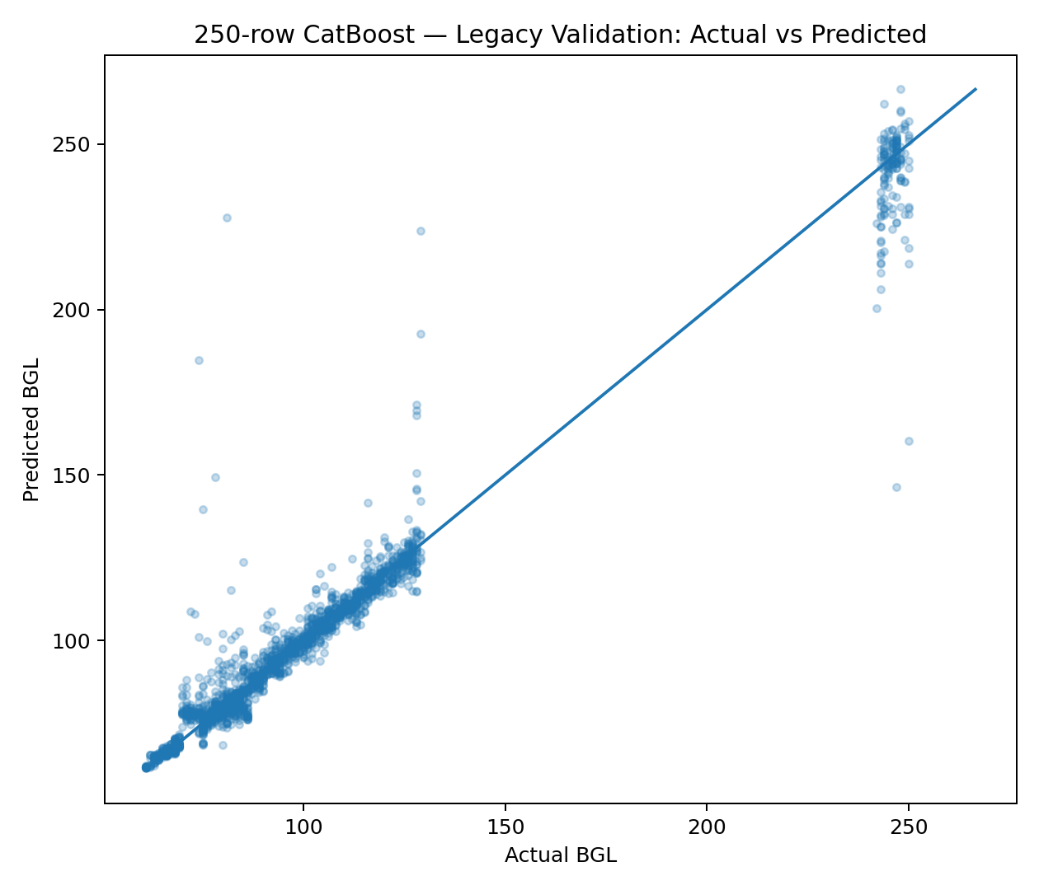
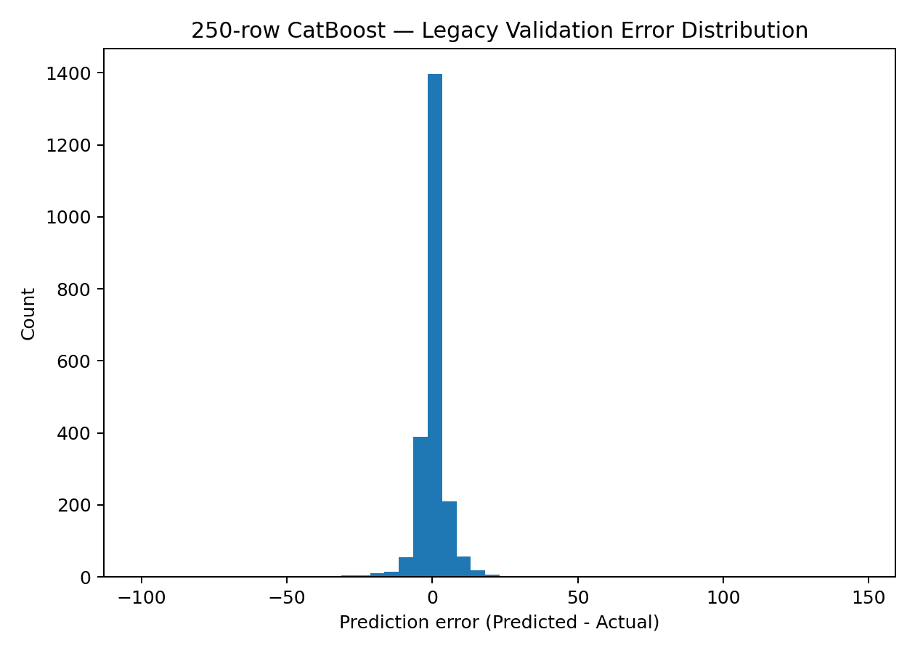
Prediction Quality
What the validation scatter actually tells us
The legacy validation predictions track the target strongly overall.
However, residuals include large errors around regime transitions; this motivated the two-stage experiment.
Plots are descriptive of this validation split, not proof of external generalization.
BGL Wearable Estimation • Engineering Review • 15
Notes:
Point out that a strong scatter plot can still hide systematic failure modes. In this dataset, the most important errors are around transitions into the high-BGL regime.

Slide 16
Reliability / Leakage Audit
The strong result triggered a deliberate audit
Rolling current-row inclusion
PASS
Legacy participant separation
FAIL
Validation history contains train rows
WARNING
Rolling-window overlap
WARNING
Block/session semantics
NOT VERIFIED
External validation
NOT VERIFIED
The rolling calculation itself is past-only.
The legacy split is not participant independent; reconstructed packaging audit found training observations inside essentially every rolling validation history.
The biggest unresolved issue is whether the 701 contiguous blocks represent sessions/recording periods that should be respected by rolling histories.
BGL Wearable Estimation • Engineering Review • 16
Notes:
Be transparent. Say 'the rolling calculation is past-only' but 'the evaluation is not leakage-free in the participant-independent sense.' Also mention that the block/session semantics are not established.

Slide 17
Current Status
COMPLETED
Model + audits
Data, features, models, leakage checks
IN VALIDATION
Participant-level 250
Packaging-time audit included
REMAINING
Block/session meaning
Must be resolved before final claim
Primary reproducible model: CatBoost + 250-row past-only physiological history.
Two-stage and probability-weighted variants are retained as experiments, not the champion.
The current 7.8812 validation score is reproducible, but reliability/generalization is not fully established.
The package contains code, notebooks, documentation, results and this presentation.
BGL Wearable Estimation • Engineering Review • 17
Notes:
This is the project status snapshot. Use the three buckets: completed, in validation, remaining. Avoid calling the project production-ready.

Slide 18
Limitations
Only 13 Age/group values are available; the dataset is small for a general-purpose physiological model.
The source description reports a mixture of true and synthetic records, with low BGL variation for non-diabetic records.
84.06% of usable observations have current BGL equal to previous BGL; a persistence baseline achieves R² ≈ 0.986.
Rolling windows are strongly overlapping, so row counts are not counts of independent samples.
Age is used as a participant/group proxy, but participant identity semantics are not independently established.
No timestamp is present in the working dataframe.
Clinical validation, prospective data collection and external validation have not been performed.
BGL Wearable Estimation • Engineering Review • 18
Notes:
The persistence baseline is a particularly important limitation. It means a high R² can partly reflect target persistence rather than a strong causal/physiological wearable signal.

Slide 19
Future Improvements
Ordered by scientific value
1. Establish block/session semantics
2. Build session-aware 250-row histories if justified
3. Repeat participant-level cross-validation
4. Evaluate diabetic vs non-diabetic/source-defined subsets
5. Freeze methodology and evaluate untouched test data
6. External/prospective validation + uncertainty
7. Production inference, monitoring and model compression
BGL Wearable Estimation • Engineering Review • 19
Notes:
The next step is not more hyperparameter tuning. The highest-value work is to establish what the blocks mean and make the history construction scientifically defensible.

Slide 20
Engineering Conclusion
Built: a reproducible, history-aware CatBoost BGL estimation pipeline.
Learned: BGL is highly persistent in this dataset, and long history captures strong regime information.
Current score: R² 0.9683 / RMSE 7.8812 on the legacy validation design.
Risk: that score is not a participant-independent or clinically validated performance claim.
Next: resolve block/session semantics and revalidate with participant- and time-aware evaluation.
BGL Wearable Estimation • Engineering Review • 20
Notes:
End with the engineering message: the project is valuable because it found a strong signal and, more importantly, identified exactly why that signal must be validated carefully before claiming real-world capability.

