Slide 1

Estimating blood glucose level using non-invasive wearable device data
2021UIC3504 LAKSHAY SHARMA
2021UIC3507 ASHISH CHANDELA
2021UIC3509 VANSH GOYAL
End Term Review
ICICC23 B. Tech Project– II

Slide 2
Contents
Introduction
Literature Survey
Gaps Identified
Aim/Objectives
Problem Statement/Methodology/Equations
Results
References

Slide 3
Introduction
Diabetes impairs the body's ability to regulate glucose, necessitating frequent monitoring of blood glucose levels (BGL).
Traditional invasive methods are often impractical for continuous use.
This study explores AI-driven, non-invasive BGL estimation using data from wearable devices
Frequency of Finger-Prick Glucose Monitoring
Frequency (per day) | % of Diabetic Patients
1–2 times | 42%
3–5 times | 36%
>5 times | 12%
Rarely/None | 10%

Slide 4
Literature Survey
Aspect | Observation | Supporting Statistic | Example Studies
Traditional ML Models | Random Forest (RF) is the most frequently used classical ML model | 34% of studies (15 out of 44) | [2], [3], [4], [5]
Task Type | Regression is preferred over classification for glucose prediction tasks | 68% of studies (30 out of 44) | [5], [6], [7], [8], [9]
Evaluation Metrics | RMSE is the most widely reported performance metric | 71% of studies (31 out of 44) | [3], [4], [5], [8], [9]
Data Balancing Technique | SMOTE and its variants (e.g., ADASYN) are commonly used for class imbalance | 27% of studies (12 out of 44) | [10], [11], [12], [13]
To assess model effectiveness, metrics such as Clarke Grid Error (CGE) [2,3,4,13] and Root Mean Square Error (RMSE) [2,3,5, 7, 8] were predominantly employed. The reported RMSE values spanned from 0.357 to 25.621

Slide 5
Gaps Identified
Gaps:
Prior work often ignored class/data imbalance issues, leading to biased models..
any studies rely on static datasets and do not account for time related dependencies, which are critical in real-world wearable data.
Under-utilized Feature Selection and model explainability tools (correlation maps, feature importance plots etc).
Metric Inconsistency: RMSE, MAE, CGE used interchangeably—hard to compare.
Wearables are often expensive, in early development, and not yet FDA-approved.
Lack of public benchmark datasets for fair comparisons.
Few papers address denoising techniques for wearables (e.g., wavelet transforms + ML).
Lack of exploration into hybrid ML-DL architectures (e.g., XGBoost for feature selection + LSTM for time-series)

Slide 6
Aim/Objectives/Scope/Limitations
Aim:
To identify the best-performing model for potential real-time deployment in non-invasive monitoring systems.
Objectives:
•Identification, Analysis & Preprocessing of the dataset from wearable devices
•Application of multiple models to estimate BGL using the processed data
•Identification of the most accurate model using metric evaluation
Scope:
A highly accurate , cross platform software ready for deployment and use
Capable of real time and continuous detection of BGL
Limitation:
Not FDA Approved or clinically proven
Still no framework for prediction based on long term data
Not compatible for all devices due to complex and long code
Results assume high-quality sensor data (may not generalize to noisy wearables).

Slide 7
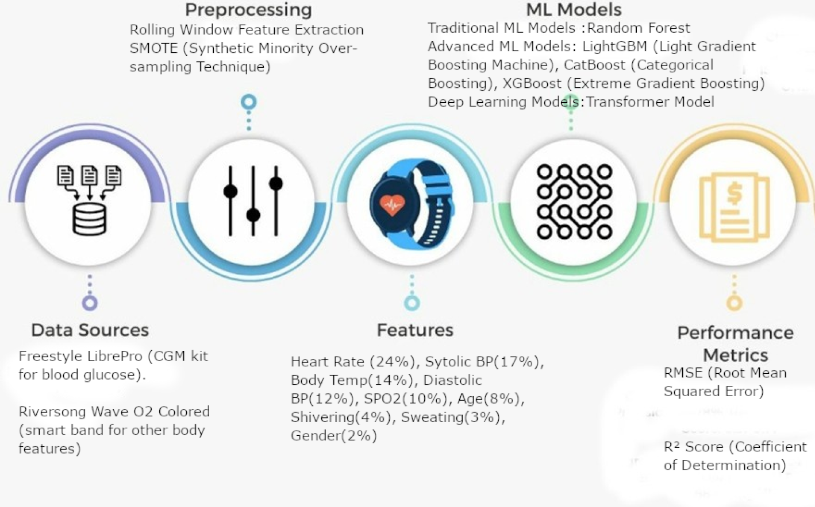
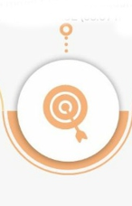


Problem Statement/Methodology/Equations Used
Problem Statement
Invasive glucose monitoring is inconvenient. We aim to estimate blood glucose non-invasively using wearable data and machine learning.

Slide 8
Result/Outcomes of the work
Result:
Model | Validation RMSE | Validation R² | Test RMSE | Test R²
CatBoost | 2.6724 | 0.9935 | 2.8193 | 0.99304
XGBoost | 2.6516 | 0.9936 | 2.9334 | 0.9925
ADASYN (XGBoost) | 2.2085 | 0.9968 | 3.5771 | 0.9939
Random Forest | 3.5449 | 0.9886 | 3.5864 | 0.9887
LightGBM | - | - | 4.5246 | 0.9902
Transformer | - | - | 8.6406 | 0.9346
RMSE (Test): Best ~2.18, worst ~8.64
R² (Test): Best ~0.9977, lowest ~0.9346
Incorporates modern ML techniques (boosting, Transformer) and evaluates generalization more robustly.
Uses a 1500-time-step rolling window and applies SMOTE for data balancing.
Outcomes:
RMSE reflects the average error in mg/dL. A lower RMSE (e.g., ~2 mg/dL in CatBoost) means near-clinical-grade accuracy, reducing the risk of false alarms or missed alerts.
An R² close to 1 (e.g., 0.9977 for CatBoost) means the model can accurately follow physiological glucose fluctuations, helping in personalized insulin dosing or lifestyle recommendations..

Slide 9
References
[1] A. Ahmed, S. Aziz, U. Qidwai, A. Abd-Alrazaq, and J. Sheikh, “Performance of artificial intelligence models in estimating blood glucose level among diabetic patients using non-invasive wearable device data,” Comput. Methods Programs Biomed. Update, vol. 3, p. 100094, 2023, doi: 10.1016/j.cmpbup.2023.100094.
[2] A. Prabha et al., “Non-invasive diabetes mellitus detection system using machine learning techniques,” in Proc. 11th Int. Conf. Cloud Comput., Data Sci. Eng. (Confluence), 2021.
[3] A. Hina and W. Saadeh, “A noninvasive glucose monitoring SoC based on single wavelength photoplethysmography,” IEEE Trans. Biomed. Circuits Syst., vol. 14, no. 3, pp. 504–515, 2020.
[4] X. Zhou et al., “Joint empirical mode decomposition and singular spectrum analysis based pre-processing method for wearable non-invasive blood glucose estimation,” in Proc. IEEE 4th Int. Conf. Signal Image Process. (ICSIP), 2019.
[5] Z. Li et al., “Wearable non-invasive blood glucose estimation via empirical mode decomposition based hierarchical multiresolution analysis and random forest,” in Proc. IEEE 23rd Int. Conf. Digital Signal Process. (DSP), 2018.
[6] B. Bent et al., “Non-invasive wearables for remote monitoring of HbA1c and glucose variability: proof of concept,” BMJ Open Diabetes Res. Care, vol. 9, no. 1, p. e002027, 2021.
[7] A. Rghioui et al., “A smart glucose monitoring system for diabetic patient,” Electronics, vol. 9, no. 4, p. 678, 2020.
[8] G. Alfian et al., “A personalized healthcare monitoring system for diabetic patients by utilizing BLE-based sensors and real-time data processing,” Sensors, vol. 18, no. 7, p. 2183, 2018.
[9] A. M. Joshi et al., “iGLU 2.0: a new wearable for accurate non-invasive continuous serum glucose measurement in IoMT framework,” IEEE Trans. Consum. Electron., vol. 66, no. 4, pp. 327–335, 2020.

Slide 10
References
[10] N. Kascheev et al., “Non-invasive monitoring of blood glucose by means of wearable tracking technology,” in Proc. IEEE East-West Design & Test Symp. (EWDTS), 2017.
[11] N. Kularathne et al., “Dia-Shoe: a smart diabetic shoe to monitor and prevent diabetic foot ulcers,” in Proc. Int. Conf. Adv. Comput. (ICAC), 2019.
[12] M. Sevil et al., “Determining physical activity characteristics from wristband data for use in automated insulin delivery systems,” IEEE Sens. J., vol. 20, no. 21, pp. 12859–12870, 2020.
[13] M. M. Islam and S. M. Manjur, “Design and implementation of a wearable system for non-invasive glucose level monitoring,” in Proc. IEEE Int. Conf. Biomed. Eng., Comput. Inf. Technol. Health (BECITHCON), 2019.
[14] Deepali Javale, Sharmishta Desai, "Dataset for People for their Blood Glucose Level with their Superficial body feature readings.", IEEE Dataport, July 7, 2021, doi:10.21227/c4pp-6347

Slide 11
Thank You
2021UIC3504 LAKSHAY SHARMA
2021UIC3507 ASHISH CHANDELA
2021UIC3509 VANSH GOYAL
End Term Review
ICICC23 B. Tech Project– II

