Slide 1
Estimating blood glucose level using non-invasive wearable device data

Slide 2
Index
What is the project about
All about Dataset
How the data was processed
Machine learning pipeline architecture
Results and outcomes
Limitations
Future work to be done

Slide 3
What is the project about
Approximately 589 to 590 million adults (aged 20–79) worldwide are living with diabetes
80% of diabetic patients perform painful finger-prick tests up to 5 times daily
CGMs are great alternatives but involves a minimal pricking
This project involves using data from smartwatches and fit bands to estimate the BGL

Slide 4
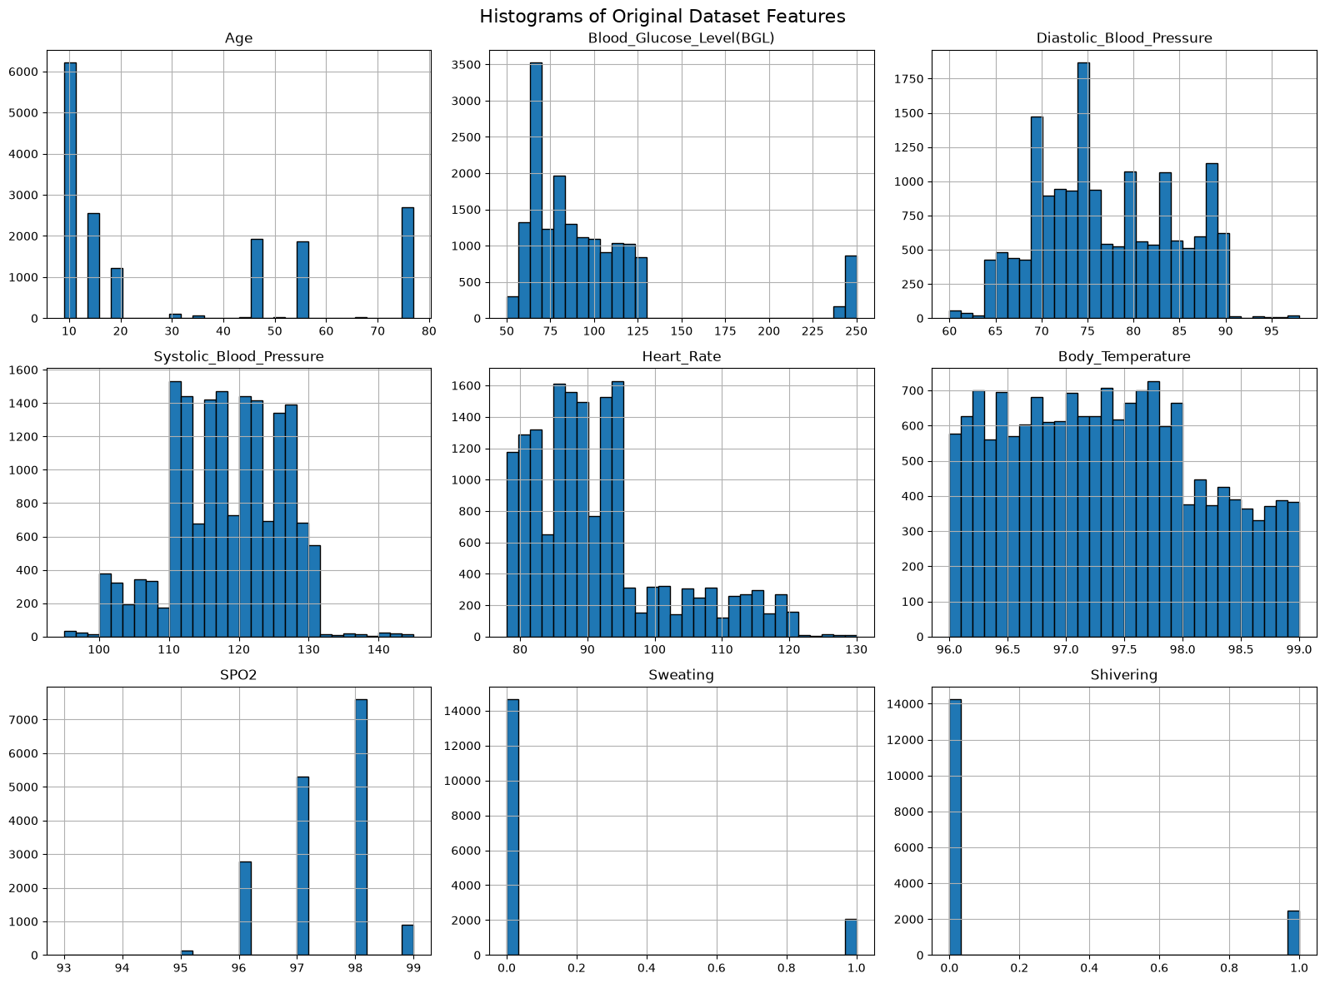
All about Dataset

Slide 5
All about Dataset

Slide 6
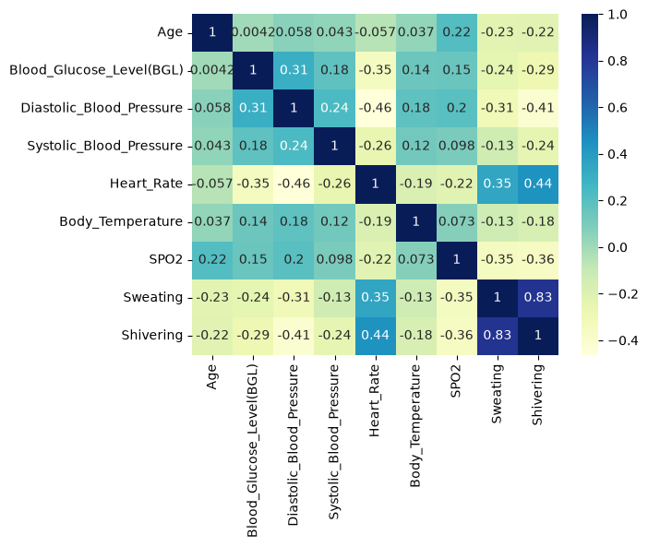
All about Dataset

Slide 7
Dataset anlaysis
Total Records: 16,969 rows across 10 features.
Missing Values: 0 null values across all columns.
Duplicate Records: 272 duplicate rows present in the dataset.
Target Variable Imbalance: Extreme class imbalance in Diabetic/Non Diabetic (D/N):
  Diabetic (D): 16,641 records (98.07%)
  Non-Diabetic (N): 328 records (1.93%)

Slide 8
Problems with dataset
There is an high imbalance in data points across age some ages like 9 have around 6000 data points but ages such as 36 ,51 and 66 have less than 50 points
The blood glucose readings are not continuous they are divided into two regimes BGL<130 and BGL 240-250

Slide 9
How the data was pre-processed
Data Cleaning: Loaded raw healthcare dataset and drop-duplicated 253 identical patient entries (16,969 to 16,715 unique rows).
Type Conversion & Binary Mapping: Converted vital health metrics to numeric types and mapped target categories into binary format (0 = Non-Diabetic, 1 = Diabetic).
Feature Engineering: Created rolling window metrics (window size = 1,500) calculating the rolling mean and rolling standard deviation across core vital signs.
Imbalance Handling: Handled severe class imbalance using SMOTE and ADASYN oversampling techniques, as well as Random Under sampling experiments.
Data Splitting: Divided the processed dataset into 80% Training, 10% Validation, and 10% Testing splits.
Feature Normalization: Scaled features using StandardScaler fitted strictly on training data to prevent data leakage across validation and test sets.

Slide 10
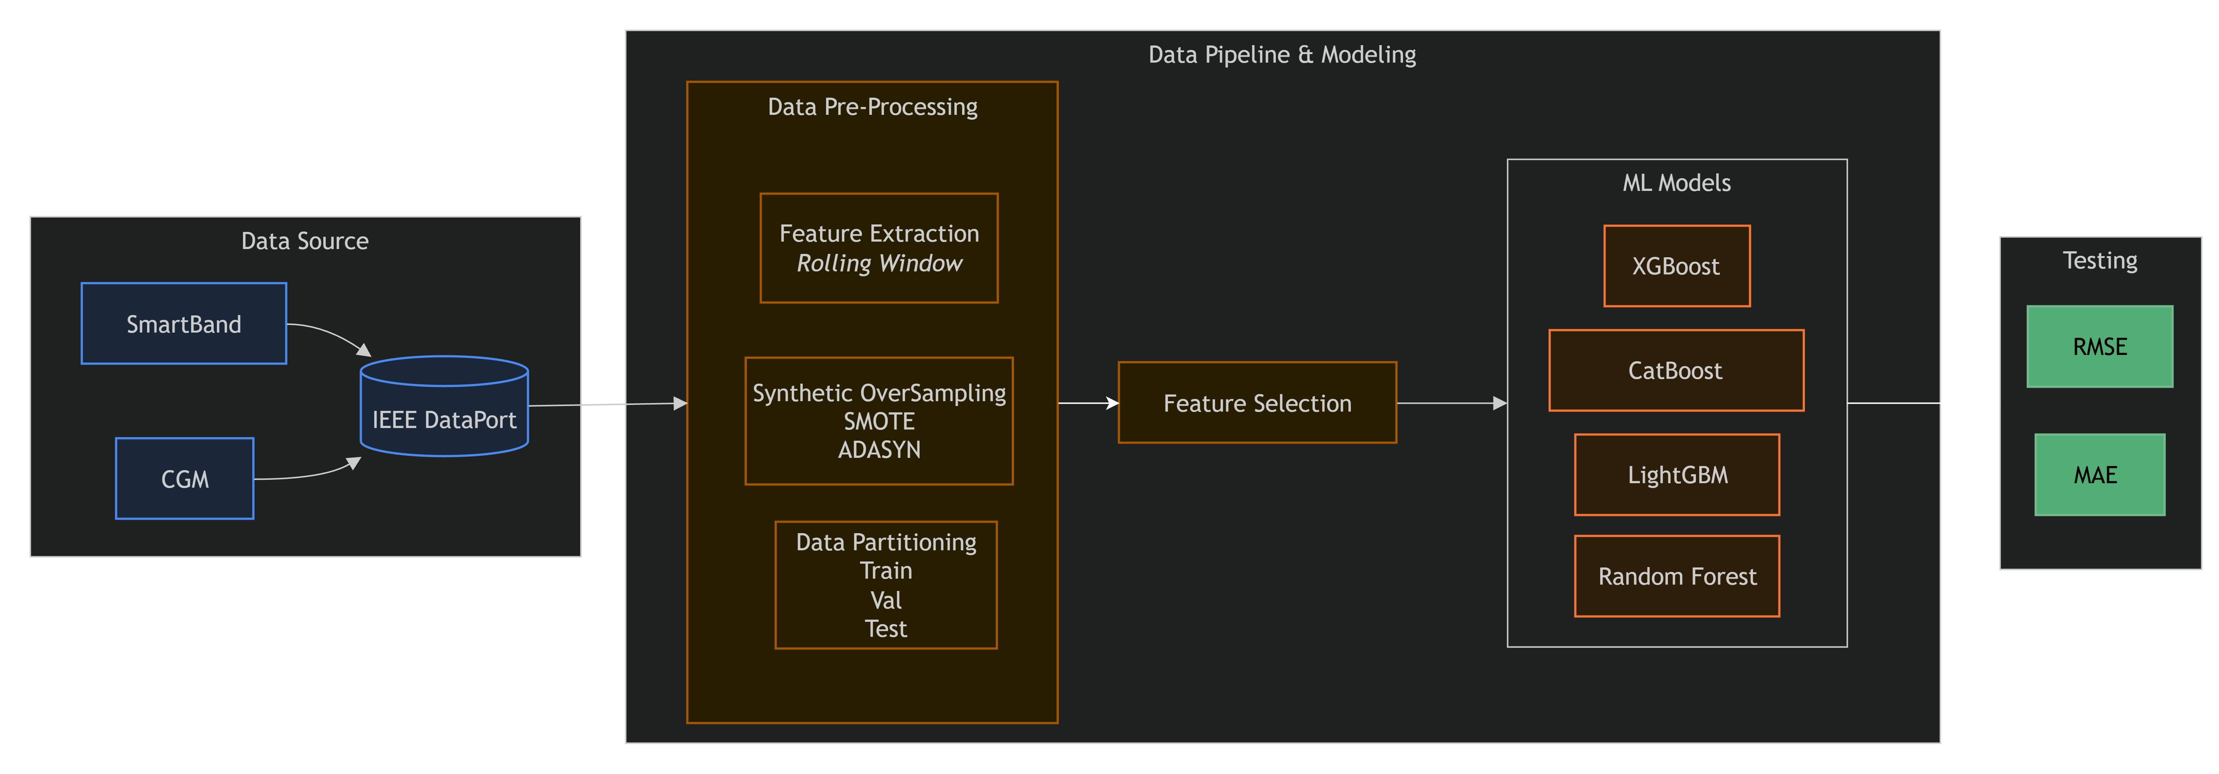
Machine learning pipeline architecture
.

Slide 11
Result/Outcomes
Model | Sampling / Resampling Strategy | Validation RMSE | Validation R2 | Test RMSE | Test R2
CatBoost | None | 3.0904 | 0.9938 | 2.1802 | 0.9977
CatBoost | SMOTE | 2.6724 | 0.9935 | 2.8194 | 0.9930
CatBoost | ADASYN | 2.0988 | 0.9971 | 2.7074 | 0.9965
LightGBM | None | — | — | 4.5246 | 0.9902
XGBoost | SMOTE | 2.4887 | 0.9944 | 3.1013 | 0.9916
XGBoost | ADASYN | 2.6898 | 0.9953 | 3.8396 | 0.9929
XGBoost | Random Undersampling | 9.7628 | 0.9381 | 5.7120 | 0.9844
Random Forest | SMOTE | 3.5449 | 0.9886 | 3.5864 | 0.9887

Slide 12
Limitations
Dataset used is very limited and highly imbalanced containing for proper training of ml models
The pre processing can be done more efficiently to give a better data for training the models
  Rolling Window feature extraction was applied in reverse giving model future readings causing extrapolated results
  SMOTER was applied before train test split causing artificial points to enter the test data
  Using StandardScaler are not useful in tree based models
  Randon splitting was done for train test val set
Uses only classical and traditional ML models

Slide 13
Future work to be done
A better dataset ( like Physio CGM: a multimodal physiological dataset for non-invasive blood glucose estimation ) can be used
Comparison Metric | Uploaded Dataset (dataset.xlsx) | PhysioCGM Dataset
Data Structure | Static tabular CSV/Excel (16,969 single-row entries). | High-resolution multi-channel time series (raw & 5-min pre-processed .pkl windows).
Physiological Modalities | Discrete summary features: Age, BP (Systolic/Diastolic), HR, Body Temp, SPO2, binary Sweating, and Shivering. | Raw continuous waveforms: High-frequency ECG (250 Hz), PPG (64 Hz), EDA/GSR, Skin Temp, and Accelerometery.
Blood Glucose Ground Truth | Single snapshot scalar readings (ranging from 50 to 250{ mg/dL}). | Continuous Glucose Monitor (Dexcom G6 CGM) readings recorded automatically every 5 minutes.
Temporal Context | Isolated point-in-time clinical/vital observations. | Multi-day longitudinal tracking (up to 17 continuous days per subject in free-living conditions).
Advanced Signal Processing | Not possible (limited to basic tabular ML like Logistic Regression or Random Forest on static vitals). | Supports advanced feature extraction (HRV, pulse wave velocity, spectral power) and deep learning models (CNNs, LSTMs, Transformers).

Slide 14
Future work to be done
Better preprocessing
  The dataset must be classified between two regimes and then regression models must be applied separately to both regimes
  Since the number of data points for every age is different the rolling window must be applied to every age separately with different window size

Slide 15
Thank you

