Slide 1

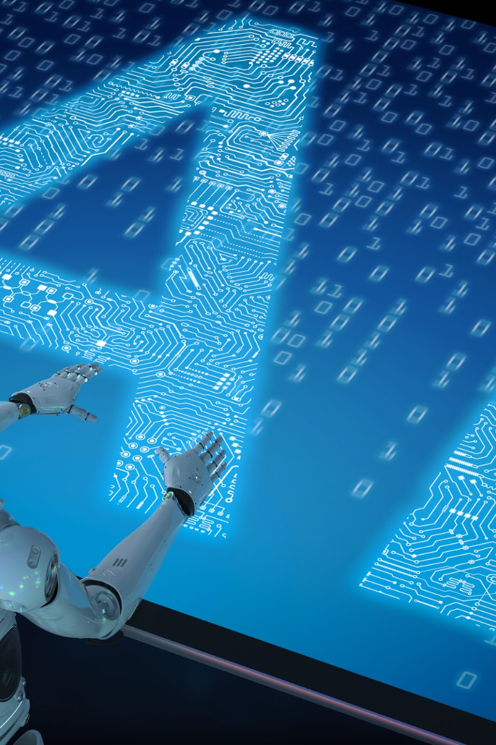
AI Text Summarizer
Discover the power of AI text summarization. Understand the importance of automating text processing and learn how this cutting-edge technology works.
BY: Jay Mehta - PC 14
Yuvraj Singh Lamba - PC 20
Keshav Jha - PC 22
Vansh Gurnani - PC 25

Slide 2

What is AI Text Summarizer?
Definition
AI text summarizer is an advanced technology capable of reducing large volumes of text into shorter summaries without losing key information.
The need for summarization
Given the ever-growing volume of information, text summarization is essential to quickly gather the main points of an article, report or research paper.
The role of AI
AI-driven text summarization technology intelligently identifies and extracts essential information from the original text, turning it into a concise and coherent summary.

Slide 3
Algorithm
1. Imports and Setup:
The code begins by importing necessary libraries, such as Flask for creating the API endpoints, NLTK for natural language processing tasks like tokenization and frequency distribution, and `heapq` for getting the top sentences.
It initializes a Flask app and enables CORS (Cross-Origin Resource Sharing) to allow cross-origin requests.
2. Routes:
There are two routes defined:
`'/'` simply returns 'Hello, World!' when accessed.
`'/get_summary'` is a POST route that expects JSON data with a 'text' key containing the input text for summarization.
3. Tokenization and Preprocessing:
The `get_summary` function retrieves the input text from the POST request's JSON payload.
It tokenizes the text into sentences using `sent_tokenize` from NLTK.
Tokenizes the words and removes English stopwords (common words that don't carry significant meaning) using NLTK's `stopwords` corpus.

Slide 4
4. Calculating Word Frequencies:
The code calculates the frequency distribution of the words in the text after filtering out stopwords.
5. Scoring Sentences:
For each sentence in the input text, it calculates a score based on the sum of frequencies of the words present in that sentence.
6. Generating Summary:
Selects the top 5 sentences with the highest scores using `heapq.nlargest`.
Joins these sentences together to create the summary.
7. Calculating Accuracy:
The `calculate_accuracy` function takes the original text and the generated summary.
It calculates the accuracy of the summary by comparing the number of shared words between the original text and the summary.
8. Running the App:
Finally, the app runs in debug mode.

Slide 5



Benefits of AI Text Summarizer
Time-saving
Increased accessibility of information
Improved productivity and efficiency
AI text summarizer saves readers and researchers significant amounts of time by quickly providing condensed information.
AI text summarizer allows people with disabilities, those with low literacy levels and others to access and understand written information quicker and easier.
AI text summarizer helps manage information overload, streamlines research procedures and helps businesses make informed decisions about market trends.

Slide 6

Use Cases and Applications
1
News and Article Summarization
AI text summarizer is widely used by media outlets to summarize news stories and make it more appealing to readers.
Academic Research and Literature Review
2
AI text summarizer is useful for students and researchers who are required to read and critically analyze a large amount of textual data.
3
Business and Market Intelligence
AI text summarizer is highly effective in helping businesses and investors keep up to date with market trends and developments, enabling them to stay ahead of the curve.

Slide 7
Future Prospects and Advancements
Emerging Trends
Potential Improvements
Impact on Industries
New trends in AI text summarization include utilizing deep learning algorithms, integrating knowledge graphs, and using multi-modal approaches to enhance the sophistication of the technology.
Future developments in AI text summarization may focus on improving interpretability, tackling the challenge of summarizing various forms of media types such as images and videos, and developing a more customizable and adaptable system.
The development of AI text summarization is set to revolutionize various industries, such as journalism, education, finance, and healthcare, making it easier for individuals and businesses to access and analyze essential information quickly and efficiently.

Slide 8
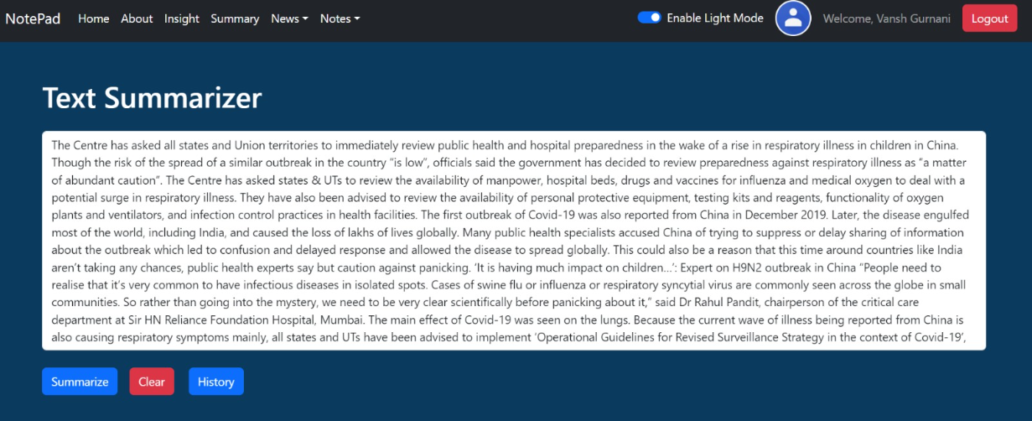
SCREENSHOTS

Slide 9

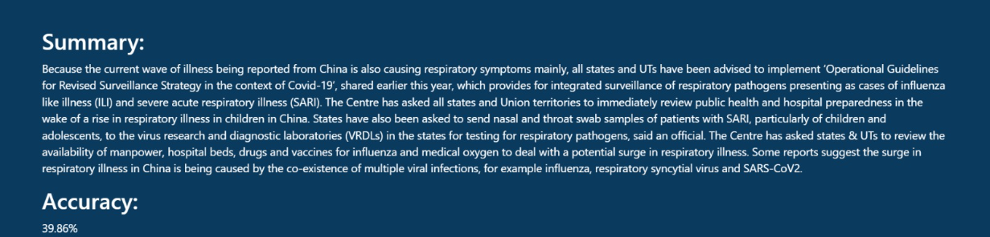

Slide 10
Conclusion
Recap of key points
Importance of AI Text Summarizer
AI text summarizer is an emerging technology that uses advanced algorithms to quickly summarize large amounts of text into concise and coherent summaries. It offers numerous benefits, including improved productivity, accessibility, and time-saving.
AI text summarizer is a game-changer as it helps people better manage information overload and make informed decisions faster. As AI technology continues to evolve, the potential for further advancements and new applications is significant.

Slide 11
Thank You

