Slide 1

Customer Churn Prediction Project
SRM INSTITUTE OF SCIENCE AND TECHNOLOGY
FACULTY OF ENGINEERING AND TECHNOLOGY
DEPARTMENT OF DATA SCIENCE AND BUSINESS SYSTEMS
21CSS202T FUNDAMENTALS OF DATA SCIENCE
- Project Review 2
Pratyush Jaitely- RA2311027010072
Aryan Nair- RA2311027010075
Srijan Ghosh - RA2311027010070

Slide 2
Table of contents
Abstract
Objectives
Architecture diagram
Sample Dataset

Slide 3
Abstract
This project addresses the critical issue of customer churn in telecom companies, aiming to develop a predictive model using historical customer data. Key features like usage patterns, billing information, and customer demographics are analyzed to identify users at risk of leaving the service.
The model utilizes various machine learning techniques, including Decision Tree Classifier, Random Forest Classifier, K-Nearest Neighbors (KNN), Support Vector Classifier (SVC), Multi-Layer Perceptron (MLP), AdaBoost, Gradient Boosting, Extra Trees, Logistic Regression.
Preprocessing steps involve standardizing data with `StandardScaler` and encoding categorical variables using `LabelEncoder`. The dataset is split into training and testing sets with `train_test_split`, and model performance is evaluated using metrics such as accuracy, recall, precision, F1-score, ROC curve, and confusion matrix. By leveraging these models and metrics, the project aims to deliver data-driven insights to help telecom companies implement effective retention strategies and reduce churn.

Slide 4
Objectives
Identify Customer Churn: Develop a predictive model to identify customers at risk of leaving the telecom service
Leverage Customer Data: Utilize historical customer data, including usage patterns, billing information, and demographics, to improve prediction accuracy.
Generate Data-Driven Insights: Provide insights that telecom companies can use to understand customer behavior and factors influencing churn.
Support Targeted Retention Strategies: Enable companies to implement focused retention strategies to reduce customer churn rates.
Enhance Customer Loyalty: Help increase customer loyalty and retention through proactive interventions based on model predictions

Slide 5
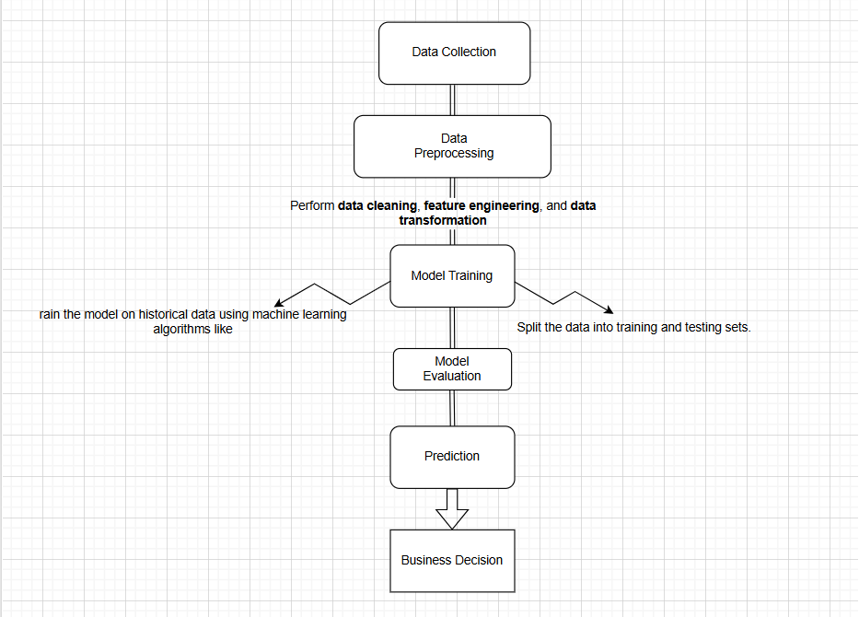
Architecture Diagram

Slide 6
Dataset variables
The dataset used in this project contains 7043 entries, each representing a customer from a telecom company. It includes various columns that capture demographic information, service usage, and billing details. The columns are as follows:
customerID: A unique identifier for each customer.
gender: Gender of the customer (Male or Female).
SeniorCitizen: Indicates whether the customer is a senior citizen (1) or not (0).
Partner: Specifies if the customer has a partner (Yes or No).
Dependents: Indicates if the customer has dependents (Yes or No).
tenure: The number of months the customer has been with the company.
PhoneService: Specifies if the customer has phone service (Yes or No).
MultipleLines: Indicates if the customer has multiple phone lines (Yes or No).
InternetService: Type of internet service (DSL, Fiber optic, or No).
OnlineSecurity: Specifies if the customer has online security service (Yes or No).

Slide 7
Dataset variables
OnlineBackup: Indicates if the customer has online backup service (Yes or No).
DeviceProtection: Specifies if the customer has device protection (Yes or No).
TechSupport: Indicates if the customer has technical support service (Yes or No).
StreamingTV: Specifies if the customer has streaming TV service (Yes or No).
StreamingMovies: Indicates if the customer has streaming movie service (Yes or No).
Contract: The type of contract the customer has (Month-to-month, One year, or Two years).
PaperlessBilling: Specifies if the customer uses paperless billing (Yes or No).
PaymentMethod: The payment method used by the customer (Electronic check, Mailed check, Bank transfer, or Credit card).
MonthlyCharges: The monthly charges for the customer.
TotalCharges: The total amount charged to the customer.
Churn: The target variable indicating whether the customer has churned (Yes or No).

Slide 8
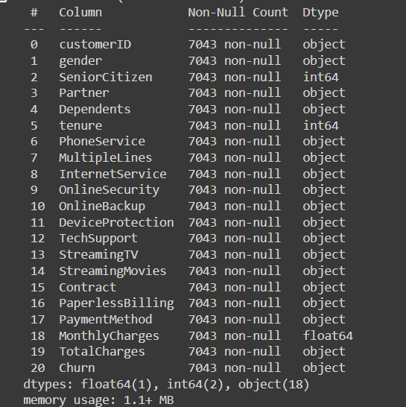
Sample dataset

Slide 9
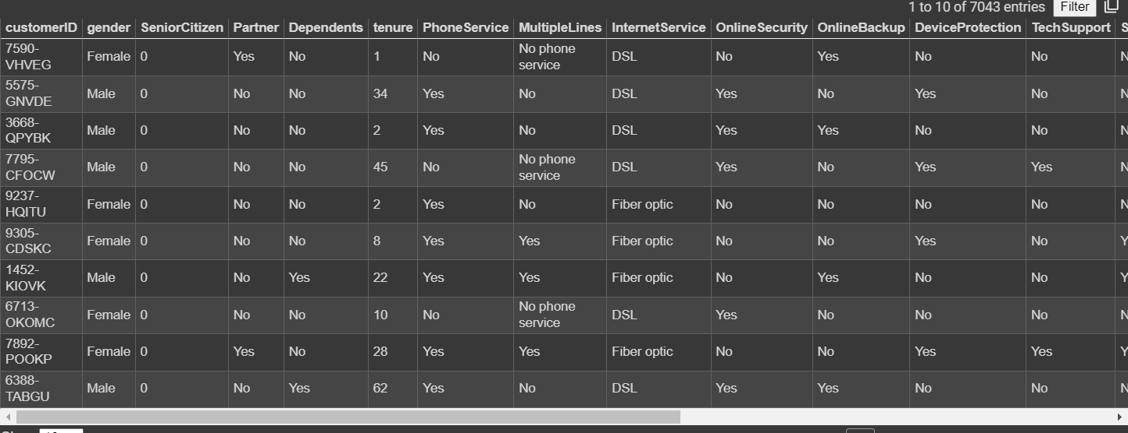

Slide 10
Thank You!

