Slide 1
Virtualization & Cloud Computing
Customer Clustering Using K-Means Algorithm Over Google Cloud Platform
Assignment 3
By: Group 01
Vanshika Gupta(G23AI2050)
Aneerban Chowdhury(G23AI2059) Shikha Soni(G23AI2075)

Slide 2
ABSTRACT
Businesses face challenges in accurately segmenting customers so that they can enhance their marketing strategies.
In this project we have used ML model- K-Means clustering for the data classification task.
A Flask web app presents the segmentation results.
The solution is then deployed on Google Cloud Platform for reliability and scalability.
We have also later established the benefits of deploying an web application over cloud platform rather than on local machines.

Slide 3
URLs To Project
Github link of our project:
https://github.com/vanshika-gup/vcc-group1-2050-59-75/tree/main
Link to our web app. We have disabled it for the moment due to cost issue.
https://vcc-group1-2050-59-75.as.r.appspot.com/

Slide 4
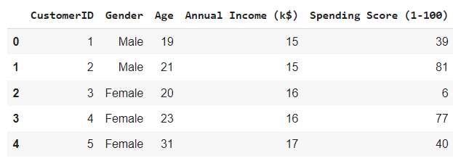
Code Working - K-Means Clustering
We used K-Means clustering for our classification task in this case. We had a dataset of Mall_Customers.csv.
The data had columns :

Slide 5
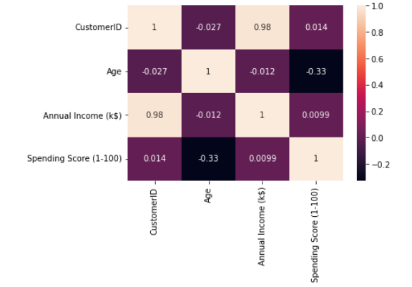
Then, we calculated the co-variance matrix for all features.
We select our features for model building then based on co-variance matrix.
1. Annual Income 2. Spending Score

Slide 6
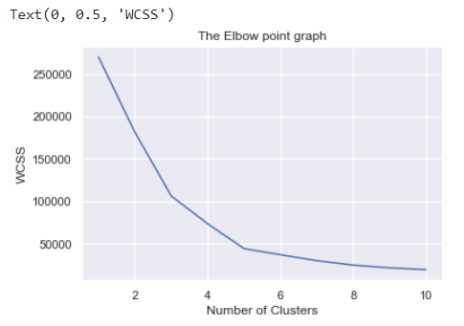
Then, we used WCSS to help us figure out number of clusters.
Based on this its clear we will be going forward with 5 clusters.

Slide 7
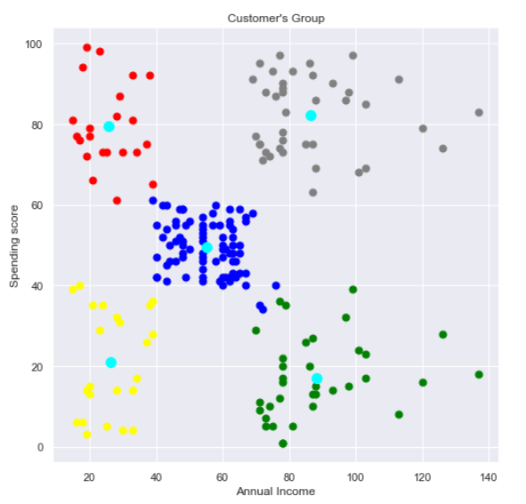
After applying our model we get our desired clusters.

Slide 8
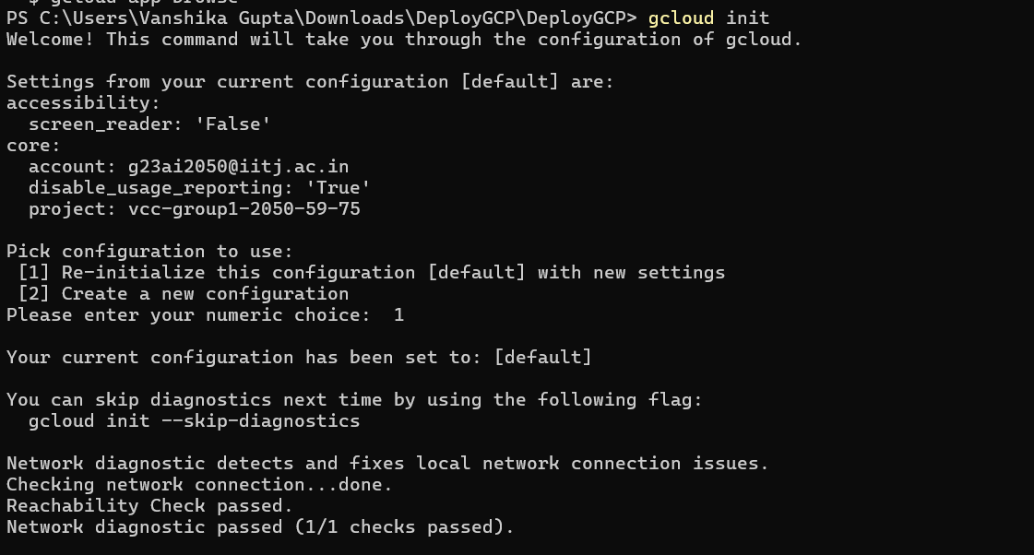
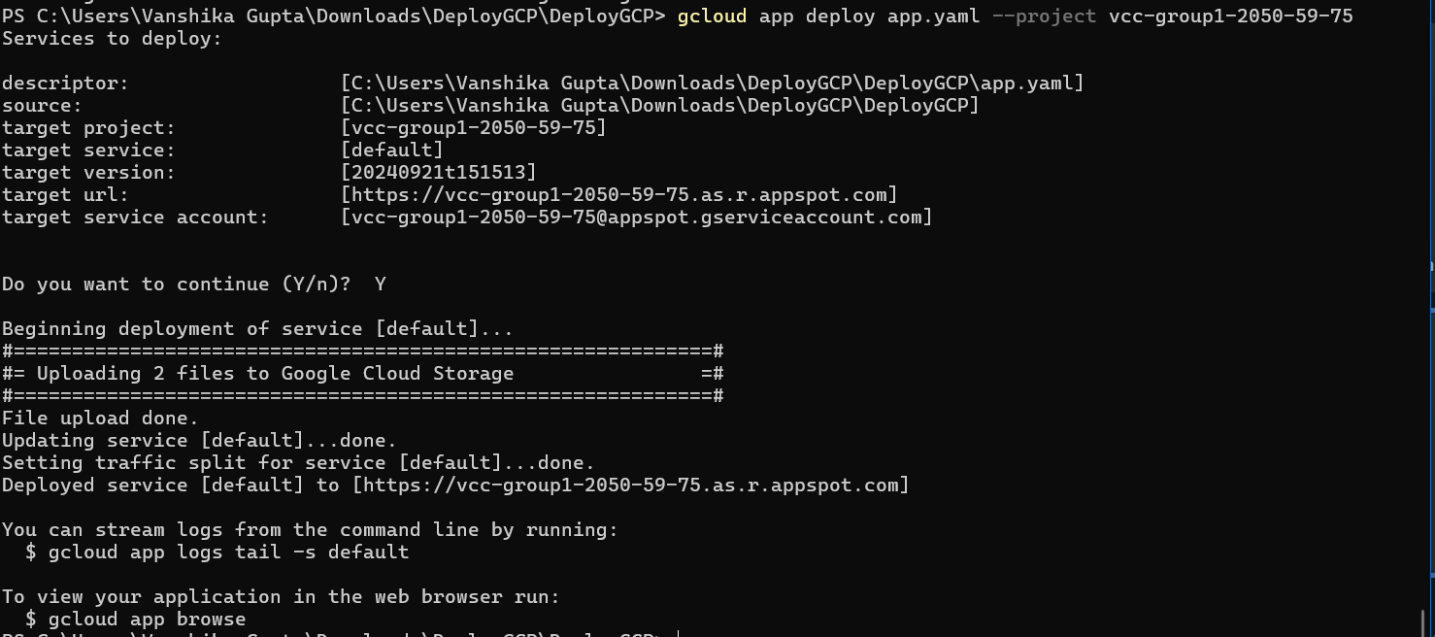
Deploying The Project On Cloud
We use the model.pkl to store the trained K-Means models, and serializing using pickle module.
We can then Flask App and a app.yaml file to visualize our model through a web application.
We then deployed our model over Google cloud.

Slide 9
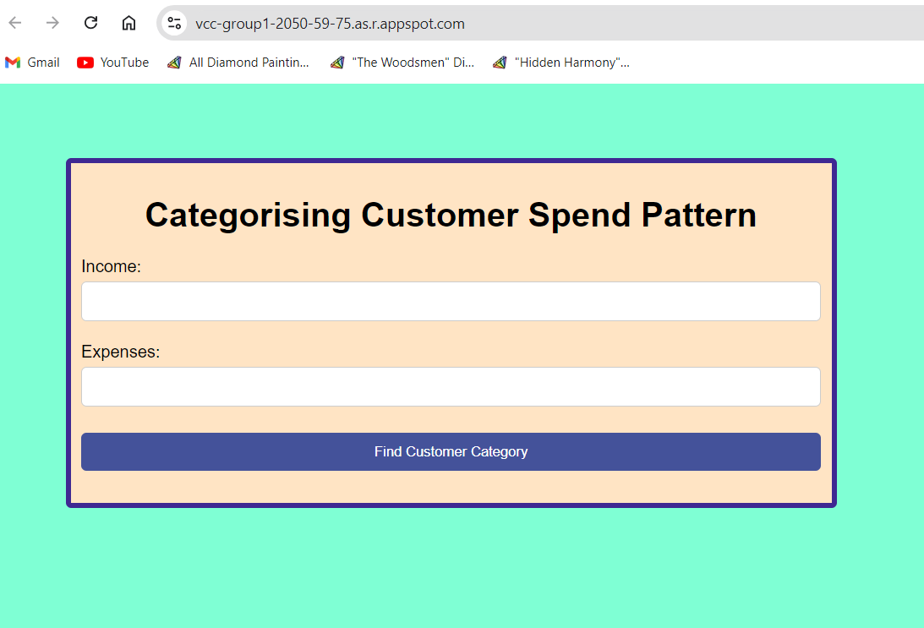
Final Outcome
Our project divides the customers into 5 clusters. The U.I interface looks like this:

Slide 10
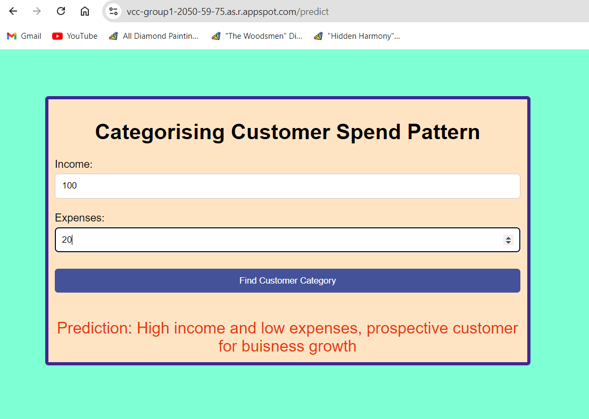

Slide 11
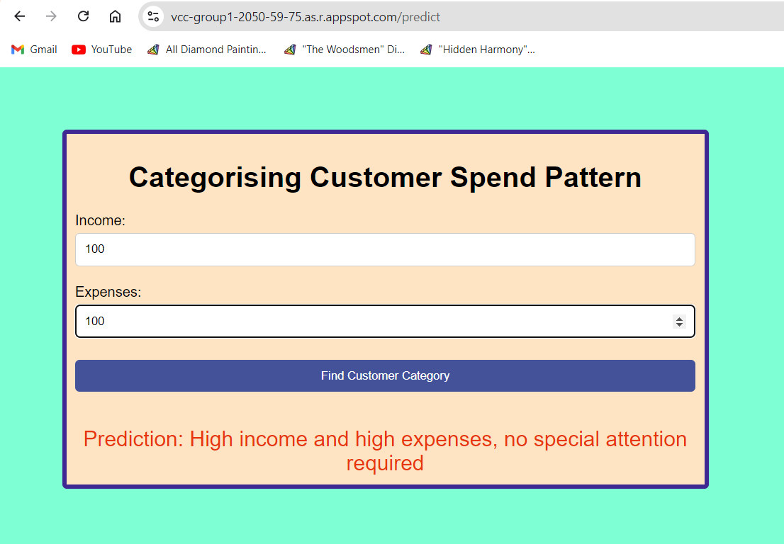

Slide 12
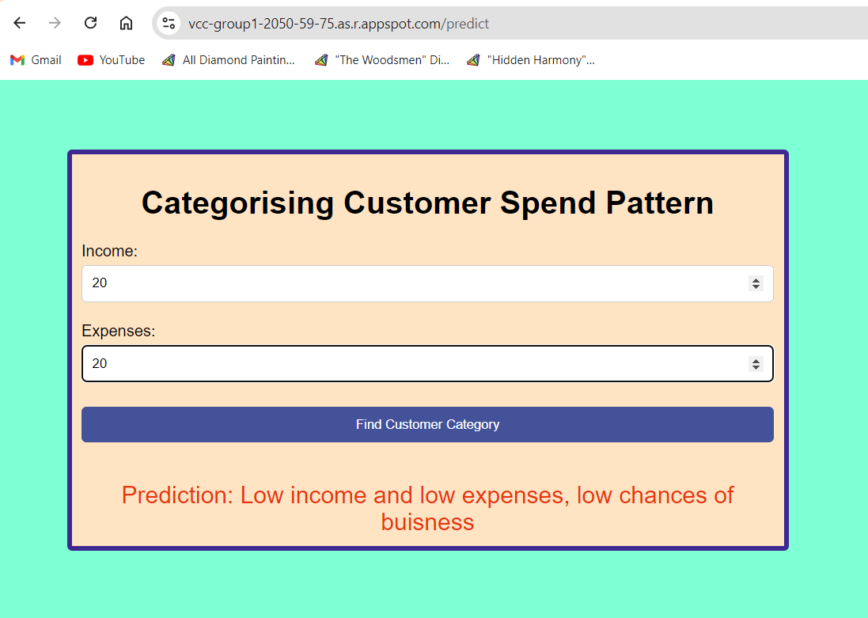

Slide 13
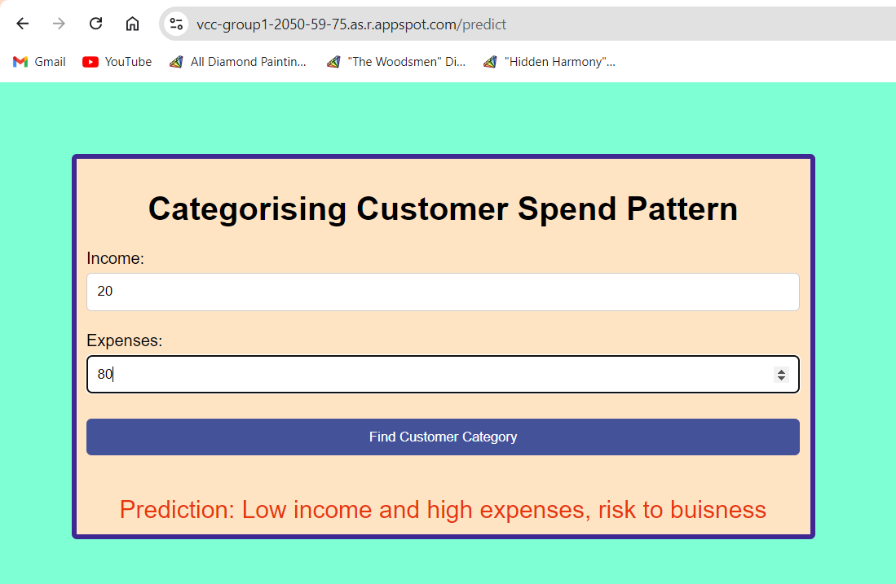

Slide 14
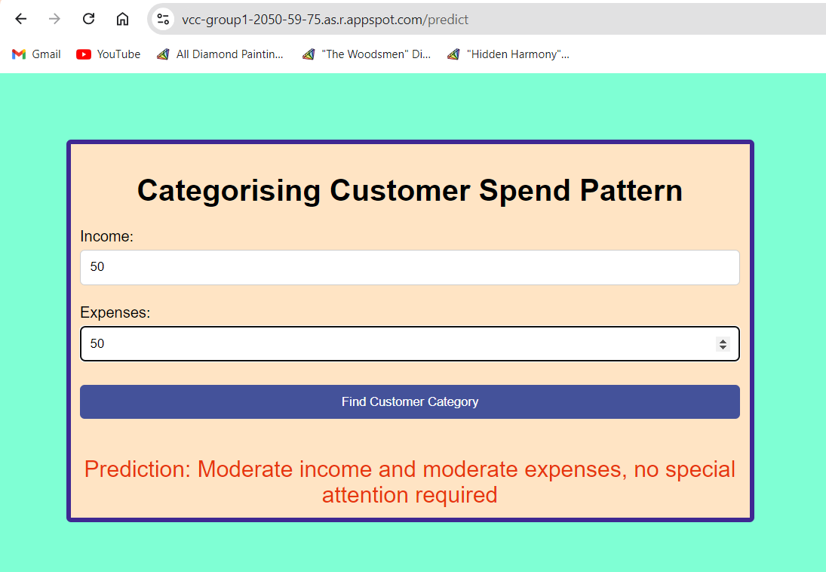

Slide 15
GCP V/S LOCAL SYSTEM
Scalability: GCP handles traffic spikes better than local setups.
Management: GCP automates updates and scaling processes.
Cost: Local development may incur higher maintenance costs over time.
Accessibility: GCP allows access from anywhere with internet.
Performance Metrics: Discuss any observed differences in response times.

Slide 16
CONCLUSION
Deploying the customer segmentation application on GCP not only improved scalability and security but also provided a powerful platform for innovation, paving the way for future enhancements and expansions in data-driven decision-making.

Slide 17
THANK YOU

