Slide 1
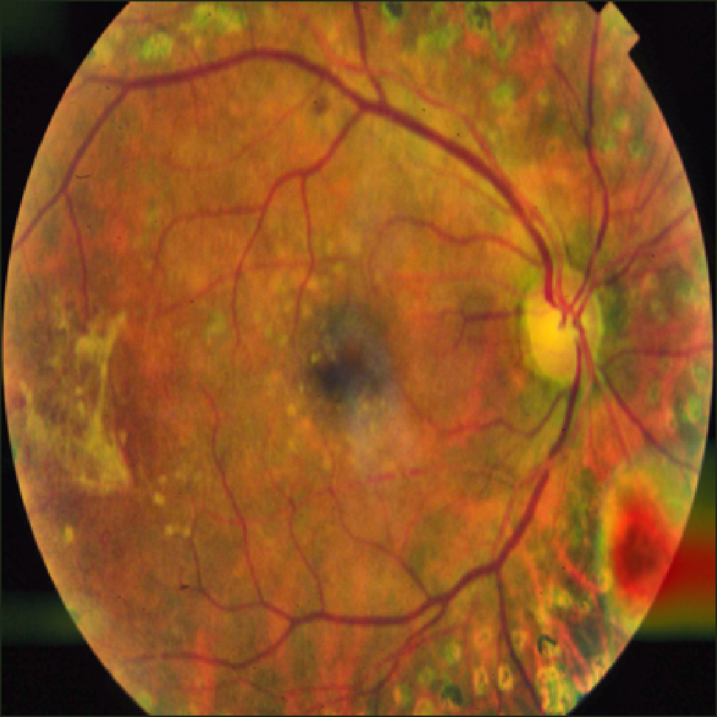
SMART INDIA HACKATHON 2026
NETRA — Neural Explainable Triage for Retinal Assessment
Problem Statement ID – 26038 Problem Statement Title – Explainable AI for Diabetic Retinopathy Screening in Rural India Theme – MedTech / BioTech / HealthTech PS Category – Software Team ID – <<TEAM ID>> Team Name – <<TEAM NAME>>
Grad-CAM attention on a held-out test image — the evidence behind the grade

Slide 2
IDEA TITLE
Your Team Name
Proposed Solution (Describe your Idea/Solution/Prototype) · Detailed explanation of the proposed solution · How it addresses the problem · Innovation and uniqueness of the solution
CAPTURE
QUALITY GATE
LESION EVIDENCE
DR GRADE
DUAL CHECK
REPORT
portable fundus camera
focus · illumination · exposure
MA · HE · EX · SE · disc
ICDR 0–4 + confidence
CNN vs lesion rules
30-second clinician review
REJECT → recapture instruction to the operator
CNN ≠ lesion rules → escalate to a human
It refuses to guess
Dual-evidence safety check
Edge-first, Simulink-proven
Refuses ungradeable captures with a specific recapture instruction, at a threshold fitted to reject the worst 4.8% of 400 real captures — not a guessed cut-off.
The CNN grade must agree with a rule-based ICDR grade read off counted lesions. It escalated 84% of the CNN's referable errors, and of 28 referable cases the CNN alone missed, 0 were auto-reported as normal.
At 100,000 patients/year manual review is an unstable queue — 167 expert-days of backlog accrue in one year. Triage flags 40%, against a 72% stability limit.
Not a black box — an evidence-based triage system that shows its work and knows when to abstain.

Slide 3
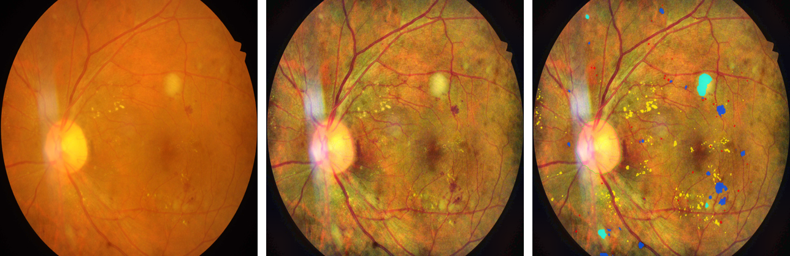
TECHNICAL APPROACH
Your Team Name
Technologies to be used (e.g. programming languages, frameworks, hardware) · Methodology and process for implementation (Flow Charts/Images/ working prototype)
M1 QUALITY ASSESSMENT
Image Processing
Image Processing
imgradient · fspecial('laplacian') · adapthisteq · regionprops → score 0–100, thresholds fitted on 400 real captures
Computer Vision
M2 ADAPTIVE ENHANCEMENT
Image Processing
Deep Learning
imgaussfilt illumination field · adapthisteq (CLAHE) · imnlmfilt denoise
Statistics & ML
M3 LESION SEGMENTATION
Deep Learning + CV
Parallel Computing
ResNet-18 encoder + U-Net decoder, 5 channels, native resolution, focal-Tversky loss
Simulink
M4 GRADING + EXPLAINABILITY
Deep Learning
verified installed, R2026a
resnet18 · trainnet · gradCAM · operating point at sensitivity ≥ 0.90
M5 DEPLOYMENT SIMULATION
Simulink
discrete-time backlog model B(k+1)=max(0,B(k)+demand−capacity), two arms on identical arrivals
raw → enhanced → lesion overlay
Dataset | Images used | Role in this build
APTOS 2019 | 3,662 | ICDR 0–4 grading — train / val / sealed test
IDRiD (Indian) | 81 pixel-annotated | Lesion ground truth — 44 train / 10 val / 27 sealed test
Neovascularisation | 0 | No pixel-level labels exist — not modelled, stated as a limit

Slide 4
FEASIBILITY AND VIABILITY
Your Team Name
Analysis of the feasibility of the idea · Potential challenges and risks · Strategies for overcoming these challenges
WHAT IS ACTUALLY BUILT AND MEASURED
RISKS AND WHAT ABSORBS THEM
Quality gate + enhancement
built+calibrated
Poor field image quality
quality gate refuses and instructs recapture
Lesion segmentation (5 channels)
trained+evaluated
DR grader (ResNet-18, ICDR 0–4)
trained+evaluated
Class imbalance (few grade 3–4)
inverse-sqrt class weights + augmentation
Grad-CAM explainability
built
Rural bandwidth limits
edge inference, only flagged cases uploaded
Dual-evidence check
built+measured
Clinician distrust of AI
lesion evidence + Grad-CAM + human-in-the-loop
App Designer GUI
built
Simulink district model
built + simulated (core Simulink)
Domain shift across cameras
illumination normalisation; external validation is future work
Neovascularisation detection
not built — no labels exist
54 annotated training images
the IDRiD benchmark's own limit — stated, not hidden
Status words, not percentages — a percentage of a module is not a measurable thing.
COST PER SCREENING
DEPLOYMENT READINESS
₹6–12
₹0
₹500–1,500
Prototype
(now)
PHC pilot
2 districts
Clinical validation
vs 3 graders
District rollout
100k/yr
per screening, camera amortised
software licence (academic)
private consult avoided
Prototype stage is where this build actually is today.
MATLAB R2026a trial (expires 4 Oct 2026): Image Processing, Computer Vision, Deep Learning, Statistics & ML, Parallel Computing and Simulink, all verified installed. SimEvents is licensed but not installed on this machine, so the district model is built from core Simulink blocks. Trained on one RTX 4060 laptop GPU — lesion net 63 min, grader 11 min.

Slide 5
IMPACT AND BENEFITS
Your Team Name
Potential impact on the target audience · Benefits of the solution (social, economic, environmental, etc.)
WHY SCREENING, NOT TREATMENT, IS THE GAP
ONE DISTRICT, 100,000 PATIENTS PER YEAR
101 million
 | ✕ Manual | ✓ With NETRA
Patients screened / year | 100,000 | 100,000
Images an expert must read | 100,000 | 40,073
Ophthalmologists (FTE) | 1.7 | 0.6
Expert reading time / day | 10 hrs of work, 6 available | 200 min
Upload volume / day | 0.86 GB | 0.35 GB
Result turnaround | 2–4 weeks | 10 s, at the point of care
adults with diabetes in India (ICMR-INDIAB, Lancet 2023)
~17 million
have diabetic retinopathy (16.9% prevalence)
~4 million
referable DR — need a specialist now
1 : 100,000
rural ophthalmologist-to-population ratio
90%
of resulting vision loss is preventable
Manual review is not a staffing shortfall — it is an unstable queue. The Simulink model accumulates 167 expert-days of backlog in one working year. An expert can absorb 72% of captures before the queue diverges; NETRA flags 40%.
The gap is not treatment. The gap is screening capacity.
districtSim.m + buildNetraSimulink.m, driven by the grader's own held-out triage rate. Assumptions named in the scripts.
Social
Economic
Systemic
Aligned
sight preserved for patients who would never reach a specialist
averts the lifetime cost of avoidable blindness per case
turns one scarce ophthalmologist into district-wide coverage
supports Ayushman Bharat HWCs and NPCBVI screening targets

Slide 6
RESEARCH AND REFERENCES
Your Team Name
Details / Links of the reference and research work
REFERABLE DR (ICDR 2+) — PUBLISHED SYSTEMS AND THIS BUILD
System | Dataset | Sensitivity | Specificity | Source
Gulshan et al. 2016 (Google) | EyePACS-1 | 90.3% | 98.1% | JAMA 316(22):2402
Gulshan et al. 2016 | Messidor-2 | 96.1% | 93.9% | high-sensitivity point
IDx-DR pivotal (Abràmoff 2018) | 900 primary-care | 87.2% | 90.7% | npj Digital Med 1:39
PS 26038 requirement | referable DR | > 90% | > 85% | the problem statement
NETRA (this build) | APTOS held-out, n = 549 | 91.9% | 95.4% | AUC 0.983 · s12_eval_grader
Operating point chosen on the VALIDATION split to meet sensitivity ≥ 0.90, then applied unchanged to a sealed test split — the protocol Gulshan 2016 and the IDx-DR trial both use. Different dataset from the rows above, so this is a like-for-like task, not a like-for-like benchmark.
LESION-LEVEL RESULTS — 27 SEALED IDRiD TEST IMAGES (Dice)
0.732
0.590
0.546
0.519
85.1% sens
Hard exudate
Haemorrhage
Soft exudate
Microaneurysm
Haemorrhage flag (region)
Datasets
Clinical standards
Methods and tooling
APTOS 2019 — kaggle.com/c/aptos2019-blindness-detection
IDRiD — ieee-dataport.org/open-access/indian-diabetic-retinopathy-image-dataset-idrid
Both used under their published licences (CC-BY-4.0 for IDRiD)
Wilkinson et al., International Clinical DR Severity Scale, Ophthalmology 2003;110:1677
ICMR-INDIAB, Lancet Diabetes & Endocrinology 2023
NPCBVI, Ministry of Health & Family Welfare
Selvaraju et al., Grad-CAM, ICCV 2017
Porwal et al., IDRiD, Medical Image Analysis 2020;59:101561
MathWorks: gradCAM, adapthisteq, trainnet, Simulink

