Slide 1

AIRBNB
New York City Analysis 2019
Data Analysis by
Vanshika Sachdeva

Slide 2
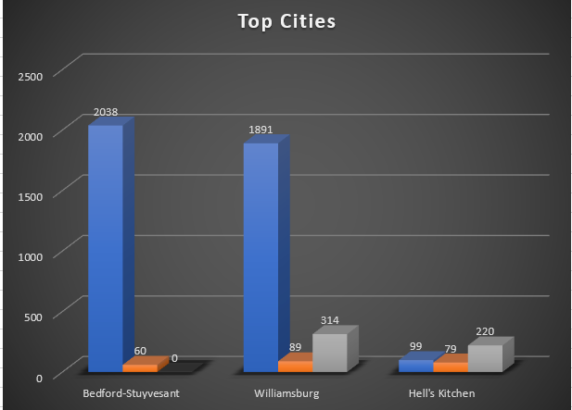

What are the most popular neighborhoods for Airbnb rentals in New York City? How do prices and availability vary by neighborhood?
Observing Airbnb rentals in different neighborhoods:
Room Count in Bedford-Stuyvesant: Bedford-Stuyvesant stands out with a high room count of 2038, indicating a wide variety of private room options for travelers.
Prices in Williamsburg: Williamsburg, with 1891 entire home/apartment listings at an average price of $89, suggests a higher demand for a more exclusive and pricier stay in this trendy neighborhood.
Shared Spaces Affordability in Hell's Kitchen: Hell's Kitchen, offering 99 shared room options at an average price of $79, caters to budget-conscious travelers seeking a more communal and cost-effective experience.
Williamsburg's Balanced Mix: Williamsburg not only leads in entire home/apartment rentals but also maintains a healthy availability of 314 listings, showing a balanced mix of demand and supply in this sought-after neighborhood.

Slide 3
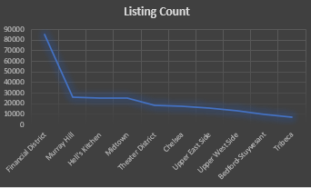
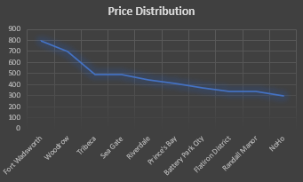
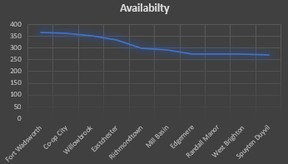
How has the Airbnb market in New York City changed over time? Have there been any significant trends in terms of the number of listings, prices, or occupancy rates?
Top 10 Neighborhoods | Listing Count
Financial District | 85454
Murray Hill | 26125
Hell's Kitchen | 25169
Midtown | 25019
Theater District | 18704
Chelsea | 18098
Upper East Side | 16282
Upper West Side | 13360
Bedford-Stuyvesant | 9688
Tribeca | 7606
Observation - Over time, the Airbnb market in New York City has seen:
Listing Count:
Financial District has the highest listing count, indicating widespread demand and popularity.
Bedford-Stuyvesant, though not the leader, maintains a consistent presence, suggesting sustained interest.
Price Distribution:
Fort Wadsworth and Woodrow exhibit higher price distributions, suggesting a market niche for premium or unique accommodations.
Tribeca, with a lower listing count but high average prices, signifies an exclusive and sought-after neighborhood.
Availability Average:
Fort Wadsworth and Co-op City consistently show low availability averages, indicating high and sustained demand.
Randall Manor, with moderate listing count but a steady availability average, reflects ongoing popularity and steady interest.
Top 10 Neighborhoods | Price Distribution
Fort Wadsworth | 800
Woodrow | 700
Tribeca | 491
Sea Gate | 488
Riverdale | 442
Prince's Bay | 410
Battery Park City | 368
Flatiron District | 342
Randall Manor | 336
NoHo | 296
Top 10 Neighborhoods | Availabilty
Fort Wadsworth | 365
Co-op City | 364
Willowbrook | 351
Eastchester | 333
Richmondtown | 300
Mill Basin | 290
Edgemere | 275
Randall Manor | 275
West Brighton | 275
Spuyten Duyvil | 270

Slide 4
Are there any patterns or trends in terms of the types of properties that are being rented out on Airbnb in New York City? Are certain types of properties more popular or more expensive than others?
Observing Airbnb properties across neighborhoods:
Listing Variety in Bushwick: Bushwick demonstrates a balanced popularity for both private and shared rooms, each having an availability of 85, suggesting diverse accommodation options in this area.
Entire Home/Apt Preference in Bedford-Stuyvesant: Bedford-Stuyvesant is favored for entire home/apartment rentals, boasting an availability of 108, indicating a preference for more private and spacious accommodations in this neighborhood.
Versatile Appeal of Hell's Kitchen: Hell's Kitchen emerges as a consistently popular area for all property types, with private rooms, entire homes/apartments, and shared rooms each having an availability of 99, reflecting versatile demand.
Premium Pricing in Hell's Kitchen: Hell's Kitchen stands out as the expensive city for both private rooms and entire home/apartments, suggesting a premium associated with this central location.
Uniform Pricing Trend in Hell's Kitchen: Pricing in Hell's Kitchen is uniform across property types, implying that the premium is tied to the neighborhood's central location rather than specific property features.
Properties | Name | Popular City (Availabilty)
Private Room | Bushwick | 85
Entire Home/Apt | Bedford-Stuyvesant | 108
Shared Room | Bushwick | 85
Properties | Name | Expensive City
Private Room | Hell's Kitchen | 99
Entire Home/Apt | Hell's Kitchen | 99
Shared Room | Hell's Kitchen | 99

Slide 5
Are there any factors that seem to be co-related with the prices of Airbnb rentals in New York City?
Observing the correlation between room rentals and prices in New York City:
1. Private Room (Co-Rel: 0): There is no apparent correlation between renting a private room and pricing, suggesting that the cost of private rooms does not consistently vary with other factors.
2. Entire Home/Apt (Co-Rel: -0.033765081): There is a weak negative correlation (-0.033765081) between renting an entire home/apartment and pricing. This suggests a minimal, possibly insignificant, relationship between the two.
3.Shared Room (Co-Rel: 0.93114079):There is a strong positive correlation (0.93114079) between renting a shared room and pricing. This indicates that the cost of shared rooms tends to rise significantly with other factors, suggesting a clear relationship.
In summary, shared rooms show a strong positive correlation with prices, while private rooms and entire home/apartments exhibit either no correlation or a weak, insignificant correlation with pricing.
Room Rental | Co-Rel
Private Room | 0
Entire home/apt | -0.0337651
Shared Room | 0.93114079

Slide 6
The Best Area in New York City for a host to buy property at a good price rate and in an area with high traffic ?
Observing the best area in New York City for a host to buy property considering price rates and high traffic:
Manhattan - High Price, High Traffic: Manhattan has the highest property price (197) but also the highest count of booking nights (9), suggesting potential for good returns despite the initial high investment.
Queens - Moderate Price, High Traffic: Queens offers a more moderate property price (100) while still attracting a high count of booking nights (5), making it an attractive option for a balanced investment.
Brooklyn - Moderate Price, Moderate Traffic: Brooklyn provides a moderate property price (124) and a moderate count of booking nights (6), presenting a balanced investment opportunity.
Bronx - Affordable Price, Moderate Traffic: The Bronx has the most affordable property price (87) with a moderate count of booking nights (5), making it an option for a cost-effective investment with reasonable traffic.
Staten Island - Moderate Price, Moderate Traffic: Staten Island offers a moderate property price (115) and a moderate count of booking nights (5), making it another option for a well-balanced investment.
Neighborhood _Group | Brooklyn | Bronx | Manhattan | Queens | Staten Island
Price | 124 | 87 | 197 | 100 | 115
Count of Booking nights | 6 | 5 | 9 | 5 | 5

Slide 7
How do the ratings of Airbnb rentals in New York City compare to their prices? Are higher price rated rentals more likely to have higher ratings ?
Observing the relationship between ratings and prices for Airbnb rentals in New York City:
1. Private Room (Price: 213, Rating: 2): The private room has a lower price but also a lower rating, suggesting that higher prices may not necessarily correlate with higher ratings.
2. Entire Home/Apt (Price: 800, Rating: 0):The entire home/apartment is the most expensive option but has the lowest rating, indicating that higher prices do not guarantee higher ratings, and in this case, there is a lower rating associated with a significantly higher price.
3. Shared Room (Price: 186, Rating: 27):The shared room has a lower price and a higher rating, suggesting that lower prices may be associated with higher ratings in this case.
In summary, the observation indicates that there is not a clear positive correlation between higher prices and higher ratings in these instances. Other factors such as amenities, location, and overall quality of the rental may play a significant role in determining the ratings. It is important for hosts and guests to consider a variety of factors beyond just the price when evaluating Airbnb rentals.
Room Rentals | Price | Rating
Private Room | 213 | 2
Entire home/apt | 800 | 0
Shared Room | 186 | 27

Slide 8
Find the total numbers of Reviews and Maximum Reviews by Each Neighborhood Group.
Observing the total numbers of reviews and the maximum reviews by each Neighborhood Group:
Total Reviews
- Brooklyn has the highest total number of reviews (486,574), indicating a high level of activity and engagement in this neighborhood.
- Manhattan follows closely with 454,569 reviews, highlighting its popularity among Airbnb guests.
- Queens and the Bronx have moderate review numbers, while Staten Island has the lowest total reviews (11,541)
Maximum Reviews
- Manhattan has the highest maximum reviews for a single listing (607), suggesting there are highly reviewed and potentially popular listings in this neighborhood.
- Queens and Brooklyn have high maximum reviews (629 and 488, respectively), indicating the presence of well-reviewed listings in these neighborhoods.
- The Bronx and Staten Island have lower maximum reviews, suggesting a smaller number of highly-reviewed listings compared to other boroughs.
In summary, Brooklyn and Manhattan have the highest total reviews, with Manhattan having the highest maximum reviews for a single listing. Queens and Brooklyn also show significant maximum reviews, while the Bronx and Staten Island have comparatively lower numbers in both total and maximum reviews.
Neighborhood _Group | Brooklyn | Bronx | Manhattan | Queens | Staten Island
Number of Reviews | 486574 | 28371 | 454569 | 156950 | 11541
Neighborhood _Group | Brooklyn | Bronx | Manhattan | Queens | Staten Island
Maximum Reviews | 488 | 321 | 607 | 629 | 333

Slide 9
Find Most reviewed room type in Neighborhood groups per month.
Observing the most reviewed room types per month in New York City's neighborhood groups:
- Brooklyn: Entire home/apartment is the most reviewed, with 10,757 reviews per month.
- Bronx: Entire home/apartment is the most reviewed, with 692 reviews per month.
- Manhattan: Entire home/apartment is the most reviewed, with 11,378 reviews per month.
- Queens: Private room is the most reviewed, with 5,221 reviews per month.
- Staten Island: Entire home/apartment is the most reviewed, with 311 reviews per month.
In summary, across all neighborhood groups, "Entire home/apartment" is the most reviewed room type, except for Queens where "Private room" takes the lead.
Neighborhood _Group | Private Room | Entire home/apt | Shared Room
Brooklyn | 10037 | 10757 | 311
Bronx | 860 | 692 | 58
Manhattan | 9141 | 11378 | 638
Queens | 5221 | 3427 | 231
Staten Island | 270 | 311 | 7

Slide 10
Find Best location listing/property location for travelers.
Observing the best location listings for travelers in New York City:
- Manhattan: With 454,569 listings, Manhattan stands out as the prime location, offering a diverse range of options for travelers.
- Brooklyn: Following closely, Brooklyn with 486,574 listings presents a vibrant and popular destination for travelers.
- Queens: With 156,950 listings, Queens offers a substantial number of options, catering to a variety of traveler preferences.
- Staten Island and Bronx: While Staten Island (11,541) and Bronx (28,371) have fewer listings, they still provide unique and potentially more serene options for travelers.
In summary, Manhattan and Brooklyn are prominent locations with extensive listings, while Queens, Staten Island, and the Bronx offer diverse choices, each catering to different preferences of travelers.
Neighborhood _Group | Best Location Listing Travelers
Brooklyn | 486574
Bronx | 28371
Manhattan | 454569
Queens | 156950
Staten Island | 11541

Slide 11
Find best location listing/property location for Hosts.
Observing the best location listings for hosts in New York City:
- Manhattan: With 277,073 listings, Manhattan emerges as the most popular location for hosts, indicating a high demand and potential profitability.
- Brooklyn: Following closely, Brooklyn has 45,925 listings, showcasing its popularity among hosts and as a sought-after destination for travelers.
- Queens: With 23,005 listings, Queens provides a substantial number of opportunities for hosts, offering diverse options for travelers.
- Staten Island and Bronx: While Staten Island (865) and Bronx (2,437) have fewer listings, they still present opportunities for hosts, especially those looking for a potentially quieter or more local experience.
In summary, Manhattan and Brooklyn are prime locations for hosts, with a large number of listings, while Queens, Staten Island, and the Bronx offer diverse opportunities for hosts to cater to various traveler preferences.
Neighborhood _Group | Best Location Listing Hosts
Brooklyn | 45925
Bronx | 2437
Manhattan | 277073
Queens | 23005
Staten Island | 865

Slide 12
Find Price variations in NYC Neighborhood groups
Observing price variations in New York City neighborhood groups:
- Manhattan (Price: 197): Manhattan has the highest price variation, suggesting a premium associated with the central and desirable location.
- Brooklyn (Price: 124): Brooklyn follows with a moderate price variation, indicating a balance between desirability and affordability for travelers.
- Queens (Price: 100): Queens presents a lower price variation, offering relatively more affordable options compared to Manhattan and Brooklyn.
- Staten Island (Price: 115): Staten Island has a moderate price variation, potentially appealing to travelers seeking a more serene experience.
- Bronx (Price: 87): The Bronx has the lowest price variation, indicating a more cost-effective destination within the city.
In summary, Manhattan has the highest price variation, suggesting premium pricing, while the Bronx offers the lowest variation, indicating a more budget-friendly option. Brooklyn, Queens, and Staten Island fall in between, providing a range of price options for travelers.
Neighborhood _Group | Price Variations
Brooklyn | 124
Bronx | 87
Manhattan | 197
Queens | 100
Staten Island | 115

