Slide 1
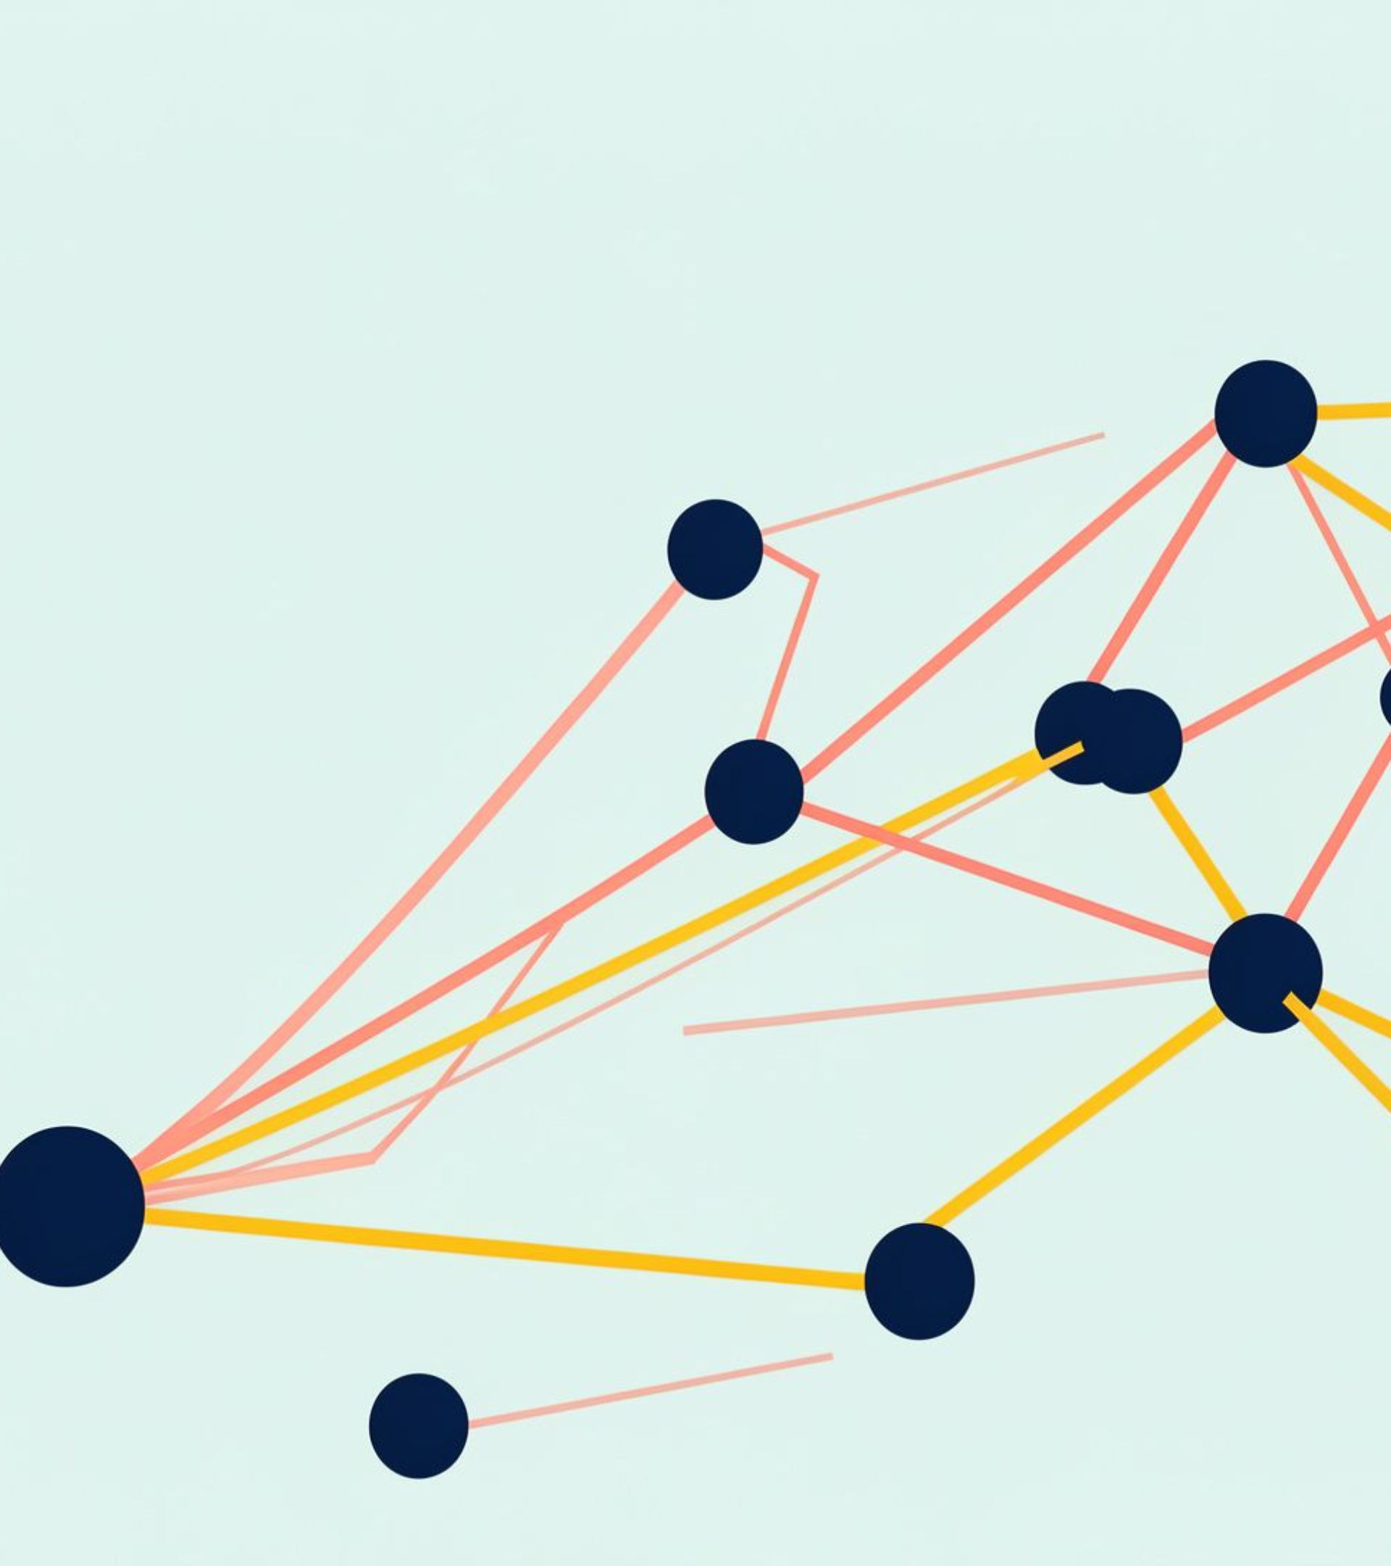
ALGORITHMS · GRAPH THEORY
Dijkstra's Algorithm
Single-source shortest paths in weighted graphs
Name: Vanshika
PRN: 25070521136
Section: C, Sem 3
Generated using: Gamma

Slide 2
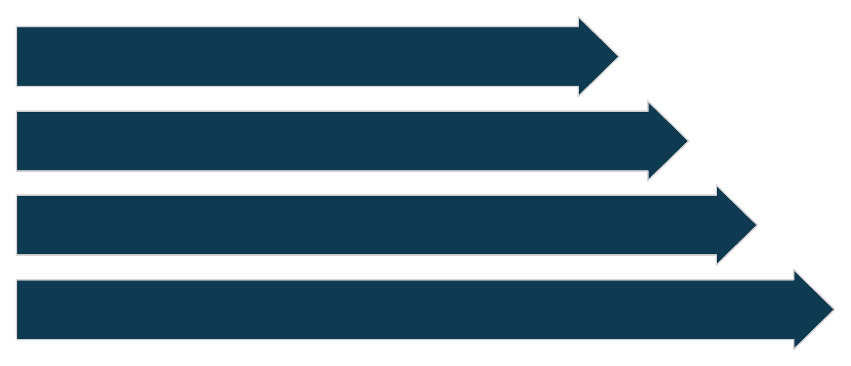
THE PROBLEM
What problem does Dijkstra solve?
Source
Edge Weight
Destination
Minimum-Cost Path
A network becomes a shortest-path problem when locations are connected by costs.
Find the minimum-cost path from one source vertex to every other destination.
Works on weighted, directed or undirected graphs with non-negative edge weights.
Useful whenever a network can be modeled as locations connected by costs.
SSSP
Single-Source Shortest Path
Q3 2026 BOARD READOUT
02

Slide 3
THE STRATEGY
The core idea is greedy
Make the smallest safe choice, then expand from it.
1
2
3
Track tentative distances
Choose the smallest
Finalize and relax
Keep a tentative distance for every vertex.
Choose the unvisited vertex with the smallest tentative distance.
Finalize it, then try to improve its neighbors.
Why is this safe? Non-negative weights make the finalized choice safe.
Q3 2026 BOARD READOUT
03

Slide 4

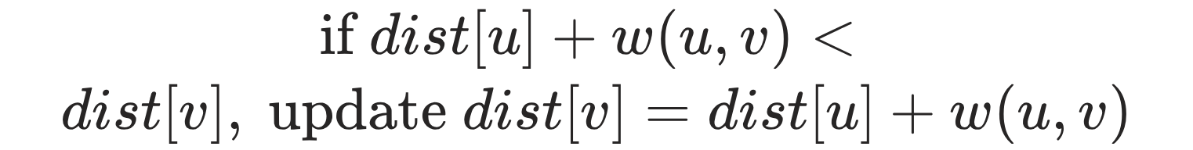
THE UPDATE RULE
Edge relaxation updates the best-known cost
Current State
Edge Check
dist[u], dist[v], predecessor shown for comparison.
Consider edge u→v with weight w to test path.
For an edge u → v with weight w, compare the current route with a route through u.
Compare
Update
Compare dist[u]+w against dist[v] to decide update.
If better, set dist[v]=dist[u]+w and predecessor=v←u.
Start with dist[source] = 0.
Set every other distance to ∞.
Record the predecessor when a shorter route is found.
Q3 2026 BOARD READOUT
04

Slide 5
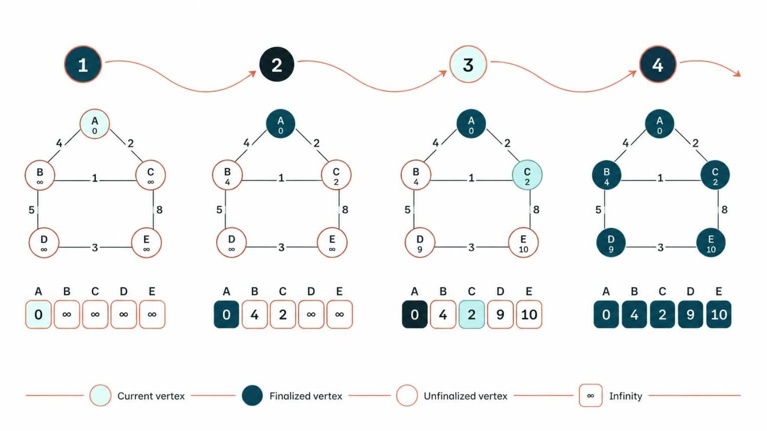
WORKED EXAMPLE
Distances become final step by step
Use a small weighted graph and trace the source, tentative distances, selected vertex, and relaxed neighbors.
01
Initialize
Source at 0; all others at ∞.
02
Select
Choose the smallest tentative value.
03
Relax
Update the neighbors.
Repeat until the queue is empty.
Q3 2026 BOARD READOUT
05

Slide 6
IMPLEMENTATION
Priority-queue implementation
The queue always exposes the next most promising vertex.
01
02
Push
Pop
Push (0, source) into a min-priority queue.
Pop the pair with the smallest distance.
03
04
Skip stale entries
Relax and push
Skip stale entries when the popped value exceeds dist[u].
Relax every neighbor and push each improved distance.
Q3 2026 BOARD READOUT
06

Slide 7
PSEUDOCODE
Pseudocode at a glance
dist[source] = 0
dist[others] = ∞
pq ← {(0, source)}
while pq is not empty:
(d,u) ← extract-min(pq)
if d > dist[u], continue
for each neighbor v with weight w:
relax and push
OUTPUT
Shortest distances
Output: shortest distances and predecessor paths.
The stale-entry check keeps the queue implementation correct when improved distances are pushed again.
Q3 2026 BOARD READOUT
07

Slide 8
PERFORMANCE
Complexity depends on the data structure
Representation | Time | Best fit
Adjacency matrix + linear search | O(V²) | Dense graphs
Adjacency list + binary min-heap | O((V + E) log V) | Common practical implementation
Fibonacci heap | O(E + V log V) amortized | Theoretical benchmark
SPACE
O(V + E)
Choose the data structure to match the graph and the implementation goal.
With an adjacency list and queue.
Q3 2026 BOARD READOUT
08

Slide 9
LIMITATION
Why negative edges break the greedy guarantee
Initial Setup
Directed compact graph with weights and source.
Tentative Finalization
Source finalizes vertex with smallest distance.
Negative Edge Appears
Later negative-weight edge creates warning marker.
Dijkstra assumes finalizing the smallest tentative distance is permanent.
A later negative-weight edge can create a cheaper route after a vertex was finalized.
Cheaper Route Found
Negative edge yields a cheaper path after finalization.
Counterexample Conclusion
Finalized distance was incorrect; highlight labels.
Use Bellman-Ford when negative edges may appear. Bellman-Ford can also detect negative cycles.
Q3 2026 BOARD READOUT
09

Slide 10




APPLICATIONS
Where the algorithm is used
The graph model changes, but the shortest-route objective stays the same.
GPS and turn-by-turn navigation
Network routing protocols such as OSPF and IS-IS
Flight and travel route planning
Game development pathfinding
THANK YOU

