Slide 1
Speech Analytics

Slide 2
OUTLINE
Objective
Multiple Use-Cases
Audio-Data Preparation
Speech to Text
Text Analysis
Data-Frame Creation
Dashboard Analysis

Slide 3
Objective
There is a lot of call data available unused. To extract meaningful insights and to better serve our customers, we will use NLP to analyze the unstructured text data from calls.

Slide 4
Multiple Use-Cases
Conversion of the phone calls
To check the demand of the product
Customer Sentiment
Call Drivers and trend
Call Quality
Where customers call from
How to reduce call center volume
How to use offline order voice calls to upsell online orders

Slide 5
Audio-Data Preparation
Role-Play
Agent - Anmol
Customer - Vanshika
Topics of Conversation - Product Enquiry, Policy Mis-Sold and Claim Enquiry
Average Conversation Time - 2.5 min
Two ways to analyze Audio Data
1. Voice Analysis
2. Text Analysis

Slide 6
Voice Analysis by Ozonetel
In-House Engineer Team
No Free APIs available
Features Readily Available as per their trained models
1. Conversation Speed
2. Conversation Volume
3. Customer Sentiment
4. Customer Demographics
5. Keyword Spotting

Slide 7
Text Analysis
Speech to Text via Google API
Agent: hello hello I am I talking to me sunchika
Customer: hello mum who is it
Agent: from Bajaj Allianz life insurance that I for enquiry on your life Bima policy that you are willing to buy I am here to help you and resolve
Customer: yes I did put Aquarius today and I wanted to purchase a policy for my son and daughter
Agent: ok mam that is good so what is the ages
Customer: what are the Ranger twins and there is there is also 1010
Agent: ok so I added a few mistakes you have in mind for your style and daughter like what they want to become in future
Customer: right now I am not very much about it but yeah I keep talking to them and they say that they want to be an Interior
Agent: ok mam engineer so having a few policies that would be good enough for your children like the live Bima policy would be good it covers till the education part of your children and they would be secured education is completed then we have future secure policy also recovered the path after education and they would be secure till their time and also we have several other policies map I can send you the details of the policy which I feel is act for you can I send you the details map Sharma
Customer: you can send it on my you can take my email and you can send me the brochure or something to that I can read the policy throughout and then if I will be enquiry I'll get back to you
Agent: ok mam will send you the brochure on your email address which you have put in the chair
Customer: thankyou
Agent: thankyou

Slide 8
Processed-Text
Agent: hello hello am I talking to miss Vanshika
Customer: hello maam who is this
Agent: I am from Bajaj allianz life insurance this is Anmol I saw your inquiry on your life beema policy that you are willing to buy so I am here to help you and resolve the inquiry
Customer: yes actually I did put a query yesterday and I wanted to purchase a policy for my son and daughter
Agent: okay maam that is good what is their ages what are their ages.
Customer: They are twins and their ages is lets say ten ten
Agent: okay maam so are there any future prospects you have in mind for your son and daughter like what they want to become in their future
Customer: right now I am not very much clear about it but yes I keep talking to them and they say that they want to be an engineer
Agent: okay maam engineer so I have in mind a few policies that would be good enough for your children like the life beema policy would be good it covers till the education part of your children and they would be secured till the education is completed then we have future secure policy also which covers the part after education and they would be secured till their retirement and also we have several other policies maam I can send you the details of the policies which I feel is apt for you can I send you the details maam
Customer: sure maam you can send it on my email you can take my email then send me the brochure or something so that I can read the policy throughout and then if I will be having query I will get back to you
Agent: okay maam I will send you the brochure on your email address which you have put in the chatbox right okay maam thank you for calling bajaj life insurance
Customer: thank you maam thank you

Slide 9
Features
Features through API
Multiple-Speakers Identification - Assign tags as speaker 1 and speaker 2
Word Time-Stamps - Customer and Agent Talk-Time can be calculated
Sentiment Score - varies between -1, 0 and 1
Sentiment Magnitude - [0,Inf)
Keyword Analysis through Topic Modelling
Topic Distribution
Relevant Words within each Topic
Note: To get meaningful topics irrelevant words needed to be removed

Slide 10
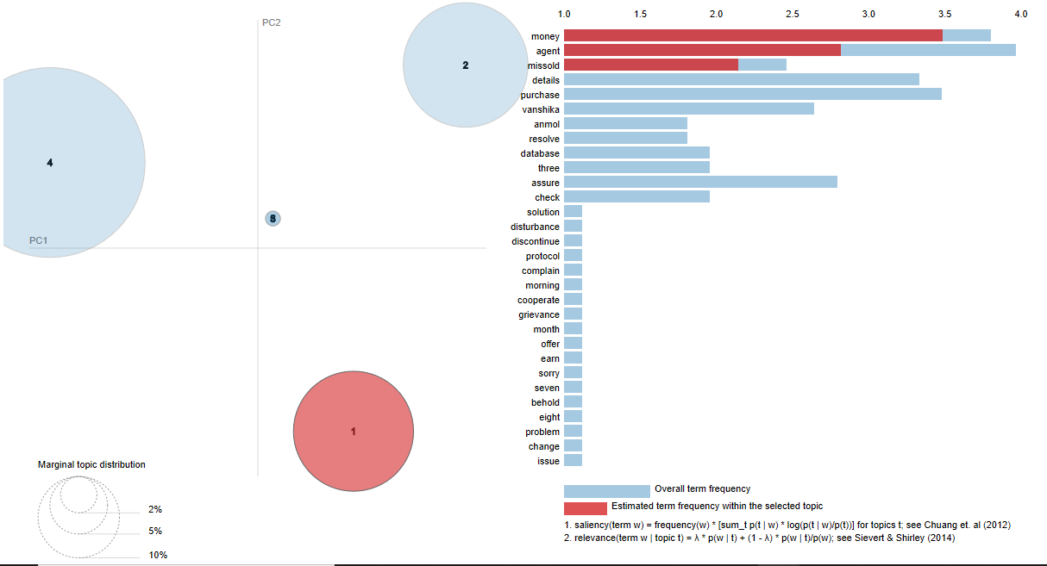
Topics Visualization

Slide 11
Data-Frame Preparation
Calls.csv
Columns: Processed_Text, Customer_Transcript, Agent_Transcript, Overall_Sentiment, Customer_Sentiment, Agent_Sentiment, Overall_Magnitude, Customer_Magnitude, Agent_Magnitude, Overall_Talk-Time, Customer_Talk-Time, Agent_Talk-Time, Silenceness, Topic_1, Topic_2, Topic_3, Topic_4, Topic_5
Rows: Call Records
Word_Frequency.csv
Columns: Call_ID, Word, Frequency
Rows: Call Records

Slide 12
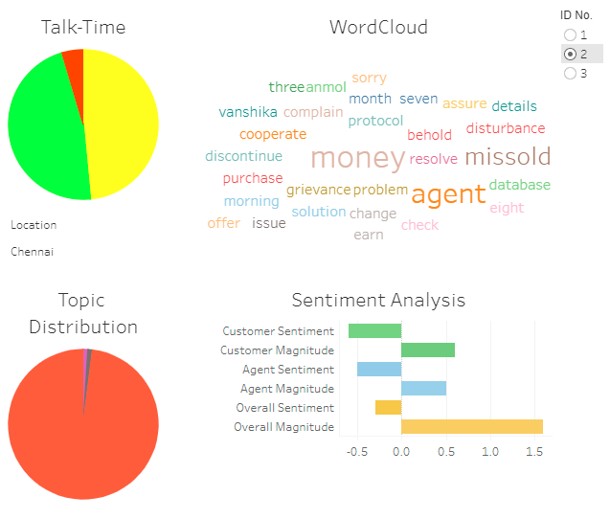
Speech Analytics Dashboard
https://public.tableau.com/profile/vanshika1914#!/vizhome/SpeechAnalytics_16075954566430/SpeechAnalytics?publish=yes

