Slide 1

TEST AUTOMATION
MID-SEM PROJECT
Vanshika Garg R171217059
CH.Sri Sai Valli R171217058
Vedansh Singhal R171217060

Slide 2

ABOUT
In software testing, test automation is the use of software separate from the software being tested to control the execution of tests and the comparison of actual outcomes with predicted outcomes.
In this project, we have automated the INDIGO website-
https://www.goindigo.in/.

Slide 3
ABOUT CODE
In this project we have used the following methods -
f()- This function has the priority=1. This function helps us to select the source, destination and type of trip,etc.
login()- This function has the priority=2. This function helps us to login to the website. Dataprovider annotation is also used for this method.
options()- This function has the priority=3. This function helps us to check the options in the homepage of the website with the help of Assert()

Slide 4
CODE
package Testngs;
import org.testng.annotations.Test;
import org.testng.Assert;
import org.testng.AssertJUnit;
import org.testng.annotations.BeforeTest;
import org.testng.annotations.DataProvider;
import org.openqa.selenium.By;
import org.openqa.selenium.WebDriver;
import org.openqa.selenium.WebElement;
import org.openqa.selenium.chrome.ChromeDriver;
import org.testng.annotations.AfterTest;
public class NewTest2 {
public static WebDriver driver;
@DataProvider(name="TestData")
public Object[][] getData() throws InterruptedException{
return new Object[][] {
{"9149166687","Devops28@"}};
}

Slide 5
@Test(priority=1)
public void f() throws InterruptedException {
WebElement element = driver.findElement(By.name("q"));
element.sendKeys("Indigo");
driver.navigate().to("https://www.goindigo.in/");
WebElement e1= driver.findElement(By.xpath("//*[@id=\"body\"]/section/div[2]/div[1]/div/div/div/div[1]/div/a[1]"));
AssertJUnit.assertTrue(e1.isDisplayed());
System.out.println(" BOOK FLIGHT");
WebElement e2 = driver.findElement(By.xpath("//*[@id=\"bookFlightTab\"]/form/div[2]/div[2]/label/label"));
e2.click();
//trying to locate the source and destination with the below code
WebElement e3= driver.findElement(By.xpath("//*[@id=\"bookFlightTab\"]/form/div[3]/div[1]/div[1]/div/div/input"));
e3.click();
e3.sendKeys("DED");
driver.findElement(By.xpath("//*[@id=\"bookFlightTab\"]/form/div[3]/div[1]/div[1]/div/div/div/div/div[2]")).click();
WebElement e4 = driver.findElement(By.xpath("//*[@id=\"bookFlightTab\"]/form/div[3]/div[1]/div[2]/div/div/input"));
e4.click();
e4.sendKeys("AUH");
driver.findElement(By.xpath("//*[@id=\"bookFlightTab\"]/form/div[3]/div[1]/div[2]/div/div/div/div/div[2]")).click();
}

Slide 6
@Test(priority=2 , dataProvider="TestData")
public void login(String username , String password) throws InterruptedException {
//login Credentials
WebElement element9 = driver.findElement(By.xpath("/html/body/div[5]/section/div[1]/nav/div/div[3]/ul/li[10]/a"));
element9.click();
//phone number
WebElement element1 = driver.findElement(By.id("memberId"));
element1.sendKeys(username);
//password
WebElement element2 = driver.findElement(By.name("memberLogin.Password"));
element2.sendKeys(password);
WebElement element3 = driver.findElement(By.xpath("//*[@id=\"mem-login-form\"]/div[4]/div/div[1]/button/span[1]"));
element3.click();
}

Slide 7
@Test(priority=3)
public void options() {
WebElement e7= driver.findElement(By.linkText("Check-in"));
Assert.assertTrue(e7.isDisplayed());
System.out.println("CHECK-IN -PRESENT");
WebElement e8= driver.findElement(By.linkText("Flight Status"));
Assert.assertTrue(e8.isDisplayed());
System.out.println("FLIGHT STATUS -PRESENT");
WebElement e9= driver.findElement(By.linkText("Edit Booking"));
Assert.assertTrue(e9.isDisplayed());
System.out.println("EDIT BOOKING -PRESENT");
WebElement e10= driver.findElement(By.cssSelector("input#igHpSearch"));
Assert.assertTrue(e10.isDisplayed());
System.out.println("SEARCH FAQS -PRESENT");
WebElement e11= driver.findElement(By.cssSelector("[alt='indigo-logo']"));
Assert.assertTrue(e11.isDisplayed());
System.out.println("INDIGO LOGO -PRESENT")
}
@BeforeTest
public void beforeTest() {
System.setProperty("webdriver.chrome.driver","webdriver.chrome.driver", "C:\\Softwares\\chromedriver.exe");
driver=new ChromeDriver();
driver.manage().window().maximize();
driver.navigate().to("http://www.google.com/");
driver.manage().window().maximize();
}

Slide 8
@AfterTest
public void afterTest() {
driver.quit();
}
}

Slide 9
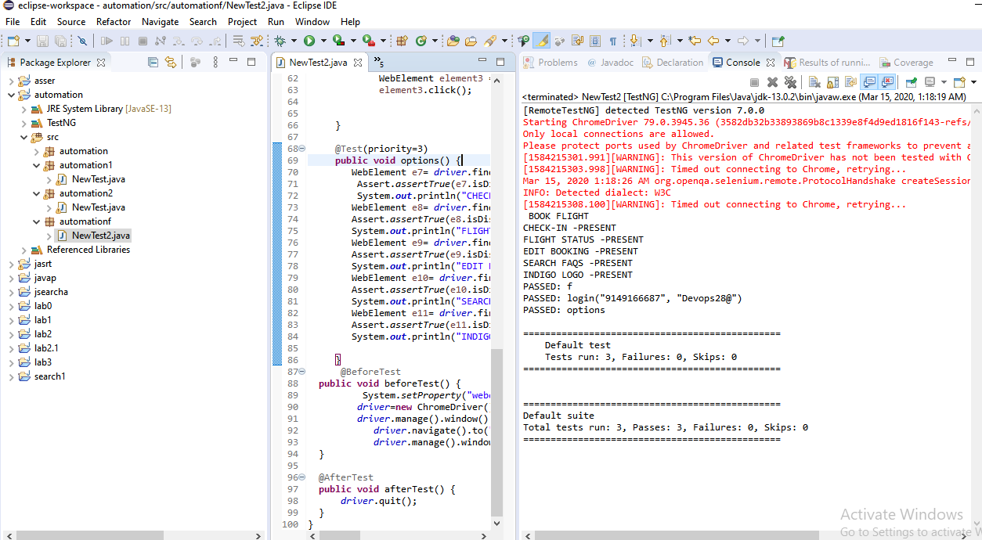
OUTPUT

Slide 10
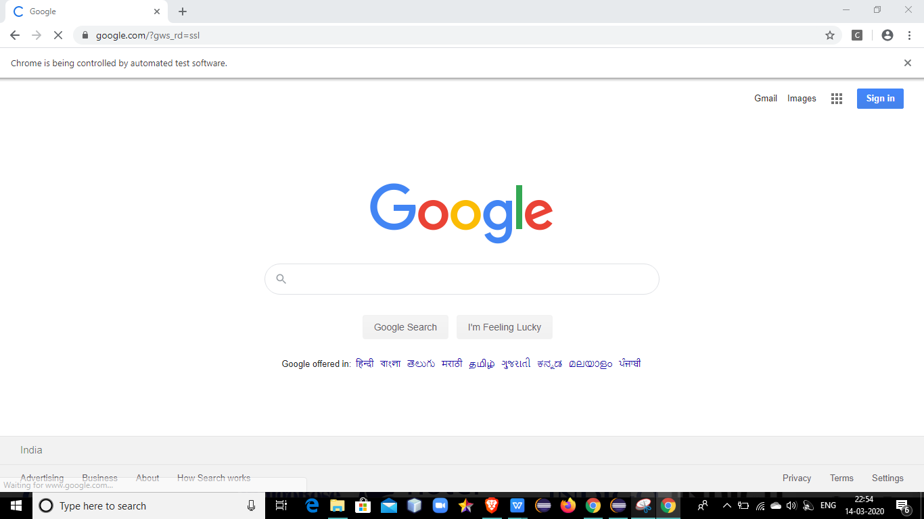

Slide 11
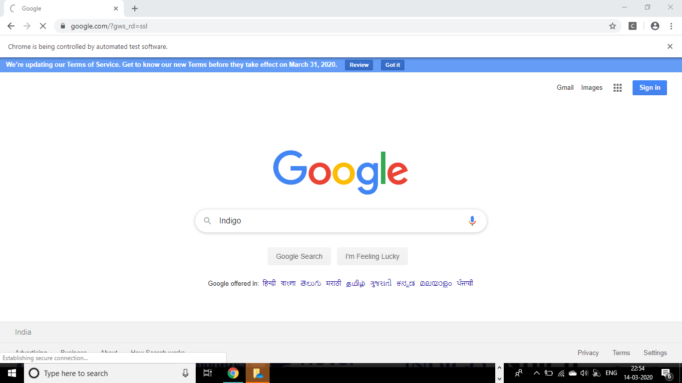

Slide 12
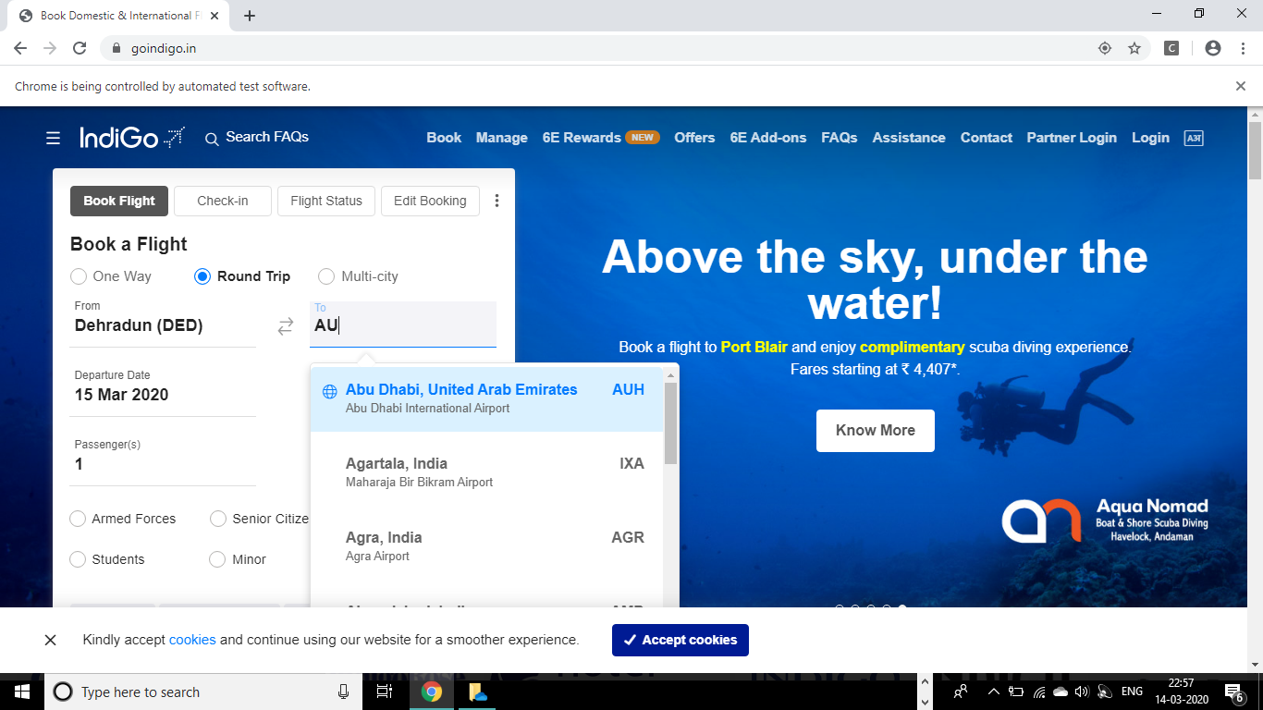

Slide 13
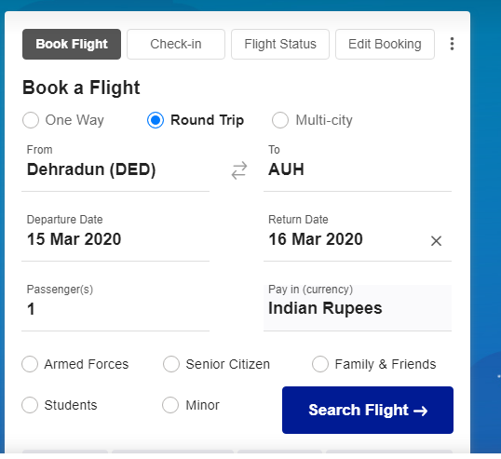

Slide 14
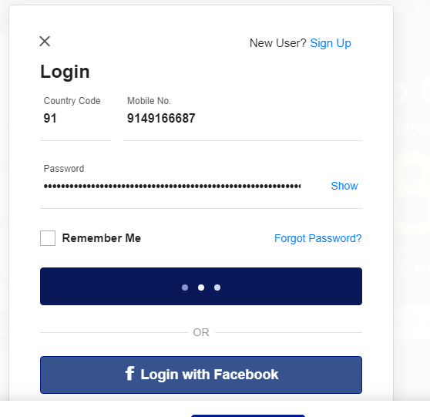

Slide 15
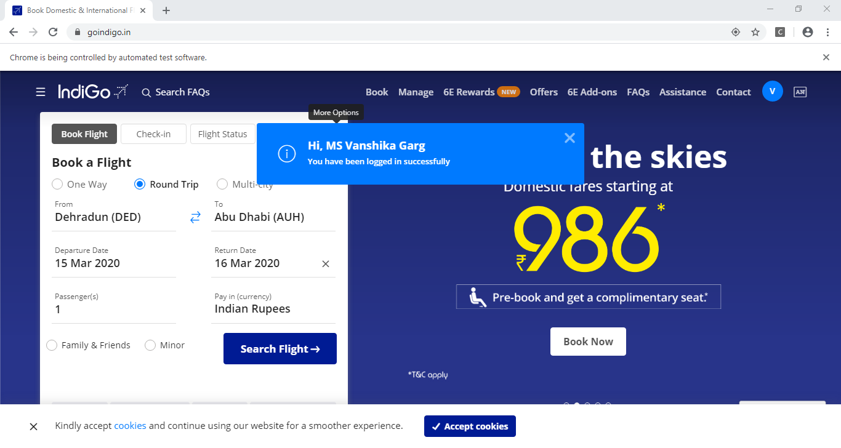

Slide 16
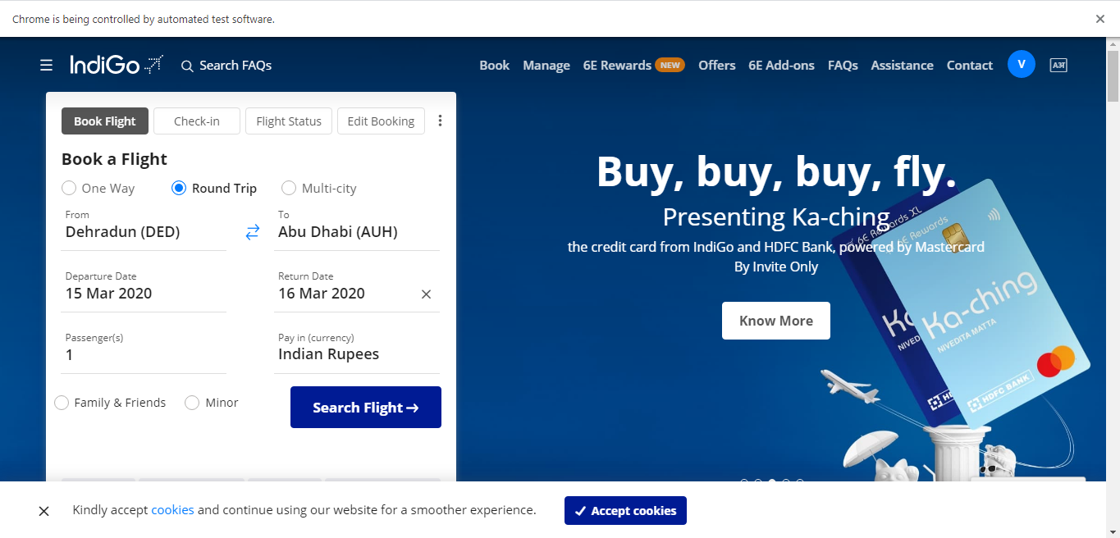

Slide 17
.HTML RESULT FILES
EMAILABLE-REPORT.HTML
INDEX.HTML

Slide 18
JAVA FILE
PROJECT JAVA FILE

Slide 19
Excel Sheet

