Slide 1
NAME: VANSHIKA GARG
SAP ID:500061511
BRANCH:DEVOPS 2017-2021
INSERT THE TITLE
OF YOUR PRESENTATION HERE
ALLPPT.com _ Free PowerPoint Templates, Diagrams and Charts

Slide 2
WORKFLOW

Slide 3
APPLICATION
WordPress is an open-source website creation
platform that is written in PHP and uses a MySQL
database.With WordPress, you can host files and database on different servers/machines very quickly as it uses MySQL as a database management system.
I have created my own WordPress and MySQL AMI on AWS from which I will be launching the instance

Slide 4
In this we will be creating our own VPC on
AWS with one public subnet and one private subnet.We will deploy WordPress in the public subnet so that it can be acccesed by the users/clients and create MySQL database in the private subnet giving only the WordPress server access to it.

Slide 5
Configuring Application Server
On the Application server,we need to install Apache webserver,on which our application can be hosted,PHP and some other PHP dependencies.Also,we will install mysql-client as WordPress acts as client to the MySQL server.

Slide 6
To configure we run this commands on our instance
~#apt-get update
~# apt-get upgrade -y
~# apt-get install apache2 -y
~# apt-get install php7.0 php7.0-curl php7.0-mysql php7.0-mbstring php7.0-dom php7.0-gd -y
~# apt-get install libapache2-mod-php7.0
~# apt-get install mysql-client -y

Slide 7
We will download the wordpress file in the
directory /var/www/html
cd /var/www/html
/var/www/html# rm -rf *
/var/www/html# wget https://wordpress.org/latest.tar.gz
/var/www/html# tar -xzvf latest.tar.gz
/var/www/html# mv wordpress/* ./
/var/www/html# chown -R www-data:www-data /var/www/html

Slide 8
Configure MySQL Database Server
~#apt-get update
~# apt-get upgrade -y
~# apt-get install mysql-server mysql-client -y
~# nano /etc/mysql/mysql.conf.d/mysqld.cnf
In this file,there is an arguement bind-address.We have to change the IP Address to the IP on which our server will be running.In case your IP is not static,you can provide bind-address=0.0.0.0

Slide 9
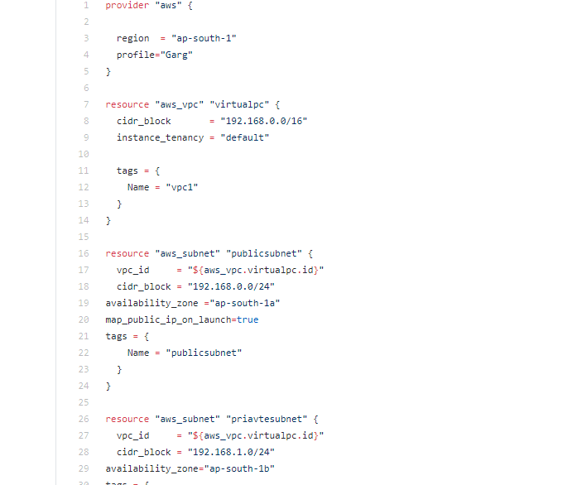

Slide 10
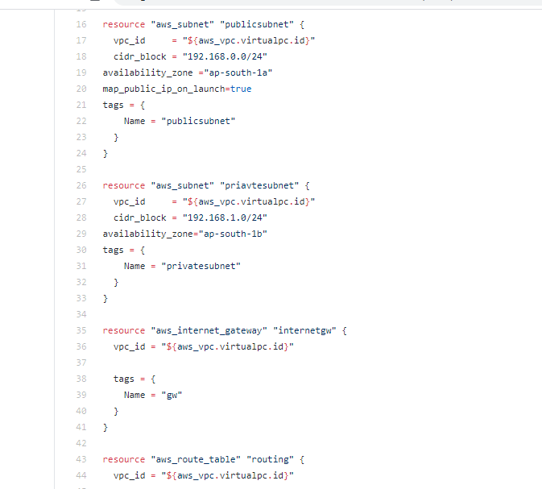

Slide 11
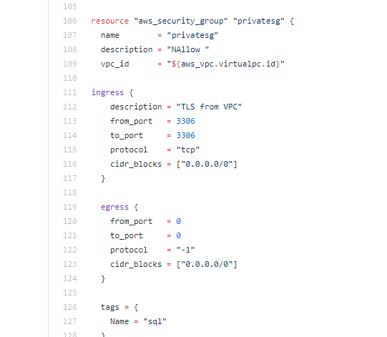

Slide 12
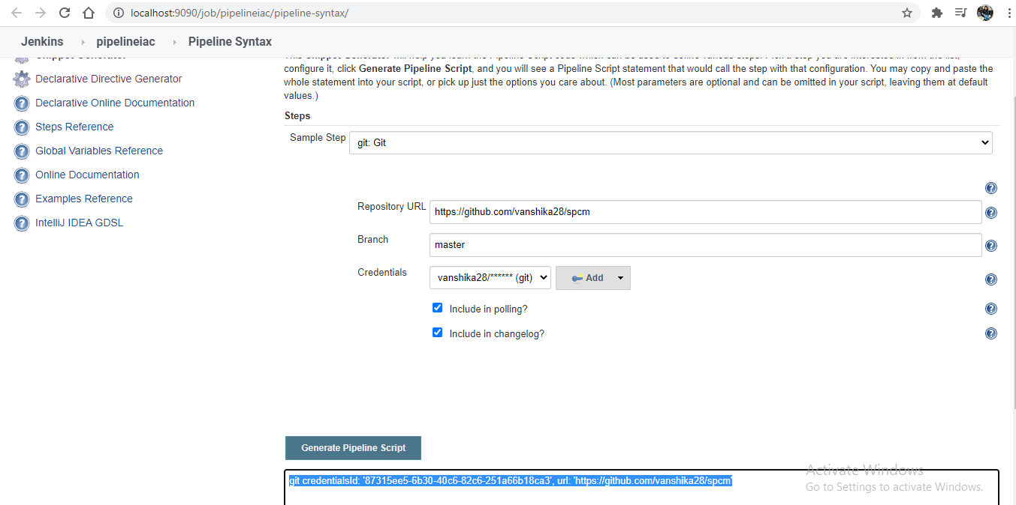
Build Job

Slide 13
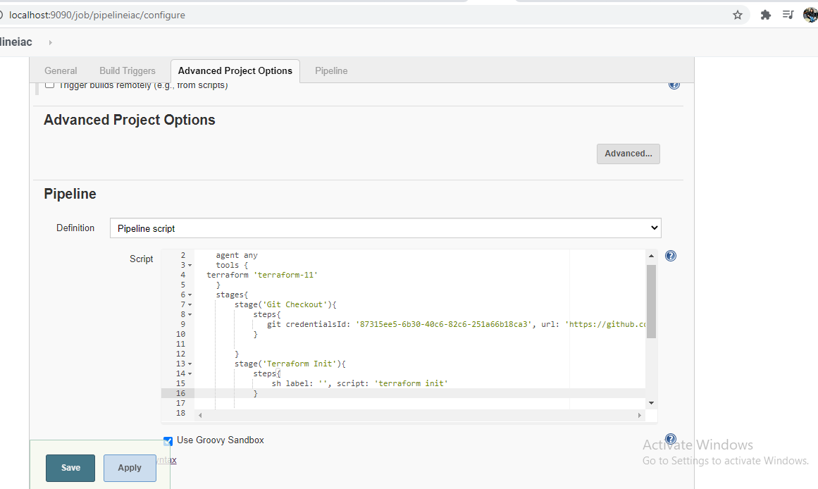

Slide 14
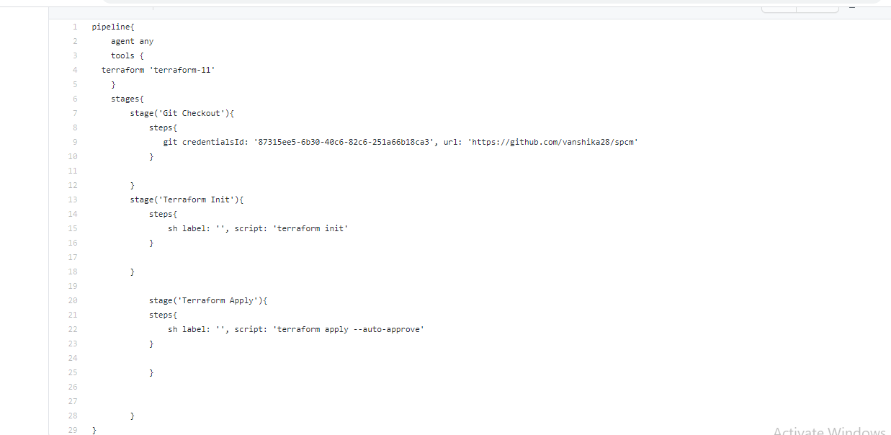

Slide 15
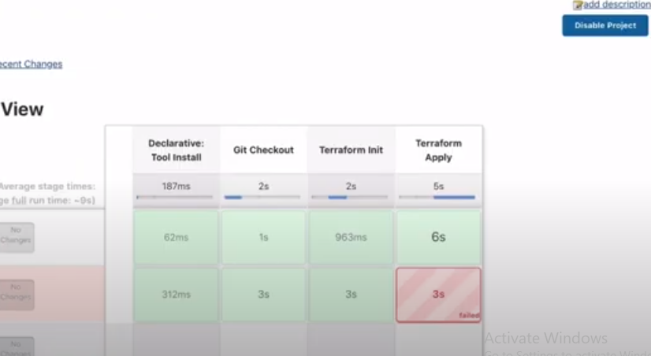
BUILD NOW

Slide 16
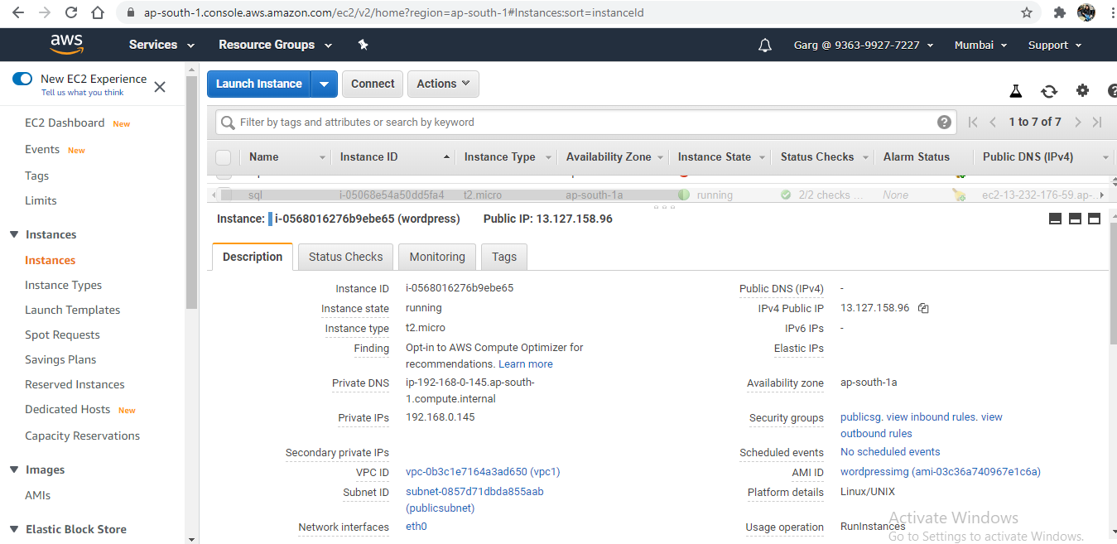

Slide 17
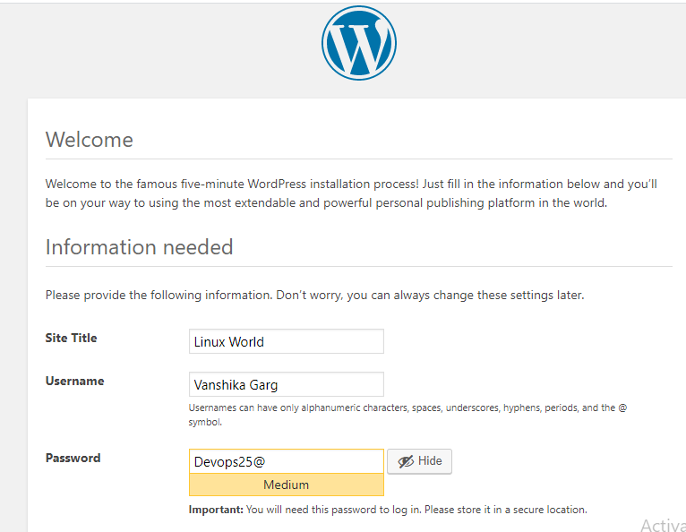

Slide 18
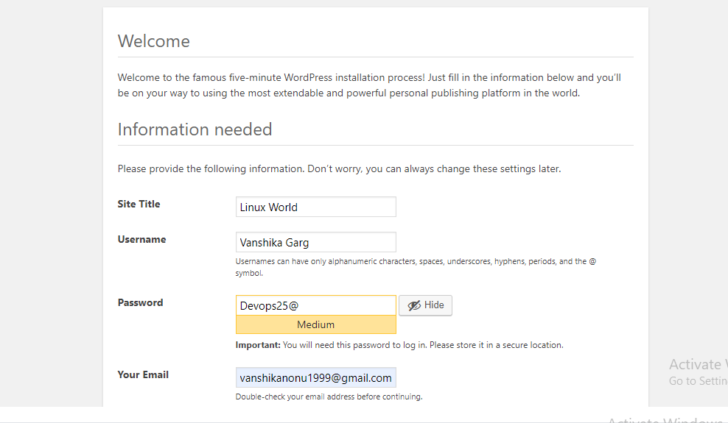

Slide 19
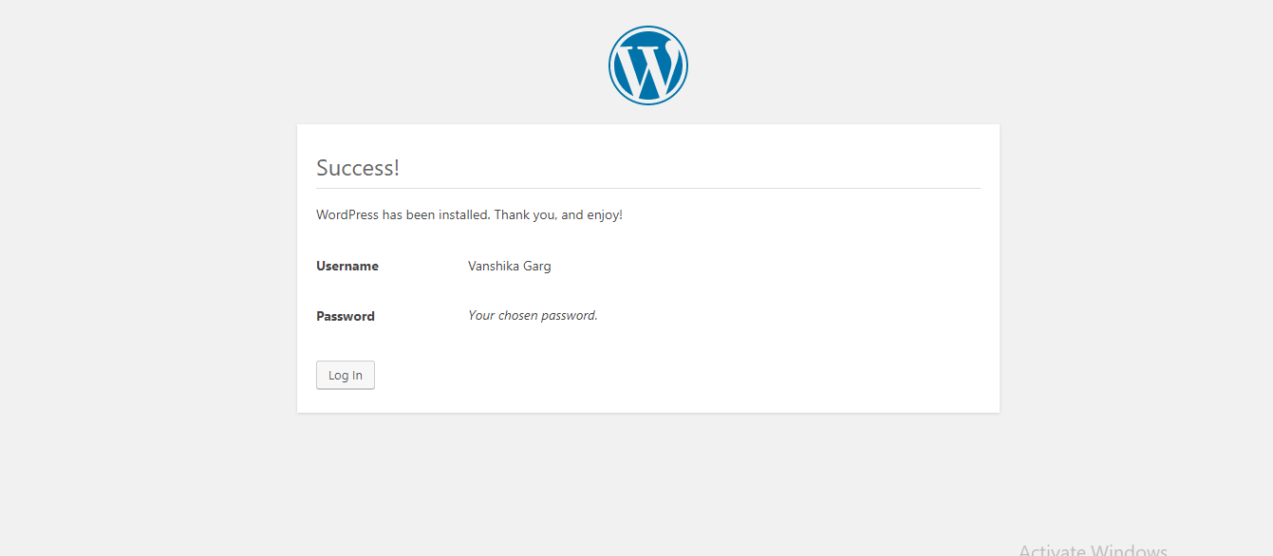

Slide 20
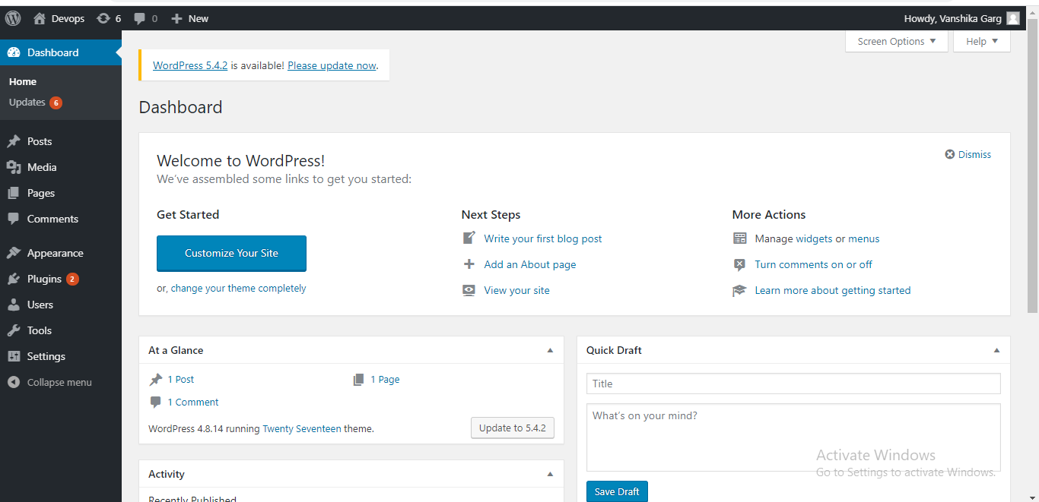

Slide 21
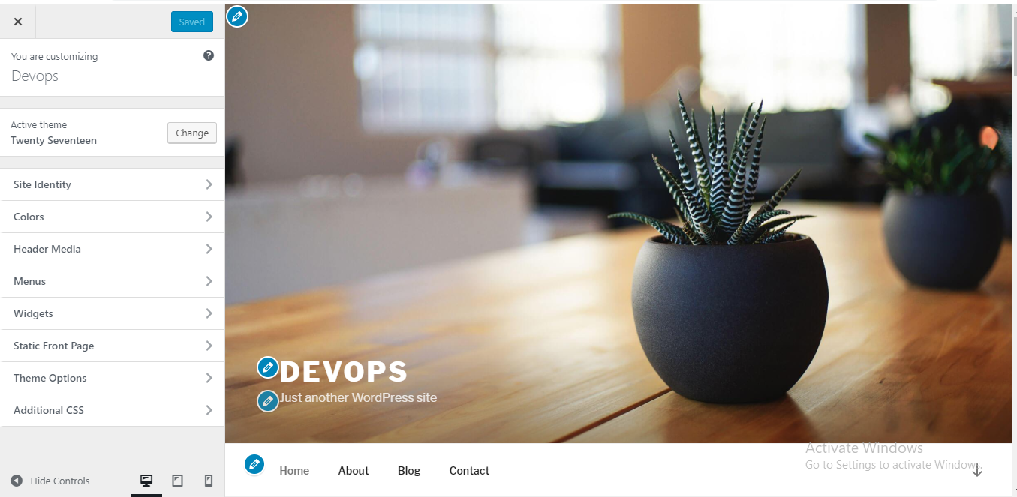

Slide 22
THANK YOU

