Slide 1
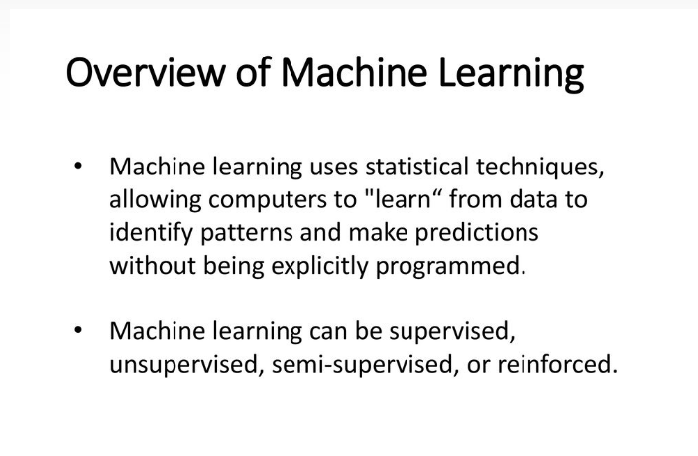

Slide 2
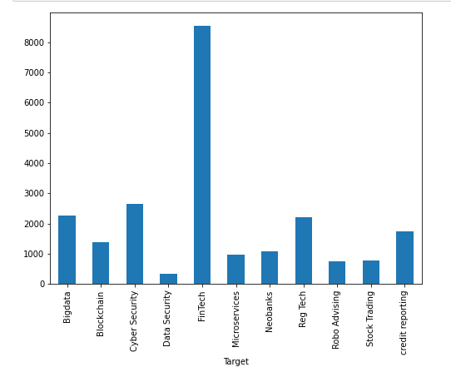
Imbalanced Classes
Imbalanced data set occurs when there is an unequal representation of classes
We see that the number of text per target is imbalanced. Target is more biased towards FinTech as compared to the others.

Slide 3
Challenges due to Imbalanced Dataset
The machine problem: Machine learning (ML) algorithms are built to minimize errors. Since the probability of instances belonging to the majority class is significantly high in imbalanced data set, the algorithms are much more likely to classify new observations to the majority class.

Slide 4
The intrinsic problem: In real life, the cost of False Negative is usually much larger than False Positive, yet ML algorithms penalize both at a similar weight.
We can also consider class weights to solve the imbalance datset problem

Slide 5
Approach to solve
Re-sampling the data in order to mitigate the effect caused by class imbalance.
Over-sampling increases the number of minority class members in the training set. The advantage of over-sampling is that no information from the original training set is lost. It increases the likelihood of overfitting since it replicates the minority class events.
Under-sampling Aims to reduce the number of majority samples to balance the class distribution. It might discard useful information.
In this case we will use Over-Sampling as no original data will be lost.

Slide 6
Text Representation
The classifiers and learning algorithms can not directly process the text documents in their original form, as most of them expect numerical feature vectors with a fixed size rather than the raw text documents with variable length. Therefore, during the preprocessing step, the texts are converted to a more manageable representation.
One common approach for extracting features from text is to use the bag of words model: a model where for each document, a complaint narrative in our case, the presence (and often the frequency) of words is taken into consideration, but the order in which they occur is ignored.
Specifically, for each term in our dataset, we will calculate a measure called Term Frequency, Inverse Document Frequency, abbreviated to tf-idf. We will use sklearn.feature_extraction.text.TfidfVectorizer to calculate a tf-idf vector for each of consumer complaint narratives:
sublinear_df is set to True to use a logarithmic form for frequency.
min_df is the minimum numbers of documents a word must be present in to be kept.
norm is set to l2, to ensure all our feature vectors have a euclidian norm of 1.
ngram_range is set to (1, 2) to indicate that we want to consider both unigrams and bigrams.
stop_words is set to "english" to remove all common pronouns ("a", "the", ...) to reduce the number of noisy features.

Slide 7
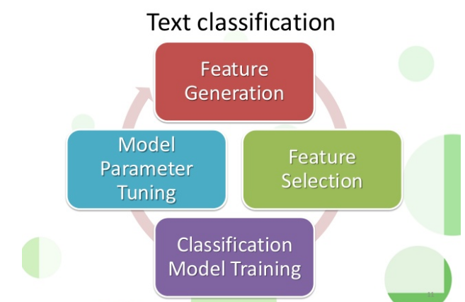

Slide 8
CountVectorizer
CountVectorizer is a great tool provided by the scikit-learn library in Python. It is used to transform a given text into a vector on the basis of the frequency (count) of each word that occurs in the entire text.
It provides a simple way to both tokenize a collection of text documents and build a vocabulary of known words, but also to encode new documents using that vocabulary.

Slide 9
I have used SMOTE oversampling technique in this case
It consists of synthesizing elements for the minority class, based on those that already exist. It works randomly picking a point from the minority class and computing the k-nearest neighbours for this point. The synthetic points are added between the chosen point and its neighbours.

Slide 10
We can use sklearn.feature_selection.chi2 to find the terms that are the most correlated with each of the Target:
# 'Bigdata': . Most correlated unigrams: . ncbi . retrieved . Most correlated bigrams: . pmid pubmed . retrieved october
# 'Blockchain': . Most correlated unigrams: . chit . permissioned . Most correlated bigrams: . draft discussion . paper strategy
# 'Cyber Security': . Most correlated unigrams: . para . security . Most correlated bigrams: . information security . security digital
# 'Data Security': . Most correlated unigrams: . privacy . protection . Most correlated bigrams: . personal data . data protection
# 'FinTech': . Most correlated unigrams: . start . data . Most correlated bigrams: . financial advisory . advisory group # 'Microservices': . Most correlated unigrams: . application . architecture . Most correlated bigrams: . cloud native . architectural style

Slide 11
# 'Neobanks': . Most correlated unigrams: . valuation . starling . Most correlated bigrams: . sanction scanner . starling bank
# 'Reg Tech': . Most correlated unigrams: . regulators . regtech . Most correlated bigrams: . financial services . financial institutions
# 'Robo Advising': . Most correlated unigrams: . advisor . advisory . Most correlated bigrams: . assets management . initial trust
# 'Stock Trading': . Most correlated unigrams: . volatility . stock . Most correlated bigrams: . stock exchange . stock market
# 'credit reporting': . Most correlated unigrams: . alternative . credit . Most correlated bigrams: . tech credit . credit information

Slide 12
Cross-Validation
To be able to realize a robust comparison between models we need to validate the robustness of each model.
Cross-validation is the process of separate the dataset in k-fold. k is the number of proportions we need to realize the data.
Generally, k is 5 or 10 it will depend on the size of the dataset (small dataset small k, big dataset big k).
The goal is to compute each metric on each fold and compute their average (mean) and the standard deviation (std).

Slide 13

Weighting of classes
It involves the creation of specific weight vectors in order to improve minority class predictions
The class-specific weights(class_weight parameter) are calculated per class

Slide 14
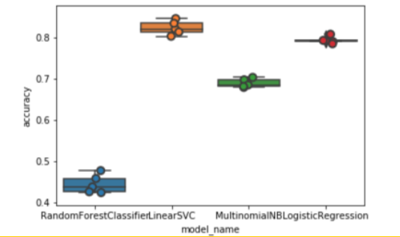
Testing Accuracy with different models

Slide 15
model_name
LinearSVC and Logistic Regression perform better than the other two classifiers, with LinearSVC having a slight advantage with a better median accuracy.

Slide 16
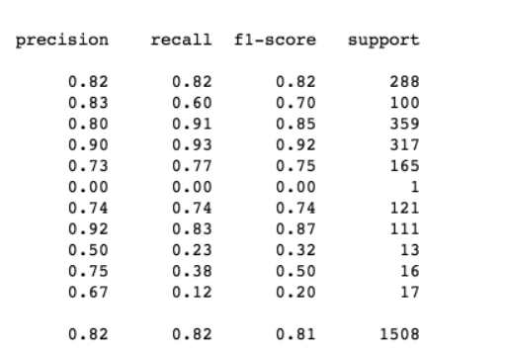
Classification Report

Slide 17
Limitation/Other approach
The model created is not the best choice for in-depth learning.
One limitaton of the dataset is that the number of text per target is imbalanced. Target is more biased towards FinTech as compared to the others.When data is imbalanced it is biased.
Overfitting of data can take place which memorizes the results and will give wrong observation for new data
We could have used NLP also using tensorflow to clasify this multi class dataset.

Slide 18
