Slide 1
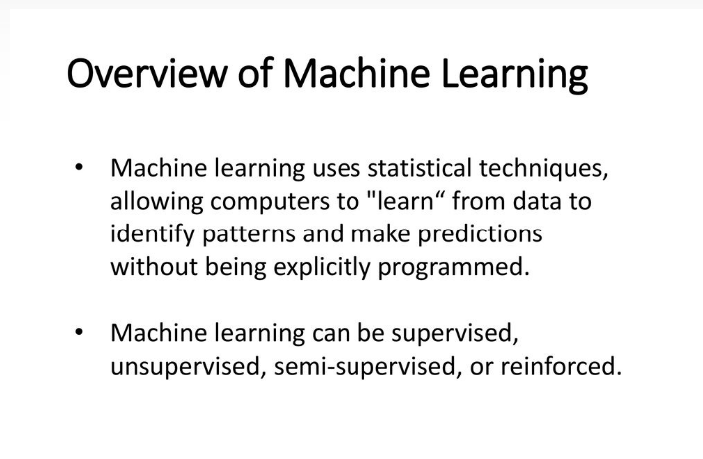

Slide 2
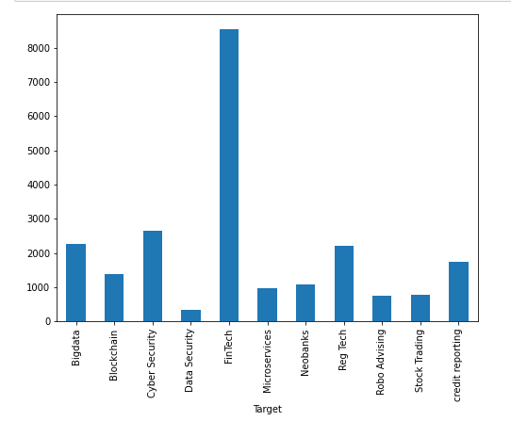
Imbalanced Classes
We see that the number of text per target is imbalanced. Target is more biased towards FinTech as compared to the others.

Slide 3
Text Representation
The classifiers and learning algorithms can not directly process the text documents in their original form, as most of them expect numerical feature vectors with a fixed size rather than the raw text documents with variable length. Therefore, during the preprocessing step, the texts are converted to a more manageable representation.
One common approach for extracting features from text is to use the bag of words model: a model where for each document, a complaint narrative in our case, the presence (and often the frequency) of words is taken into consideration, but the order in which they occur is ignored.
Specifically, for each term in our dataset, we will calculate a measure called Term Frequency, Inverse Document Frequency, abbreviated to tf-idf. We will use sklearn.feature_extraction.text.TfidfVectorizer to calculate a tf-idf vector for each of consumer complaint narratives:
sublinear_df is set to True to use a logarithmic form for frequency.
min_df is the minimum numbers of documents a word must be present in to be kept.
norm is set to l2, to ensure all our feature vectors have a euclidian norm of 1.
ngram_range is set to (1, 2) to indicate that we want to consider both unigrams and bigrams.
stop_words is set to "english" to remove all common pronouns ("a", "the", ...) to reduce the number of noisy features.

Slide 4
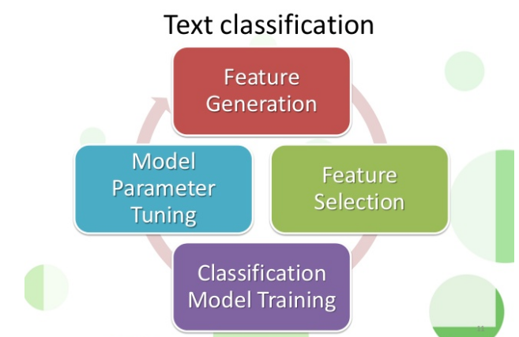

Slide 5
We can use sklearn.feature_selection.chi2 to find the terms that are the most correlated with each of the Target:
# 'Bigdata': . Most correlated unigrams: . ncbi . retrieved . Most correlated bigrams: . pmid pubmed . retrieved october
# 'Blockchain': . Most correlated unigrams: . chit . permissioned . Most correlated bigrams: . draft discussion . paper strategy
# 'Cyber Security': . Most correlated unigrams: . para . security . Most correlated bigrams: . information security . security digital
# 'Data Security': . Most correlated unigrams: . privacy . protection . Most correlated bigrams: . personal data . data protection
# 'FinTech': . Most correlated unigrams: . start . data . Most correlated bigrams: . financial advisory . advisory group # 'Microservices': . Most correlated unigrams: . application . architecture . Most correlated bigrams: . cloud native . architectural style

Slide 6
# 'Neobanks': . Most correlated unigrams: . valuation . starling . Most correlated bigrams: . sanction scanner . starling bank
# 'Reg Tech': . Most correlated unigrams: . regulators . regtech . Most correlated bigrams: . financial services . financial institutions
# 'Robo Advising': . Most correlated unigrams: . advisor . advisory . Most correlated bigrams: . assets management . initial trust
# 'Stock Trading': . Most correlated unigrams: . volatility . stock . Most correlated bigrams: . stock exchange . stock market
# 'credit reporting': . Most correlated unigrams: . alternative . credit . Most correlated bigrams: . tech credit . credit information

Slide 7
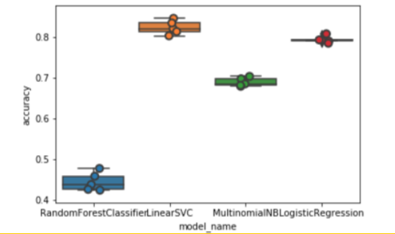
Testing Accuracy with different models

Slide 8
model_name LinearSVC: 0.822890 LogisticRegression: 0.792927 MultinomialNB: 0.688519 RandomForestClassifier: 0.443826 Name: accuracy, dtype: float64
LinearSVC and Logistic Regression perform better than the other two classifiers, with LinearSVC having a slight advantage with a median accuracy of around 82%.

Slide 9
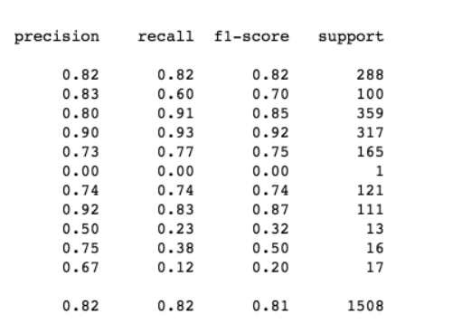
Classification Report

Slide 10
Limitation/Other approach
The model created is not the best choice for in-depth learning.
One limitaton of the dataset is thatthe number of text per target is imbalanced. Target is more biased towards FinTech as compared to the others.
We could have used NLP also using tensorflow to clasify this multi class dataset.

Slide 11
NLP
By using Natural Language Processing (NLP), text classifiers can automatically analyze text and then assign a set of pre-defined tags or categories based on its content.
It includes text classification, vector semantic and word embedding, probabilistic language model, sequential labeling, and speech reorganization.

