Slide 1
Covid dashboard
File created on: 6/23/2022 8:17:23 PM

Slide 2
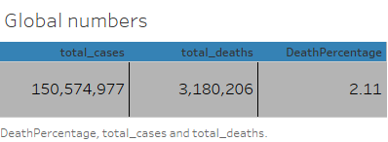

Slide 3
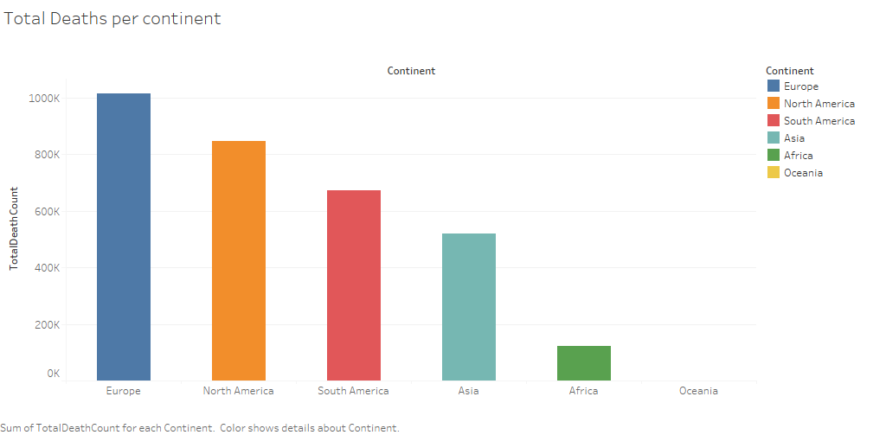

Slide 4
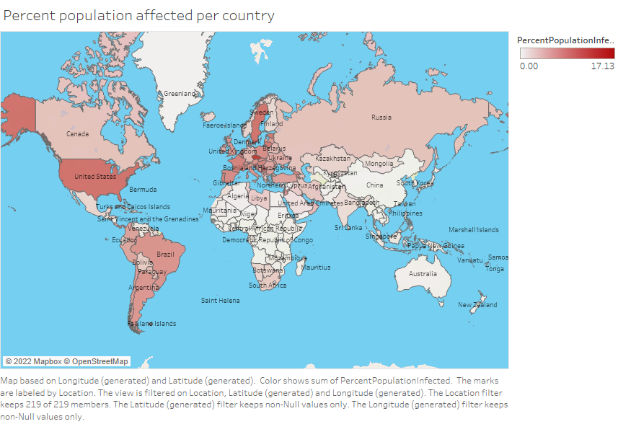

Slide 5
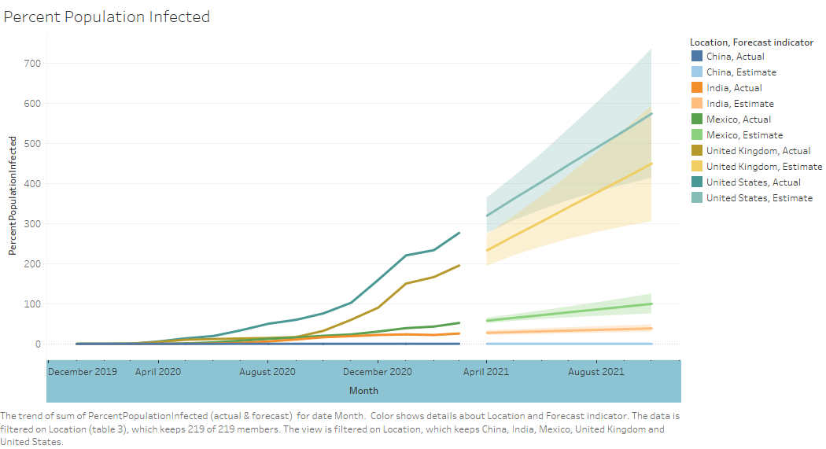

Slide 6
