Slide 1

MLSA Internship:
Full Stack Development

Slide 2
Internship Overview
Objective
To gain hands-on experience in full-stack web development.
Skills
Strengthen HTML, CSS, and JavaScript foundations
Projects
Personal Webpage
Simple Calculator Application

Slide 3

Project 1:
Personal Webpage
Objective
To create a simple, visually appealing, and
informative personal webpage
Components
Introduction, Bio, and hobbies social media
Profile links
VANSHIKA
About Me
Hi, I am Vanshika
From Jhansi,UP
I enjoy exploring new ideas, blogging, and connecting with like-minded individuals. In my free time, you can find me reading, learning new skills, and working on personal projects.
Connect with Me
LinkenIn
GitHub
Blogger
Instagram

Slide 4
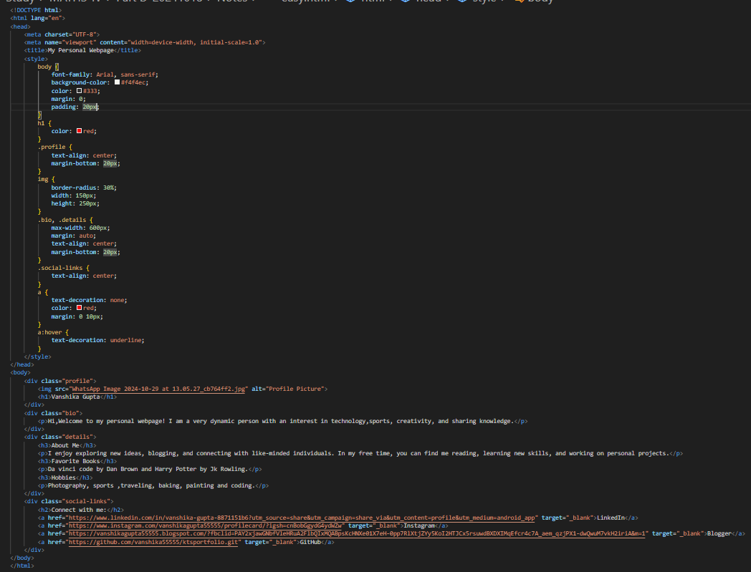

Project 1:
Implementation
1. HTML Structure:
Created a basic HTML structure with sections for 'About Me', ‘favouritebooks’, ‘hobbies’ 'Connect with me' with the use of semantic HTML elements like header, nav, main, section, and footer.
2. CSS Styling:
Applied CSS to style the layout, colors, fonts, hover and overall appearance.
3. Content:
Used CSS to create a responsive design that adapts to different screen sizes.
Added relevant personal information, and details.

Slide 5



Project 1:
Key Learnings
HTML Structuring
Semantic elements for better organization
CSS Styling
Enhanced layout techniques and responsive design

Slide 6
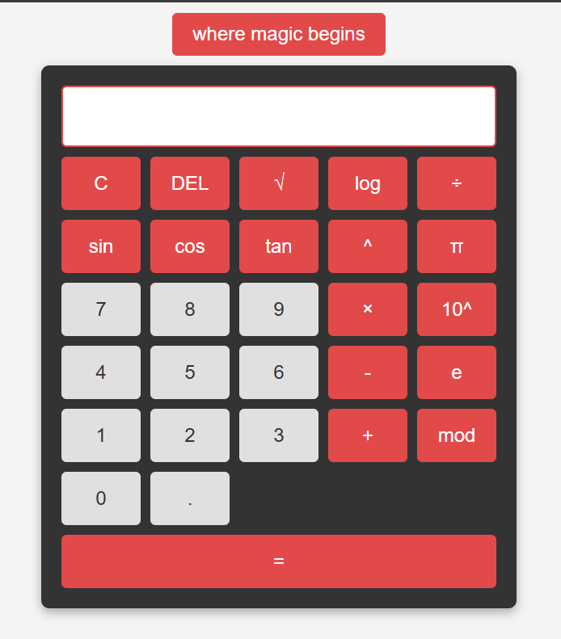
Project 2:
Simple Calculator Application
Objective
To create a basic calculator that performs simple arithmetic operations
Functions
Addition, subtraction, multiplication, and division and many other
Focus
User-friendly interface with real-time calculations

Slide 7
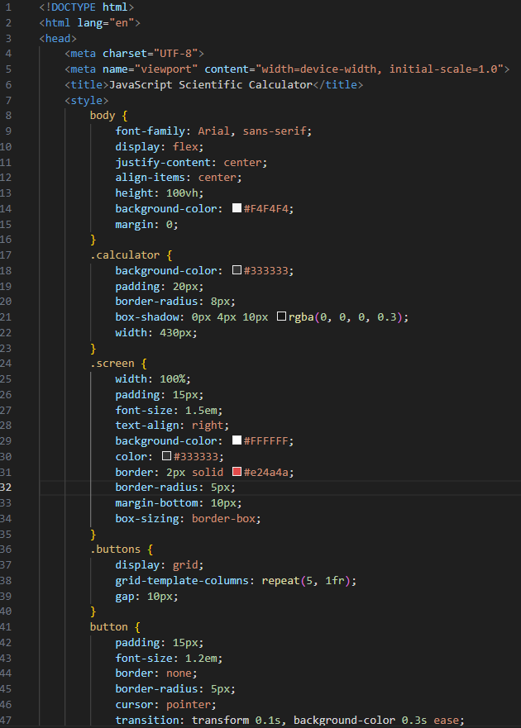
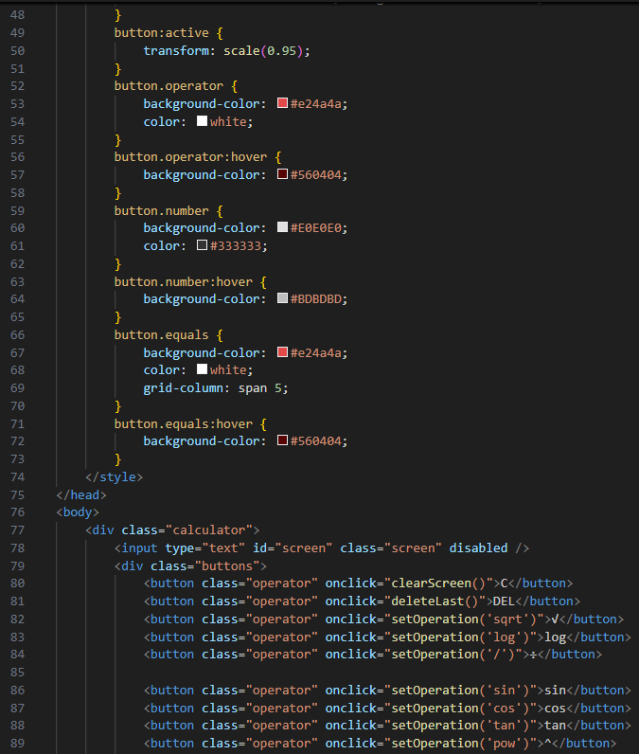
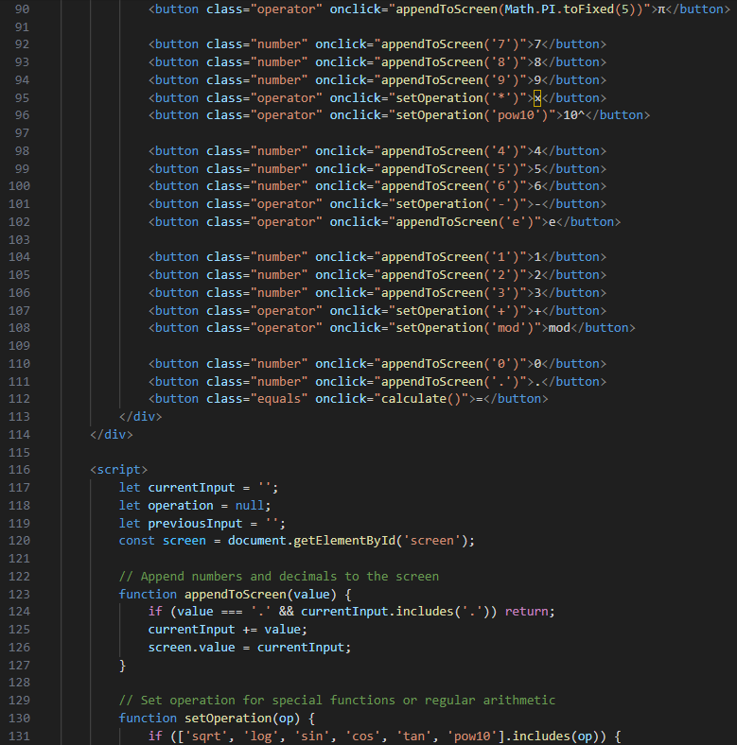
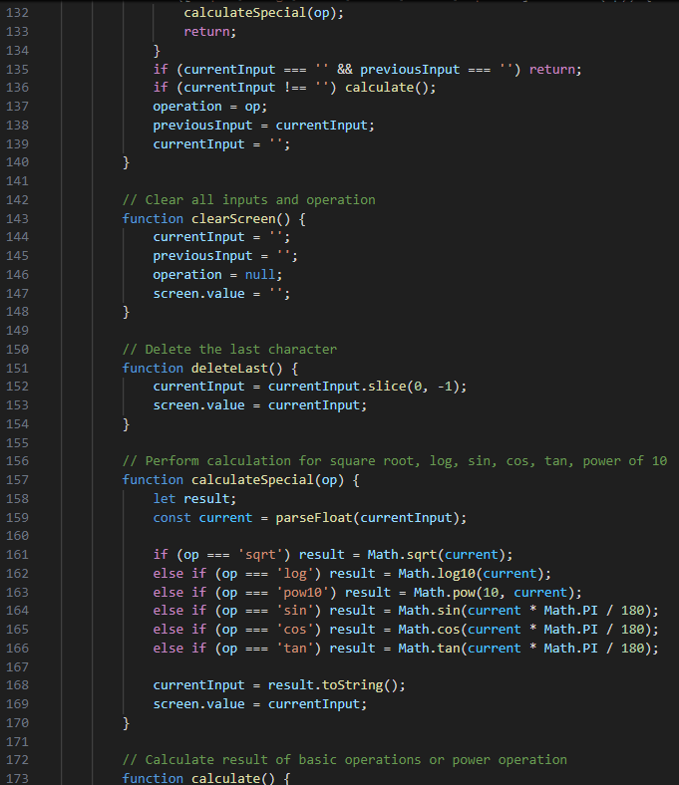
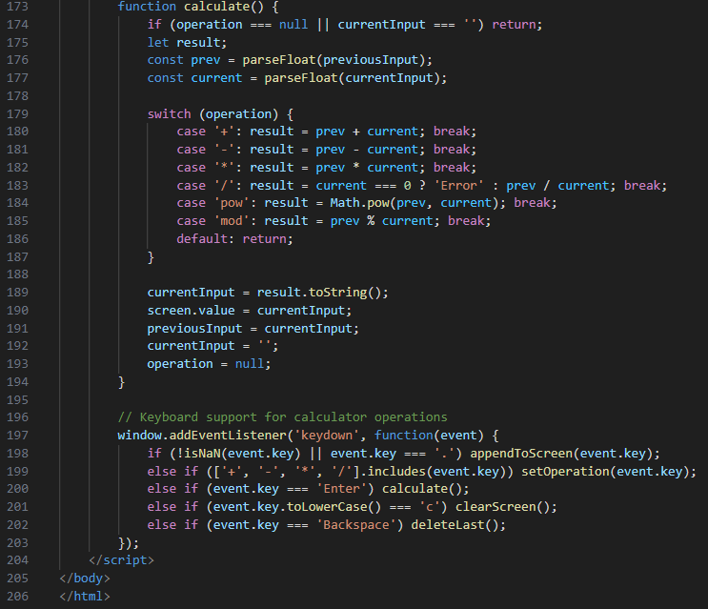
Project 2: Implementation
1. HTML Structure:
Created a basic HTML structure with an input field and buttons for numbers and operators.
2. JavaScript Logic:
Implemented JavaScript logic to handle button clicks and perform calculations. Used the eval () function to evaluate expressions. Also enjoying this project made some extra operational calculator function.
3. CSS Styling:
Applied CSS to style the calculator's appearance, including button colors, font sizes, and layout. I tried creating an rgb theme selector for the calculator . for seleting various theme and making user friendly looking calculator.

Slide 8
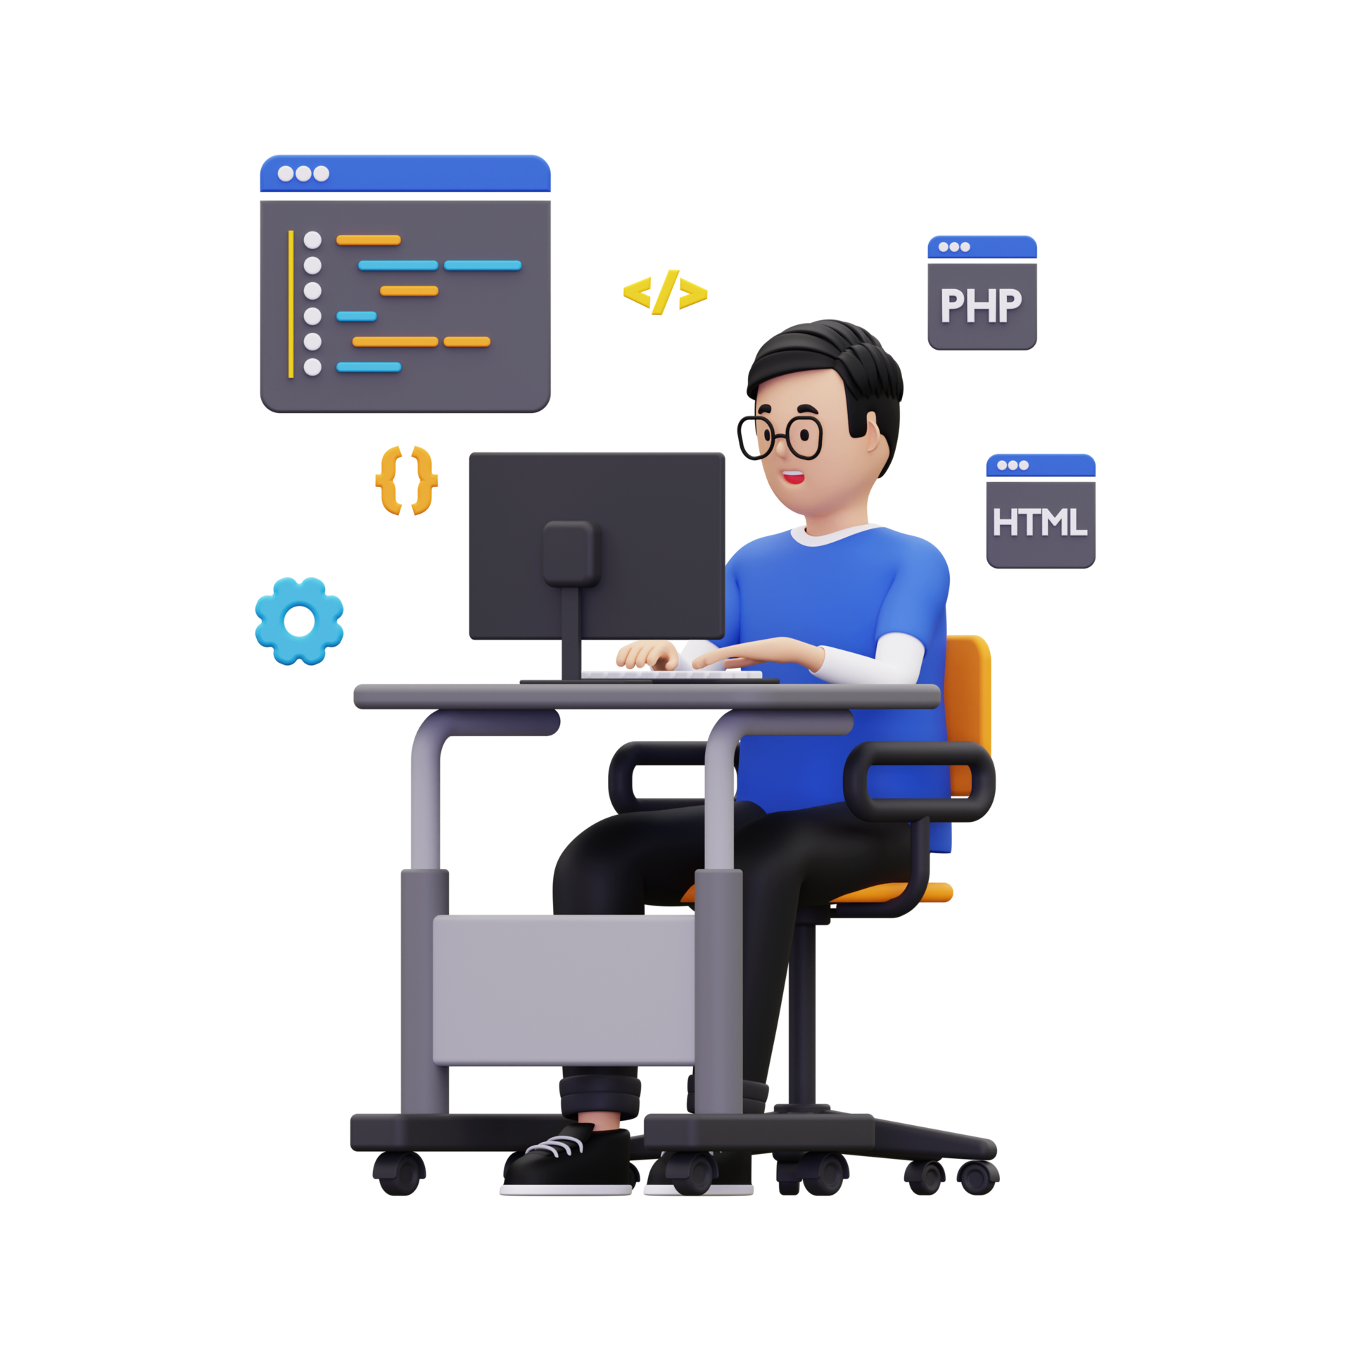
Project 2: Key Learnings
JavaScript Functions
Efficient handling of arithmetic operations
DOM Manipulation
Dynamic input capture and result display
Problem-Solving
Debugging and handling edge cases effectively

Slide 9

Overall Internship Experience
Overall, both projects were successfully implemented and demonstrate a basic understanding of HTML, CSS, and JavaScript. The personal webpage provides a platform to showcase skills and experience, while the calculator is a practical application of web development concept

Slide 10

Name- Vanshika Gupta
Branch- CSE
Roll No.-2300290100279

