Slide 1
Project Presentation of Industry Oriented Hands on Experience (22CS422)
On
Rental House Price Prediction Using Machine Learning
Vanshika
2210992506
Supervised By
Dr. Swati Goel
Department of Computer Science and Engineering,
Chitkara University, Punjab

Slide 2
Introduction
India's residential rental market has grown rapidly due to urbanization, professional migration, and an expanding middle class. Cities like Mumbai, Delhi, and Bangalore see constantly fluctuating rents influenced by complex structural and locational factors. With the rise of online rental platforms, large volumes of structured property data are now available, making machine learning-based rental price prediction both feasible and highly valuable for tenants, landlords, and real estate professionals.
2

Slide 3
Problem Statement
Traditional rental price estimation relies heavily on real estate agents whose judgments are subjective, inconsistent, and often biased. Online listings frequently carry incorrect prices, and manual comparison of properties is time-consuming and error-prone. There is a clear need for a data-driven, automated system that can accurately predict rental prices based on property attributes, reducing human dependency and improving decision-making in the rental market.

Slide 4
Objectives
To perform exploratory data analysis on Indian city rental data and identify key factors influencing rental prices.
To build and systematically compare five machine learning regression models for rental price prediction.
To apply domain-specific feature engineering and robust preprocessing techniques including IQR-based outlier removal.
To optimize the best-performing model using GridSearchCV with 5-fold cross-validation.
To develop a functional prediction interface that provides real-time rent estimates based on user-input property details.

Slide 5
Dataset
Source: House Rent Dataset, Kaggle
Size: 4,746 property listings across 6 Indian cities — Mumbai, Delhi, Bangalore, Kolkata, Chennai, Hyderabad
Features: 12 attributes including BHK, Size, Floor, City, Furnishing Status, Bathroom, Tenant Preferred
Target Variable: Monthly Rent (Rs. 1,200 – Rs. 35,00,000)
Preprocessing: IQR outlier removal, Label Encoding, Feature Engineering (FloorNumber, TotalFloors, PostedMonth)

Slide 6
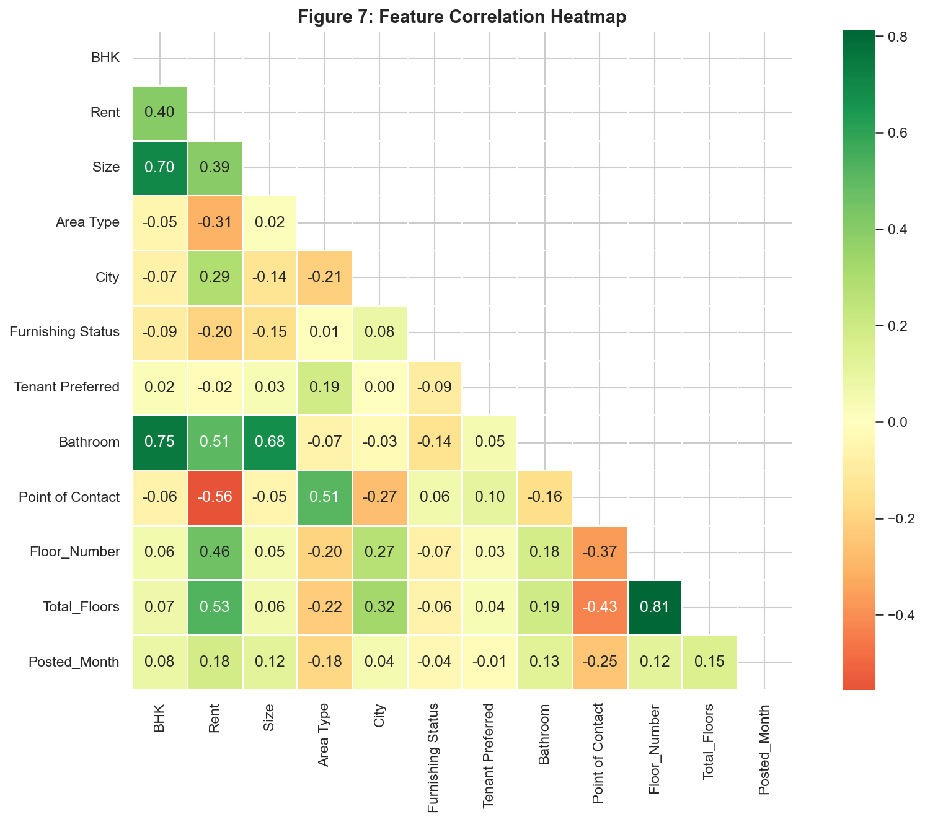
Correlation Heatmap

Slide 7
Models Used
Linear Regression — Baseline model assuming a linear relationship between features and rent; scaled using StandardScaler.
Decision Tree Regressor — Rule-based model splitting data on feature conditions; controlled with max_depth=10 to avoid overfitting.
Random Forest Regressor — Ensemble of 200 decision trees trained on bootstrap samples; predictions averaged for robustness.
Gradient Boosting Regressor — Sequential ensemble where each tree corrects errors of the previous; 200 estimators with learning rate 0.1.
XGBoost Regressor — Optimized gradient boosting with L1/L2 regularization and parallel computation for faster, more generalized predictions.

Slide 8
Results
Random Forest achieved the best performance with R² = 0.74, RMSE = Rs. 7,020, and MAE = Rs. 4,710. Ensemble models clearly outperformed Linear Regression (R² = 0.62). After hyperparameter tuning via GridSearchCV, the cross-validation R² reached 0.86. City and Size were identified as the top two features, contributing over 45% of predictive power.
Model | R² Score | RMSE (Rs)
Linear Regression | 0.6162 | 8,578
Decision Tree | 0.6835 | 7,790
Random Forest | 0.7430 | 7,020
Gradient Boosting | 0.7339 | 7,143
XGBoost | 0.7225 | 7,295

Slide 9
Applications
For Tenants — Helps renters quickly verify whether a listed price is fair before negotiating or signing a lease.
For Landlords — Enables property owners to set competitive and data-driven rental prices without relying on agent opinions.
For Real Estate Portals — Can be integrated into listing platforms to auto-suggest price ranges for new property postings.
For Property Investors — Assists investors in identifying undervalued rental properties across cities for better returns.
For Government & Urban Planners — Provides insights into city-wise rental trends useful for housing policy and urban development planning.

Slide 10
Conclusion
This project successfully built and compared five ML regression models for Indian rental price prediction. The tuned Random Forest model with R² = 0.74 proved most reliable. The system demonstrated that data-driven approaches can effectively replace subjective agent-based estimation, offering accurate and scalable predictions for real-world use.

Slide 11
Future Scope
Incorporate location-based features like proximity to schools, hospitals, and public transport to improve accuracy.
Expand the dataset to cover more Indian cities and recent listings for better temporal and geographic generalization.
Explore deep learning models such as neural networks or transformer-based architectures for further performance gains.
Deploy the system as a public web application using Flask or Streamlit for wider accessibility.

Slide 12
References
[1] Sirmans et al., "The composition of hedonic pricing models," Journal of Real Estate Literature, 2005.
[2] Limsombunchai, "House price prediction: Hedonic price model vs. ANN," 2004.
[3] Phan, "Housing price prediction using ML: Melbourne city," iCMLDE, 2018.
[4] Truong et al., "Housing price prediction via improved ML techniques," Procedia CS, 2020.
[5] Kangane et al., "Real Estate Price Prediction," IJEAST, 2021.
[6] Chen & Guestrin, "XGBoost: A scalable tree boosting system," KDD, 2016. [7] Breiman, "Random forests," Machine Learning, 2001.

Slide 13
Thank You
13

