Slide 1

AI-LMS
AI-Enhanced Learning Management System
Intelligent, Personalized, and Integrated Digital Learning.
Presented by Vanshika Garg, Satya Prakash Kumar, Vinayak Gupta, Rajneesh Kumar, Sarita Verma · B.Tech Computer Science Engineering · KIET Deemed to be University
Notes:
AI-LMS is a proposed centralized platform for course management, assessment, progress tracking, and AI-powered academic assistance.

Slide 2












Fragmented learning creates avoidable academic friction
Resources and activities are scattered across platforms.
Manual evaluation is time-consuming, while students may lack immediate doubt support.
Learning gaps, study priorities, and responsible academic-integrity review are difficult to manage consistently.
Objective: centralize learning, simplify assessment, monitor progress, personalize support, and assist teachers with evidence-led review.

Slide 3
SYSTEM REQUIREMENTS SPECIFICATION
01
02
The SRS defines four capability areas and quality constraints
Student
Teacher
Registration, enrollment, materials, submissions, quizzes, notifications, progress, feedback, and learning support.
Courses, materials, assignments, quizzes, evaluation, announcements, and analytics.
Functional requirements describe system behavior. Non-functional requirements describe quality and constraints.
03
04
Admin
AI services
Users, roles, categories, reports, security, and audit logs.
Course-context Q&A, recommendations, study support, quiz and feedback assistance, and similarity analysis.
Quality constraints: security and RBAC · usability and accessibility · reliability · maintainability · scalability · privacy · transparent AI use.
Notes:
Source: LMS SRS.

Slide 4




GOVERNED ENVIRONMENT
Four actors share one governed learning environment
Student
Teacher
Learns, submits, attempts quizzes, tracks progress, and uses AI assistance.
Creates learning experiences, evaluates work, publishes updates, and reviews analytics and integrity reports.
Role-based access keeps capabilities aligned to responsibility.
Admin
AI Service
Governs users, roles, security, reports, categories, and auditability.
Processes course-grounded questions, learning resources, performance signals, recommendations, and review assistance.
RBAC
Notes:
Source: LMS SRS.

Slide 5
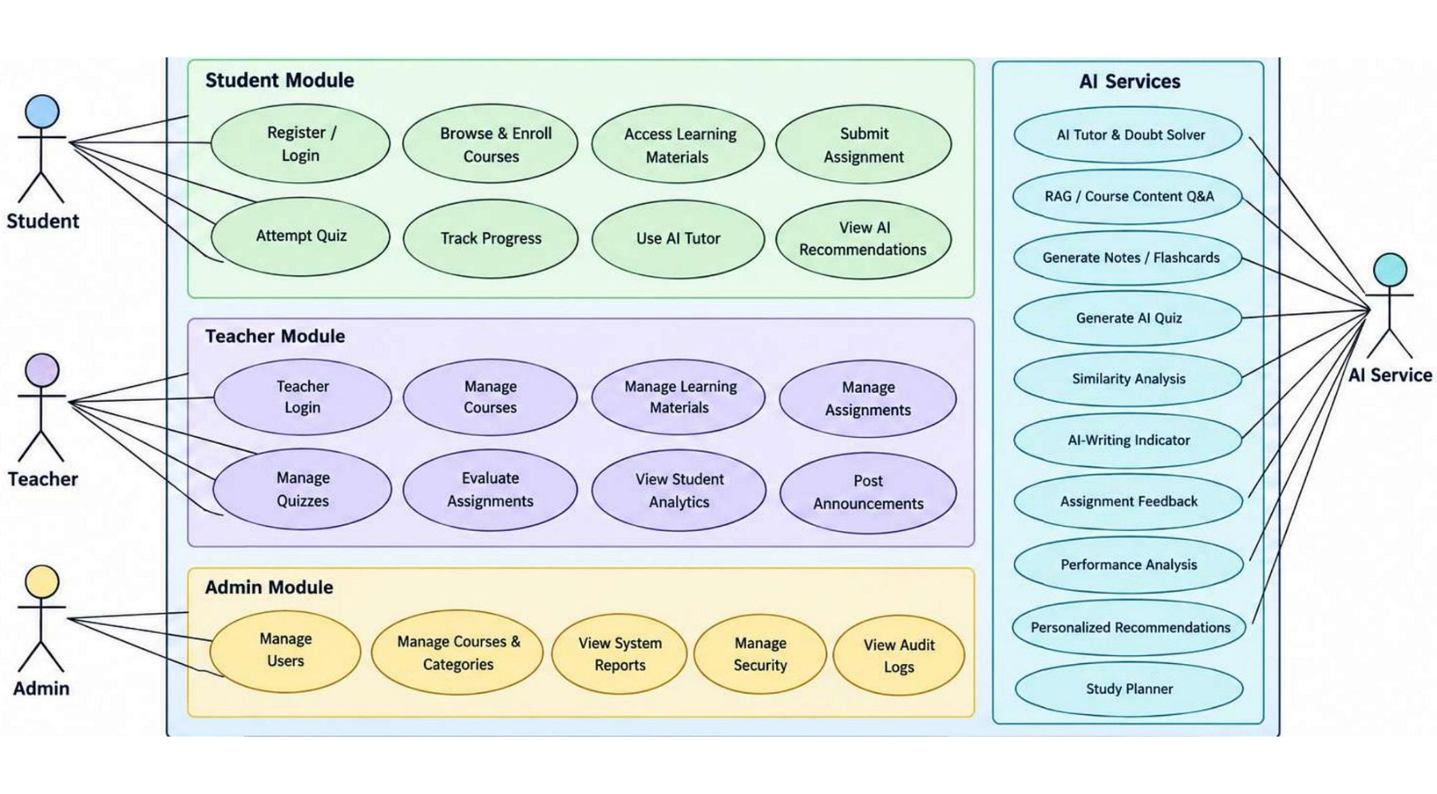
USE-CASE VIEW
Use cases connect learning, teaching, governance, and AI
Actors, system boundary, associations, and AI interactions define the main flows.
SOURCE FIGURE
Notes:
Use the attached high-level UML use-case diagram as the source figure. Emphasize the main flows rather than shrinking every use case into unreadable text.

Slide 6
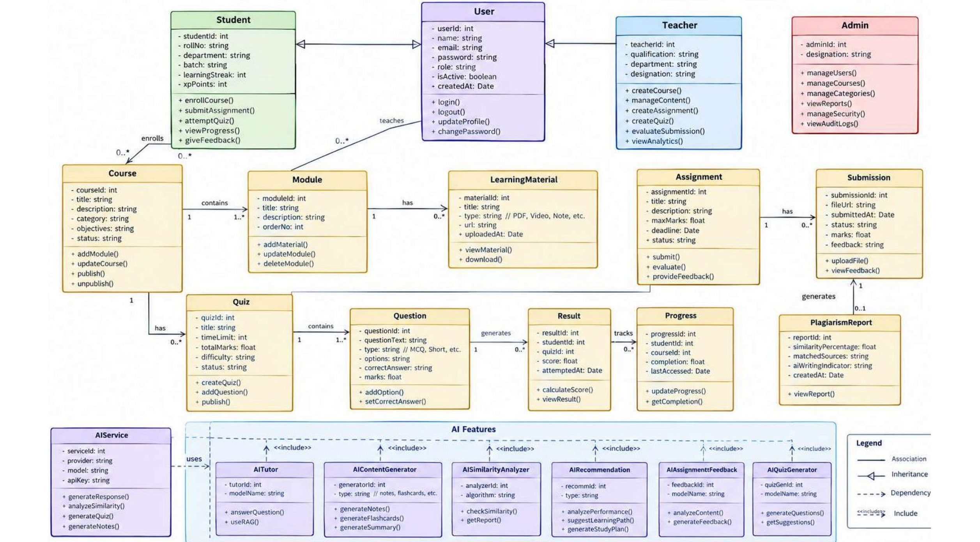
PROPOSED DESIGN
The proposed data model links core LMS objects to AI services
Preserve inheritance, representative relationships, multiplicities, and AI-service dependencies.
Notes:
Use the attached class diagram as the source figure. The model is proposed design, not implemented evidence.

Slide 7
CONTEXTUAL ASSISTANCE
AI should ground assistance in course context and teacher oversight
AI supports learning and instructor productivity; it does not replace teacher judgment.
01
02
03
Extract and chunk
Retrieve
Generate
Course materials are extracted and chunked.
Relevant content is retrieved for the learner’s question.
The AI model produces a contextual answer or learning resource.
04
05
Support
Review
Students receive tutor support, notes, flashcards, recommendations, and study planning.
Teachers review AI-generated quizzes and feedback before use.
Verify before relying: AI responses may be inaccurate and should be verified.
Notes:
Source: LMS SRS.

Slide 8
ACCOUNTABLE REVIEW
Assignment review combines automation with accountable human judgment
Automation creates evidence. The teacher interprets it and decides.
Review process
Safeguards
Student submits assignment.
Text is extracted and screened for similarity against available sources.
Where supported, an AI-writing indicator adds a limited signal.
The system produces a highlighted report for teacher review.
Teacher interprets evidence, decides, and may use AI-assisted feedback.
Similarity percentage is not proof of plagiarism.
AI-writing detectors can produce false positives.
Privacy, access control, and careful handling of submissions are essential.
Notes:
Source: LMS SRS.

Slide 9
The architecture separates user experience, core services, data, and AI
Presentation layer
Application layer
Student, teacher, and admin dashboards.
Authentication, course, assignment, quiz, progress, notification, and reporting services.
Data layer
AI layer
Database, learning-material storage, submissions, results, and progress records.
Tutor, retrieval pipeline, notes and quiz generation, similarity analysis, feedback assistance, and recommendation engine.
Conceptual flow: User interface → backend/API → database and file storage → AI services when required → response to user interface.
Providers, frameworks, and deployment choices remain to be determined.
Notes:
Conceptual flow: User interface → backend/API → database and file storage → AI services when required → response to user interface.

Slide 10

AI-LMS brings centralized learning with responsible intelligence
BENEFITS
One learning environment, simpler assessment management, better performance visibility, faster doubt resolution, personalized support, and more structured review.
LIMITATIONS
AI answers may be inaccurate; quality depends on materials and data; similarity and AI-writing signals require interpretation.
Conclusion: AI-LMS extends conventional LMS capabilities while preserving teacher oversight, privacy, security, and academic-integrity responsibility.
Thank You · Questions?
Notes:
AI-LMS extends conventional LMS capabilities while preserving teacher oversight, privacy, security, and academic-integrity responsibility.

