Slide 1
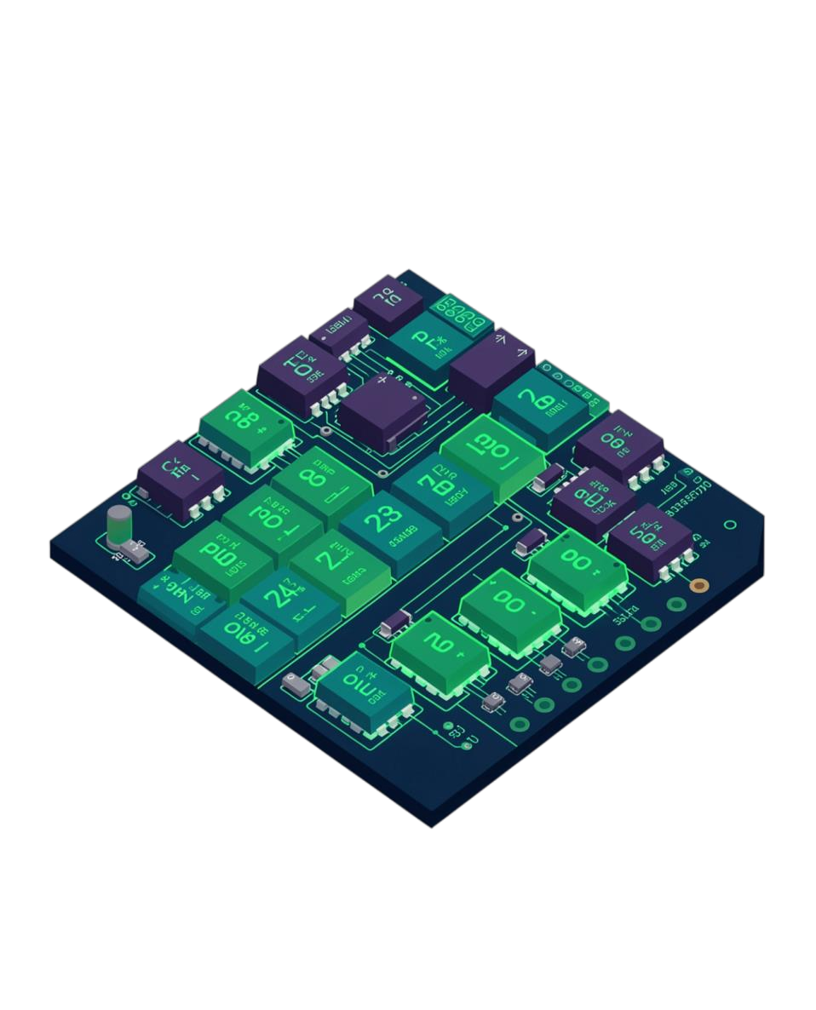
Design and Simulation of Half Adder and Full Adder Using Logisim
Exploring binary arithmetic circuits through digital logic design and simulation
Team Member | Roll Number
P. Vanshika | 2620080035
S. Aditya | 2620080052
K. Varnikha | 2620080025
S. Veena Akshaya | 2620090069

Slide 2
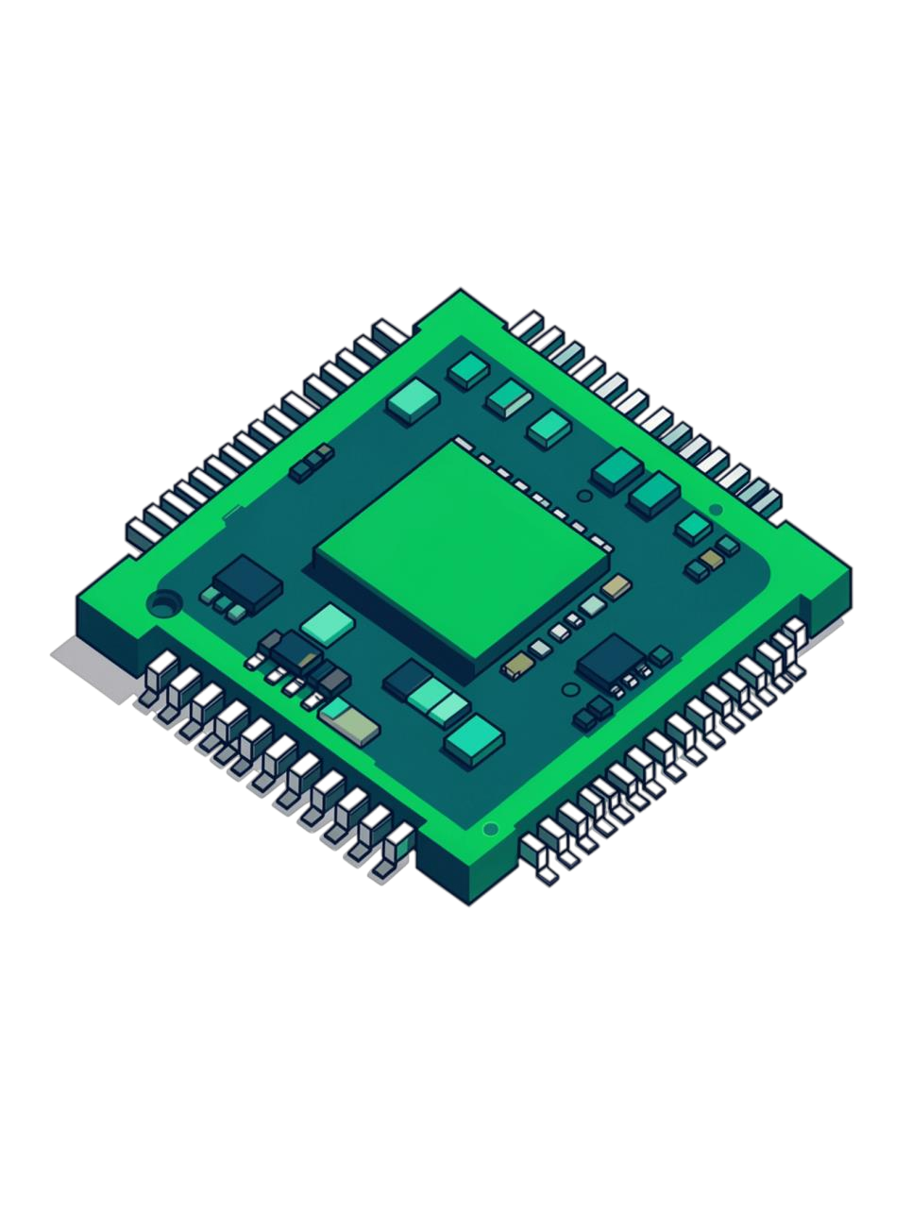
Introduction and Objective
An adder is a digital circuit used to perform binary addition — a fundamental building block of digital electronics and computer systems.
Computers & CPUs
Core arithmetic in central processing units
Calculators
Powering every numeric computation
ALUs
Arithmetic Logic Units in processors
Microcontrollers
Embedded processors and digital devices
Objective
To design a Half Adder and a Full Adder using basic logic gates (XOR, AND, OR). To simulate both circuits in Logisim and verify the outputs against their truth tables. To understand how these circuits form the basis of multi-bit binary addition.

Slide 3
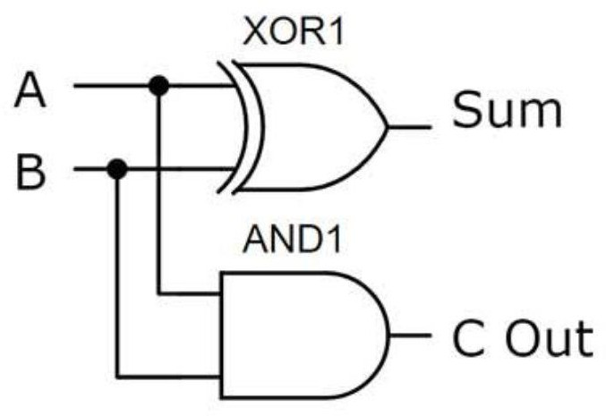
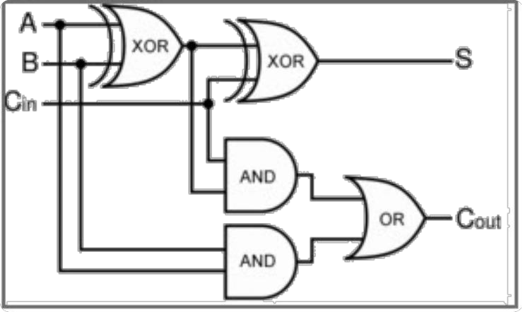
Theory and Logic Circuit
Binary addition is built from three gates: XOR (output 1 when inputs differ), AND (output 1 only when both inputs are 1) and OR (output 1 when at least one input is 1).
Half Adder
Adds two 1-bit inputs and produces Sum and Carry.
Inputs: A, B Outputs: Sum, Carry
Full Adder
Adds a third input (Cin) to handle carry-in from previous additions, enabling multi-bit addition.
Inputs: A, B, Cin Outputs: Sum, Cout
Sum = A ⊕ B ⊕ Cin Cout = AB + Cin(A ⊕ B)
Sum = A ⊕ B (XOR)
Carry = A · B (AND)
Gates used: 1 XOR, 1 AND
Gates used: 2 XOR, 2 AND, 1 OR

Slide 4
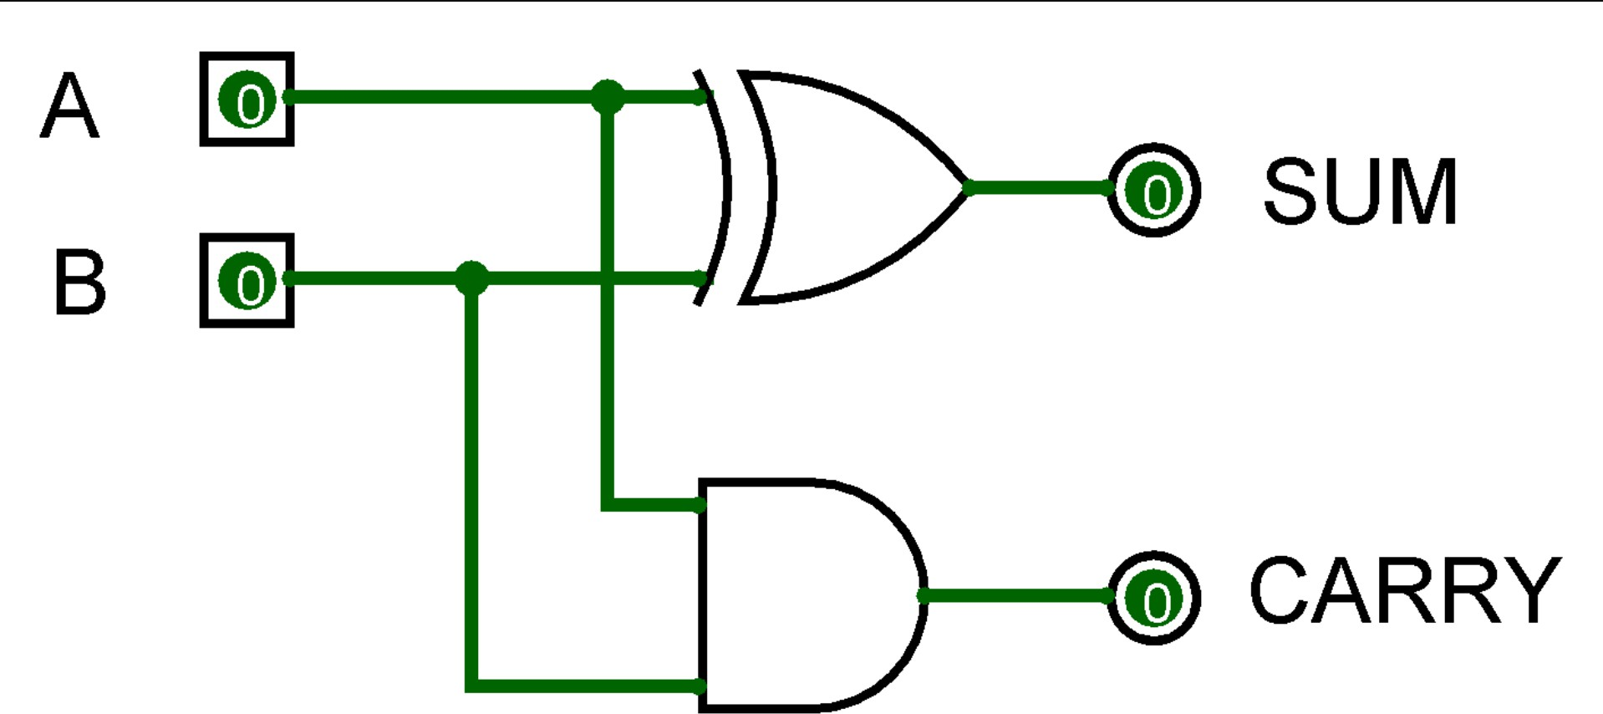
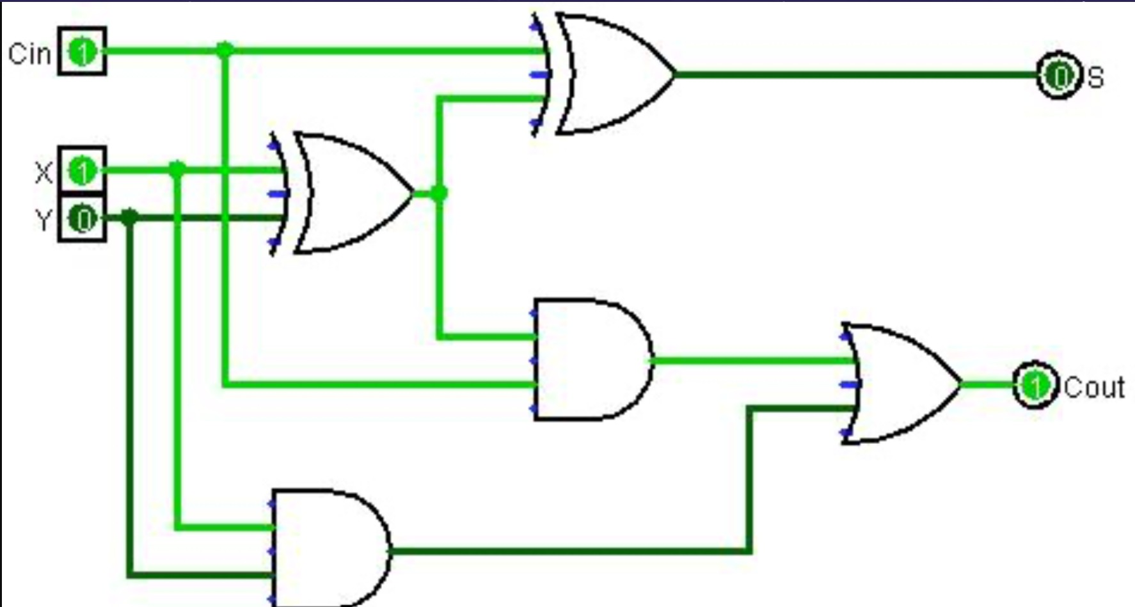
Circuit Design in Logisim
Half Adder
Full Adder
2 Input Pins
A and B binary inputs
1 XOR Gate
Produces the Sum output
3 Input Pins (A, B, Cin) Multiple XOR Gates Multiple AND Gates
1 OR Gate
2 Output Pins/LEDs (Sum, Cout)
1 AND Gate
Produces the Carry output
2 Output Pins
Sum and Carry LEDs
Working: The XOR gate produces the sum of the two bits, while the AND gate generates the carry output — forming the foundation for more complex adder designs.
Working: The first XOR combines A and B; a second XOR adds Cin to give Sum. Two AND gates feed an OR gate to produce Cout. Logisim lets you visualize how each gate processes the inputs in real time.
Logisim enables interactive simulation — toggle any input and instantly observe how Sum and Cout respond across all gate stages.

Slide 5
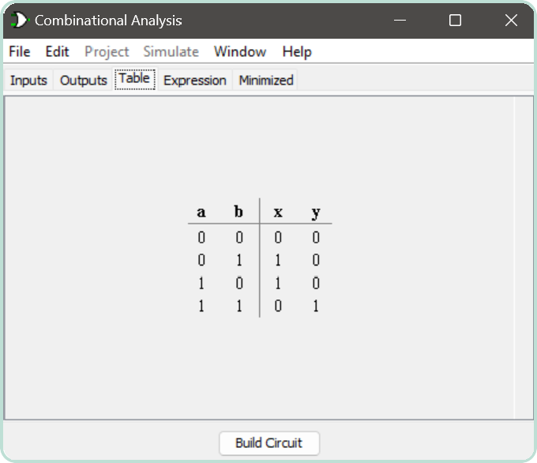
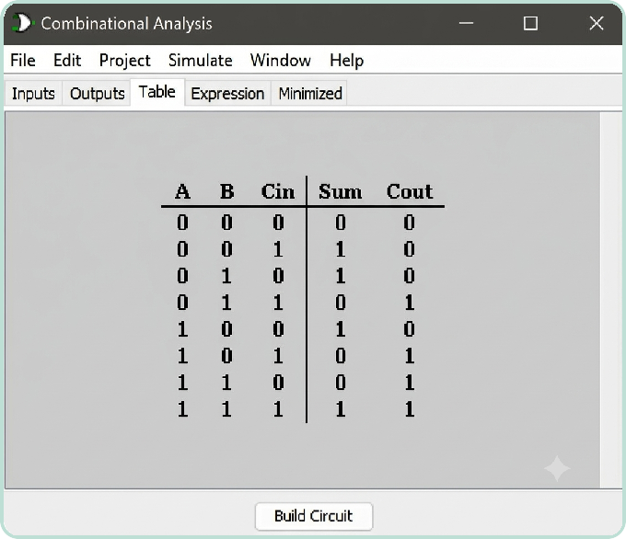
Simulation Results
Half Adder
Full Adder
A | B | Sum | Carry
0 | 0 | 0 | 0
0 | 1 | 1 | 0
1 | 0 | 1 | 0
1 | 1 | 0 | 1
A | B | Cin | Sum | Cout
0 | 0 | 0 | 0 | 0
0 | 0 | 1 | 1 | 0
0 | 1 | 0 | 1 | 0
0 | 1 | 1 | 0 | 1
1 | 0 | 0 | 1 | 0
1 | 0 | 1 | 0 | 1
1 | 1 | 0 | 0 | 1
1 | 1 | 1 | 1 | 1
Logisim Combinational Analysis – truth table (x = Sum, y = Carry)
Logisim Combinational Analysis – truth table
Simulated outputs for every input combination match the truth tables, confirming that both circuits work correctly.

Slide 6

Conclusion and Applications
1 Half Adder 2 Full Adder
Adds two bits without carry-in — the simplest binary addition circuit using XOR and AND gates.
Adds three bits including carry-in from previous stages, enabling scalable multi-bit arithmetic.
3 Logisim Simulation
4 Building Blocks of Computing
Provides an intuitive platform to design, test, and verify digital circuits against truth tables in real time.
The foundation of ALUs, processors, and all binary arithmetic operations in modern computing systems.
Applications
Computers & CPUs Calculators
ALUs in processors
Microcontrollers and embedded devices
Possible Improvements
Cascade full adders to build a 4-bit ripple-carry adder.
Use a carry-look-ahead design to reduce propagation delay.
Extend the design into an adder-subtractor or a simple ALU.

