Slide 1
SALES ANALYTICS
Data Storytelling &
Statistical Validation
A data-driven look at what's really behind our top-performing segment.

Slide 2
01
Electronics leads every revenue chart in this dataset. But does it lead because customers spend more per order, or simply because it sells more often?
Objective
Why this analysis matters to the business.
That distinction changes strategy: premium pricing vs. reach and frequency. This deck follows the data from raw rows to a statistically validated answer.
Clean
Explore
Segment
Validate
Prepare trustworthy, analysis-ready data
Surface early patterns and trends
Define KPIs and key customer segments
Confirm the pattern statistically

Slide 3
02
Foundation: Cleaning & Preparing the Data
1,000 raw sales transactions were profiled, cleaned, and enriched before any analysis began.
1,000
0
12→17
3
Transactions cleaned
Missing Age / City values remaining
Columns after feature engineering
New fields: Region, Age Group, Order Month/Year
What was fixed:
Why it matters
Missing Age and City values imputed — zero gaps remain
Order_Date standardized to a consistent datetime format
Region derived from City for location-based analysis
Age Group and Order Month/Year engineered for segmentation
Every insight in this deck — from top categories to the hypothesis test — depends on this step. Clean, complete data means the statistical conclusions ahead can be trusted.

Slide 4
03
Early Patterns: Exploration & SQL
Seven business questions answered in SQL surfaced the first signals worth investigating.
Key findings
Electronics is the #1 category by both orders (354) and revenue (₹50.7M)
East India leads all regions with ₹52.6M in revenue
Revenue splits nearly evenly by gender — 52% Male, 48% Female
Every product category cleared its assigned revenue target
The open question this raised:
Is Electronics' lead about higher spend per order — or just higher order volume? That's tested directly next.

Slide 5
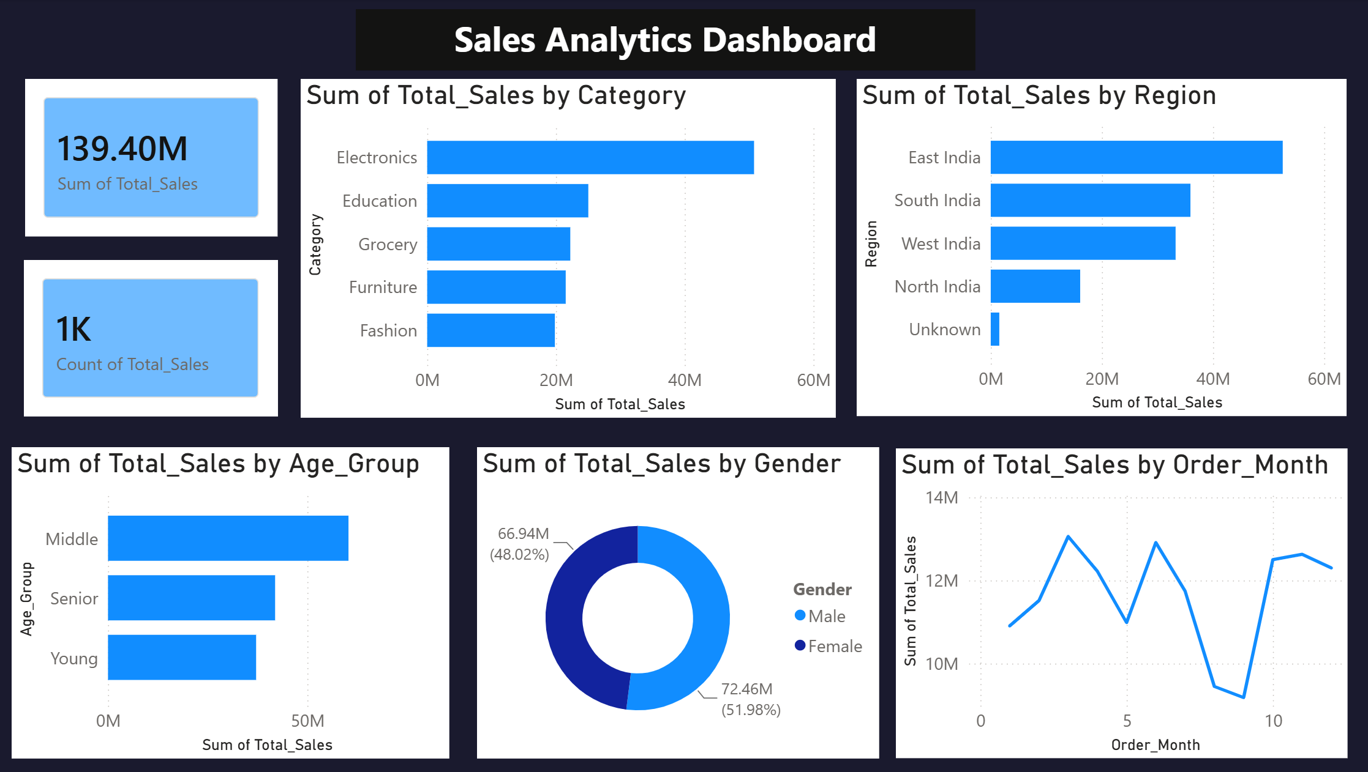
04
Going Deeper: KPIs & Segmentation
Core KPIs were defined and revenue was broken down across four customer segments.
Top-performing segments
Category
Electronics — ₹50.7M
Region
East India — ₹52.6M
Age Group
Middle-aged — ₹60.3M
Gender
Male — ₹72.5M (51.98%)
Every top segment leads on total revenue. The question is whether they also lead on spend-per-order — tested next.
Live KPI dashboard

Slide 6
05
Putting It to the Test
A statistical test to check whether Electronics truly earns more per order.
H₀ (Null)
No difference in average order value between Electronics and other categories.
H₁ (Alternative)
Average order value does differ between Electronics and other categories.
Independent-samples T-test on Total_Sales, Electronics (n=354) vs. all other categories (n=646)
t-statistic
0.82
p-value
0.414
95% CI of difference
-₹8,738 to ₹21,255
Result: p = 0.414 > 0.05 → fail to reject H₀. No statistically significant difference in spend per order.

Slide 7
06
Conclusion & Recommended Action
Electronics — and East India — lead on total revenue because of higher purchase VOLUME, not higher spend per order. Pricing behavior is consistent across every segment tested.
What the business should do next:
1
2
3
Grow reach & frequency
Don't assume premium pricing works
Apply the same lens elsewhere
Invest in acquisition and repeat-purchase efforts within Electronics and East India — that's what's actually driving their lead.
Order values are uniform across segments, so pricing power hasn't been proven — treat it as untested, not assumed.
Use volume-focused strategy for underperforming segments (North India, Fashion) rather than price changes.

Slide 8
Thank You
Vanshika Dharpure
Data Analytics Intern — ApexPlanet Software Pvt. Ltd.

