Slide 1
☎
Telecom Customer
Churn Analysis
Customer Churn Analysis
using Tableau
Presented By: Vanshika ,Yogita
Roll No.: 25653, 25742

Slide 2
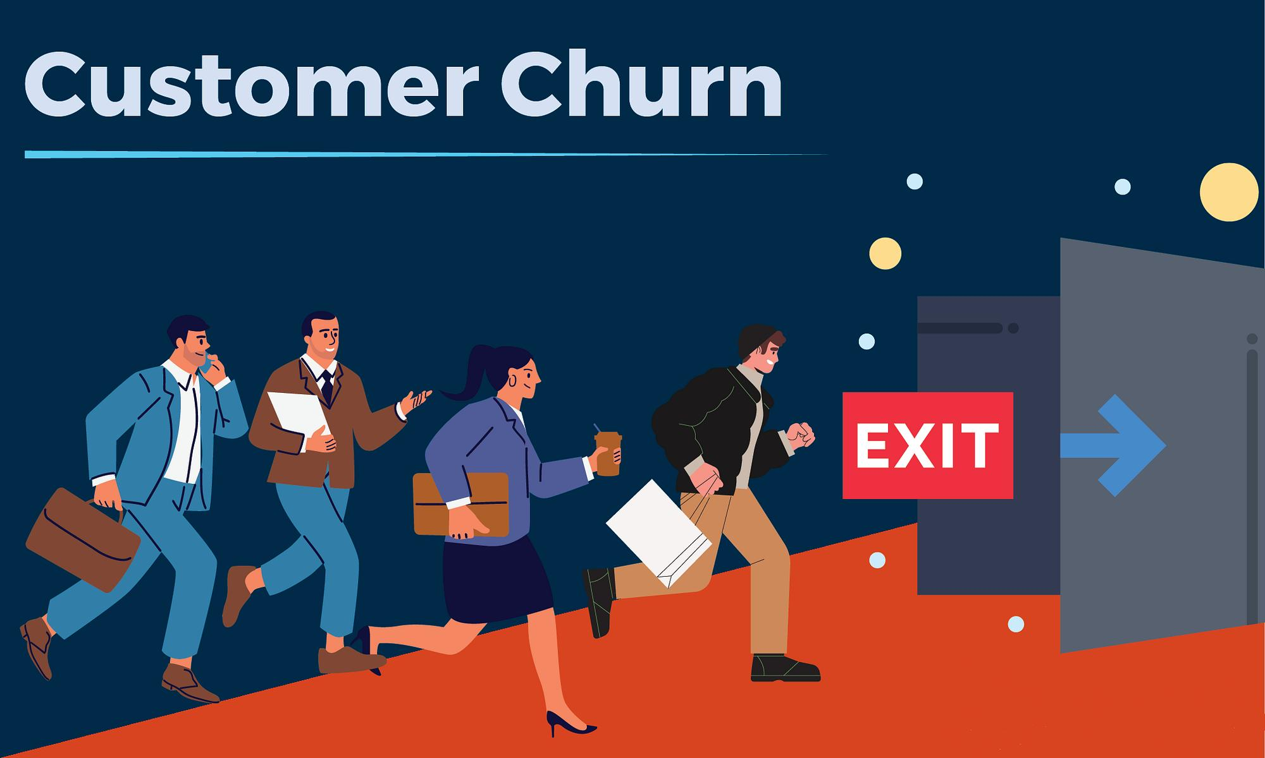
About the Project
What is Customer Churn?
When a customer stops using a company's service.
Why is it important?
1. Customer Loss
2. Revenue Loss
3. Finding Churn Reasons
4. Improving Customer Retention
5. Understand Customer Behaviour
6. Stay Competitive
02

Slide 3





OBJECTIVES & METHODOLOGY
Project Objectives
To understand customer churn
To find the main reasons for customer churn
To compare different customer groups
To analyse contract, age, charges and payment method
To understand the effect of churn on the company
METHODOLOGY
Dataset
Tableau
Visualizations
Dashboards
Insights
03

Slide 4
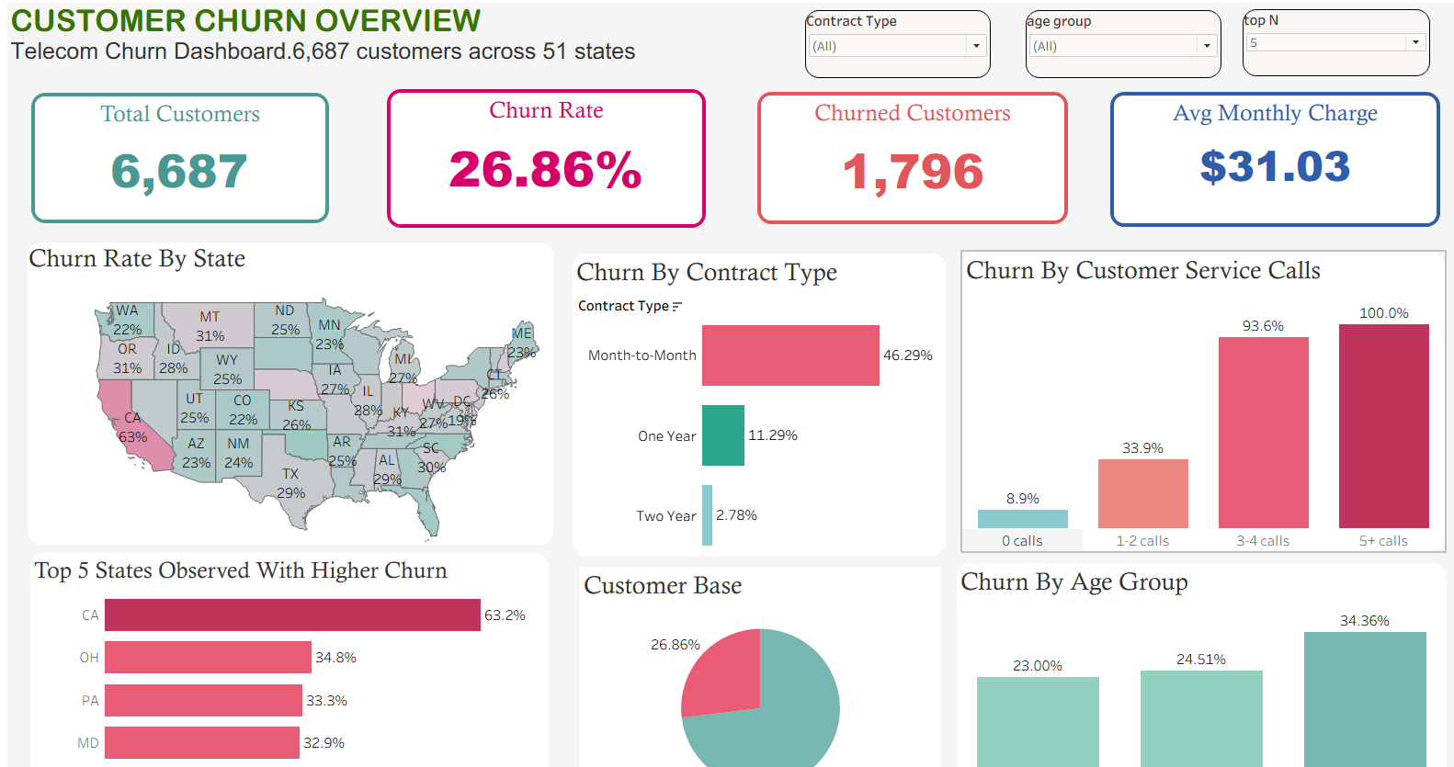
Customer Churn Overview
This dashboard shows:
1.👥 Total Customers
2. Churned Customers
3. 📊 Churn Rate
4.📄 Churn by Contract Type
5.👥 Churn by Age Group
6.📍 State-wise Churn Rate
7.📞 Customer Service Calls
8.💰 Avg Monthly Charges
9. Top State Observed With Higher Churn
10.Customer Bas
04

Slide 5
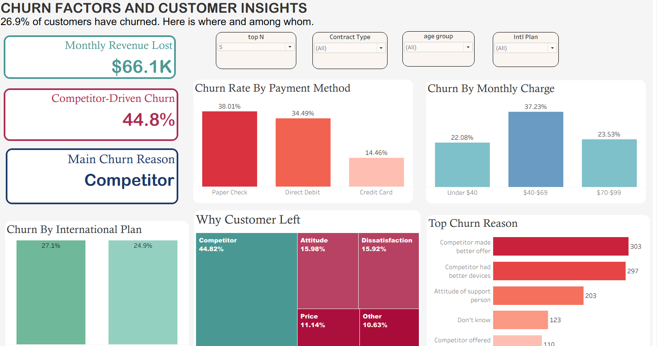
Churn Factors & Customer Insights
This dashboard focuses on:
1.💰 Monthly Revenue Charges
2.💳 Payment Method
3.🌍 International Plan
4.❓ Main Churn Reasons
5.🏢 Competitor-related Churn
6.📉 Monthly Revenue Lost
7.Customer Left
05

Slide 6
Conclusion
📊 Tableau Analysis: Tableau helped us analyse telecom customer data through visualizations.
👥 Customer Understanding: The dashboards helped us understand customer churn and different customer groups.
🔍 Churn Factors: We studied factors such as contract, age, charges, payment method and service calls.
💡Useful Insights: The dashboards helped us understand possible reasons related to customer churn
💰 Business Impact: Customer churn can affect the company's revenue.
🎯 Customer Retention: The analysis can help the company understand customer problems and work towards retaining customers.

Slide 7
Key Findings
📝
☎
👛
Contract Type
Customer Service Calls
Payment Method
Churn behaviour can be different for different types of contracts.
Frequent service calls can help identify customer problems related to the service
Churn patterns can be different across various payment methods.
💳
🏆
Monthly Charges
Competition
Monthly charges can be compared with churn to understand customer behaviour..
Competitor-related factors are one of the areas considered when studying customer churn.
11

Slide 8
Loyalty Builds Over Time
💬 Improve Customer Service
Solve customer problems quickly and improve service experience.
💳 Improve Payment Experience
Understand payment preferences and make payment options convenient.
🎯 Focus on At-Risk Customers
Identify customers who may be more likely to leave.
🏢 Monitor Competitors
Understand competitor-related reasons for customer switching.
📄 Review Plans & Contracts
Understand which plans and contracts may need improvement
💰 Monitor Charges
Study monthly charges and customer churn together.

Slide 9
✓
Thank You
📊 📱 💡
Telecom Customer Churn Analysis
Using Tableau

