Slide 1
Heart disease prediction using machine learning
Group 14 - Learners
Varun Parekh - AU2040011
Vanshit Shah - AU2040098
Ushmay Patel - AU2040253
Madhvendra Jhala - AU2040162

Slide 2
Introduction
Machine learning is an emerging issue in the healthcare industry for identifying disease and diagnosis.
The disease prediction system could be useful for the hospital administrators, doctors, physicians etc.
One of the most crucial topics in the data analysis part is predicting cardiovascular disease

Slide 3
Problem statement
The World Health Organization estimates that heart disease causes 12 million deaths globally each year.
By analysing patient data that uses a machine-learning algorithm to categorise whether a patient has heart disease or not, this project hopes to predict future cases of heart disease.

Slide 4
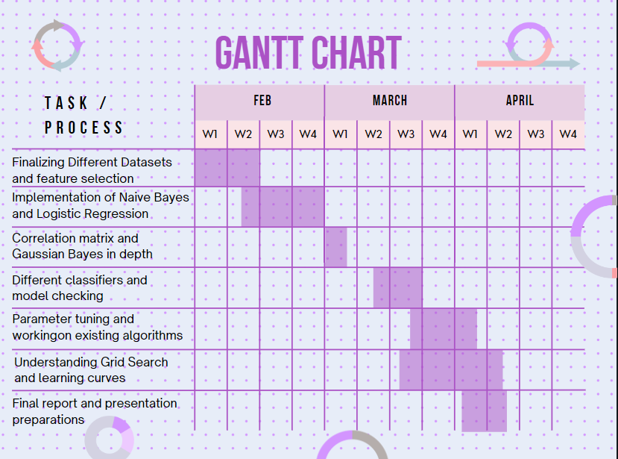

Slide 5
Existing body of work
There is a common set of core risk factors that determine whether or not someone will eventually be at risk for heart disease, despite the fact that heart disease can develop itself in various ways. Various methodologies like Logistic Regression, Naive Bayes, AdaBOOST, Random Forest etc. have been used till date.
Accuracy becomes a key role while predicting in Machine Learning especially if we are dealing with heart related issues. We came across other projects with the same aim and that is to optimise quality of life and accuracy of these algorithms.

Slide 6
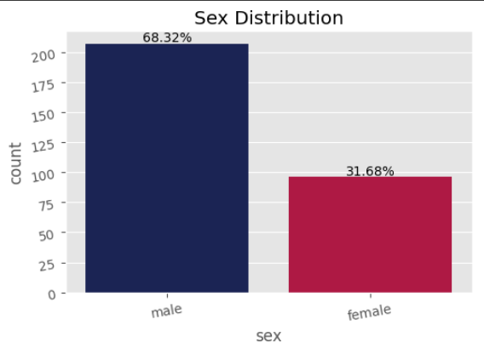
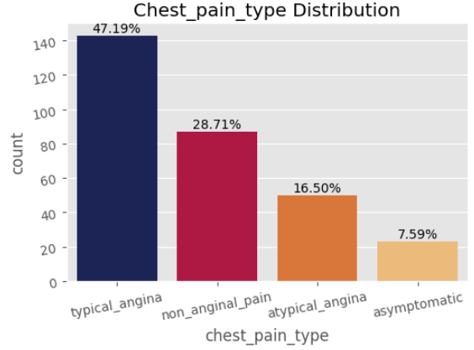
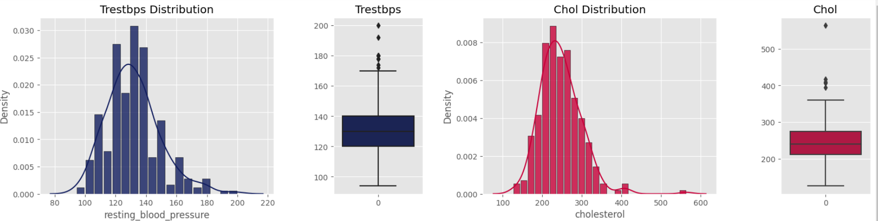
Approach
Dividing the features with respect to the parameters.
Distribution and box-plot implementation for all the features.

Slide 7
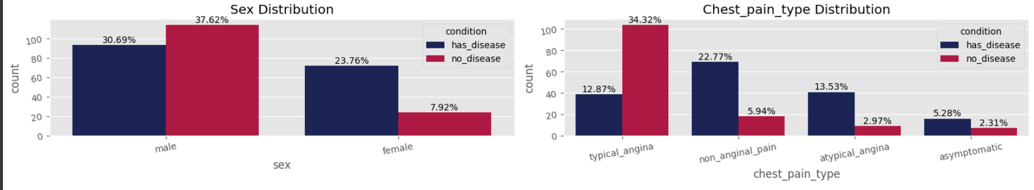
Categorized based upon “Disease” and “No_Disease”.
Correlation matrix between features and Condition.

Slide 8
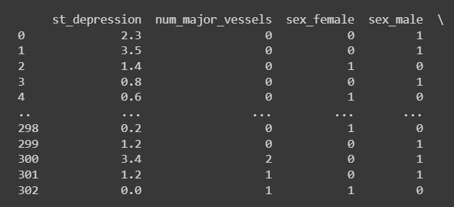
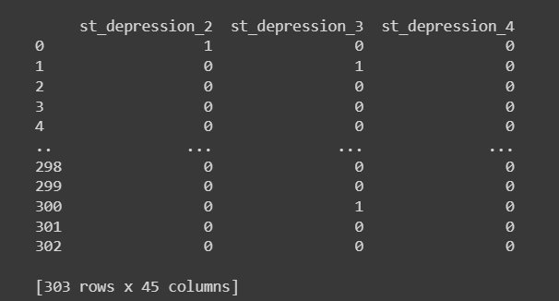
Before One-Hot Encoding
After One-Hot Encoding
Parameters like Sex, Chest_pain and Resting_blood_pressure are encoded

Slide 9
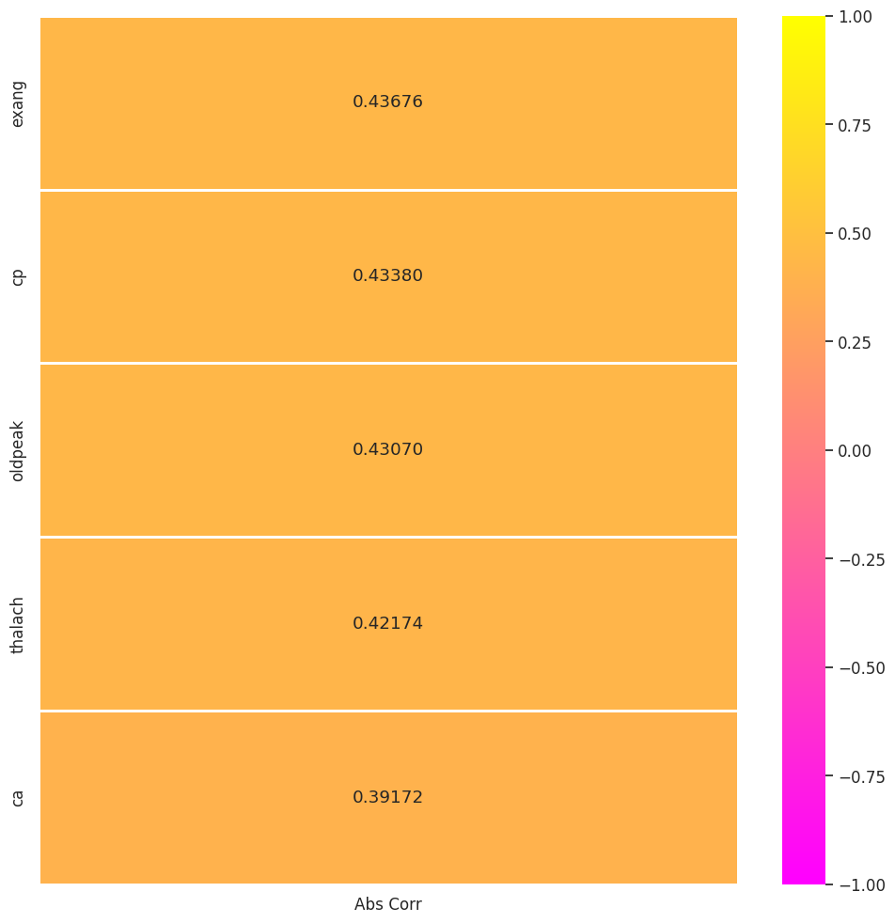
Correlation
The absolute value of correlation between our condition and features in decreasing order to get features with maximum importance .

Slide 10
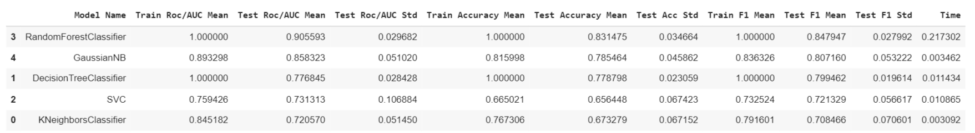
Result
Performed a model check and found out values like F1 score and accuracy to check if there is any overfitting and how well the classifier works on different test sets.

Slide 11
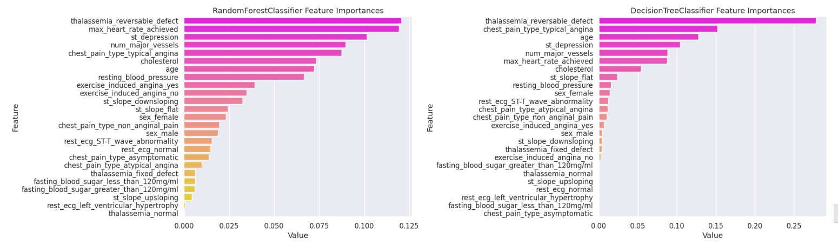
Feature Importance(On Decision based tree)

Slide 12
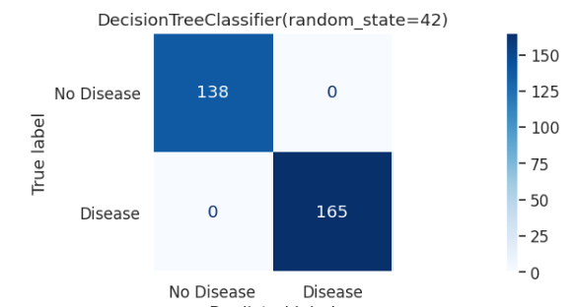
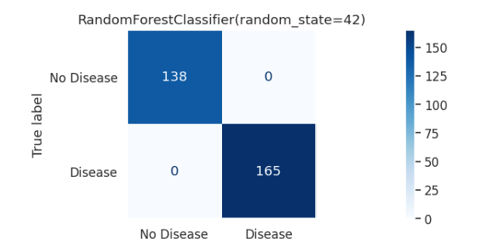
Confusion matrix (Overfitting)

Slide 13
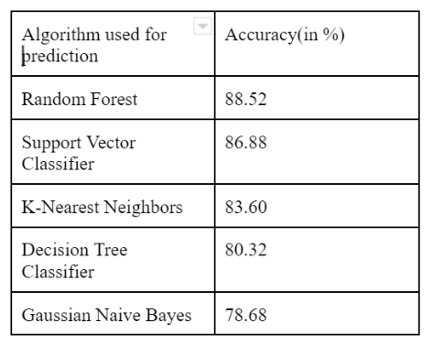
Accuracy Obtained:

Slide 14
Conclusion
Machine Learning can effectively predict the occurrence of heart disease in patients.
Random Forest Classifier worked the best for our dataset giving an accuracy of 88.52%.
Reduce the high mortality rate associated with heart disease worldwide.

Slide 15
Role
Madhvendra:Implementing different classifiers and hyper parameter tuning.
Varun: Implementing different classifiers and hyper parameter tuning.
Vanshit: Implementing different classifiers and hyper parameter tuning.
Ushmay: Implementing different classifiers and hyper parameter tuning.

Slide 16
References
A. S. Abdullah and R. R. Rajalaxmi, ‘‘A data mining model for predicting the coronary heart disease using random forest classifier,’’ in Proc. Int. Conf. Recent Trends Comput. Methods, Commun. Controls, Apr. 2012, pp. 22–25.
Chen A H, Huang S Y, Hong P S, Cheng C H & Lin E J (2011, September). HDPS: Heart disease prediction system. In 2011 Computing in Cardiology (pp. 557-60). IEEE.
J. Thomas and R. T. Princy, ‘‘Human heart disease prediction system using data mining techniques,’’ in Proc. Int. Conf. Circuit, Power Comput. Technol. (ICCPCT), Mar. 2016, pp. 1–5.

