Slide 1

TEAM
TIKI TAKA TECHS
1. Ashish Dadhich
2. Hitesh Kumbhar
3. Rishikesh Dound
4. Shubham Korde
5. Vanshita Biyani

Slide 2
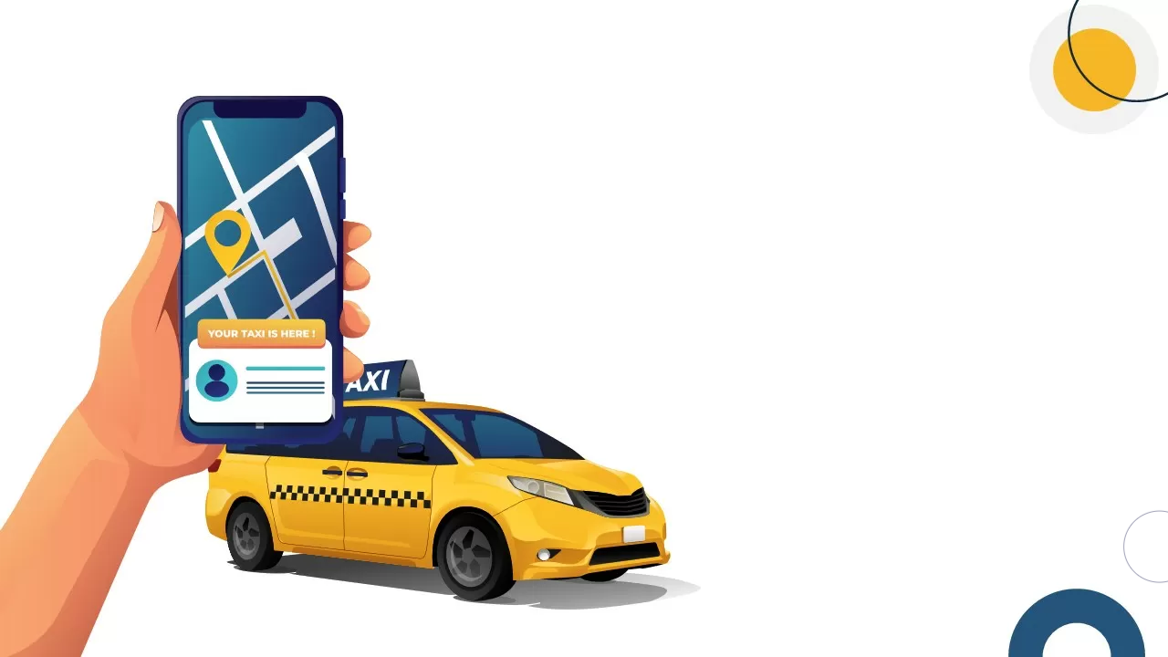
CAB FARE PREDICTION SYSTEM

Slide 3
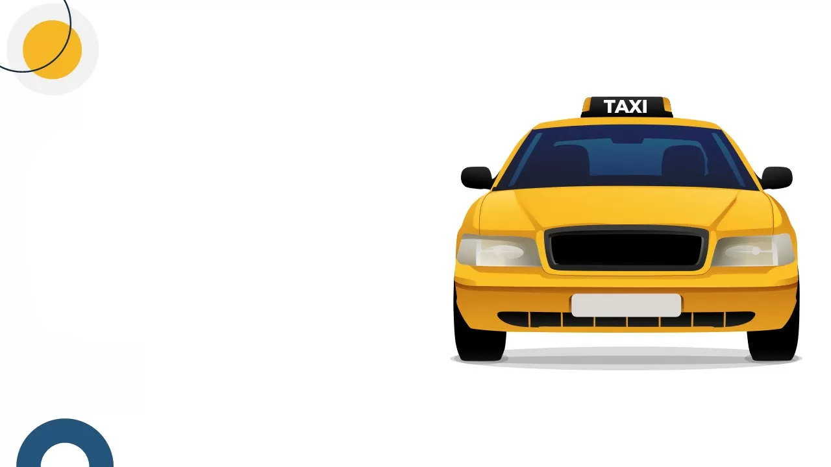
Problem Statement
Traditional cab fare estimates are often inaccurate due to unpredictable traffic and route variations, leading to unexpected costs for passengers. This project builds an AI-powered fare prediction system that integrates real-time traffic data to provide accurate and transparent pricing. This ensures fair fare estimates, improves customer trust and enhances trip planning efficiency.

Slide 4
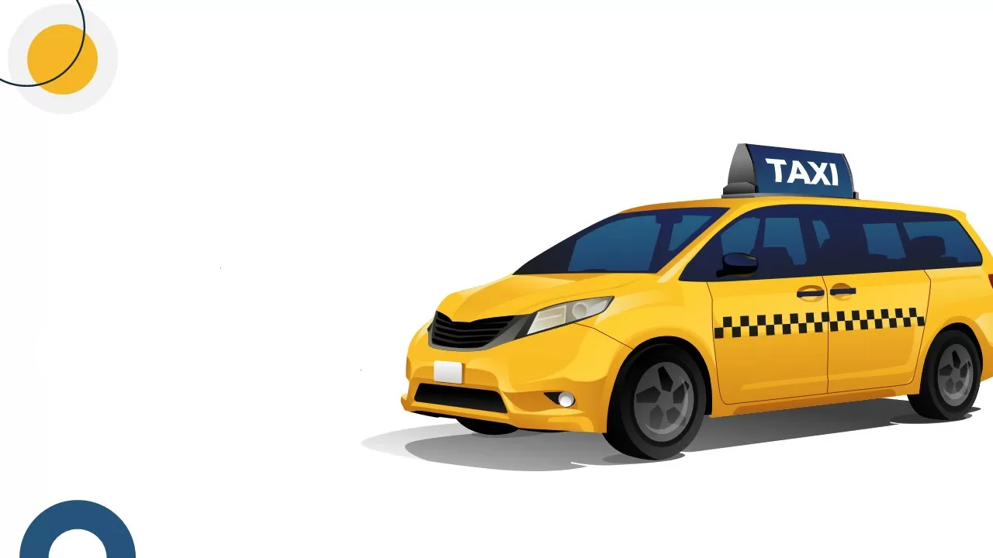
Tech Stack
1)Language- Python
2)Cloud- AWS(S3,EC2,Glue,Sagemaker)
3)Big Data- PySpark
4)Machine Learning
5)UI– Streamlit
6)Data Visualisation– PowerBI
7)API Integration- TomTom API

Slide 5

Why did we choose this?
Incorrect fare estimates due to static pricing models.
Sudden fare surges from traffic, peak hours, or high demand.
Riders lack understanding of fare calculations, causing distrust.
Dynamic fare hikes make rides unaffordable during peak hours or bad weather.
Inaccurate fare and time estimates make trip planning difficult.

Slide 6

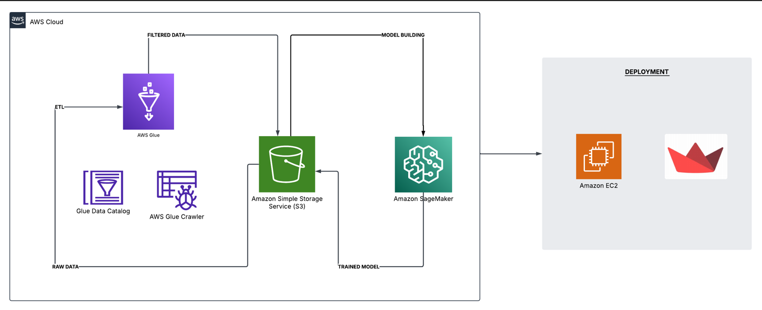
Project Workflow

Slide 7
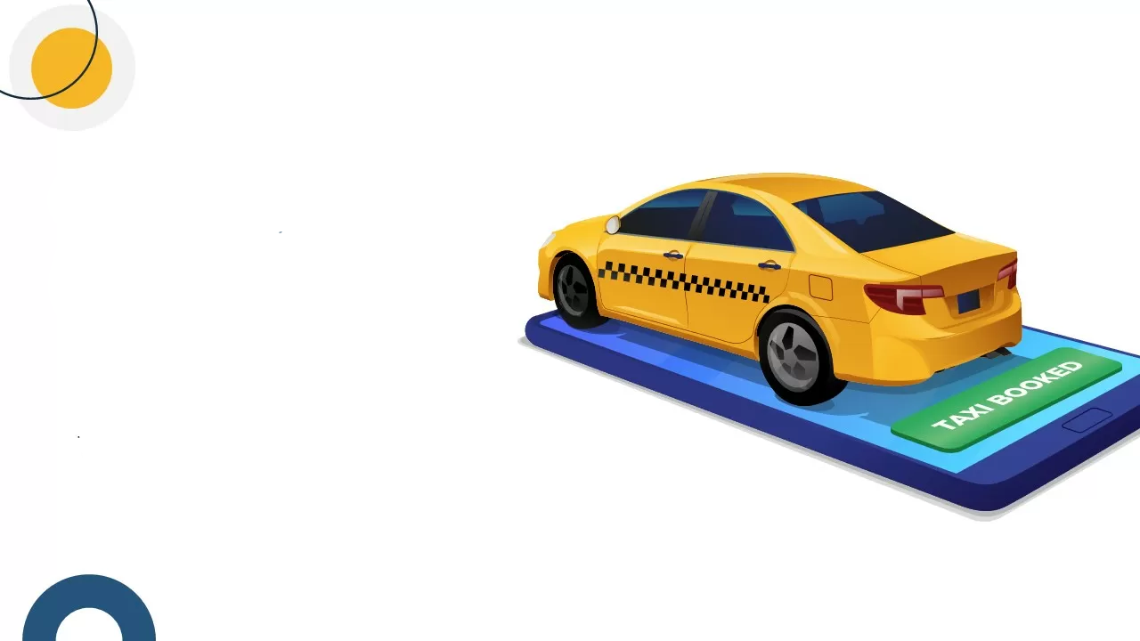
PROJECT DEMO
Website link-
Cab Fare Prediction System

Slide 8
Future Scope
Real-Time Traffic & Demand-Based Fare Adjustment - Using Kafka for real-time data streaming, traffic conditions and demand fluctuations can be processed instantly to dynamically adjust fares, ensuring more accurate and fair pricing.
Multi-Modal Transport Integration - Expanding the system to include public transport options (buses, metros, trains) can allow users to compare taxi fares with alternative travel methods, making transportation more cost-effective and efficient.

Slide 9
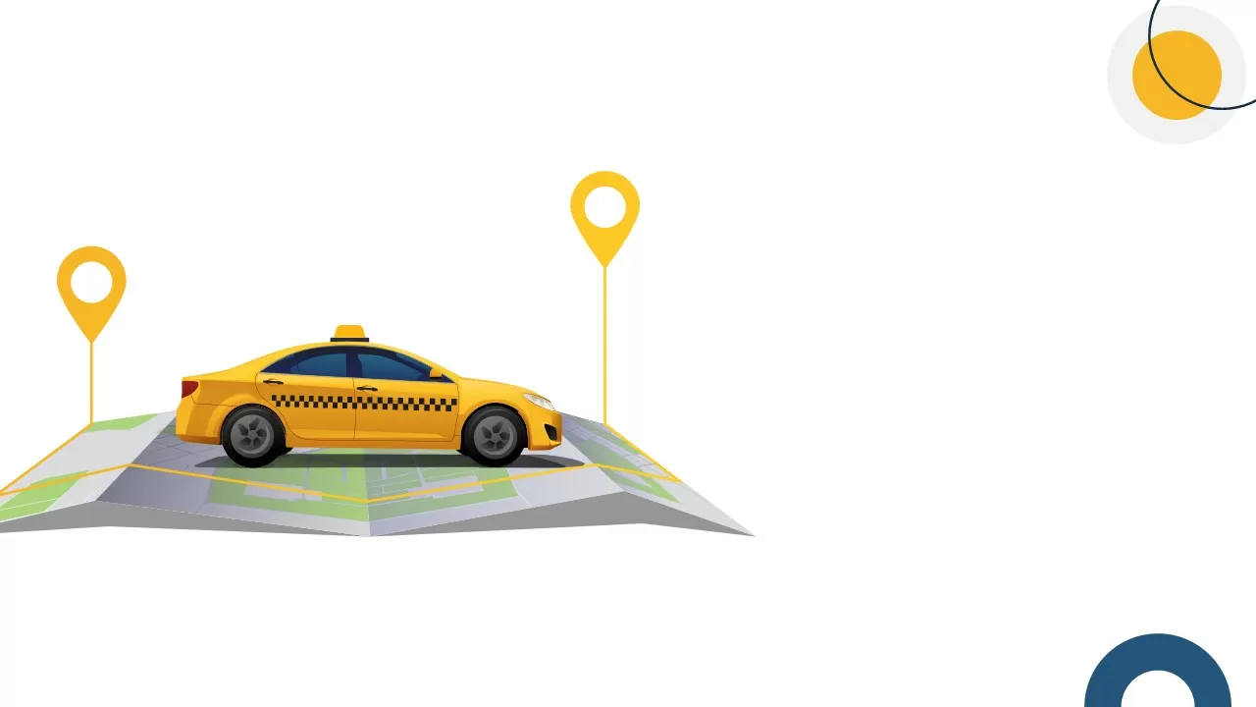
Real World Use
Logistics & Delivery Services – Enhances route optimization and cost estimation, leading to faster and more cost-effective deliveries.
Corporate & Employee Transportation – Helps businesses optimize travel expenses by providing accurate and predictable fare estimates for employees.
Smart City & Traffic Management – Assists government authorities in urban mobility planning by analyzing fare trends and traffic congestion patterns.

Slide 10
