Slide 1

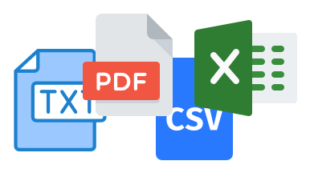


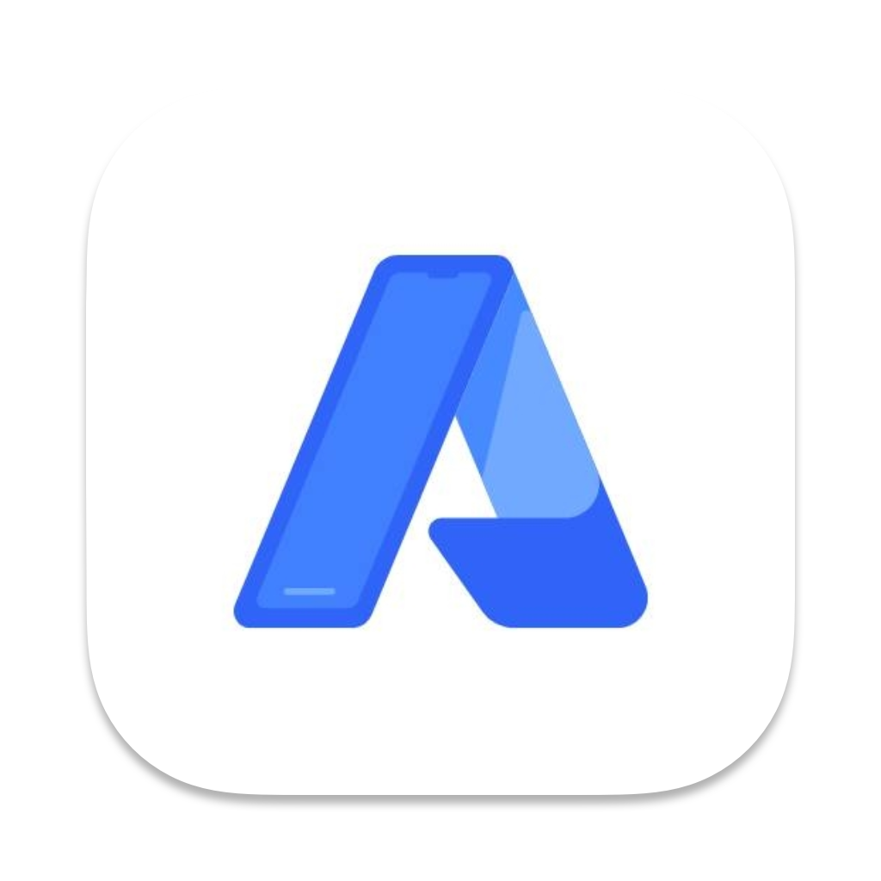



Multi Agent AI Architecture using LangGraph
Data Source
+
User Query
Routing Agent
Embeddings
Vector DB
Wiki Search
Astra DB Vector Store
Prompt
LLM
+
Llama 3.1 hosted on Groq
Output

