Slide 1



CAPSTONE SUBMISSION
Smart Patient Readmission & Care Intervention Platform
Data Science Training Program | Capstone Project 1
Team / Participant Name
Vansh, Amartya, Abhinav, Rohit
Batch
Team VAAR
Delivery Date
28 Oct 2026
Notes:
1

Slide 2
SECTION 01
Business Problem
02
BUSINESS PROBLEM
  Avoidable 30-day readmissions are a persistent drain on hospital leadership, care teams and patients.
  About 1 in 6 admissions ends in a return within 30 days. Half of them happen in the first 7 days after discharge.
  Chronic conditions hit hardest contributing to readmissions.
Build an end-to-end analytics platform that predicts readmission risk, explains the causes, segments patients, reads discharge notes, recommends outreach, and gives leaders one trustworthy dashboard.
THE LEADERSHIP QUESTION
If Kaiser Permanente invests in patient outreach programs, which patient groups should be targeted first and what interventions are most likely to reduce readmissions?
Notes:
2

Slide 3
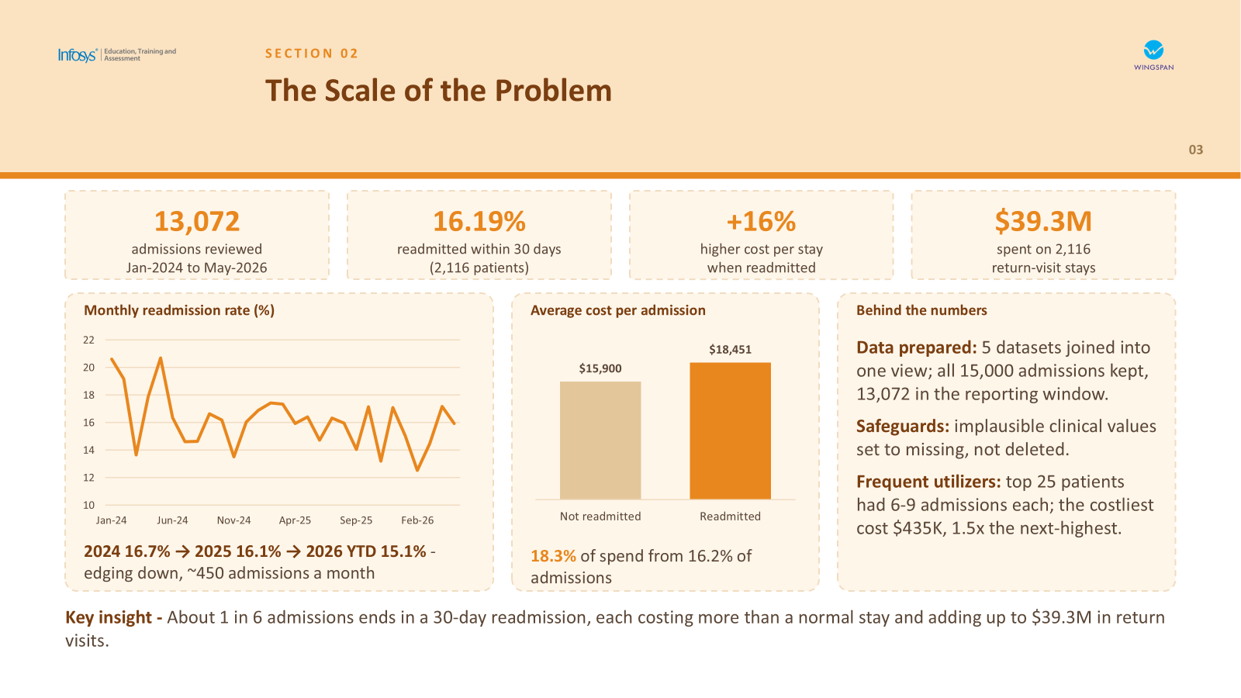

Slide 4
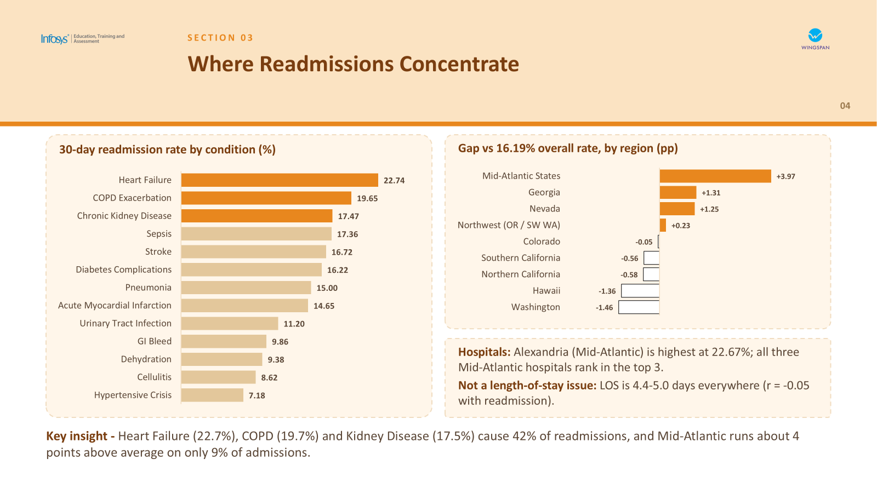

Slide 5
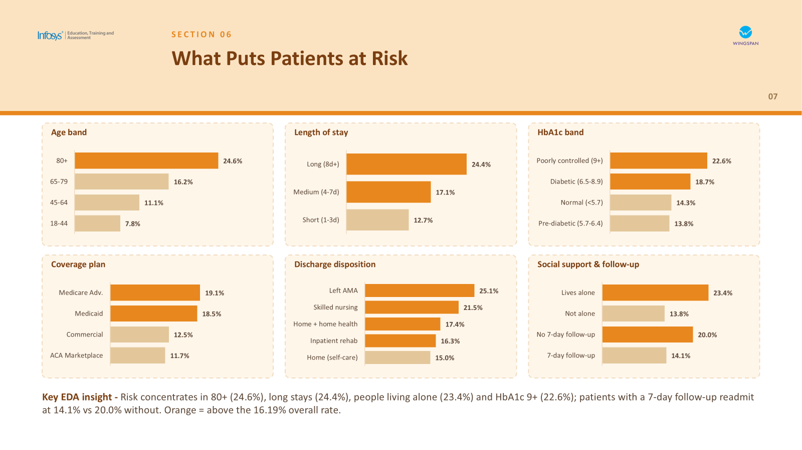

Slide 6
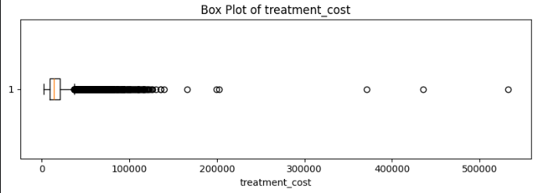
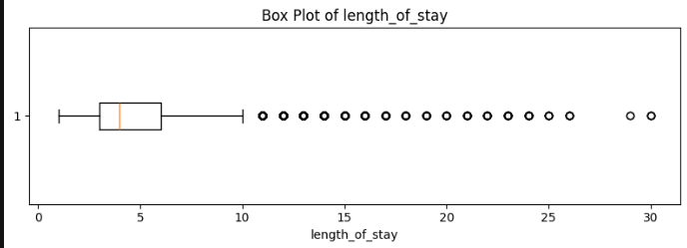
SECTION 04
Statistical Insights
Right-skewed cost and stay length point to a subset of high-cost admissions
05
30%
4 days
$13,436
0.81
30-day readmission rate
Median length of stay
Median treatment cost
LOS–cost correlation
95% CI: 29.55%–30.45%
Mean: 4.72 days
Mean: $16,643
Strong positive relationship
Outlier analysis
Business insight
  Treatment cost is strongly right-skewed (skewness 5.82).
  Length of stay is right-skewed (skewness 1.78).
  Potential outliers signal unusually high costs or prolonged stays; investigate them rather than removing automatically.
A subset of admissions may contribute disproportionately to healthcare expenditure and resource utilization.
Dataset: 40,000 admissions | 35,080 unique patients

Slide 7
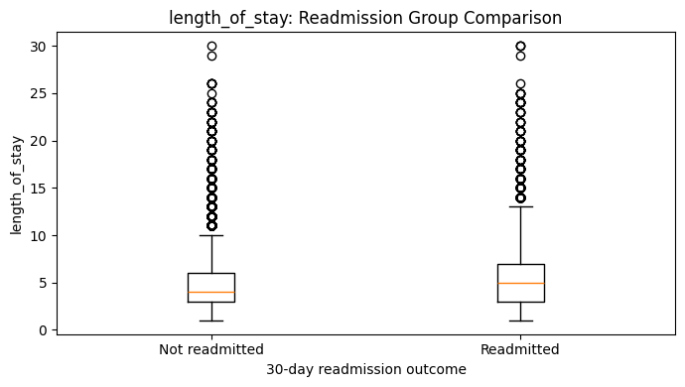
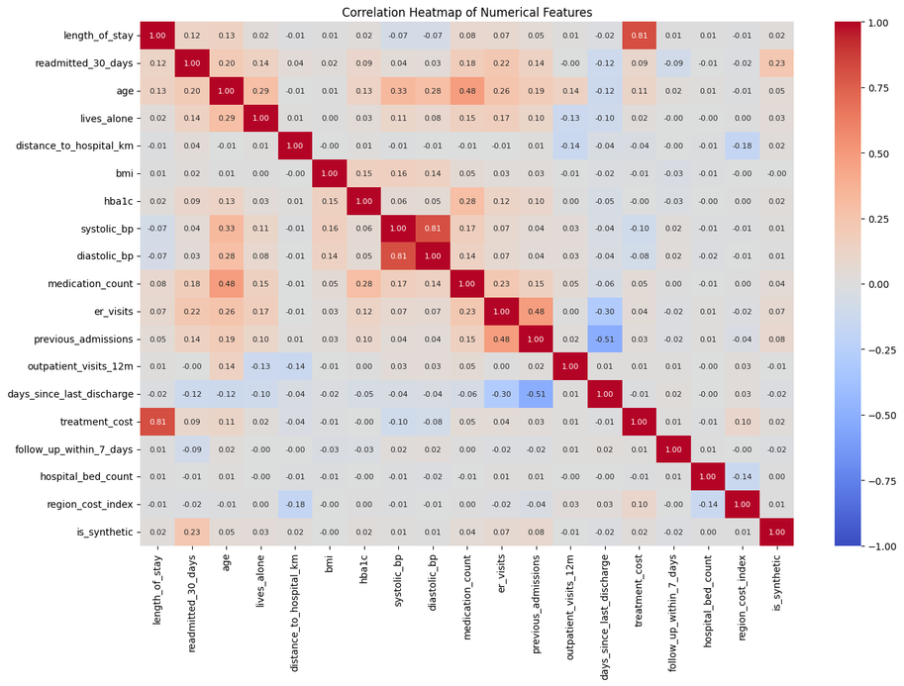
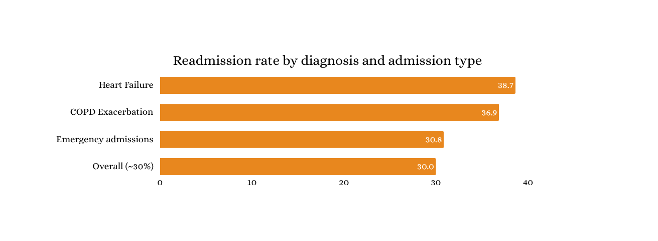
SECTION 05
EDA Findings
Older Age and Higher Treatment Costs Characterize Readmitted Patients
06
Key findings
  Readmitted patients are about 8 years older on average (73.6 vs 65.3).
  Median cost is about $2,000 higher ($14,888 vs $12,863).
  Mean HbA1c is higher: 6.79 vs 6.45.
  Heart Failure (38.65%) and COPD (36.85%) lead.
Business insight: Older age, certain diagnoses and higher observed costs are associated with readmission and can guide further risk analysis. These associations do not establish causation.

Slide 8
SECTION 06
Feature Engineering
Transforming raw data into meaningful predictors
07
Engineered feature | Logic | Note
Prior Utilization Score | Combines scaled previous admissions, ER visits and outpatient visits | Single summary of prior care use
Exploratory Risk Index | Combines flags: age ≥65, prior admission, frequent ER visits, medication burden | Exploratory risk signal
Cost Per Day | Treatment cost ÷ length of stay | Check availability at prediction time
Medication Burden Score | Flags medication count ≥5 | Captures heavy medication load
ER Dependency Ratio | ER visits ÷ (ER + outpatient visits) | Reliance on ER vs outpatient care
Leakage prevention
  Chronic Condition Count, calculated using all admissions, is excluded because it may incorporate future information.
  Readmission history, final length of stay and treatment cost must be checked against the intended prediction time.
  Use only features available when the model is expected to generate a prediction.
Raw clinical & utilization data
Feature engineering
Leakage check
Model-ready features

Slide 9
SECTION 07
Prediction Model Results
08
Model | Accuracy | Precision | Recall | F1 Score | ROC-AUC
Logistic Regression + SMOTENC | 66.24% | 45.58% | 60.93% | 52.15% | 69.77%
Decision Tree + SMOTENC | 79.83% | 65.54% | 70.01% | 67.70% | 77.05%
Random Forest — Baseline | 92.41% | 97.92% | 76.47% | 85.87% | 97.41%
Random Forest + SMOTENC | 92.19% | 93.54% | 79.63% | 86.03% | 96.47%
Gradient Boosting + SMOTENC | 73.31% | 60.48% | 33.40% | 43.04% | 75.27%
Deep Neural Network (64, 32, 16,1) | 86% | 75% | 77% | 76% | 90%
Deep Neural Network (128, 64, 32, 1) | 66% | 46% | 73 % | 56% | 74%
Deep Neural Network (256, 128, 64,1) | 69% | 49% | 76% | 59% | 77%
Best recall: Random Forest + SMOTENC (79.63%); it detected 1,912 of 2,401 readmissions and missed 489. Baseline RF had higher precision (97.92%) and ROC-AUC (97.41%). Split: 32,046 train / 7,954 test, with no patient overlap. Validate prediction-time leakage before deployment.

Slide 10
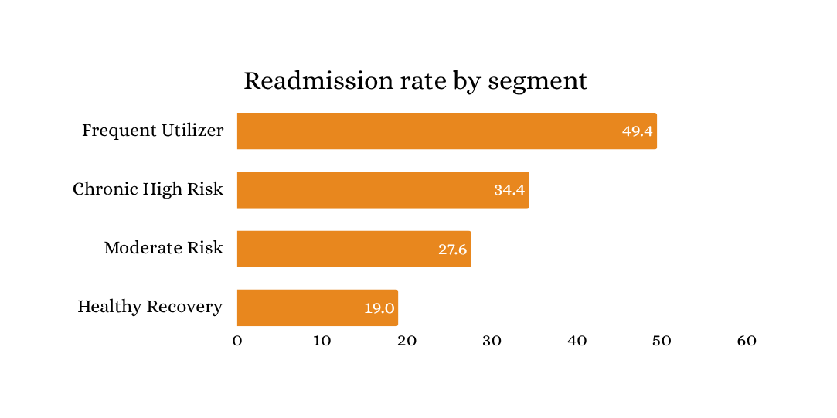
SECTION 08
Patient Segmentation
K-Means identifies four potential patient segments
09
Segment | Patients / admissions | Readmission rate | Potential intervention
Frequent Utilizer | 5,560 (13.90%) | 49.44% | Coordinated follow-up and utilization review
Chronic High Risk | 13,112 (32.78%) | 34.40% | Chronic disease management and medication review
Moderate Risk | 8,087 (20.22%) | 27.55% | Targeted monitoring and follow-up
Healthy Recovery | 13,241 (33.10%) | 18.97% | Standard discharge guidance and routine follow-up
Technical validation
  K-Means on standardized features across 40,000 admissions.
  First three PCA components explain 46.8% of variance.
  Hierarchical clustering (2,000-row sample): adjusted Rand index 0.2085 vs K-Means.
  Silhouette scores low (~0.10–0.13): limited cluster separation.
Insight: Frequent Utilizers have the highest observed readmission rate; clusters are exploratory and need clinical validation.

Slide 11
NLP Findings: Discharge Summary Assistant
Rule-based Clinical NLP Assistant
SECTION 14
15
🔸 Text processing -
Section-based parsing of discharge summaries using header detection, alias mapping and sentence segmentation to convert unstructured clinical notes into structured sections.
🔸 Medication extraction -
Regex-based information extraction identifies medication name, dose, route, frequency and status (NEW / CHANGED / STOPPED / CONTINUE) from discharge medication sections.
🔸 Clinical summarization -
TF-IDF sentence ranking combined with clinical keyword weighting (started, stopped, changed, creatinine, culture, discharged) to generate an extractive hospital course summary.
🔸 Key insight -
Automated extraction of medication changes, follow-up tasks, pending results and warning signs significantly improves discharge note review efficiency
Raw Discharge Note
↓
Section Detection
↓
Medication Extraction
↓
Follow-up & Warning Extraction
↓
Clinical Summarization
(TFIDF Score + Clinical Score)
↓
Clinician Brief

Slide 12
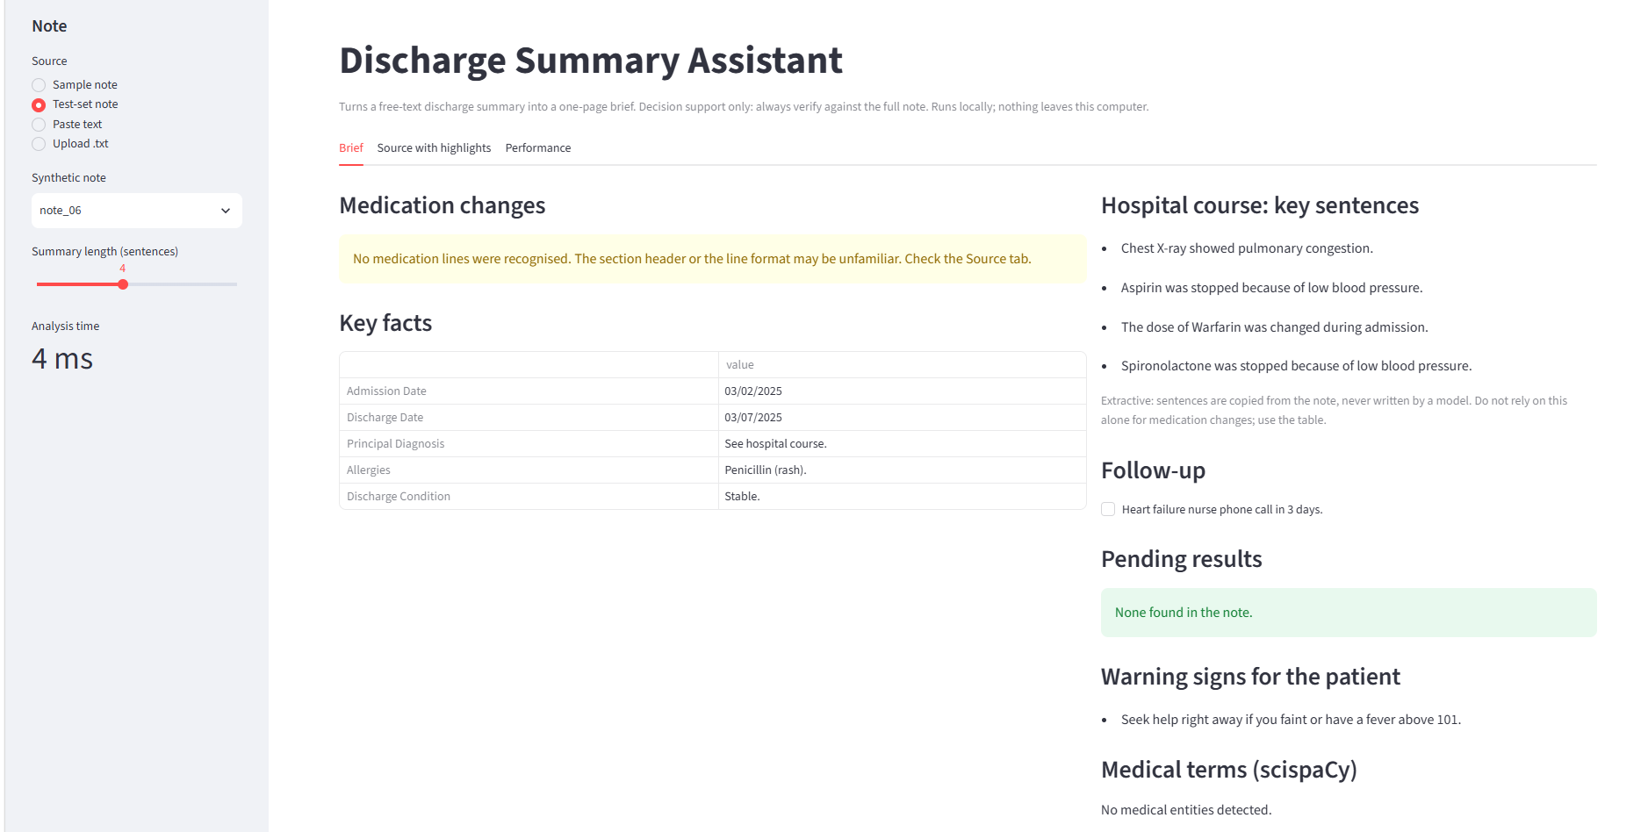
Notes:
8

Slide 13
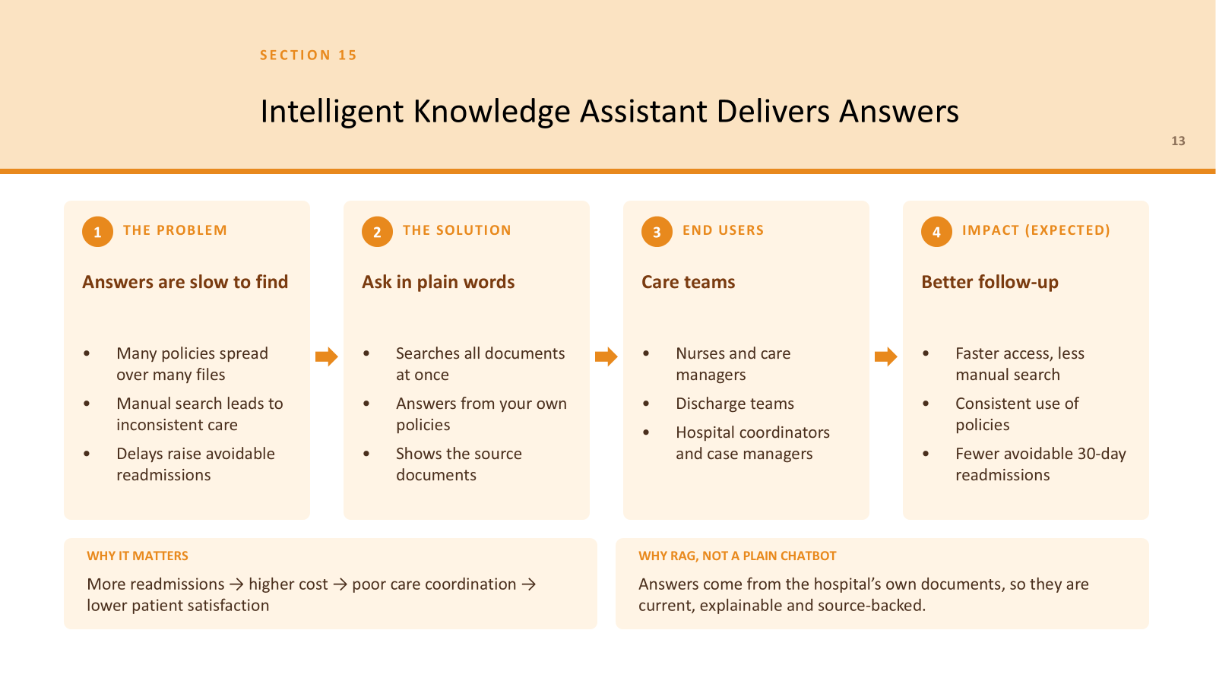

Slide 14
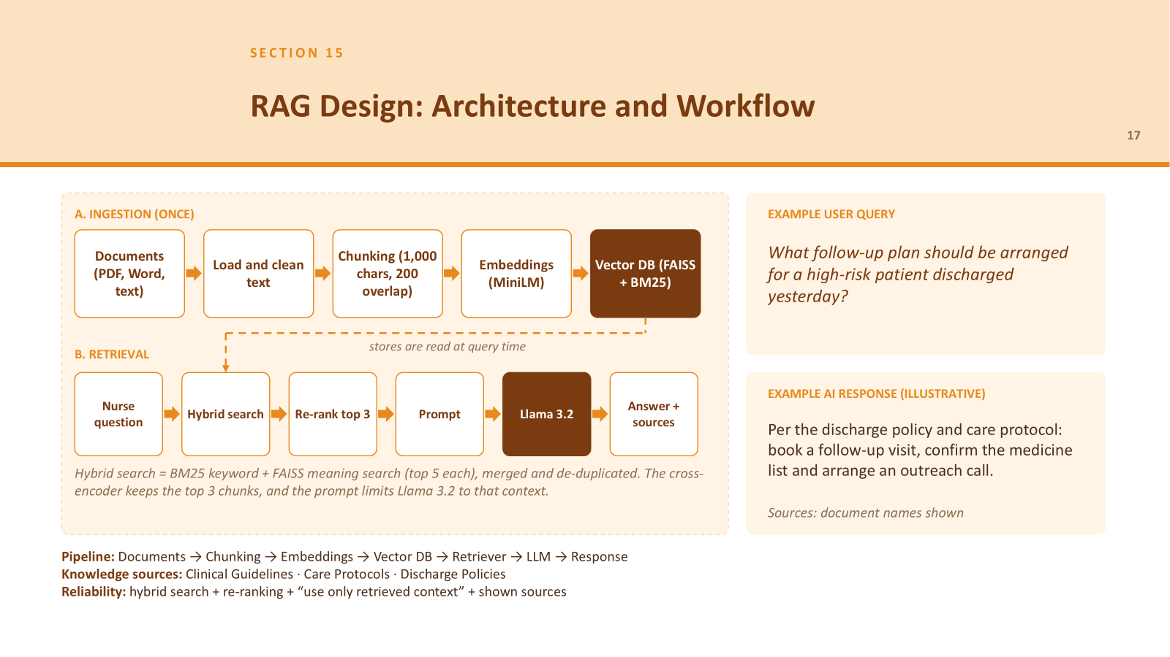

Slide 15
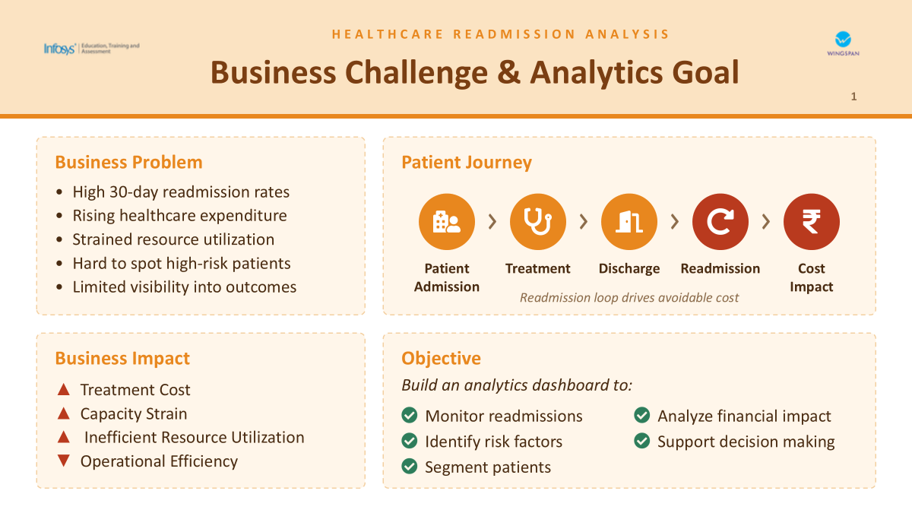

Slide 16
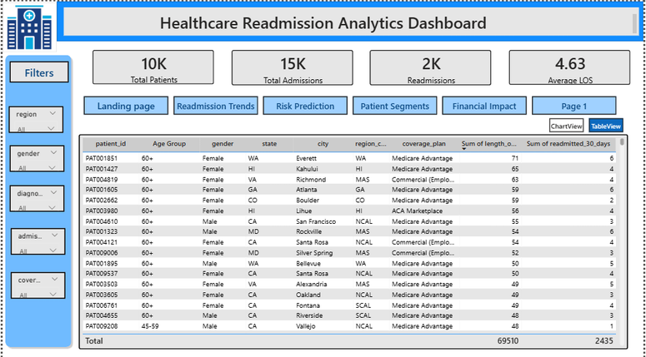
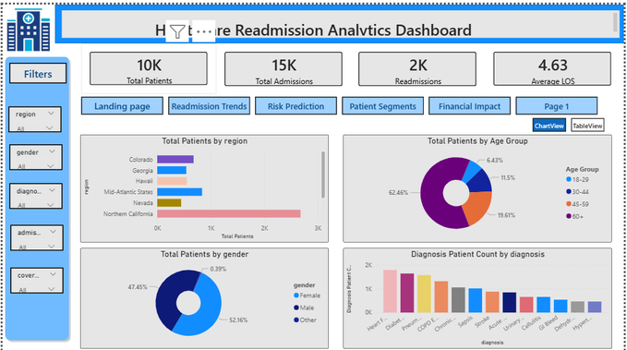
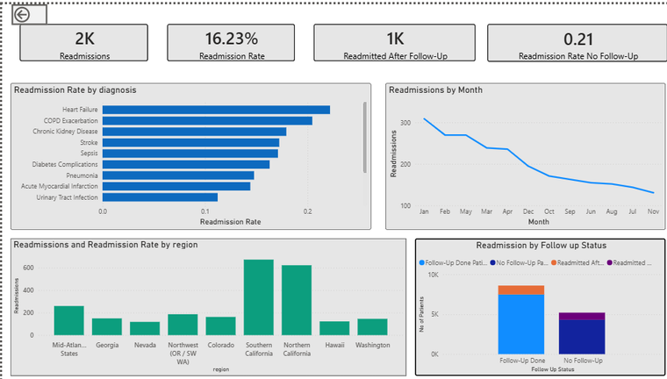
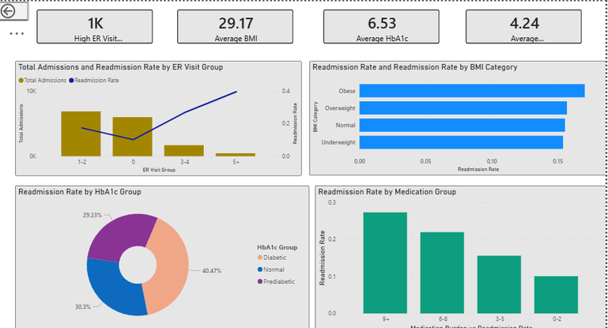
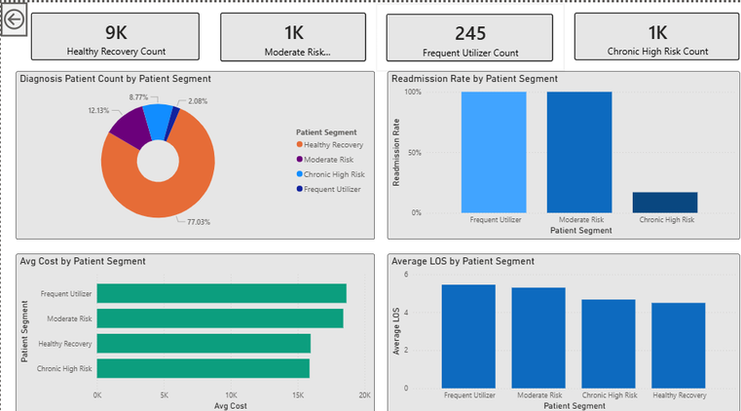
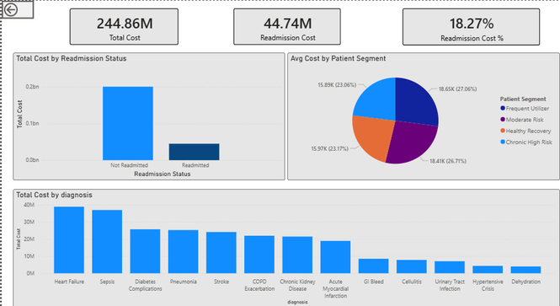
SECTION 16
Power BI Demonstration
17
Patient Overview -1
Patient Overview -2
Readmission Trends
Risk Prediction
Patient Segments
Financial Impact
Must include - Star schema · Date table · DAX & time intelligence · Drill-through · Slicers · RLS design

Slide 17
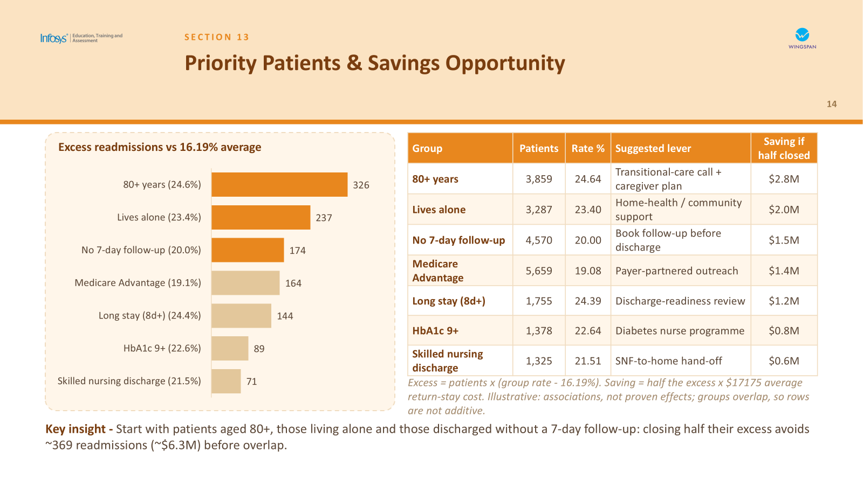

Slide 18
SECTION 17
Business Recommendations
18
THE QUESTION WE ANSWER
If Kaiser Permanente invests in patient outreach programs, which patient groups should be targeted first and what interventions are most likely to reduce readmissions?
Start with three high-risk groups: A transitional-care call with a caregiver plan for 80+, home-health or community support for those living alone, and a follow-up visit booked before the patient leaves the hospital.
Run condition-specific programs : Heart-failure nurse calls within days of discharge, chronic disease management with medication review, and a diabetes nurse programme for HbA1c 9+ patients (22.6%).
Give each patient segment its own care pathway : Coordinated follow-up and utilization review for Frequent Utilizers, medication review for Chronic High Risk, light monitoring for Moderate Risk, and standard discharge guidance for Healthy Recovery.
Deploy the risk model safely, as a decision-support tool with governance : Assign an owner, require clinician sign-off, and keep audit logs.

Slide 19
Thank You
Questions & Discussion
Notes:
8

